Slide 1
BANGALORE INSTITUTE OF TECHNOLOGY
K.R Road, V.V Pura,Bengaluru-04
DEPARTMENT OF COMPUTER SCIENCE & ENGINEERING
“ Hyrbid Technique for Data Encryption”
Presented by
Nishit Khamesra
1BI20CS117
Priyam
1BI20CS132
Gaurav Saraiwala
1BI20CS069
Saket R Vaishnaw
1BI20CS149
Under the Guidance
Ms. Pooja
Professor
Computer Science

Slide 2
Agenda
Introduction
Problem Statement
Drawbacks of existing system
Architecture
Software and hardware requirements
Design
Implementation
Results
Applications
Conclusion
References
1/20

Slide 3
Introduction
Data encryption has been widely applied in data processing areas. Various encryption algorithms have been developed for processing text documents, images, video etc.
Today in the era of internet everyone should a need for a secure data security algorithms is required
Objective
To collaborate the advantages of different existing encryption methods which offers better security and protection.
2/20

Slide 4
Existing System
A host of different algorithms are available today , common ones being :
AES :
  Advanced Encryption technique
  It is used even by US government and also widely in private sector
  Its invulnerable to all attacks including brute force
Triple DES :
  Triple DES (Data Encryption Standard) applies the DES algorithm three times to every data block
  It is commonly used to encrypt UNIX passwords and ATM PINs.
RSA :
  RSA is a public-key encryption asymmetric algorithm
  It is robust and reliable because it creates a massive bunch of gibberish
6/20

Slide 5
Existing System
Blowfish
  This symmetric tool breaks messages into 64-bit blocks and encrypts them individually
  It was designed to replace DES
  Blowfish is commonly found on e-commerce platforms, securing payments, and in password management tools.
Twofish
  Two fish is Blowfish’s successor
  It’s license-free, symmetric encryption that deciphers 128-bit data blocks , does 16 rounds of encryption.
  Its Fastest and used for software and hardware enviroments
  Today file and folder encryption software solutions use this method.

Slide 6
Problem statement
“To implement Hybrid Technique for data encryption”
Input: Data to be transferred securely.
At Sender side data is encrypted by using a AES algorithm
Output: Data reached at destination correctly.
At receivers side decrypted and used.
3/20

Slide 7
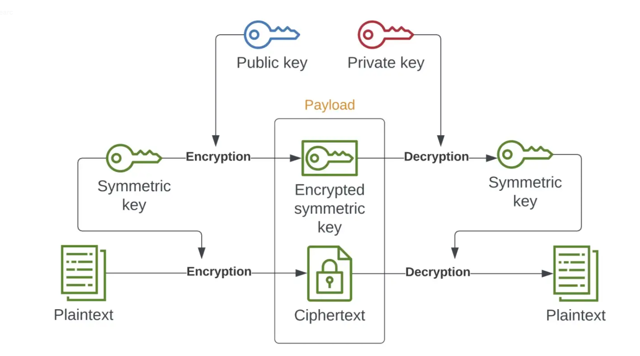
Architecture
<number>/20

Slide 8
Design
Algorithm :
Generate public + private keypair and share the private key with the receiver (a one-time thing)
Generate a symmetric key
Encrypt our data with the symmetric key
Encrypt the symmetric key with the public key
Encode the data and the symmetric key with base64
Send the data along with the encrypted symmetric key
Receive
Decode the data and the symmetric key from base64
Decrypt the symmetric key with the private key
Decrypt data with the symmetric key
<number>/20

Slide 9
Implementation
Python Packages and modules identified and implemented :
Pycrpto Package:
This is a collection of both secure hash functions (such as SHA256 and RIPEMD160), and various encryption algorithms (AES, DES, RSA, ElGamal, etc.).
General:
Function : open(file, mode)
Use :Opens a file stored internally and returns it as a file object.
Function : write(byte)
Use : On file object, to insert specified text or byte object.
Function : read(size)
Use : On file object, to return specified number of bytes.
<number>/20

Slide 10
Implementation
Modules and their functions
Cipher Module
Secret-key (AES, DES, ARC4) and public-key encryption (RSA PKCS#1) algorithms
AES sub-module
AES (Advanced Encryption Standard) is a symmetric block cipher standardized by NIST. It has a fixed data block size of 16 bytes. Its keys can be 128, 192, or 256 bits long.
Function : new(key, *args, **kwargs)
Use : Create a new AES cipher
Functions perfromed on AES cipher object :
Function : encrypt(self, plaintext)
Use : Encrypt data with the key and the parameters set at initialization.

Slide 11
Implementation
Modules and their functions
Function : denrypt(self, plaintext)
Use : Decrypt data with the key and the parameters set at initialization.
AES sub-module Keyword arguments :
Arguments : iv (bytes, bytearray, memoryview)
Use : The initialization vector to use for encryption or decryption.
Arguments : MODE_CBC
Use : Here Cipher-Block Chaining (CBC). Each of the ciphertext blocks depends on the current // and all previous plaintext blocks. An Initialization Vector (IV) is required.
AES sub-module Keyword variables :
Variable : block_size
Use : Size of a data block (in bytes)

Slide 12
Implementation
Modules and their functions
Protocol module
Implements various cryptographic protocols (Chaffing, all-or-nothing transform, key derivation functions). This package does not contain any network protocols
KDF submodule
It contains key derivation functions that derive one or more secondary secret keys from one primary secret (a master key or a pass phrase).
Function : PBKDF2(password, salt, dkLen=16, count=1000, prf=None)
Use : Derive one or more keys from a password (or passphrase) according to PKCS#5 standard (v2.0) by means of PBKDF2 algo

Slide 13
Implementation
Modules and their functions
Util module
Various useful modules and functions (long-to-string conversion, random number generation, number theoretic functions)
Function : pad(data_to_pad, block_size, style='pkcs7')
Use : Apply standard padding.
Function : unpad(padded_data, block_size, style='pkcs7')
Use : Remove standard padding.

Slide 14
Implementation
Modules and their functions
Random sub-module
used to generate random numbers
Function : get_random_bytes(N)
Use : Return a random byte string of length N.

Slide 15
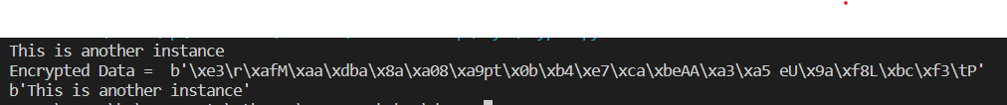
Results
<number>/20

Slide 16
Applications
All practical implementations of public key cryptography today employ the use of a hybrid system.
TLS protocol and the SSH protocol, that use a public-key mechanism for key exchange (such as Diffie-Hellman) and a symmetric-key mechanism for data encapsulation (such as AES).
Can be implemented for Bluetooth (IJSR research paper)
To protects high-valued sensitive health records against malicious users and ensure integrity of patients’ database. (IJCSE research paper)
<number>/20

Slide 17
Conclusion
Hybrid Encryption combines the efficiency of symmetric encryption with the convenience of public-key (asymmetric) encryption. Only users with the private key can decrypt the data. To encrypt a message, a fresh symmetric key is generated and used to encrypt the plaintext data. This provides safe mechanism for data transmission over the network.
21

Slide 18
References
[1] IJSR(International Journal of Science and Research),”Cryptography Algorithm based on DES and RSA in Bluetooth Communication”, Veeresh K. , Arunkumar Madupu, E-ISSN : 2319-7064,
https://www.ijsr.net/archive/v3i12/U1VCMTQ3ODI=.pdf
[2]IJCSE (International Journal of Computer Sciences and Engineering),”Hybrid Encryption for Radio Frequency Identification in Healthcare System: Object-Oriented Analysis and Design Approach ”, Amanze, B.C ., Ononiwu, C. C., Eleberi, E.L & Chilaka , U.L. , E-ISSN: 2347-2693, Vol. 8, Issue.4, Apr 2020
https://www.ijcseonline.org/pub_paper/12-IJCSE-07890-22.pdf
[3] Medium.com,"Hybrid encryption in python", Jun 14
https://medium.com/@igorfilatov/hybrid-encryption-in-python-3e408c73970c
[4] diltz.net , “Package Crypto”
https://www.dlitz.net/software/pycrypto/api/2.6/Crypto-module.html
[5] pycryptodone.readthedocs.io , “AES”
https://pycryptodome.readthedocs.io/en/latest/src/cipher/aes.html
[6] w3schools.com , “ Python File Read Method”
https://www.w3schools.com/python/ref_file_read.asp
[7] pypi.org,”pycrypto 2.6.1”
https://pypi.org/project/pycrypto/
[8] wikipedia , “PKBDF2”
https://en.wikipedia.org/wiki/PBKDF2
21

Slide 19

<number><number>

