Slide 1
Microsoft needs Analyses
Author: Mitra Zamani
May 14, 2023

Slide 2

Summary This project analyzes the movies databases like imdb for Microsoft. Descriptive analysis of domestic gross, worldwide gross, genres and ratings of movies which help us to find the best genre, release month and type of movie studio.

Slide 3
Outline
Business Problem
Data and Methods
Results
Conclusions

Slide 4
Business Problem
Microsoft sees all the big companies creating original video content and they want to get in on the fun. They have decided to create a new movie studio, but they don’t know anything about creating movies. using movies databases and analysing them, I describe what types of films are currently doing the best at the box office and midb. I find the best genre, month for release and type of movie studio that could help the head of Microsoft's new movie studio to decide what type of films to create.
Best genre
Best month for releasing movie
Best type of movie studio

Slide 5
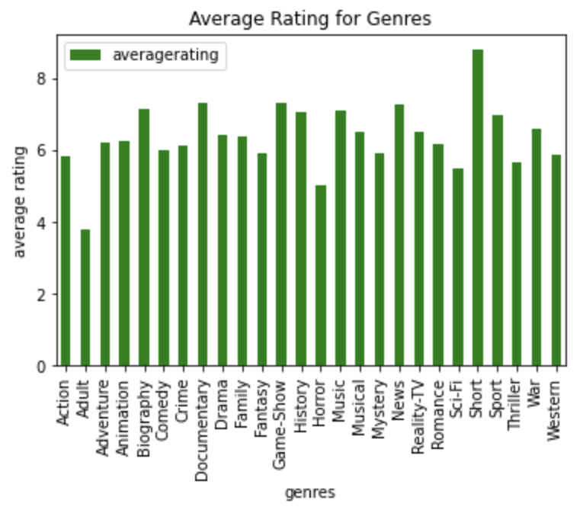
Data and Methods The data that I used are from different movies data bases like box office and midb. Every movie has a unique ID. The data files provide the ratings, duration of runtime, genre, type of studio, release date, domestic and worldwide gross of the movies.

Slide 6
Results what is the best genre? by analysing the below graphs which indicate the average rating of each genres, I realized most of the movies are short. This graph help me to find the genres of the movies with the highest ratings.

Slide 7
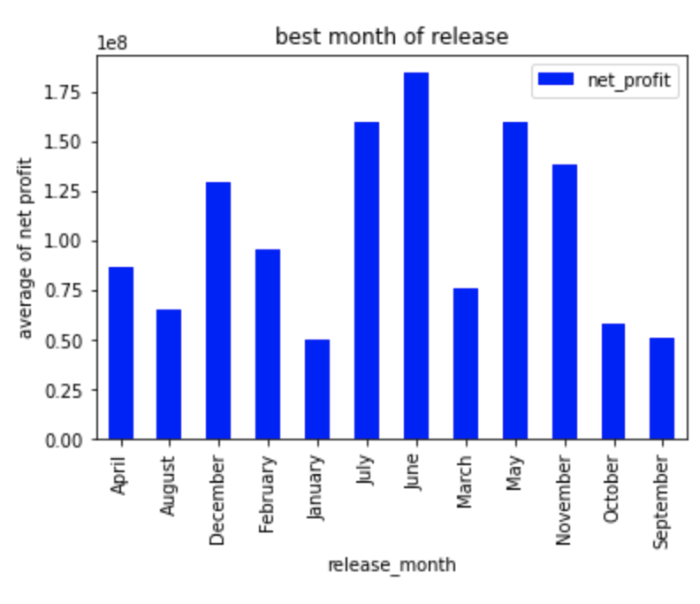
What is the best month of releasing? This graph indicates the best month of the releasing which is June. Most of the movies that are releasing in the June have the highest average net profit.

Slide 8
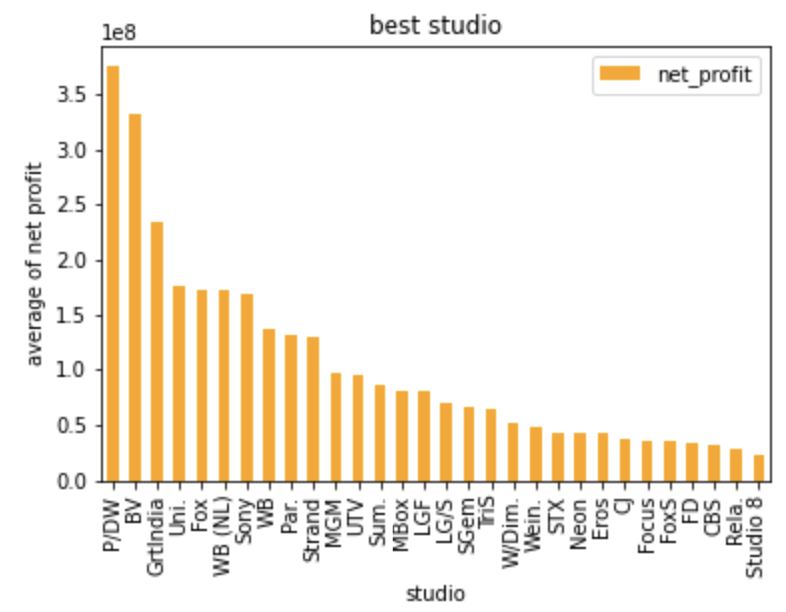
What is the best type of Movie Studio? The best type of movie Studio for creating movie is P/DW. The graphs indicates the studio with the highest average net profit is P/DW.

Slide 9
Conclusion
This analysis leads to three recommendations for creating movie to the Microsoft:
1) The genre for the movie that they want to create is better to be Short because the graph indicates that the genre with the highest average rating is short.
2) The best month for releasing movie is June. The graphs indicates the month with the highest average net profit is also June.
3) The best type of movie Studio for creating movie is P/DW. The graphs indicates the studio with the highest average net profit is P/DW.

Slide 10
Thank you! Email : zmitra15@gmail.com GitHub : @MitraZamani

