Slide 1
ITP App Tests
Student: Mitre Flavia Antonia
Year III, Computers in english 31b

Slide 2
ITP App Tests
Admins Service Tests
Clients Service Tests

Slide 3
Admins Service Tests

Slide 4
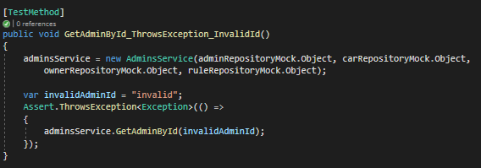
GetAdminById_ThrowsException_InvalidId()
This test checks if the GetAdminById method throws an entitiy not found exception for an admin id that does not exist

Slide 5
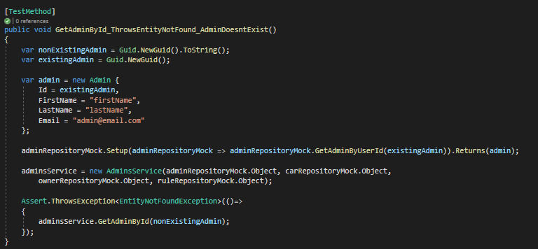
GetAdminById_ThrowsEntityNotFound_AdminDoesntExist()
This test throws an entity not found exception for the method GetAdminById for an admin with an id that does not exist

Slide 6
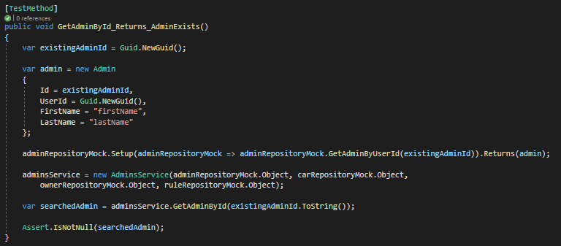
GetAdminById_Returns_AdminExists()
The test checks if the GetAdminById method returns a non null result for an existing admin

Slide 7
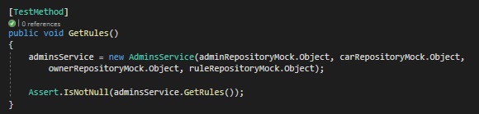
GetRules()
This test checks if the GetRules method returns a result different than null

Slide 8
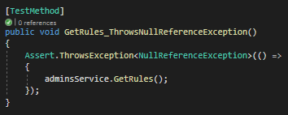
GetRules_ThrowsNullReferenceException()
This test returns a null reference exception for using the GetRules method with an invalid admin service

Slide 9
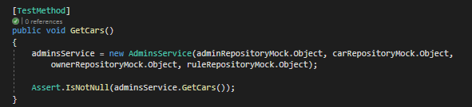
GetCars()
This test checks if the GetCars method returns a result different than null

Slide 10
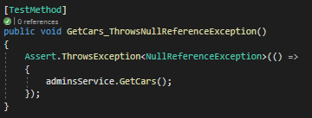
GetCars_ThrowsNullReferenceException()
This test returns a null reference exception for using the GetCars method with an invalid admin service

Slide 11
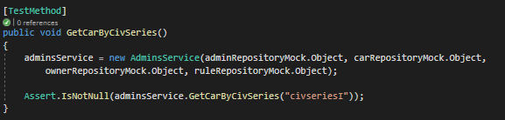
GetCarByCivSeries()
This test checks if the GetCarByCivSeries method returns a result different than null, for a specific civ series

Slide 12
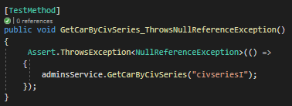
GetCarByCivSeries_ThrowsNullReferenceException()
This test checks if the GetCarByCivSeries method throws a null reference exception for using an invalid admin service, for a specific civ series

Slide 13
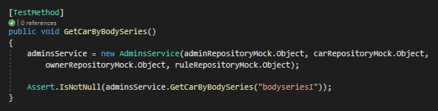
GetCarByBodySeries()
This test checks if the GetCarByBodySeries method returns a result different than null, for a specific body series

Slide 14
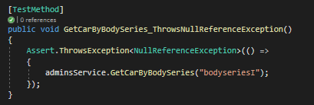
GetCarByBodySeries_ThrowsNullReferenceException()
This test checks if the GetCarByBodySeries method throws a null reference exception for using an invalid admin service, for a specific body series

Slide 15
Clients Service Tests

Slide 16
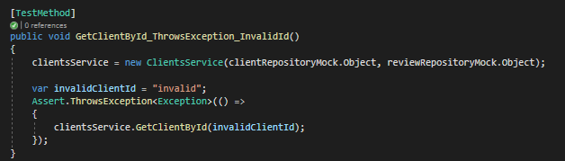
GetClientById_ThrowsException_InvalidId
This test checks if the GetClientById method throws an entitiy not found exception for a client id that does not exist

Slide 17
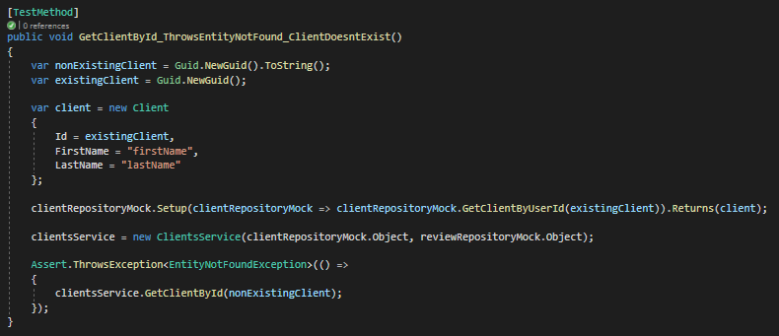
GetClientById_ThrowsEntityNotFound_ClientDoesntExist()
This test throws an entity not found exception for the method GetClientById for a client with an id that does not exist

Slide 18
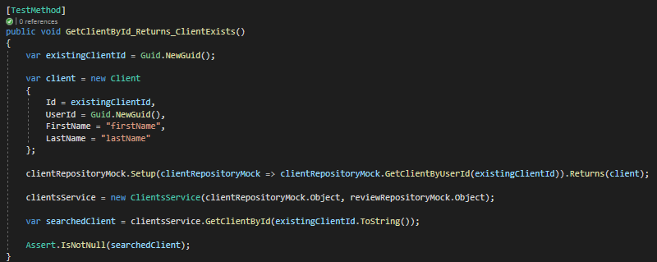
GetClientById_Returns_ClientExists()
The test checks if the GetClientById method returns a non null result for an existing client

Slide 19
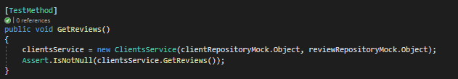
GetReviews()
This test checks if the GetReviews method returns a result different than null

Slide 20
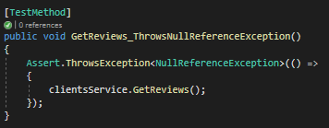
GetReviews_ThrowsNullReferenceException()
This test returns a null reference exception for using the GetReviews method with an invalid client service

