Slide 1
Documentation for Pocket Plane App Tests
Group Name: Echipa Racheta
Barbu Mircea-Alexandru CEN 3.1
Efrem Ion-Ștefan CEN 3.1
Hagiu Teodora-Adriana CEN 3.1
Mitre Flavia-Antonia CEN 3.1
Instructor: Stoica Spahiu Cosmin
Course: Project II – Use of Databases

Slide 2
Pocket Plane App Tests
Admins Service Tests
Clients Service Tests

Slide 3
Admins Service Tests

Slide 4
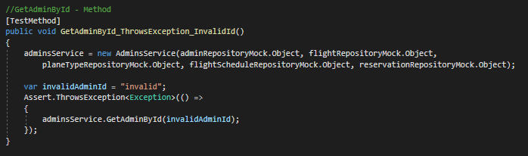
GetAdminById_ThrowsException_InvalidId()
This test checks if the GetAdminById method throws an entitiy not found exception for an admin id that does not exist

Slide 5
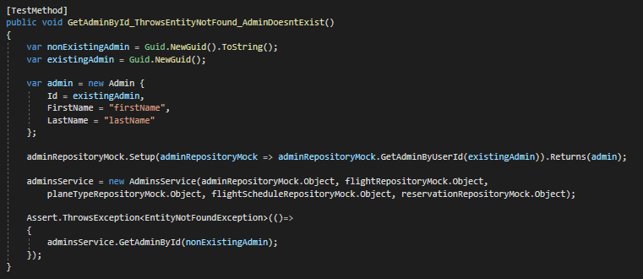
GetAdminById_ThrowsEntityNotFound_AdminDoesntExist()
This test throws an entity not found exception for the method GetAdminById for an admin with an id that does not exist

Slide 6
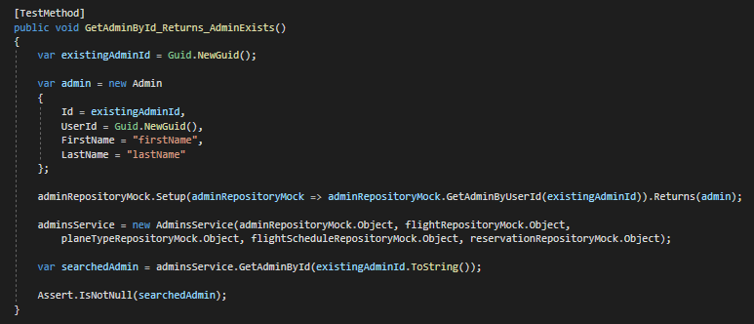
GetAdminById_Returns_AdminExists()
The test checks if the GetAdminById method returns a non null result for an existing admin

Slide 7
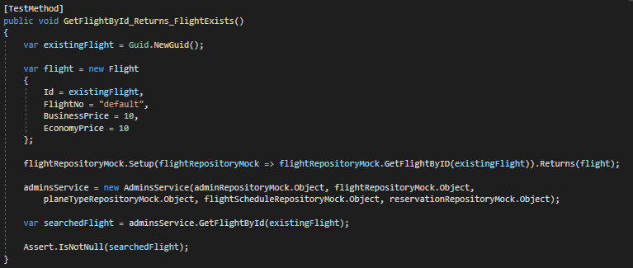
GetFlightById_Returns_FlightExists()
This test checks if the GetFlightById method returns a result different than null, for an existing flight

Slide 8
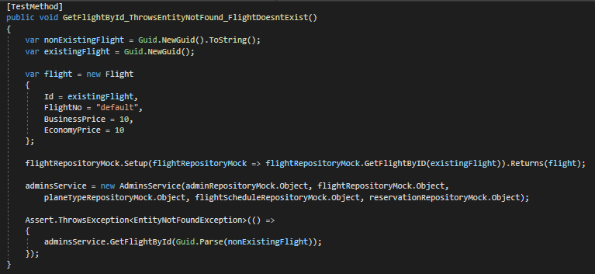
GetFlightById_ThrowsEntityNotFound_FlightDoesntExist()
This test throws an entity not found exception for a non existing flight (an incorrect ID)

Slide 9
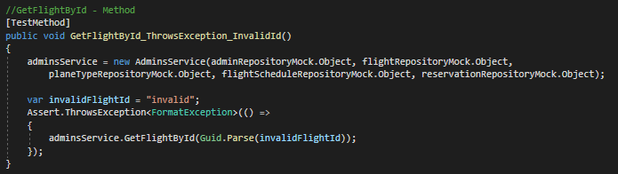
GetFlightById_ThrowsException_InvalidId()
This test throws an exception for the function GetFlightById, using an invalid ID

Slide 10
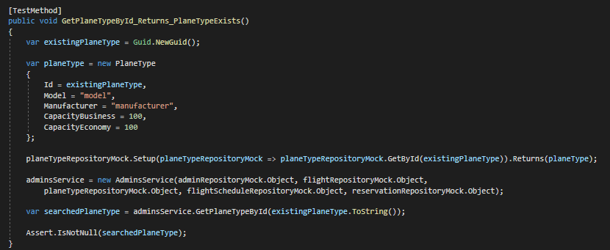
GetPlaneTypeById_Returns_PlaneTypeExists()
This test checks if the GetPlaneTypeById method returns a result different than null, for an existing plane type

Slide 11
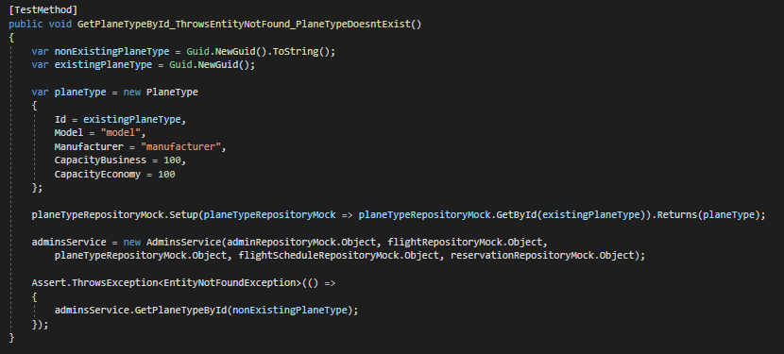
GetPlaneTypeById_ThrowsEntityNotFound_PlaneTypeDoesntExist()
This test throws an entity not found exception for a non existing plane type (an incorrect ID)

Slide 12
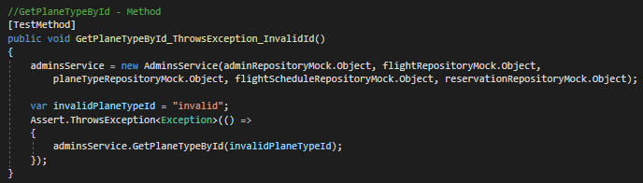
GetPlaneTypeById_ThrowsException_InvalidId()
This test throws an exception for the function GetPlaneTypeById, using an invalid ID

Slide 13
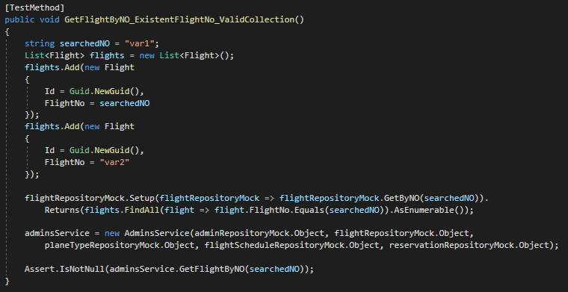
GetFlightByNO_ExistingFlightNo_ValidCollection()
This test returns a non null result for the method GetFlightByNO, for the given NO, that exists

Slide 14
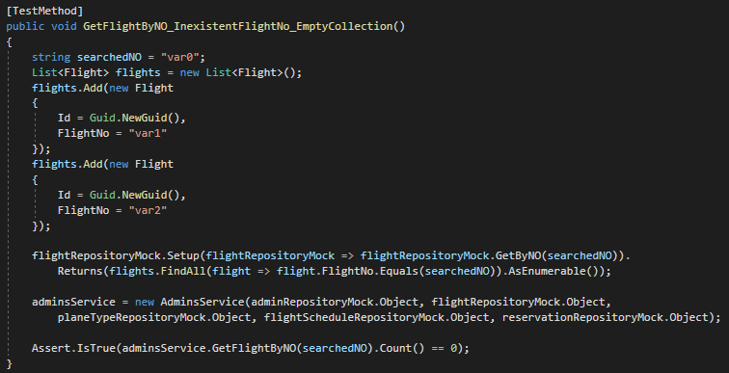
GetFlightByNO_InexistentFlightNo_EmptyCollection()
This test checks if the GetFlightByNO method returns zero objects when the search is performed for a NO that does not correspond to any of the existing ones

Slide 15
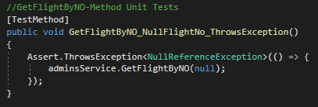
GetFlightByNO_NullFlightNo_ThrowsException()
This test throws an exception for the function GetFlightByNO, using a null parameter

Slide 16
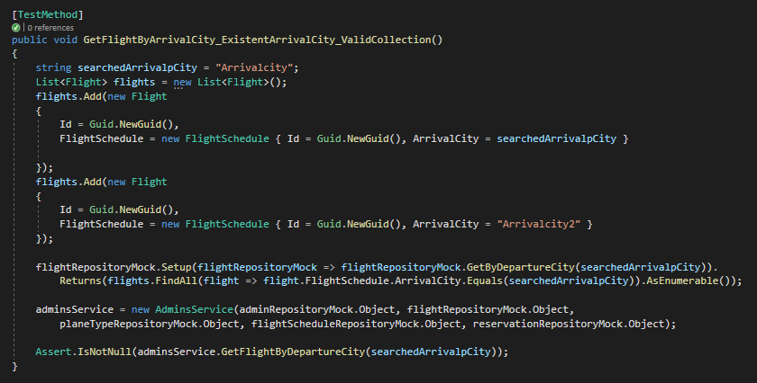
GetFlightByArrivalCity_ExistentArrivalCity_ValidCollection()
This test returns a non null result for the method GetFlightByArrivalCity, for the given arrival city, that exists

Slide 17
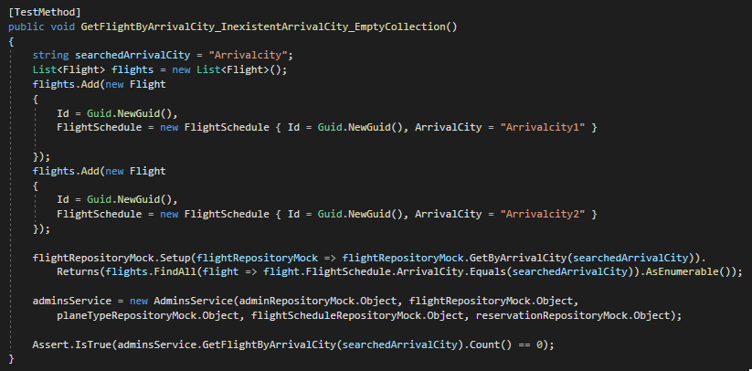
GetFlightByArrivalCity_InexistentArrivalCity_EmptyCollection()
This test checks if the GetFlightByArrivalCity method returns zero objects when the search is performed for an arrival city that does not correspond to any of the existing ones

Slide 18
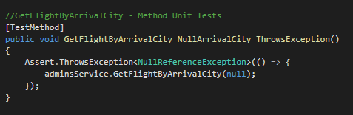
GetFlightByArrivalCity_NullArrivalCity_ThrowsException()
This test throws an exception for the function GetFlightByArrivalCity, using a null parameter

Slide 19
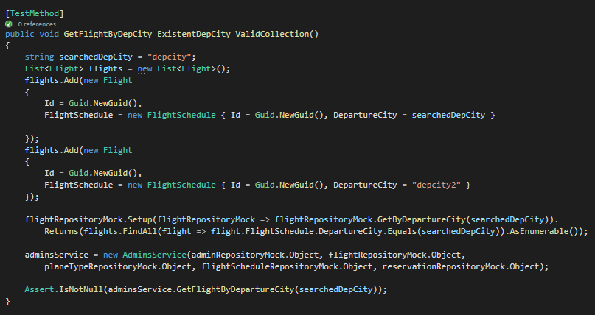
GetFlightByDepCity_ExistentDepCity_ValidCollection()
This test returns a non null result for the method GetFlightByDepartureCity, for the given departure city, that exists

Slide 20
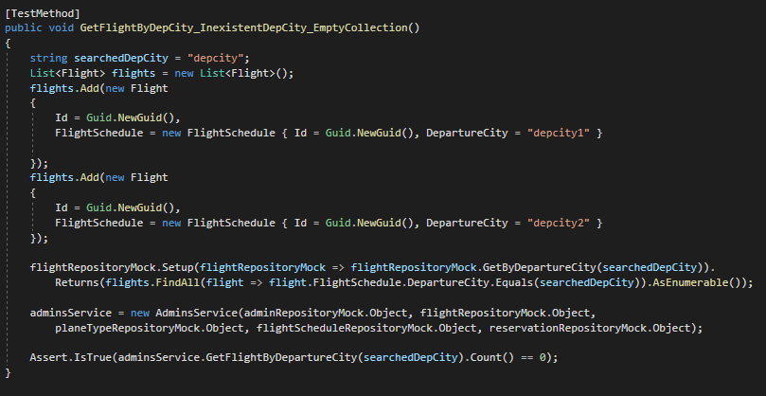
GetFlightByDepCity_InexistentDepCity_EmptyCollection()
This test checks if the GetFlightByDepartureCity method returns zero objects when the search is performed for a departure city that does not correspond to any of the existing ones

Slide 21
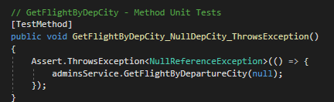
GetFlightByDepCity_NullDepCity_ThrowsException()
This test throws an exception for the function GetFlightByDepartureCity, using a null parameter

Slide 22
Clients Service Tests

Slide 23
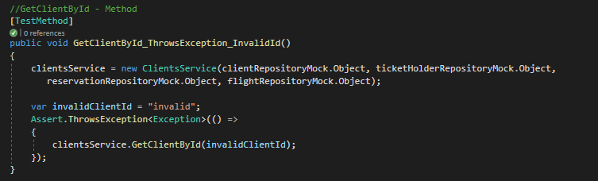
GetClientById_ThrowsException_InvalidId()
This test checks if the GetClientById method throws an entitiy not found exception for a client id that does not exist

Slide 24
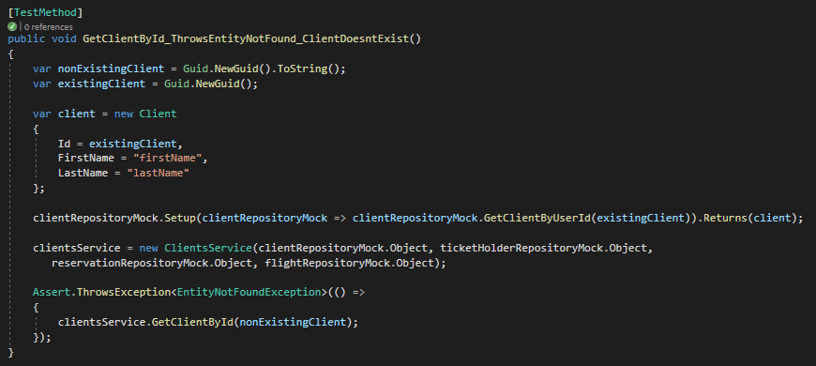
GetClientById_ThrowsEntityNotFound_ClientDoesntExist()
This test throws an entity not found exception for the method GetClientById for a client with an id that does not exist

Slide 25
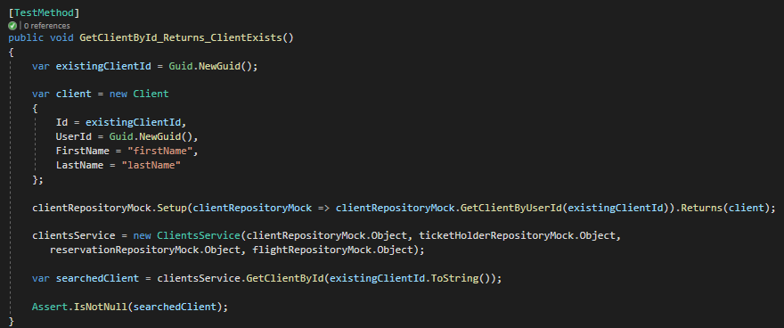
GetClientById_Returns_ClientExists()
The test checks if the GetClientById method returns a non null result for an existing client

Slide 26
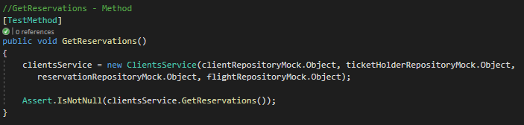
GetReservations()
This test checks if the GetReservations method returns a result different than null

Slide 27
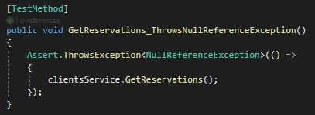
GetReservations_ThrowsNullReferenceException()
This test returns a null reference exception for using the GetReservations method with an invalid client service

Slide 28
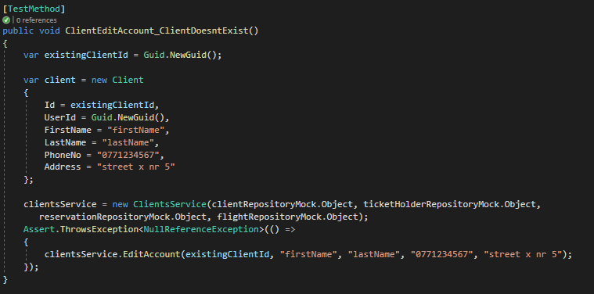
ClientEditAccount_ClientDoesntExist()
This test returns a null reference exception for using the EditAccount method for a client that has no account yet

Slide 29
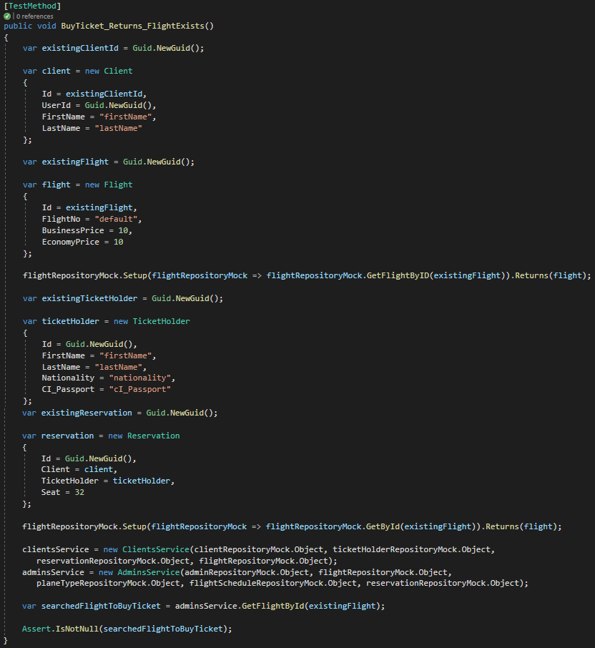
BuyTicket_Returns_FlightExists()
This test returns a non null result when searching a certain flight to buy ticket to

Slide 30
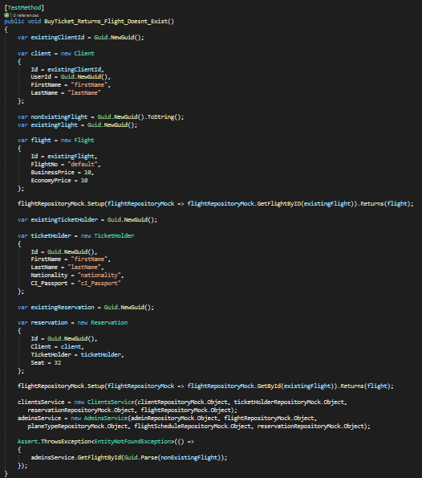
BuyTicket_Returns_Flight_Doesnt_Exist()
This test throws an entity not found exception when searching a certain flight to buy ticket to, but the flight ID doesn’t exist

