Slide 1



How we using PPS, RR?
Preemptive Priority Scheduling (PPS) & Round Robin Scheduling (RR)

Slide 2
Instructions for new users
how to use our program:
1 - you need to determine the number of processes .
2- determine the burst and arrival time.
3- for the RR technique you also need to determine the quantum number .
4- for the PPS technique you also need to determine the number of priority .

Slide 3

Overview:
Computer processor scheduling is a course of figuring out which interaction will claim CPU for execution while another cycle is waiting. the principle errand of CPU booking is to ensure that at whatever point the CPU stays inactive, the OS basically select one of the cycles accessible in the prepared line for execution....
There are many of CPU Scheduling and we will talk about two of them in our project
Round-Robin Scheduling
Preemptive Priority Scheduling

Slide 4
What is Round-Robin Scheduling?
The name of the algorithm comes from the round- robin principle, where everyone takes turns to get an equal share of things. It is the oldest and simplest scheduling algorithm, mainly used for multitasking. In Round-robin scheduling, each ready task only runs in a circular queue within a limited time slice in turn. The algorithm also provides starvation-free execution of the process.

Slide 5

What is preemptive priority scheduling?
In Preemptive Priority Scheduling, at the hour of appearance of a cycle in the prepared line, its Priority is contrasted and the need of different cycles present in the prepared line just as with the one which is being executed by the CPU by then of time.

Slide 6




Round-Robin Scheduling

Slide 7

Features and capabilities:
·Round-robin scheduling is straightforward, simple to execute, and starvation-free
Each of the jobs get a reasonable portion of CPU. It manages all process with no need any priority
Allows OS to use the Context switching method to save states of preempted processes.
It gives the best performance in terms of average response time.

Slide 8

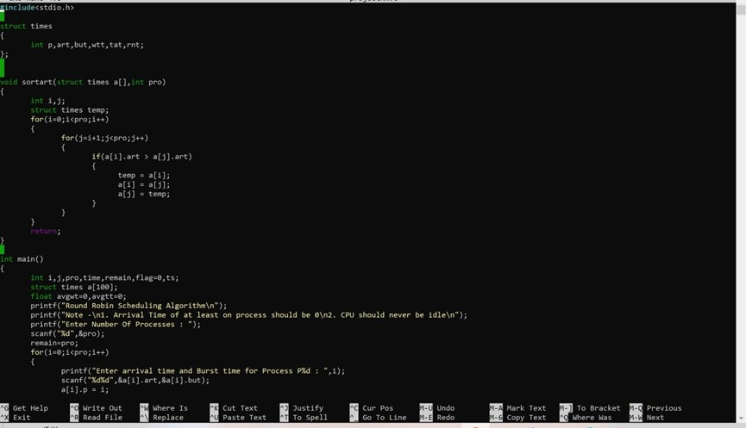
Code:
I
(1)

Slide 9

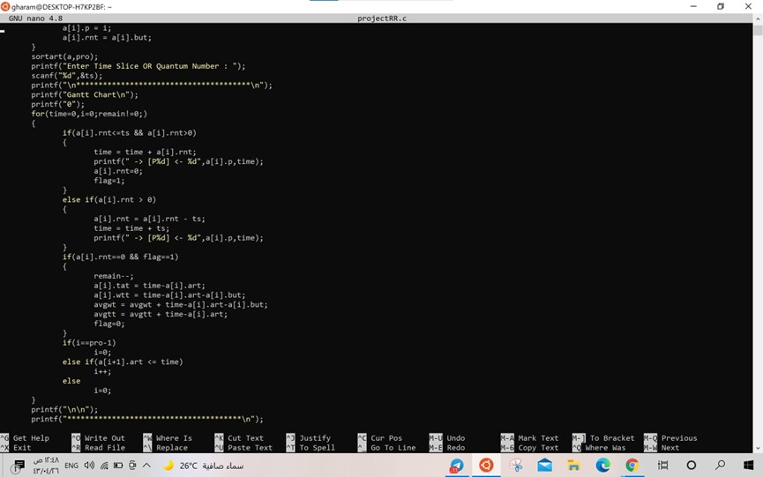
Code:
I
(2)

Slide 10
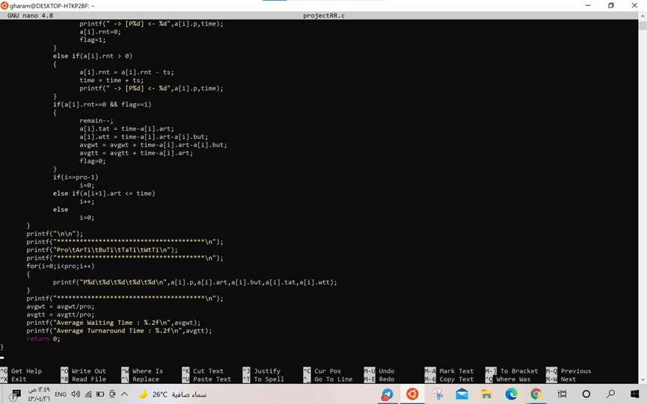
Code:
I
(3)

Slide 11
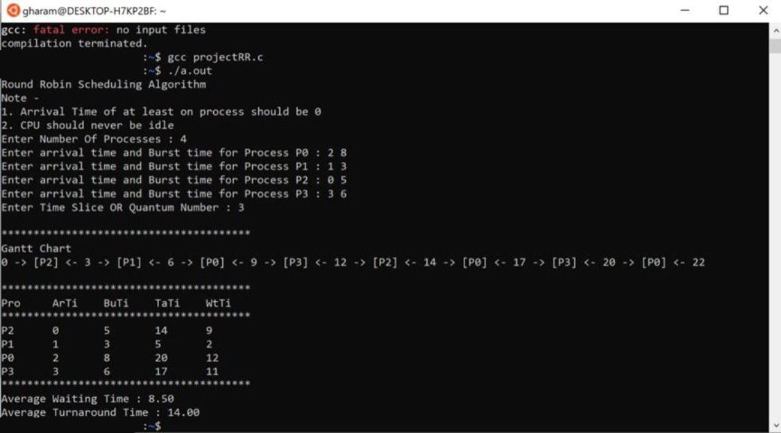

Output:

Slide 12

Preemptive Priority scheduling

Slide 13
Features and capabilities:
Great method for guaranteeing processes with higher needs are taken care of first. Preemptive Scheduling is useful when we use it for the multi-programming climate. Good when the resources are limited and priorities for each process are defined beforehand
Flexible
Pausing and reaction time of preemptive Scheduling is less.
The OS ensures that CPU utilization is the same by all running cycle.

Slide 14
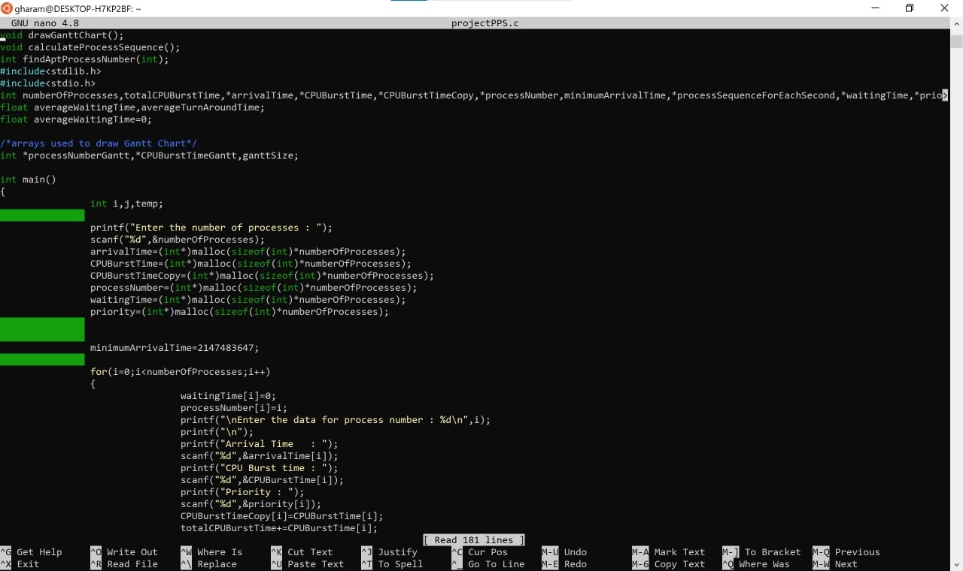
Code:
(1)

Slide 15
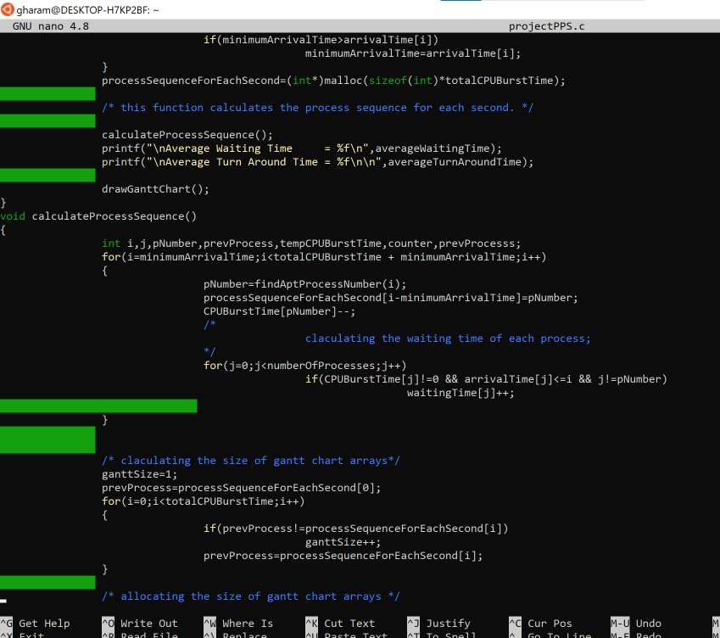
Code:
(2)

Slide 16
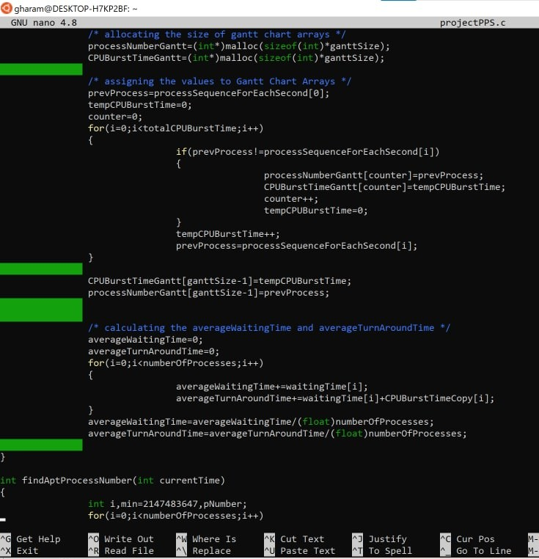
Code:
(3)

Slide 17
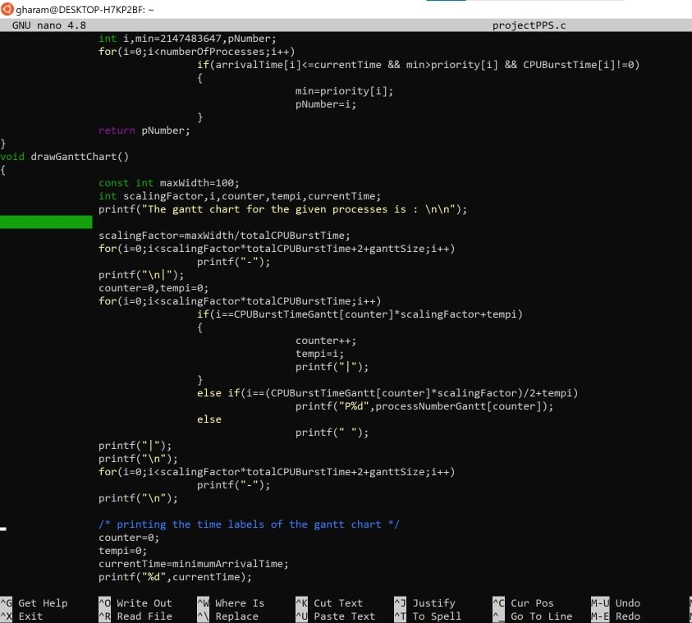
Code:
(4)

Slide 18
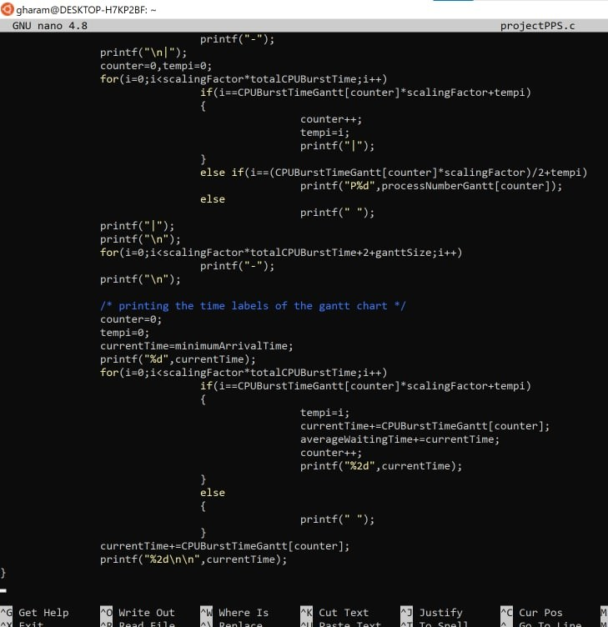
Code:
(5)

Slide 19
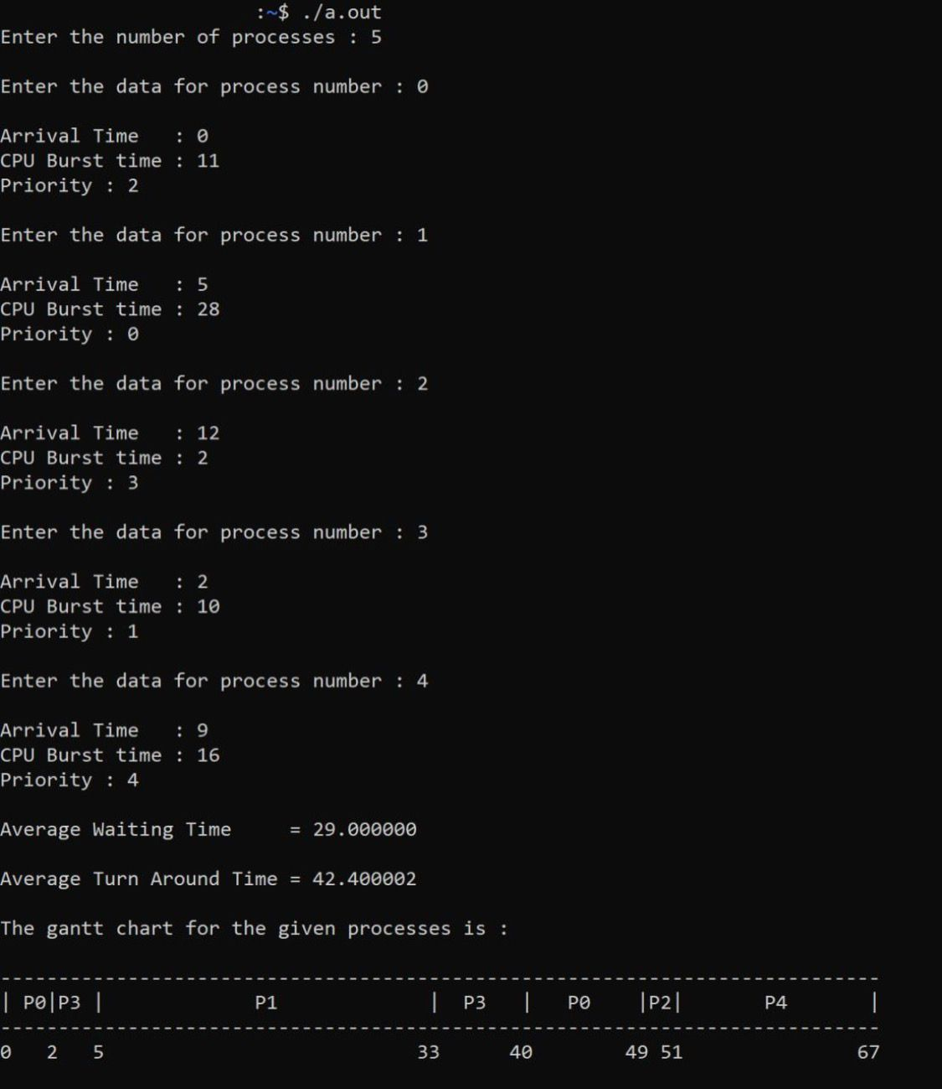
Output:

Slide 20

S U M M A R Y :
R R :
T H E N A M E
O F T H I S A L G O R I T H M C O M E S F R O M T H E R O U N D - R O B I N W H E R E
P R I N C I P L E , T U R N S .
E A C H P E R S O N G E T S A N E Q U A L S H A R E O F S O M E T H I N G I N
O N E O F T H E O L D E S T , F A I R E S T , A N D E A S I E S T A L G O R I T H M S A N D W I D E L Y U S E D
M E T H O D S I N T R A D I T I O N A L O S . I S A P R E - E M P T I V E A L G O R I T H M
PPS:
S C H E D U L I N G
if a task is currently being executed, it is important to execute a higher priority task immediately. For example, when a call is received, even if other applications are currently in use, the CPU will be immediately assigned to the task. This is because incoming calls have higher priority than other tasks.
uses real-time systems.

