Slide 1

E1
E2
E3
E4
A1
A2
2
4
6
1
3
5
7

Slide 2
POWER-ON
Device Mode will be saved in flash.
NORMAL Device
KONAMI Device
Firmware Update

Slide 3
NORMAL MODE
EFFECT Mode
Hold
5 seconds
SETUP Mode
TT Effect
Key Off Color
Key Theme
Key On
Color

Slide 4
SETUP MODE
Normal Reversed Off
Analog
Analog Reversed
I2C
I2C Reversed
First LED
Last LED
LED
Mode
Sensor
Mode
LED Select
OK
Cancel
1.4°
2.8°
4.2°
Analog Deadzone
256 ppr
128 ppr
96 ppr
64 ppr
Resolution

Slide 5
EFFECT MODE
Channel Selection
Dial
OK
Cancel
17%
50%
83%
0%
33%
67%
100%
1-7 Quick Set

Slide 6
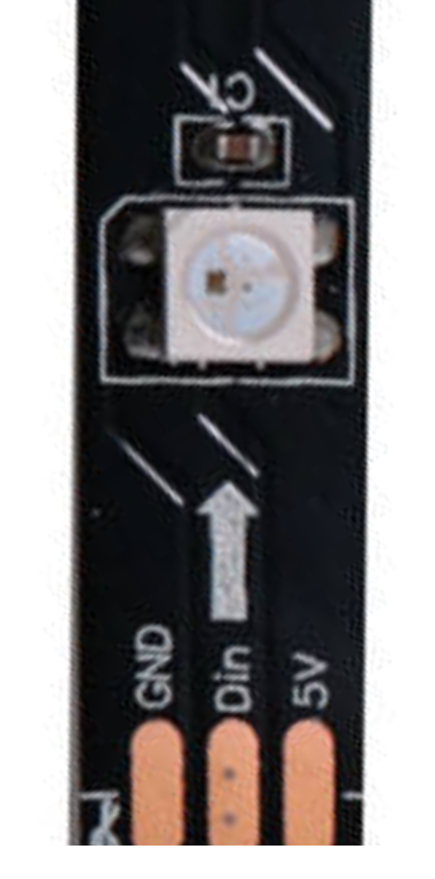
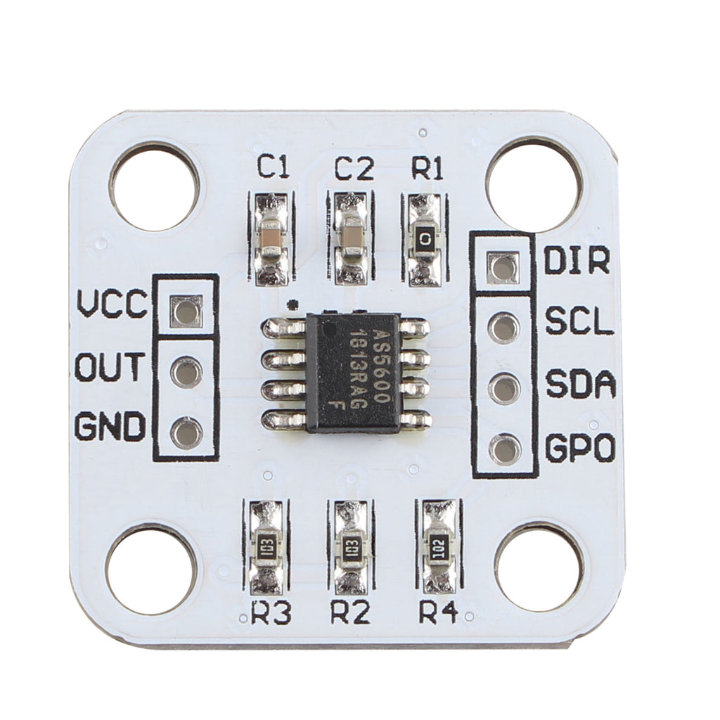
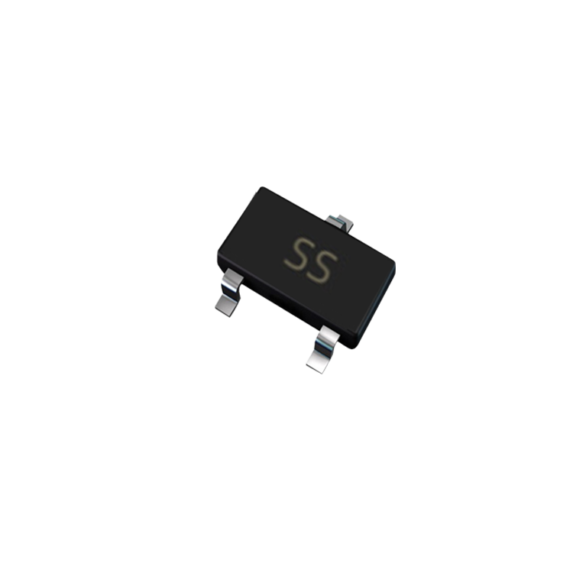
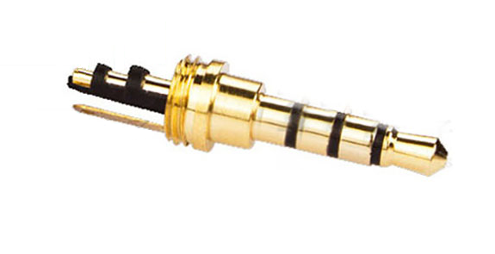
WS2812B LED Strip
REF3030

