Slide 1
PROJECT MANAGEMENT SYSTEM
MITTAL PANCHAL

Slide 2
INTRODUCTION
PROPOSED SYSTEM REQUIREMENT GATHERING
SYSTEM ANALYSIS AND DESIGN
INPUT / OUTPUT DESIGN

Slide 3
INTRODUCTION
This project is all about interaction between senior and junior developers.Senior developer create new project and assigned that project any junior developers and assigned any task .and uses chat with any developers and group of project. Junior developer submit daily timesheet to senior developer.

Slide 4
List Of Requirement:-
List of Requirements :-
There are different requirement are gathering technique.
Create or Login account.
Add project
Assigned any task
Track task details
Search task
Add timesheet

Slide 5
PROPOSED SYSTEM REQUIREMENTS GATHERING
1)Admin
2)senior developers
3)junior developers

Slide 6
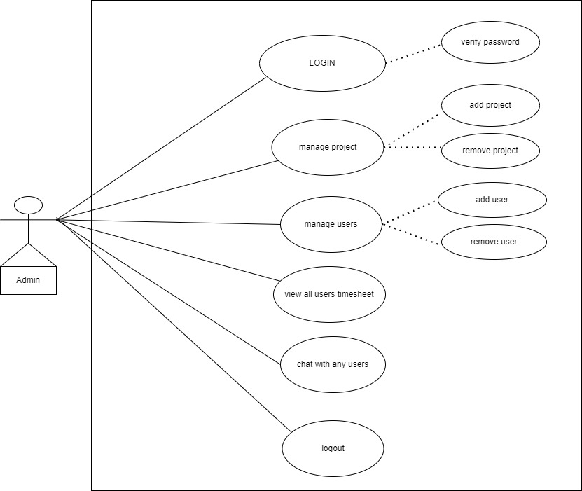
SYSTEM ANALYSIS AND DESIGN admin:-

Slide 7
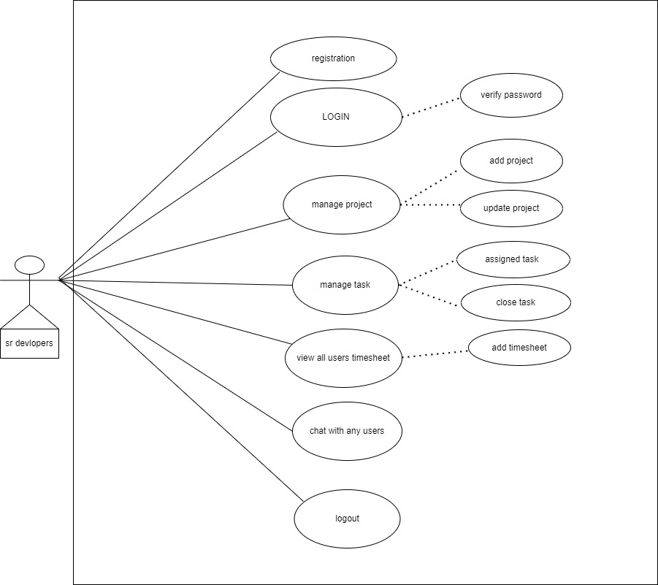
Sr developers:-

Slide 8
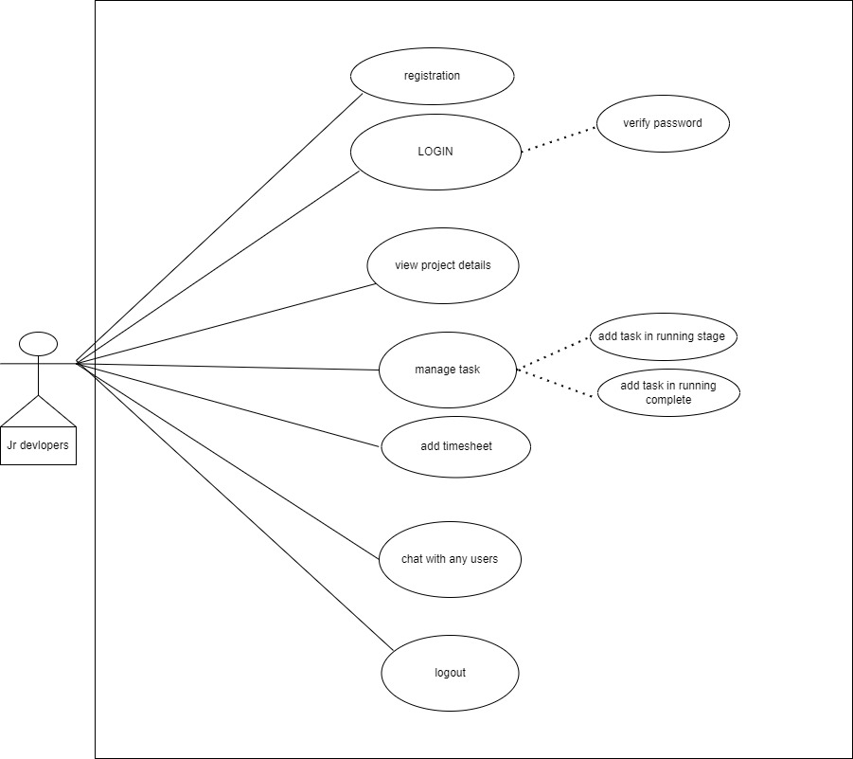
Jr developers:-

Slide 9
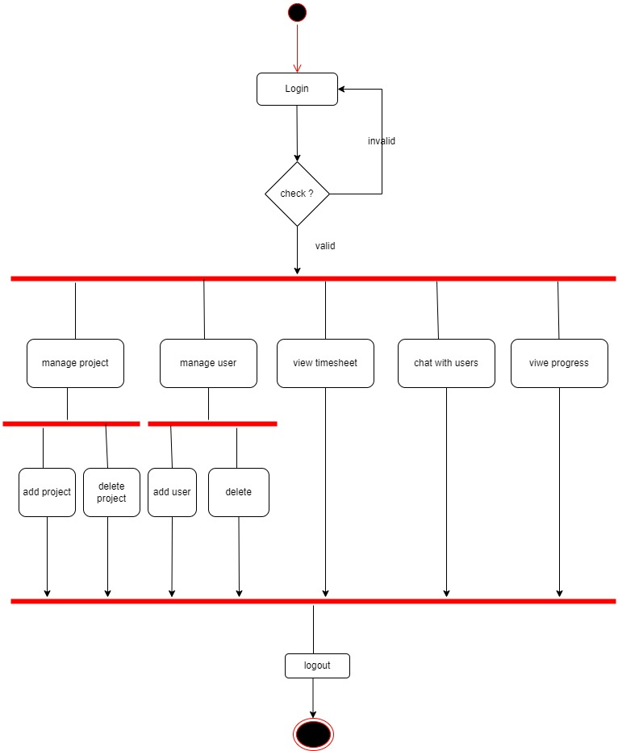
Activity Diagram :- 1)Admin:-

Slide 10
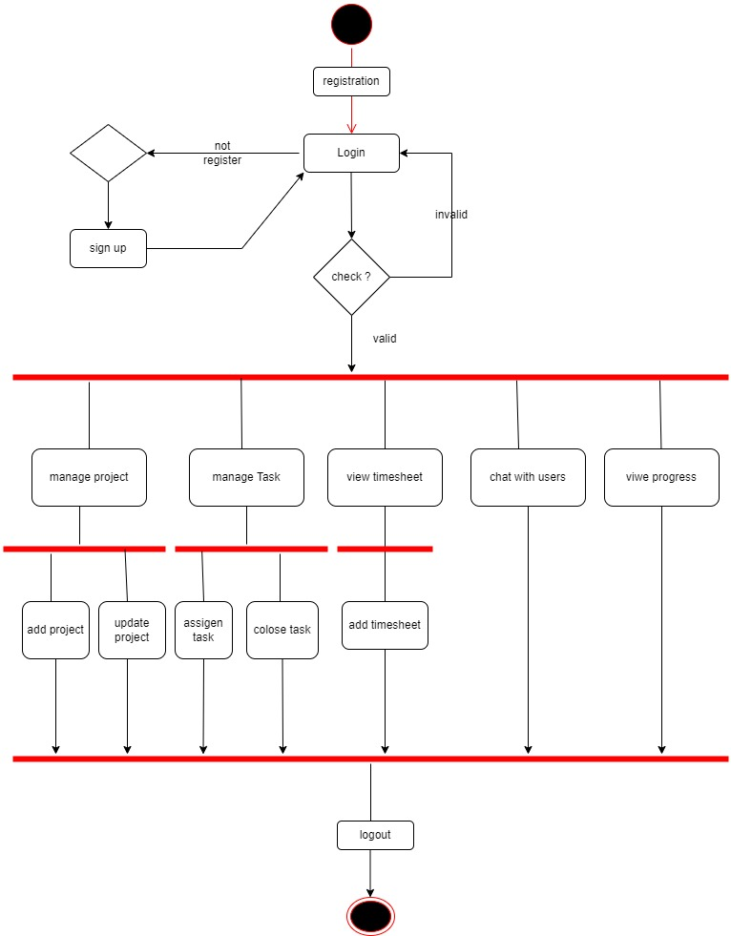
Sr developers:-

Slide 11
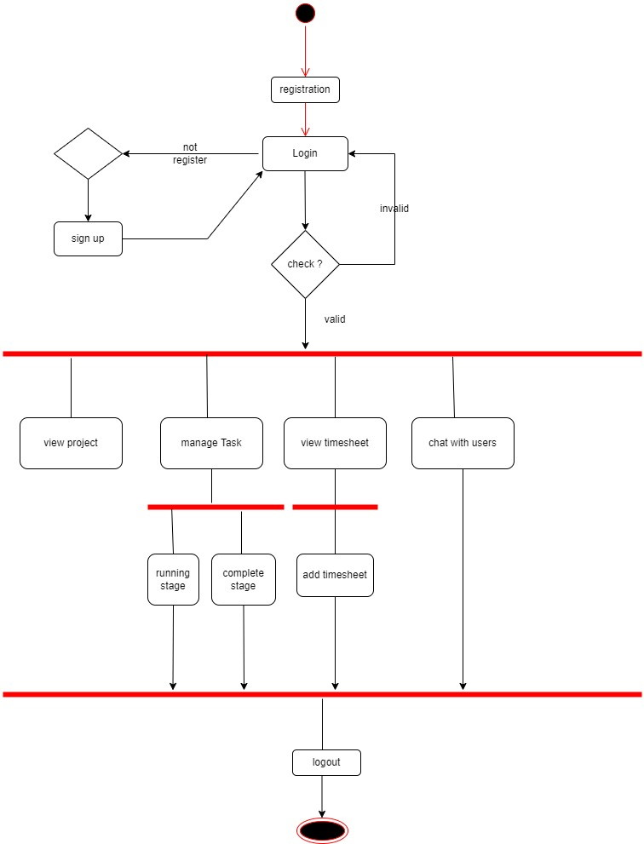
Jr developers:-

Slide 12
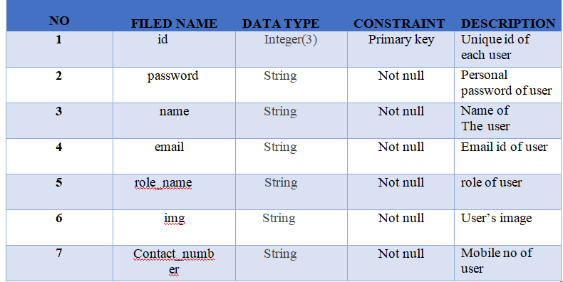
Data Dictionary:- user:-

Slide 13
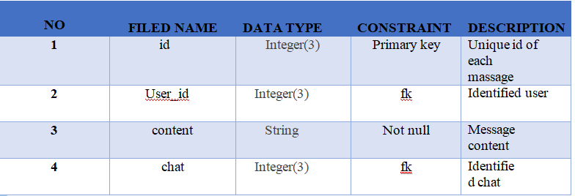
2)Message table:-

Slide 14
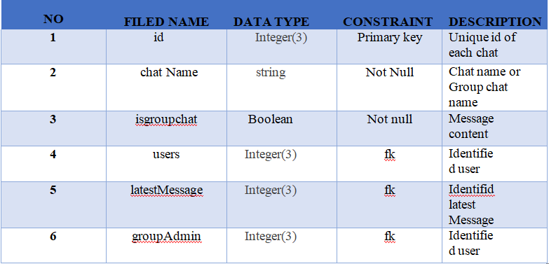
3)chat model:-

Slide 15
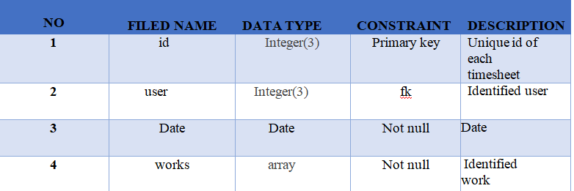
4)timesheet:-

Slide 16
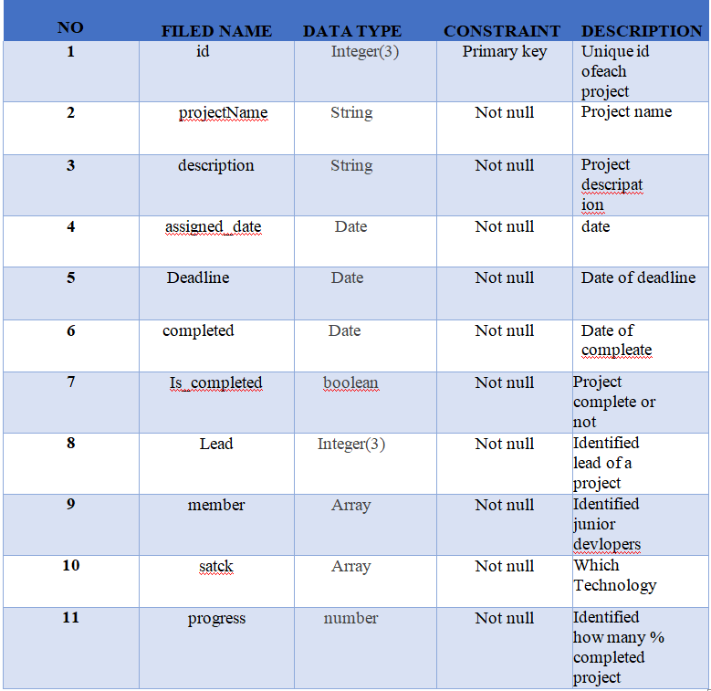
5)project table:-

Slide 17
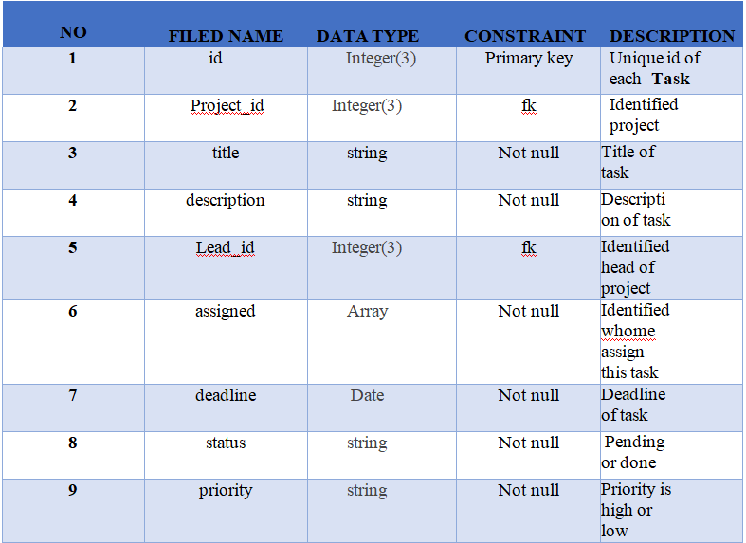
6)Task table

Slide 18

INPUT/output

Slide 19
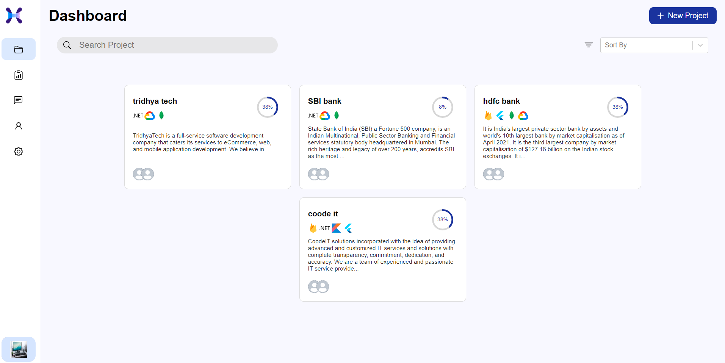

Slide 20
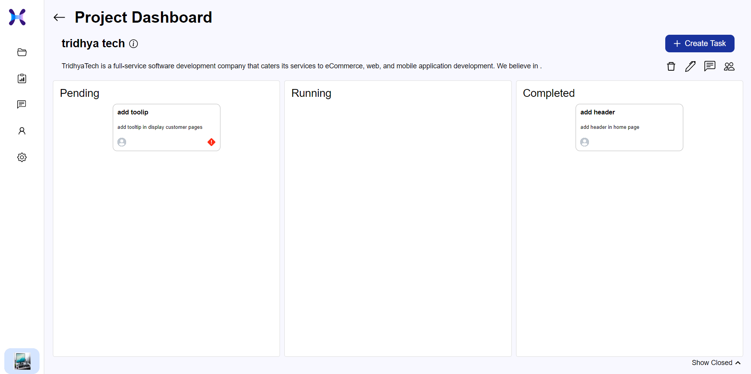

Slide 21
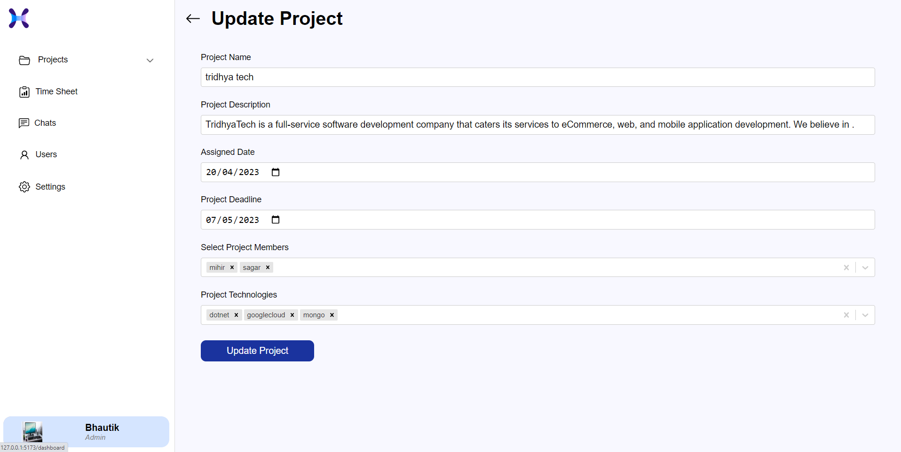

Slide 22
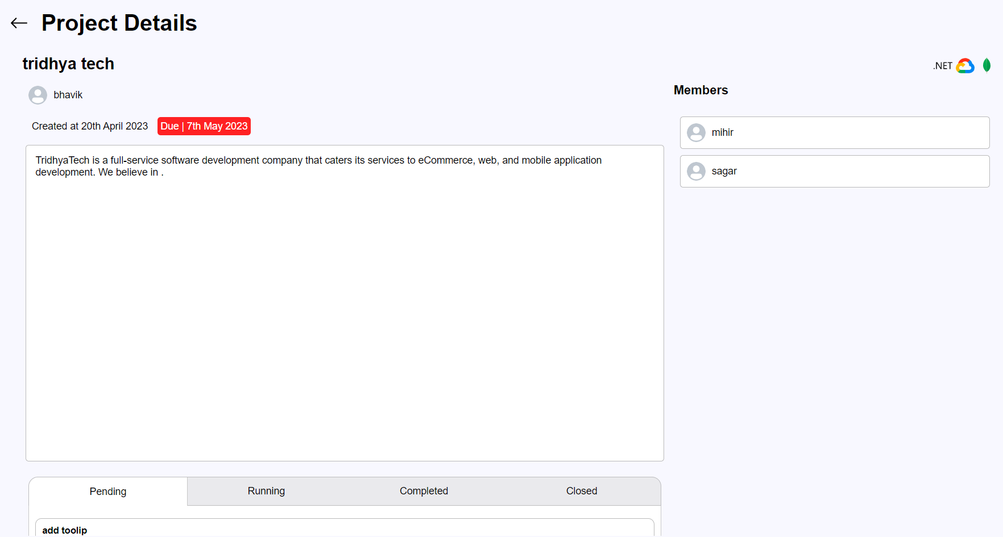

Slide 23
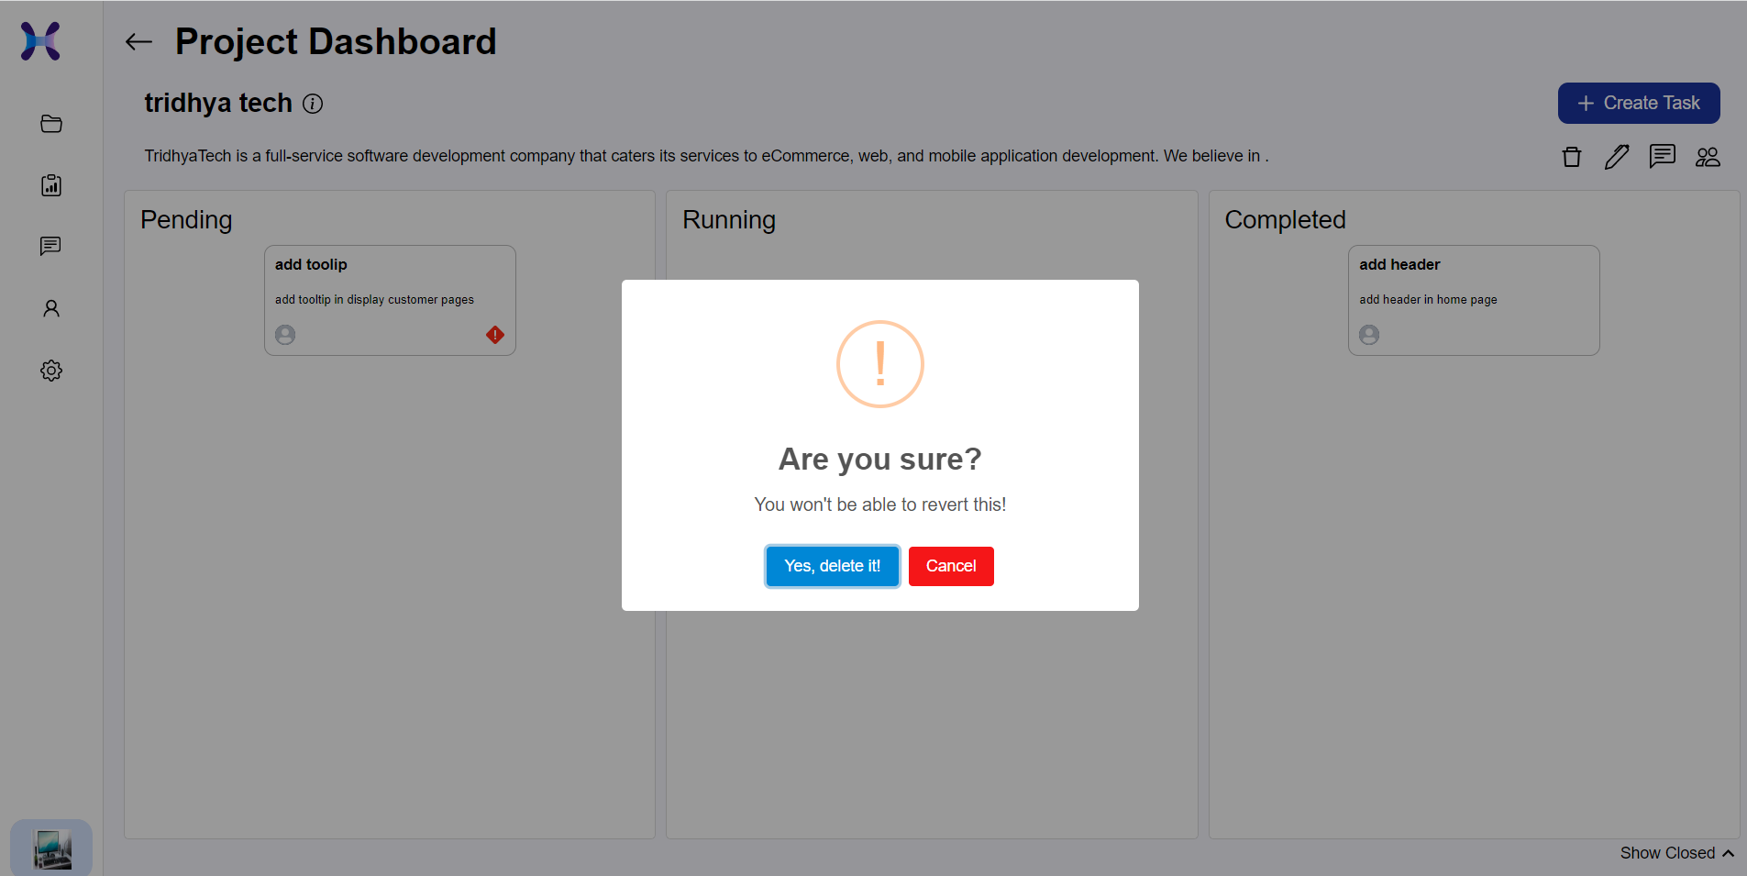

Slide 24
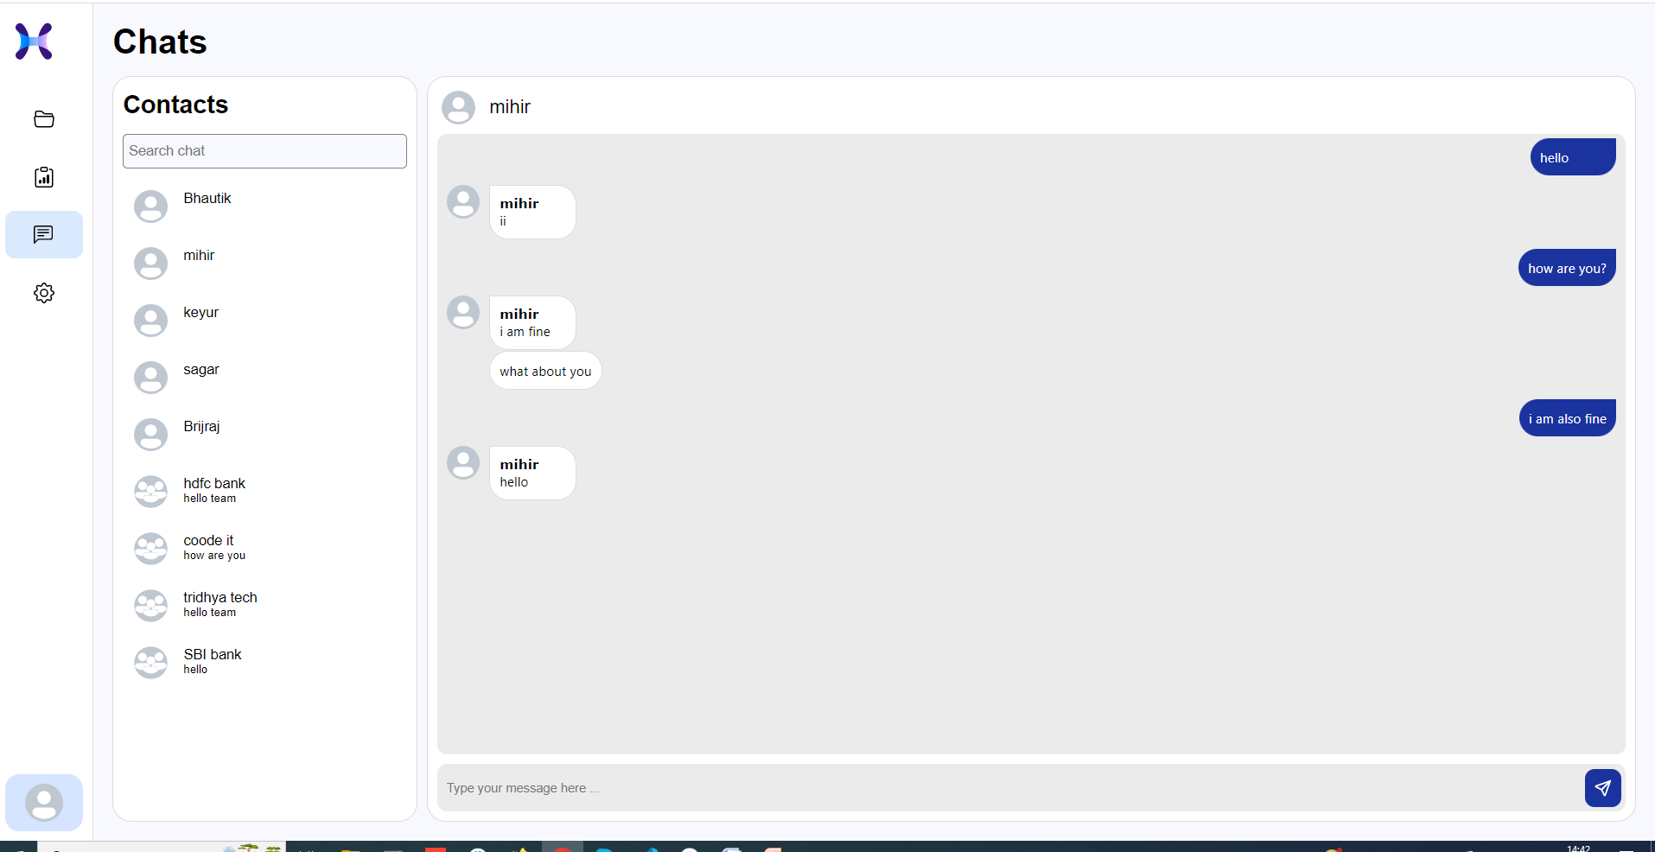

Slide 25
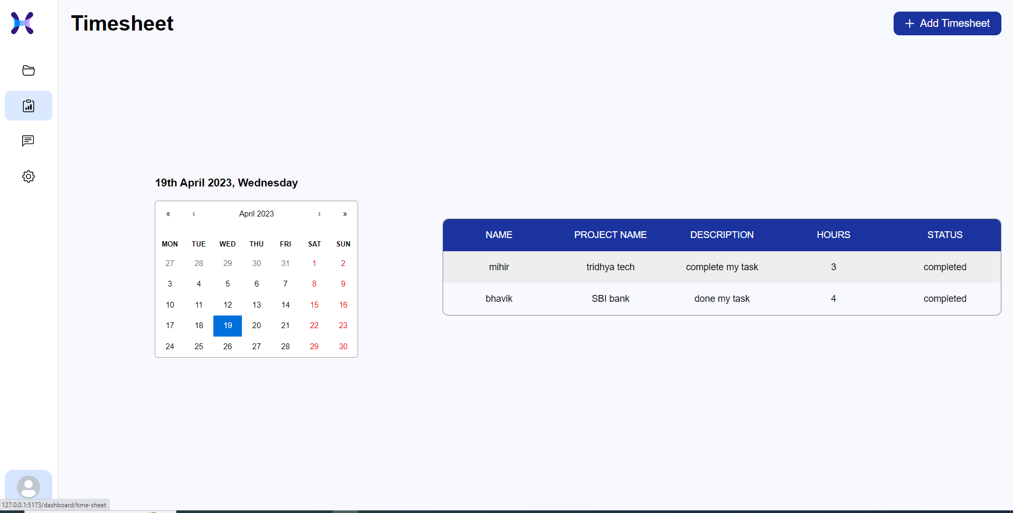

Slide 26
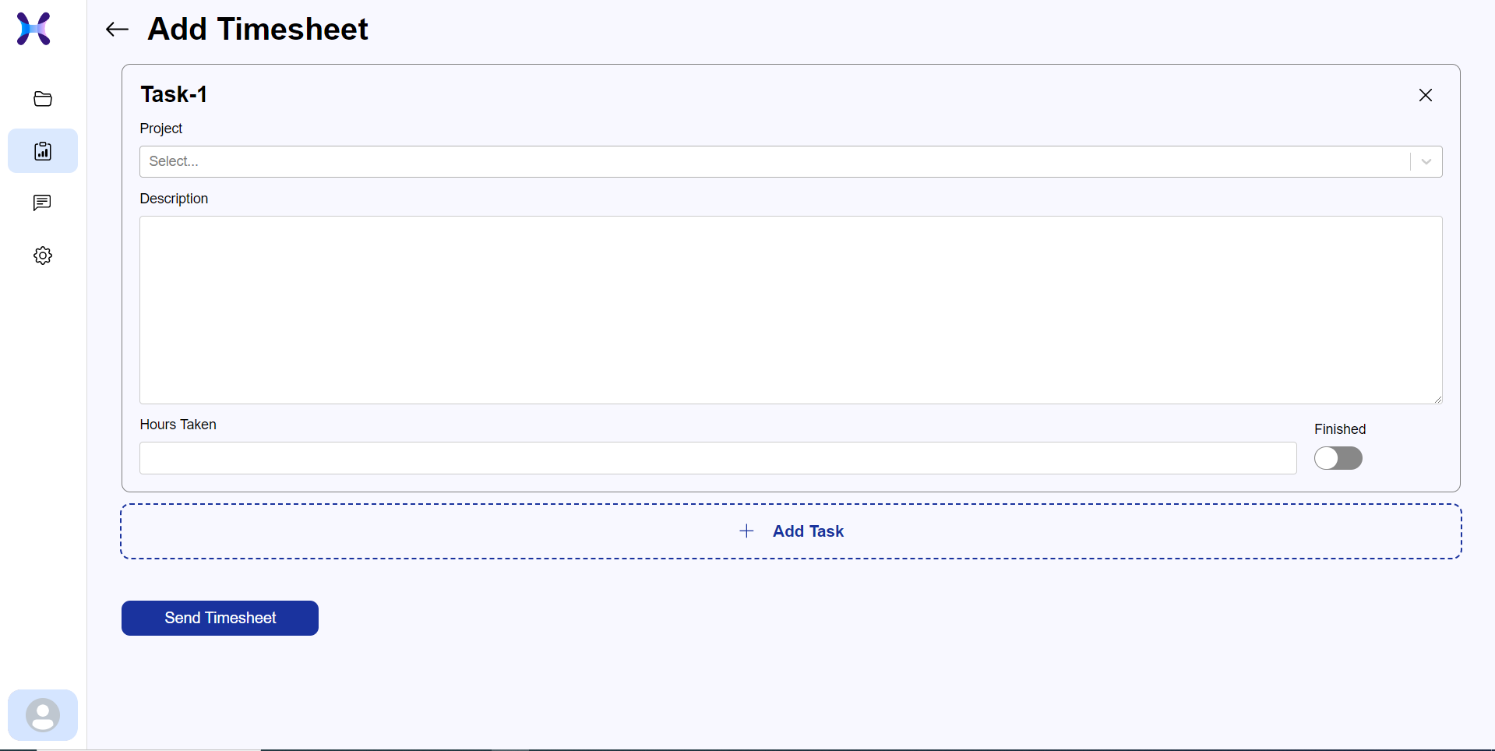

Slide 27
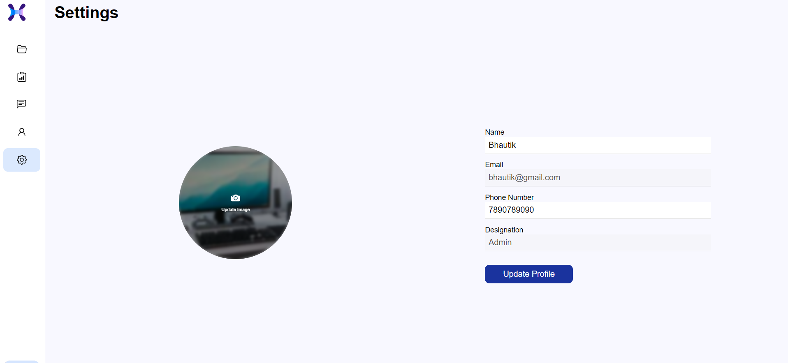

Slide 28
Thank you

