Slide 1

Team GLADIATORS
GladConnect

Slide 2
Gladiator’s members
Sahil Mittal (Leader)
Jayesh Jeevan Mulay
Palak Tiwari
Sarthak Agarwal
Neha Gajanan Shanbhag
Riya Khandelwal
Sahil Bhatt
Nikita Patil

Slide 3
Features Of The Application
Create and update your profile.
Send friend request and add more people to your contact list.
Personalize your contact list.
Block unwanted people.
Admin have separate user interface to view activities of all users and it can disable anyone based on their activity.
Login authentication using SHA.

Slide 4
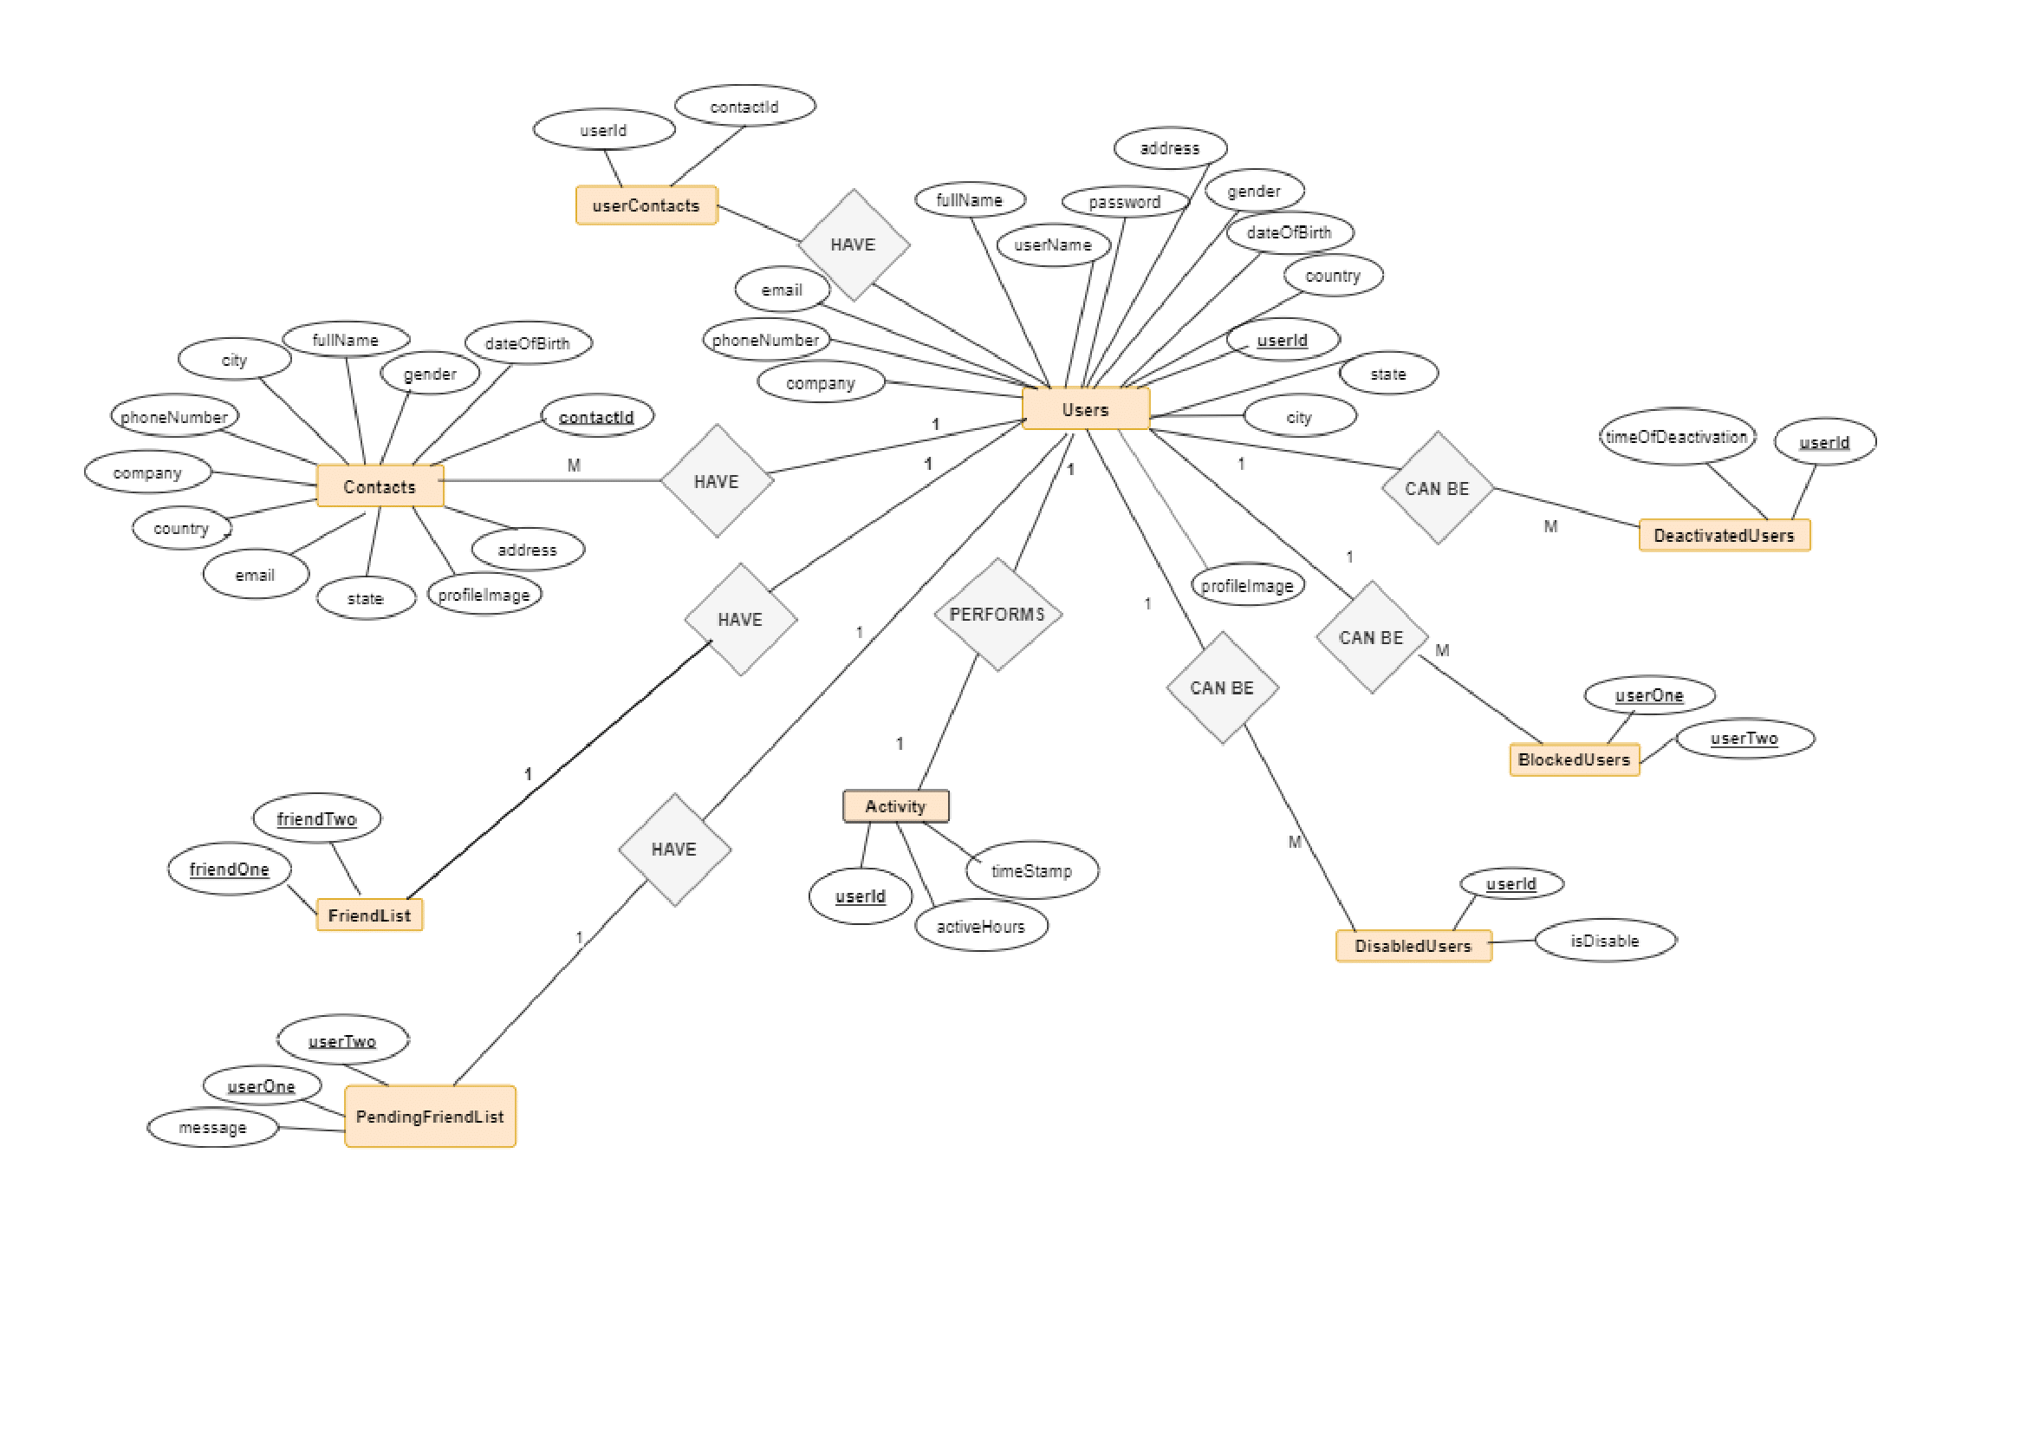
ER Diagram

Slide 5
Learning Concepts
To make the code more reusable, a modular approach was used to break the job up into smaller tasks and include them into individual functions.
Adaptable design strategy to incorporate new features with the least amount of changes.
Organized, reliable, and cooperative approach for best result.
Set up daily meetings to assess progress and determine future objectives.
Prioritization based on value in the product development process.
To avoid delays in achieving goals, knowledge management and team collaboration are required.

Slide 6
Tools
Spring tool suite for developing Dynamic Java web application .
Derby database.
Apache tomcat server.
GitHub for source code management.
https://github.com/MittalSahil/Gladiators_hsbc

Slide 7
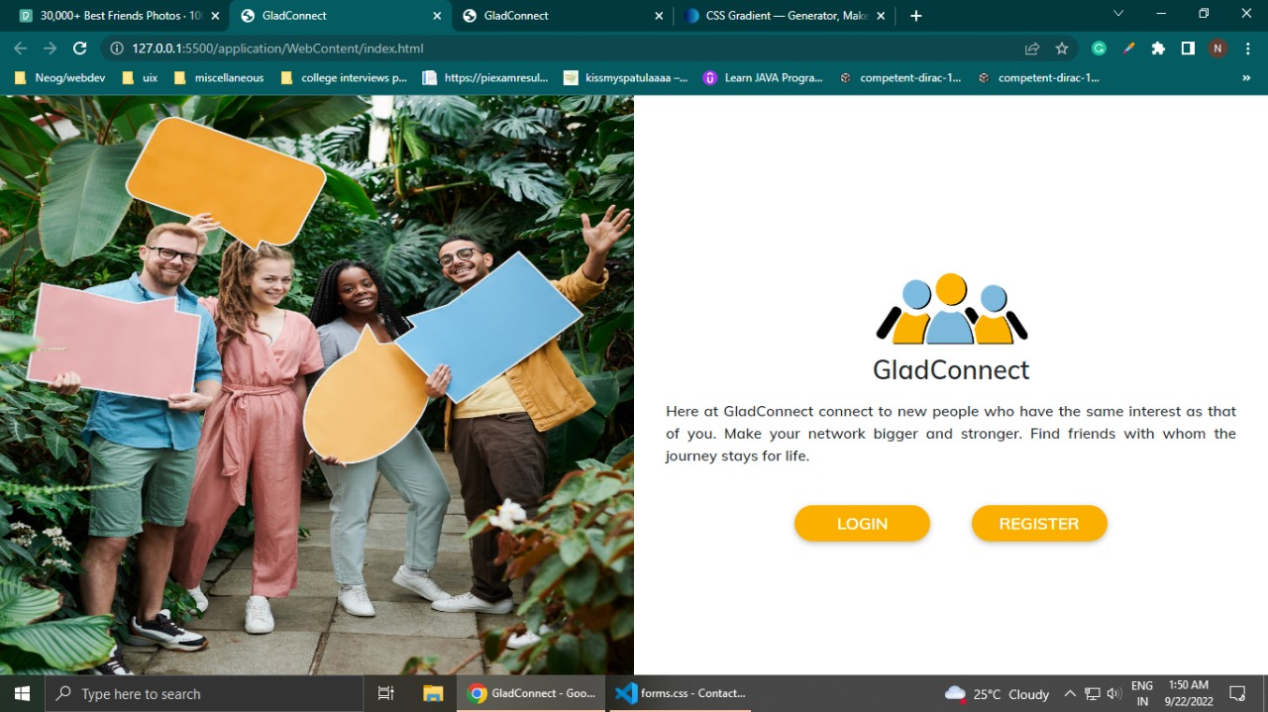
User Interface

Slide 8
