Slide 1

SHOPEZ – MERN Stack E-Commerce Application

Slide 2
Contents
Introduction
Objectives
Technologies Used
System Architecture
Database Design
Key Features
Application Flow
Implementation
Conclusion & Future Work

Slide 3
Introduction
ShopEZ is designed to provide a smooth and user-friendly online shopping experience.
The application allows users to create accounts, log in securely, browse available products, and place orders.
It also includes an admin panel for managing products and monitoring orders.
The system follows a client-server architecture where the frontend interacts with the backend through REST APIs.
The main goal of this project is to build a scalable and efficient e-commerce platform using modern web technologies.

Slide 4
Objective of the Project
The primary objective of ShopEZ is to develop a complete e-commerce web application using the MERN stack. The project focuses on implementing secure authentication, efficient database management, and proper communication between frontend and backend. It aims to provide users with an easy way to discover products, manage their cart, and complete purchases. At the same time, it provides administrators with tools to manage products and track orders.

Slide 5
Technologies Used
The project is built using the MERN stack. React.js is used for building the user interface because it allows reusable components and dynamic rendering. Node.js provides the runtime environment for executing JavaScript on the server side. Express.js is used to create REST APIs and handle routing. MongoDB is used as the database to store user details, products, cart items, and order information. Mongoose is used to define schemas and interact with MongoDB efficiently.
Additional tools such as Git and GitHub are used for version control, and Visual Studio Code is used as the development environment.

Slide 6
System Architecture
ShopEZ follows a three-layer architecture: frontend, backend, and database layer. The frontend is developed using React and handles all user interactions. When a user performs an action such as login or placing an order, the frontend sends a request to the backend server. The backend, built using Express and Node.js, processes the request and interacts with the MongoDB database. After processing, the backend sends a response back to the frontend.
This separation of layers ensures better maintainability, scalability, and security.

Slide 7
Database Design
The database consists of multiple collections such as Users, Products, Cart, Orders, and Admin. The Users collection stores user information like name, email, and password. The Products collection stores product details including name, price, description, and category. The Cart collection temporarily stores products added by users before purchase. The Orders collection stores confirmed purchase details, including shipping address and payment information.
Each order is linked to a specific user using a userId reference, which maintains relational integrity within the NoSQL database.

Slide 8
Key Features
ShopEZ provides several important features that make it a complete e-commerce system. Users can register and log in securely using authentication mechanisms. They can browse products, filter them based on categories, and add items to their cart. The application allows users to enter shipping details and payment methods before placing an order.
On the admin side, the dashboard enables administrators to add new products, manage existing products, and view all orders placed by users. This ensures smooth management of the platform.

Slide 9
Application Flow
The application starts with user registration and login. After successful authentication, the user is redirected to the home page where all available products are displayed. Users can select products and either add them to the cart or directly buy them. During checkout, users provide shipping address and payment details. Once the order is placed, the information is stored in the Orders collection.
For the admin, the flow begins with admin login. After logging in, the admin can manage product listings and monitor orders through the dashboard.

Slide 10
Implementation
The backend implementation includes setting up an Express server, defining API routes, creating Mongoose schemas, and implementing CRUD operations. Authentication middleware is used to protect secure routes. The frontend implementation includes creating reusable components, setting up routing using React Router, and integrating APIs using HTTP requests.
The project can be run locally by installing dependencies using npm and starting the development server.

Slide 11
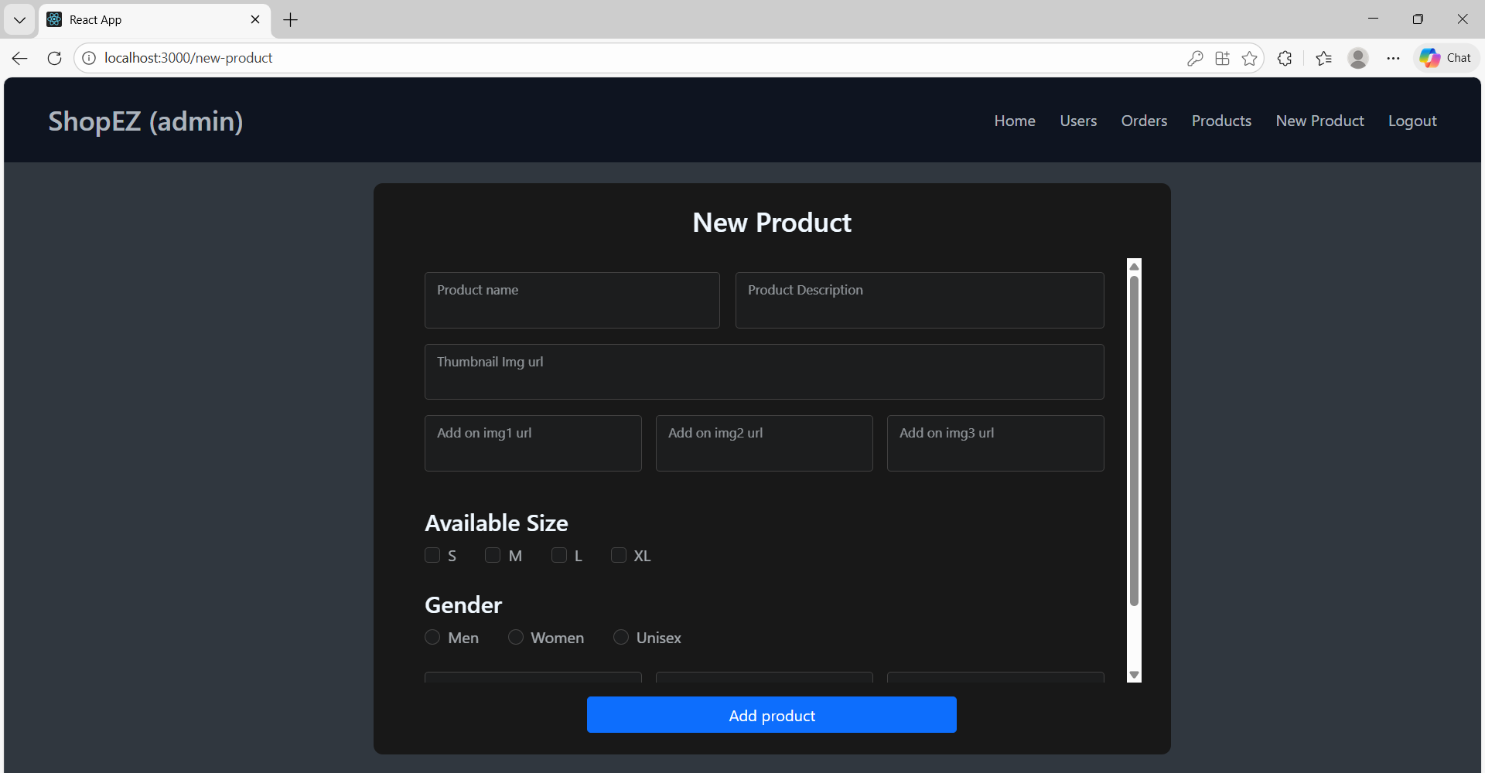
Output Screenshots

Slide 12
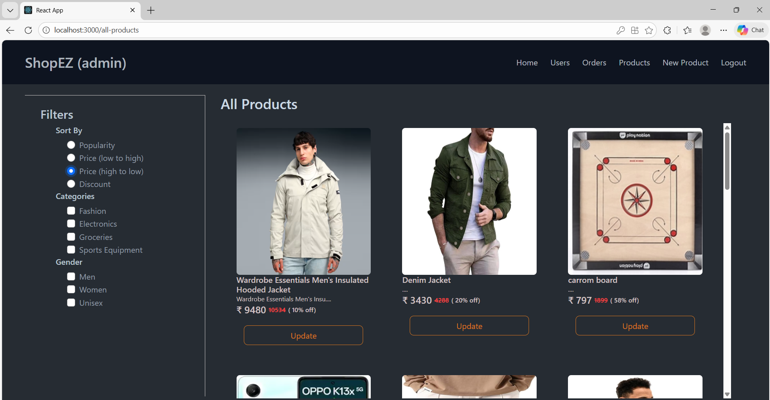

Slide 13
Git hub Link:
https://github.com/MittanaBhagyalaxmi33/SHOPEZ-MERNSTACK-APPLICATION
Output Images Link: https://drive.google.com/drive/folders/1F9Lq25kfEIhlfxAMnnvmPrjbf9WLA0IY
Demo Video Link : https://drive.google.com/file/d/1ZWb4TaZFDomJcUiQheRItbjN6GStwrW6/view

Slide 14
Conclusion and Future Scope
In conclusion, ShopEZ successfully demonstrates the development of a full-stack e-commerce web application using the MERN stack. It integrates frontend, backend, and database technologies to provide a complete shopping experience. The project highlights practical implementation of authentication, CRUD operations, and API integration.
In the future, the application can be enhanced by integrating online payment gateways, adding product reviews and ratings, implementing JWT-based authentication, and deploying the project on cloud platforms for public access.

Slide 15
THANK YOU

