Slide 1
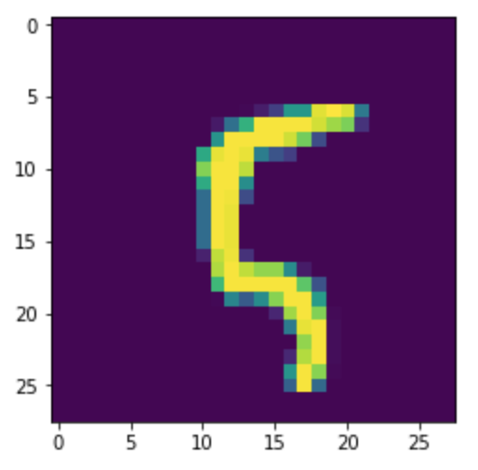
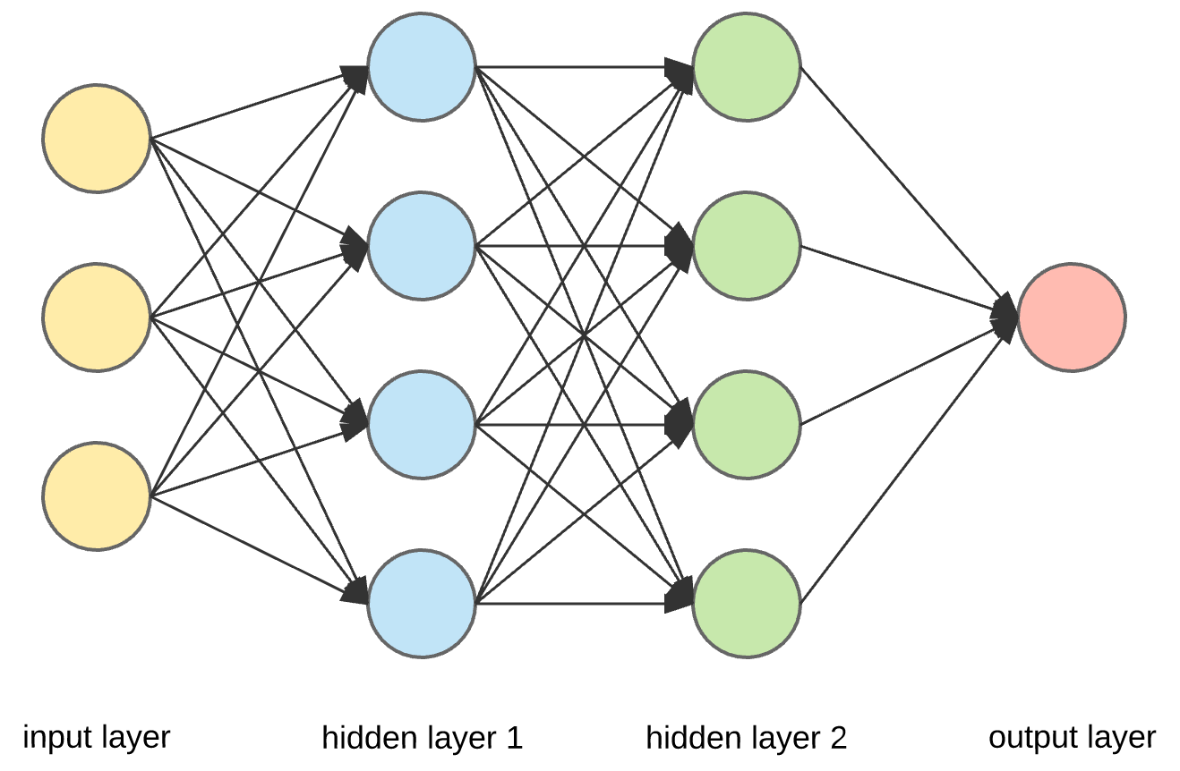
Artificial Neural Network for Digit Recognition
5

Slide 2
Requirements
Design
Implementation
Verification
Neural Network
Accuracy ~ 90%
Efficient
Hyperparameters
Interface
Register user input
Pass drawing to NN
Predict digit
> 95%
Batch gradient descent?
Fine
Yes
Yes
Yes, but…

Slide 3
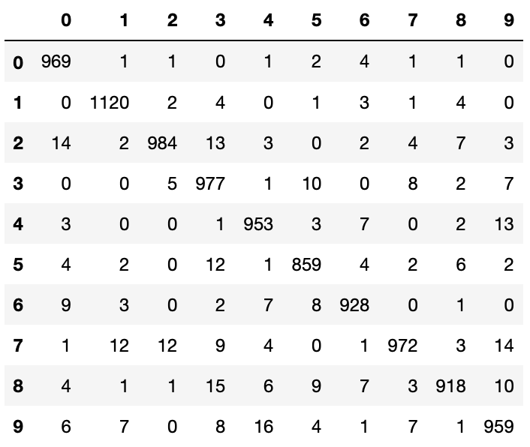
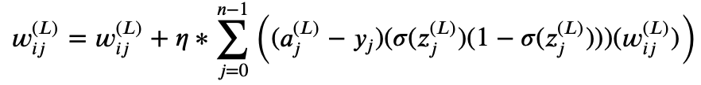
Requirements
Design
Implementation
Verification
Preprocess data
Create NN
Train NN
Evaluate NN
Save NN

Slide 4
Requirements
Design
Implementation
Verification
User
Program
Write digit
Register mouse
Click ‚Reset‘
Click ‚Recognize‘
Display drawing
Process drawing
Display output
Run NN
Click ‚Reset‘

Slide 5
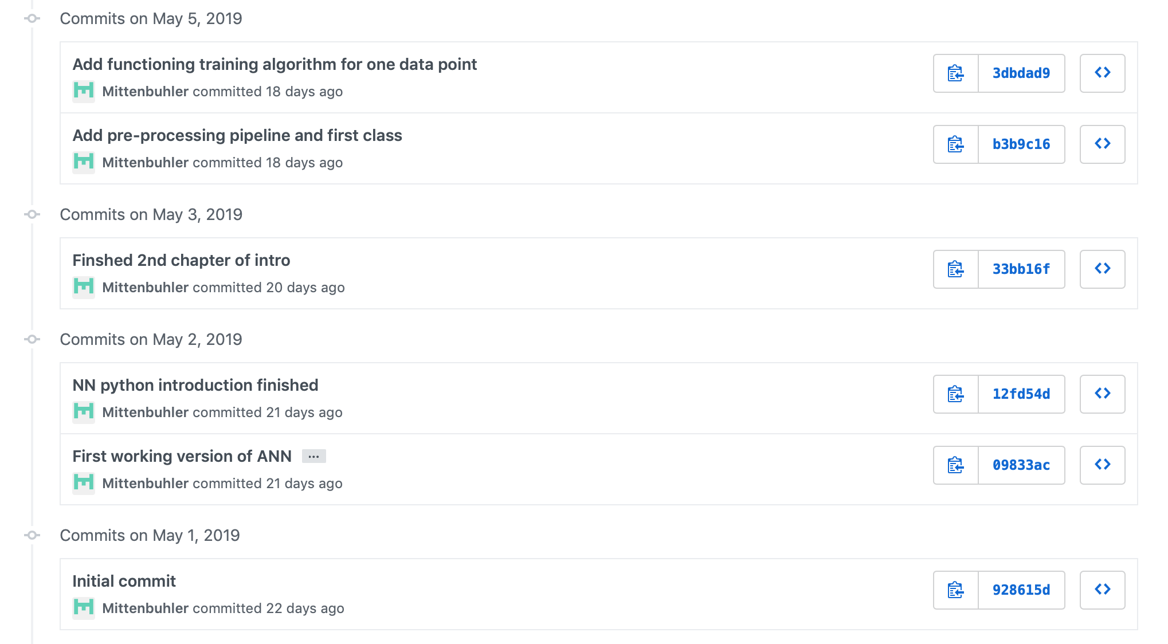
Implementation
Requirements
Design
Implementation
Verification
Neural Network

Slide 6
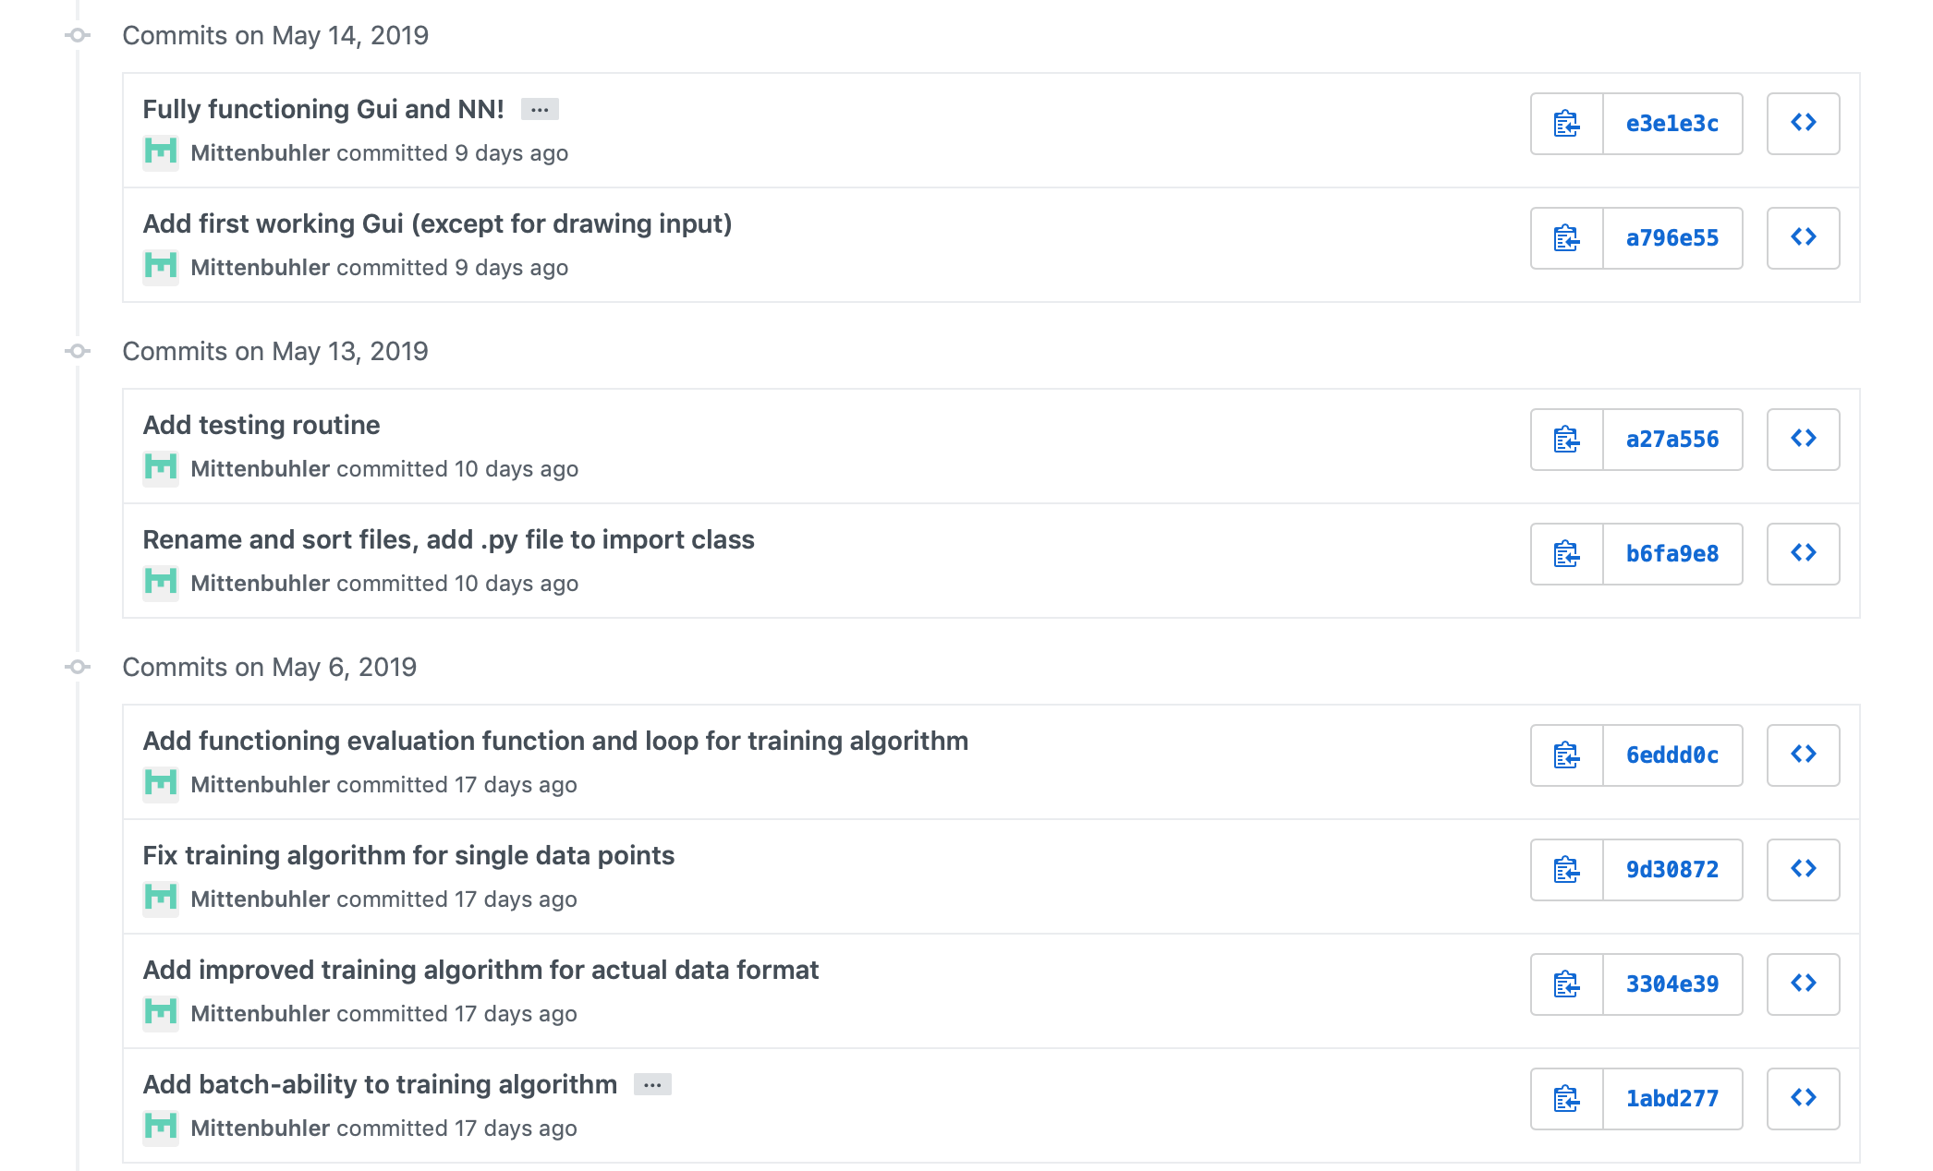

Implementation
GUI
Requirements
Design
Implementation
Verification
Neural Network

Slide 7
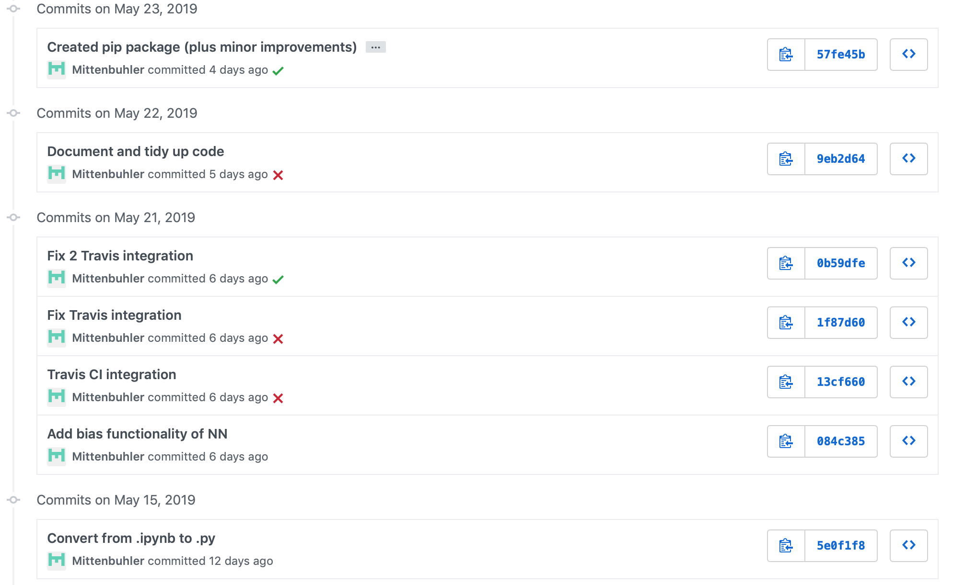
Implementation
Requirements
Design
Implementation
Verification
Bits & Pieces

Slide 8
Requirements
Design
Implementation
Verification
Works! However...
Location
Non-numbers
Improvements:
Improve training set!
(or preprocessing)

