Slide 1
Lending Case study
By
Mittinpreet & Melvin

Slide 2
Objective
Data cleaning
Univariant/Bivariant /Multivariant analysis
Recommendations
Data
understanding
To pinpoint applicants at risk of defaulting on loans, enabling a reduction in credit losses. This case study aims to achieve this goal through exploratory data analysis (EDA) using the provided dataset.
EDA flow chart

Slide 3
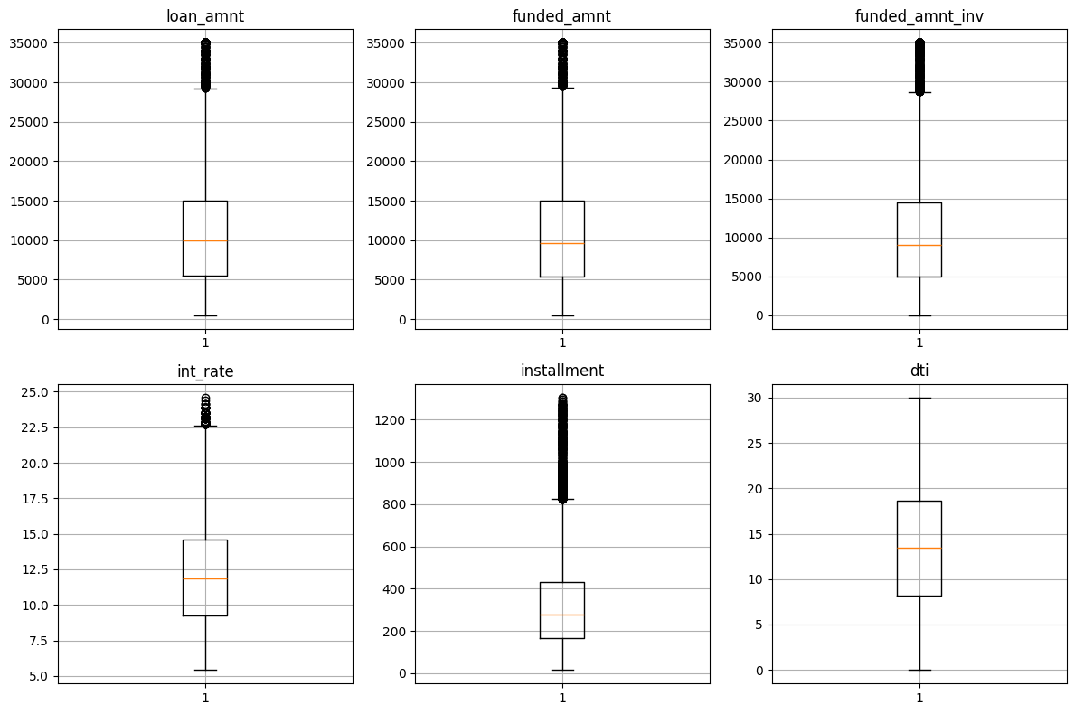
Boxplots

Slide 4
Boxplots
Loan amounts typically fall between 5,000 and 15,000 USD for the majority of applicants.
Funded amounts commonly range from 5,000 to 14,000 USD for loan recipients.
Investors typically fund loans within the range of 5,000 to 14,000 USD.
Interest rates on loans generally range between 9% and 14%.
Monthly installment amounts for loans typically range from 160 to 440 USD.
Debt-to-income ratios for applicants typically range between 8 and 18.

Slide 5
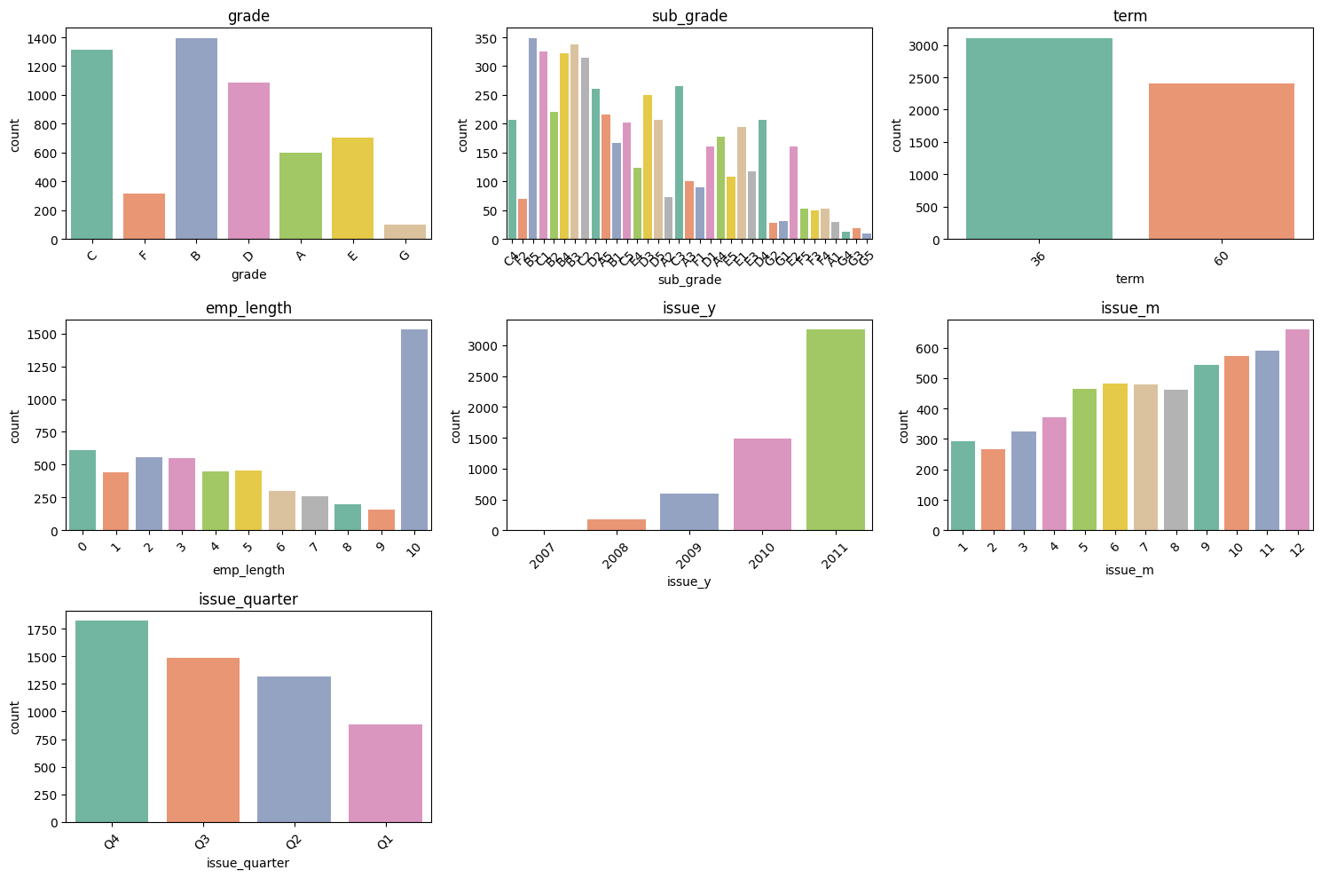
Univariant analysis-Ordered categorical

Slide 6
Univariant analysis-Ordered categorical
Grade B had the most "Charged off" loan applicants, totaling 1,352, indicating repayment challenges for this credit grade.
Short-term loans of 36 months were most popular among "Charged off" applicants, with 3,006 applications. This suggests defaults were common with shorter repayment periods.
Applicants with over 10 years of employment accounted for the highest "Charged off" loans, totaling 1,474. Long-term employment did not guarantee successful repayment.
In 2011, there were 3,152 "Charged off" loan applications, marking a peak in defaults over the years, possibly reflecting economic challenges.

Slide 7
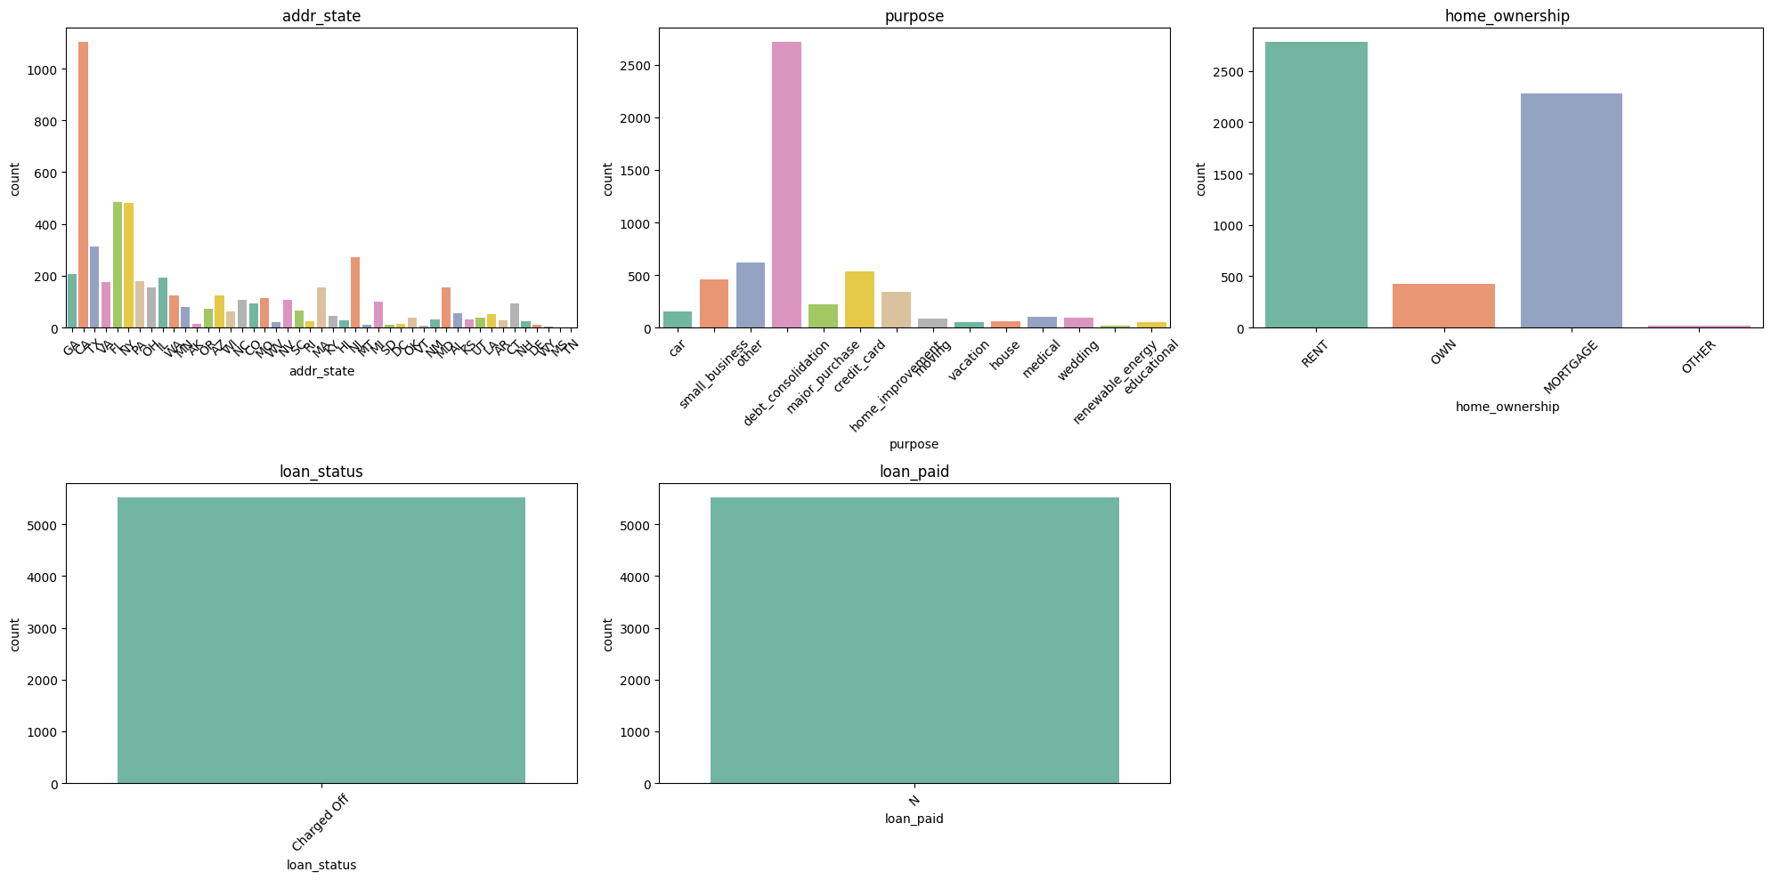
Univariant analysis-Unordered categorical

Slide 8
Univariant analysis-Unordered categorical
Key findings and Recommendations
High "Charged Off" Rates in California as 1,055 applicants from California were "Charged off.“
Action: Implement stricter eligibility criteria and credit assessments for applicants from California.
2,633 "Charged off" applicants selected debt consolidation as their loan purpose.
Action: Exercise caution when approving debt consolidation loans.
High Number of Loan Defaulters
Action: Enhance risk assessment practices, implement stricter credit checks, and lower loan-to-value ratios. Offer financial education and support services to improve loan repayment outcomes.

Slide 9
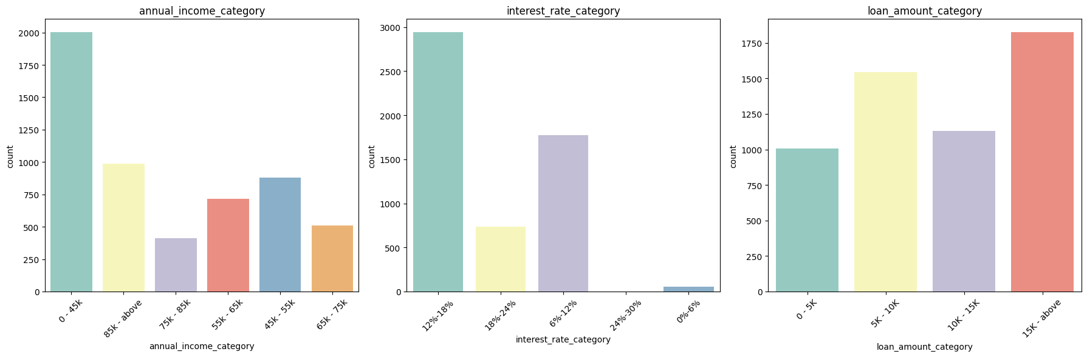
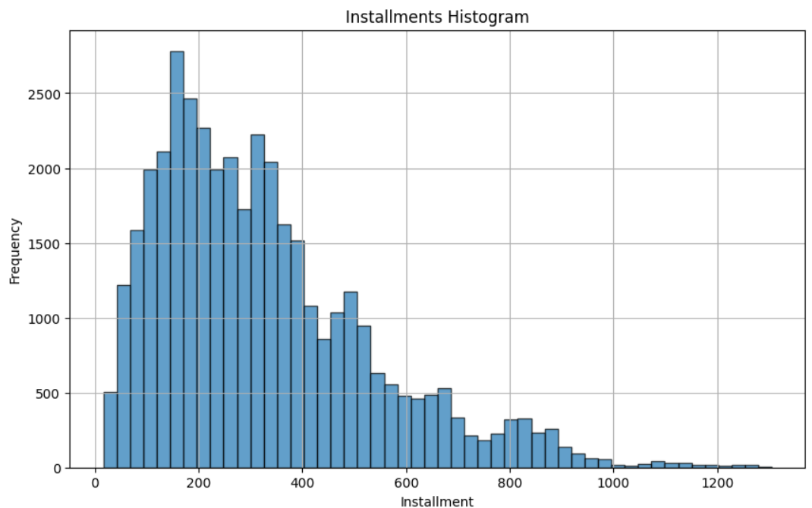
Univariant analysis-Quantitative variables

Slide 10
Univariant analysis-Quantitative variables
Key findings and Recommendations
2000 were charged off with annual salaries < $45,000.
Action: Implement rigorous income verification and assess repayment capacity more thoroughly for low-income applicants.
Around 3000 were charged off in the 12%-18% interest rate bucket.
Action: Consider offering loans at lower interest rates to reduce the risk of default.
Around 1800 were charged off with loans of $15,000 and above.
Action: Evaluate applicants seeking higher loan amounts carefully and ensure strong credit history and repayment capability.
Majority charged off with monthly installments in the range of $160-$450
Action: Closely monitor and assess applicants with similar installment amounts to mitigate the risk of loan defaults.

Slide 11
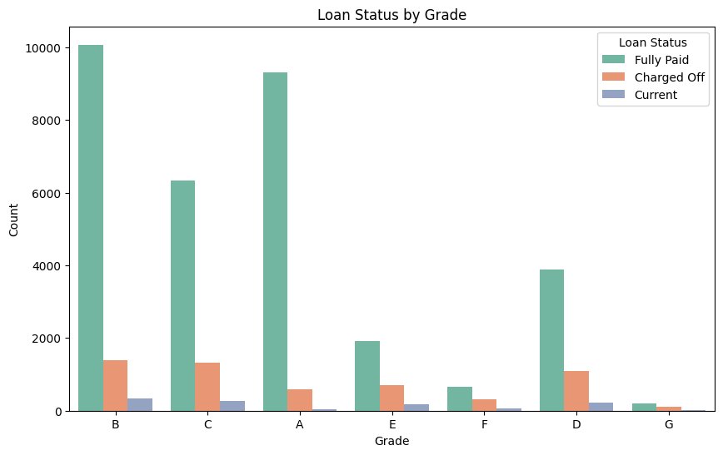
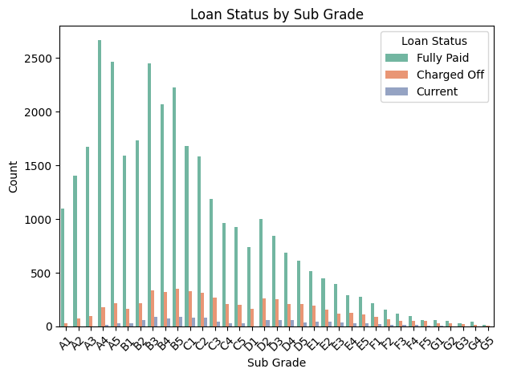
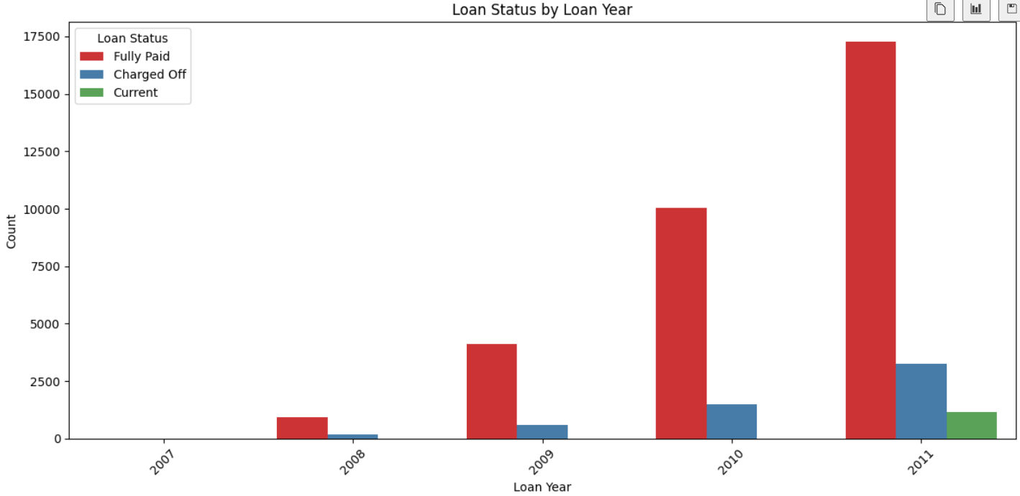
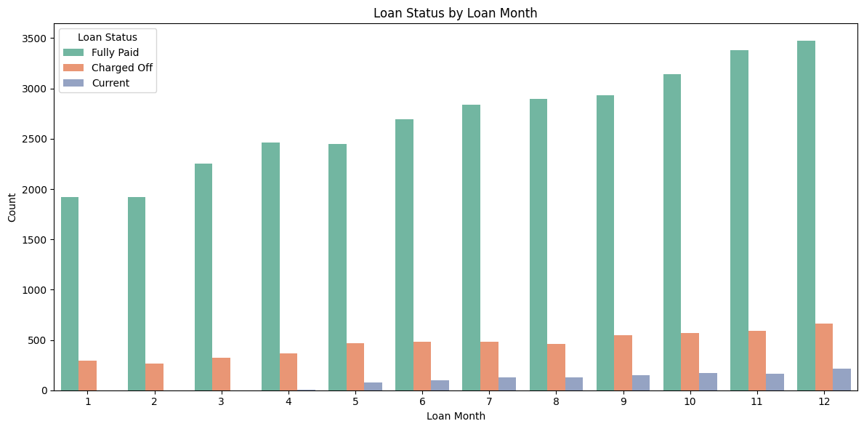
Bivariate Analysis-Ordered Categorical

Slide 12
Bivariate Analysis-Ordered Categorical
Key findings and Recommendations
Higher grade loans (B, A, C) have more "Fully Paid" statuses, while lower grade loans (D, E, F, G) have higher "Charged Off" rates.
Action: Implement stricter credit assessments for these sub grades to mitigate the risk of defaults.
Sub grades B3 to D5 have a notable number of "Charged Off" loans compared to their fully paid counterparts.
Action: Review and update lending policies implemented in 2011 to identify and correct issues leading to higher charge-offs.
A significant increase in "Charged Off" loans in 2011 compared to previous years.
Action: Review and update lending policies implemented in 2011 to identify and correct issues leading to higher charge-offs.
The number of "Charged Off" loans is relatively consistent across months, with a slight increase towards the end of the year.
Action: Monitor and possibly adjust lending criteria towards the year's end to manage seasonal fluctuations in charge-offs.

Slide 13
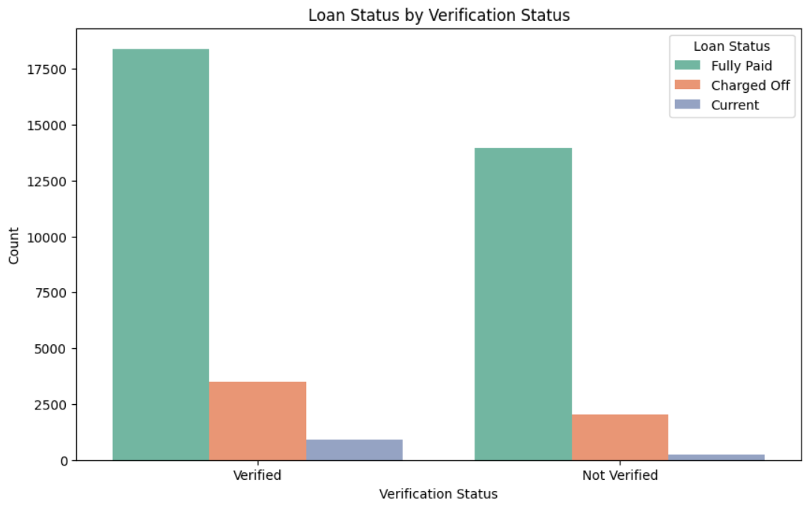
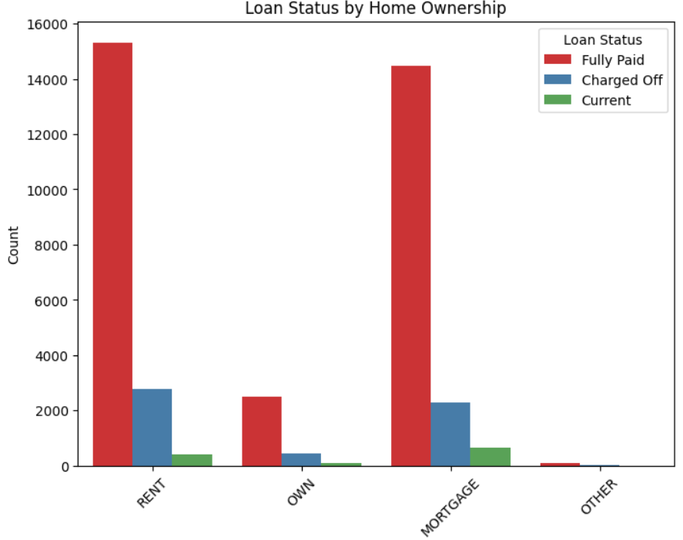
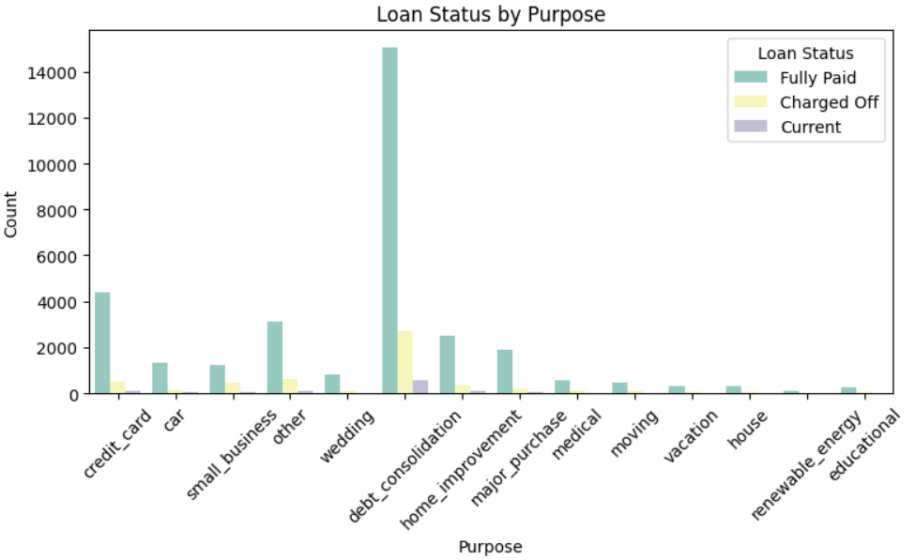
Bivariate Analysis Unordered Categorical

Slide 14
Bivariate Analysis Unordered Categorical
Key findings and Recommendations
Verified loans have a higher count of "Fully Paid" statuses compared to non-verified loans, which have more "Charged Off" statuses.
Action: Emphasize verification processes to reduce the risk of loan defaults.
Renters have a significantly higher number of "Charged Off" loans compared to homeowners.
Action: Implement stricter credit assessments and financial stability checks for renters to mitigate risk.
Debt consolidation loans have the highest number of "Charged Off" statuses among all loan purposes.
Action: Exercise caution and implement thorough risk assessments for debt consolidation loan applications.

Slide 15
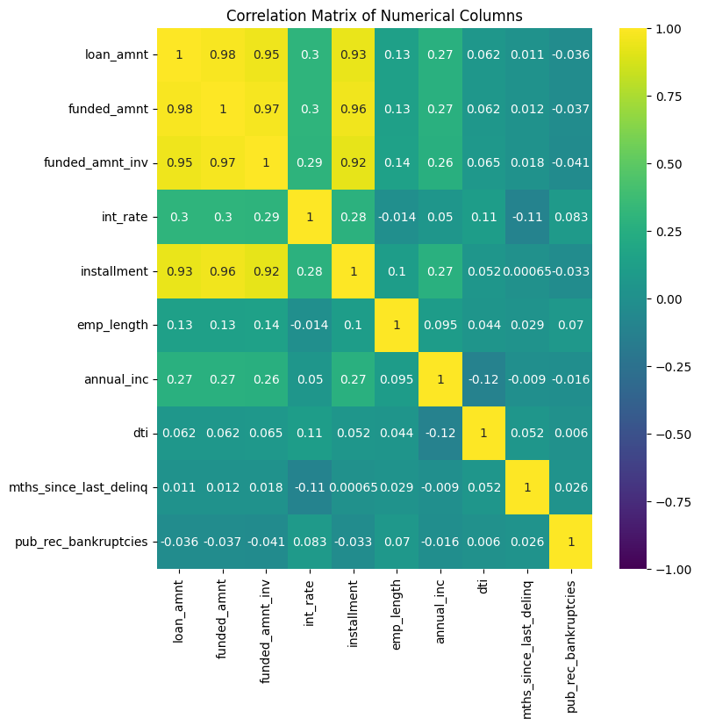
Multivariate Analysis
loan_amnt, funded_amnt, and funded_amnt_inv have very high correlations with each other (>0.95).
Higher loan amounts and installments are associated with higher interest rates
Variables like emp_length, dti, mths_since_last_delinq, and pub_rec_bankruptcies show low correlations with other variables.
These variables might provide unique information and should be considered in risk assessments despite their low correlations.

Slide 16
Conclusion
Based on overall analysis implementing these recommendations below can help reduce the risk of loan defaults and improve overall credit portfolio performance.
Stricter Credit Assessments: Tighten eligibility criteria for high-risk groups (e.g., Grade B, short-term loans, applicants from California).
Policy Review: Update lending policies from 2011 to reduce high default rates.
Interest Rate Adjustments: Offer lower interest rates to decrease default risk.
Enhanced Verification: Strengthen verification processes to ensure creditworthiness.
Income Verification: Thoroughly verify income and assess repayment capacity for low-income applicants.
Seasonal Monitoring: Adjust lending criteria at year-end to manage seasonal charge-offs.

