Slide 1
Lending Case study
By
Mittinpreet & Melvin

Slide 2
Objective
Data cleaning
Univariant/Bivariant /Multivariant analysis
Recommendations
Data
understanding
To pinpoint applicants at risk of defaulting on loans, enabling a reduction in credit losses. This case study aims to achieve this goal through exploratory data analysis (EDA) using the provided dataset.
EDA flow chart

Slide 3
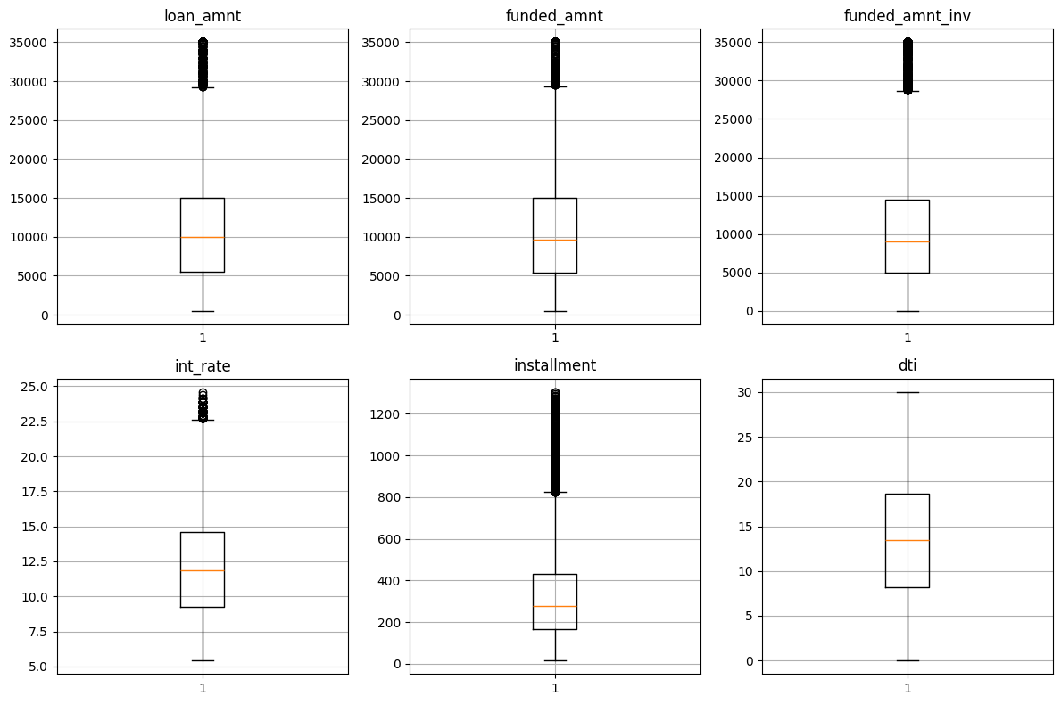
Boxplots

Slide 4
Boxplots
Loan amounts typically fall between 5,000 and 15,000 USD for the majority of applicants.
Funded amounts commonly range from 5,000 to 14,000 USD for loan recipients.
Investors typically fund loans within the range of 5,000 to 14,000 USD.
Interest rates on loans generally range between 9% and 14%.
Monthly installment amounts for loans typically range from 160 to 440 USD.
Debt-to-income ratios for applicants typically range between 8 and 18.

Slide 5
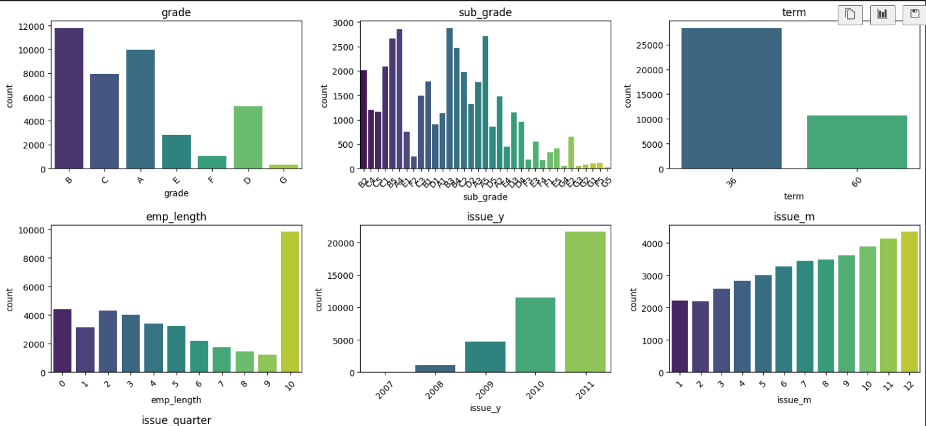
Univariant analysis-Ordered categorical

Slide 6
Univariant analysis-Ordered categorical
Grade B had the most "Charged off" loan applicants, totaling 1,352, indicating repayment challenges for this credit grade.
Short-term loans of 36 months were most popular among "Charged off" applicants, with 3,006 applications. This suggests defaults were common with shorter repayment periods.
Applicants with over 10 years of employment accounted for the highest "Charged off" loans, totaling 1,474. Long-term employment did not guarantee successful repayment.
In 2011, there were 3,152 "Charged off" loan applications, marking a peak in defaults over the years, possibly reflecting economic challenges.
"Charged off" loans peaked in the 4th quarter, especially in December, with 2,284 applications, indicating financial pressures during the holiday season may have contributed to defaults.

Slide 7
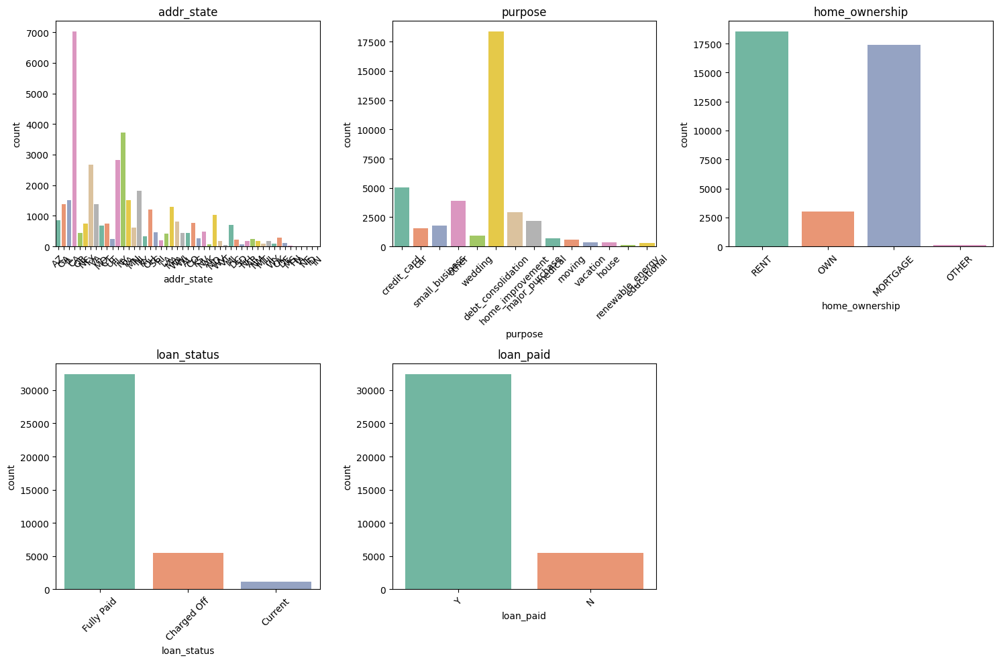
Univariant analysis-Unordered categorical

Slide 9
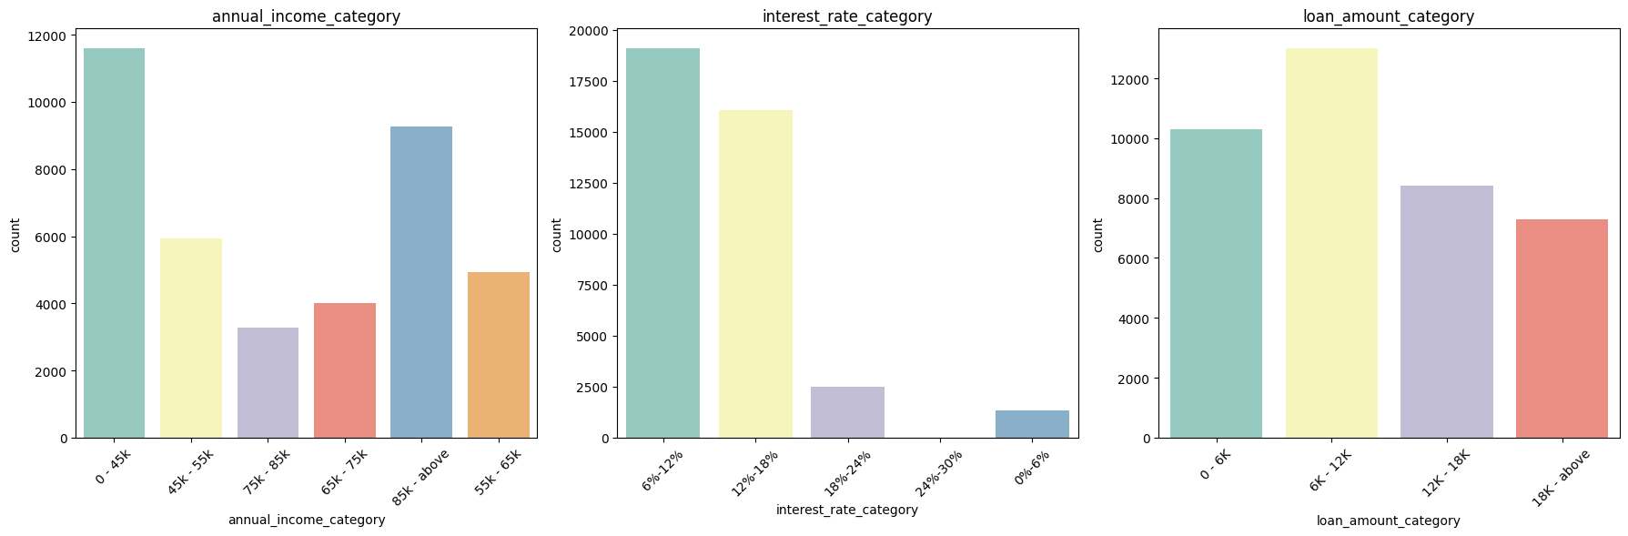

Slide 10
