Slide 1


Slide 2
Power
Current and voltage are the two basic variables in an electric circuit, they are not sufficient by themselves. For practical purposes, we need to know how much power an electric device can handle. We all know from experience that a 100-watt bulb gives more light than a 60-watt bulb. We also know that when we pay our bills to the electric utility companies, we are paying for the electric energy consumed over a certain period of time. Thus, power and energy calculations are important in circuit analysis.
Power is defined as the rate at which work is done or energy is expended.
It is expressed in watts (W). Power is one watt if one joule of energy is expended in transferring one coulomb of charge through the device in one second.
Mathematically, the relationship is :- p = dw / dt
where ‘p’ is power in watts (W), ‘w’ is energy in joules (J) & ‘t’ is time in seconds.
Also p = dw / dt = dw / dq X dq / dt = vi

Slide 3
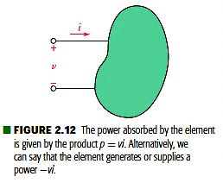
Power
The absorbed power must be proportional both to the number of coulombs transferred per second (current) and to the energy needed to transfer one coulomb through the element (voltage).
The conventions for current, voltage, and power are shown in Fig. 2.12.
Thus, the power absorbed or supplied by an element is the product of the voltage across the element and the current through it. If the power has a +ve sign, power is being delivered to or absorbed by the element. If, on the other hand, the power has a -ve sign, power is being supplied by the element.

Slide 4
Passive Sign Convention
The passive sign convention is satisfied when the current arrow is directed into the element at the plus-marked terminal.
It says that if the current arrow and the voltage polarity signs are placed such that the current enters that end of the element marked with the positive sign, then the power absorbed can be expressed by the product of the specified current and voltage variables.
If the numerical value of the product is negative, then we say that the element is absorbing negative power, or that it is actually generating power and delivering it to some external element.
In the first case the +ve terminal is at 5 volts wrt the other terminal.
In the second case the +ve terminal is at – 5 volts wrt the other terminal.
3 A
+
5 V
15 w
(absorbed)
_
_
- 5 V
15 w
(absorbed)
- 3 A
+
+
- 3 A
5 V
-15 w
(absorbed)
_

Slide 5
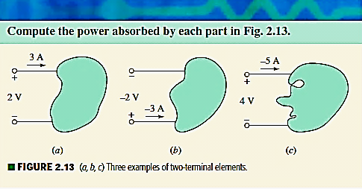
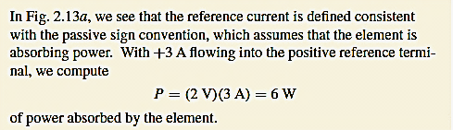
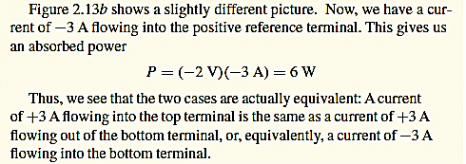
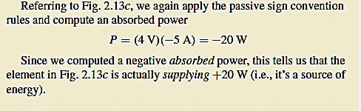
Example : Power

Slide 6
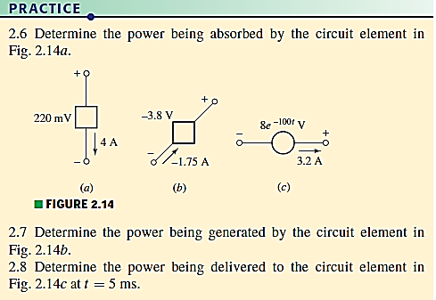
PRACTICE : Power

Slide 7
Example : Power
How much energy does a 100 - watt electric bulb consume in two hours?
We know p = dw / dt where w is in joules and t in seconds.
So 100 = w (joules) / (2X60X60)
Hence w = 720 k joules.
Also pdt = dw
So watt X sec = joules
Or watt X 3600 X sec = joules X 3600
Hence 1watt-hour = 3600 joules
And 200 watt - hr = 720 k joules (watt-hr is the unit used by electrical companies)
The Circuit Elements !

Slide 9
The Circuit Elements
Each component of the circuit is called an element.
The circuit elements can be described as :-
Active elements and
Passive elements
Voltage sources and current sources are classified as active elements. These are capable of delivering power to some external device.
Passive elements include resistors, capacitors and inductors.
Incidentally, the voltage – current relationship is :-
V ∞ i , V ∞ ∫ idt , V ∞ di /dt
Voltage & Current Sources !

Slide 10
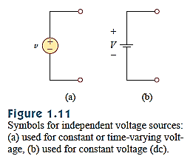
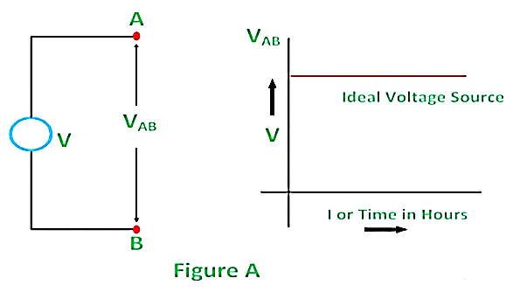
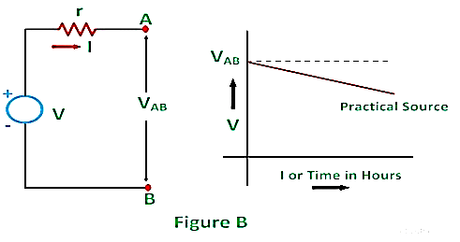
Independent Voltage Sources
An Ideal Independent voltage source is a voltage source that maintains the constant Voltage across its terminals no matter how much current is drawn from it.
An ideal Voltage source will have Zero internal resistance.
The symbols for independent voltage sources are:-
Small ‘v’ is used for time varying or constant voltages.
Capital ‘V’ is used for constant voltages only.
Independent current sources !

Slide 11
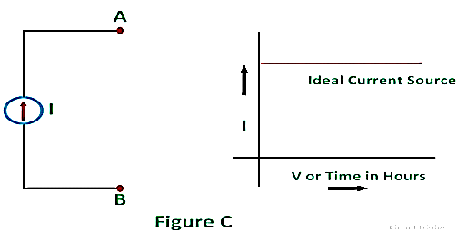
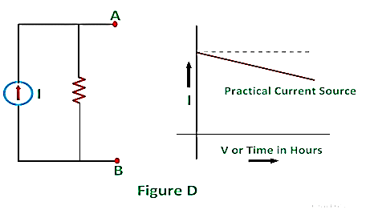
Independent Current Sources
An ideal Independent current source is a current source which can supply constant current regardless of any voltage drops in the circuit.
The ideal current source will have infinite internal resistance.
The symbols for independent current sources are:-
Small ‘i’ is used for time varying or constant currents.
Capital ‘I’ is used for constant currents only.
Dependent (controlled) Sources !
i
I

Slide 12
Dependent Sources
An ideal dependent (or controlled) source is an active element in which the source quantity is controlled by another voltage or current existing in the circuit being analyzed.
There are four types of dependent sources :-
A voltage controlled voltage source.
A current controlled voltage source.
A voltage controlled current source.
A current controlled current source.
The symbols (diamonds) for dependent voltage sources are:-
Voltage controlled voltage source has ‘k’ which is a dimensionless scaling constant.
Current controlled voltage source has a scaling constant ‘r’ with units of V/A.
Dependent sources …contd !
+
+
kv_{x}
_
ri_{x}
_

Slide 13
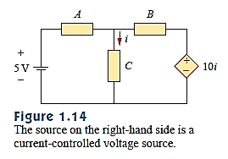
Dependent Sources…contd
The symbols for dependent current sources are:-
Current controlled current source has a scaling constant ‘k’ which is a dimensionless scaling constant.
Voltage controlled current source has a scaling constant ‘g’ which has units of A/V.
Example dependent source !
ki_{x}
gv_{x}

Slide 14
Dependent Source : DC Equivalent Model of a Transistor
C
This is the symbol of a transistor.
The dc equivalent model of the transistor.
Networks & Circuits !
I_{B}
B
E
I_{B}
C
B
βI_{B}
E

Slide 15
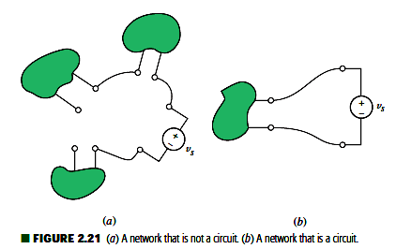
Networks & Circuits
Network : Interconnection of two or more elements forms an electrical network
Circuit : a network providing one or more closed paths, it is also an electric circuit.
Note: Every circuit is a network, but not all networks are circuits (see Fig. 2.21)!
Active Network : A network that contains at least one active element, such as an independent voltage or current source, is an active network. contains active element
Passive Network : A network that does not contain any active elements is a passive network.no active element
Networks have branches, nodes, paths, loops and meshes etc.
Ohm’s Law !

Slide 16
Ohm’s Law
Relationship between current and voltage for a resistor : found in 1827 by Georg Simon Ohm (German physicist 1787 – 1854)
Forty-six years earlier Henry Cavendish, a semi recluse, had also discovered this relationship.
Ohm’s Law states that the voltage ‘v’ across a conducting material is directly proportional to the current ‘i’ flowing through the material
Mathematically,
v ∞ i
v = Ri
where the constant of proportionality R is called the resistance. The unit of resistance is the ohm, which is V/A and customarily abbreviated by a
capital omega (Ω)
i
+
R
_
v
Ohm’s Law…contd!

Slide 17
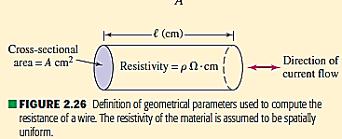
The Resistor
In general, materials resist the flow of electric charge.
This physical property or ability to resist current is known as resistance and is represented by symbol ‘R’.
For the material shown,
R ∞ l
R ∞ l / A
So R = ρ (l / A)
Where ρ is resistivity in ohm – meters.
Resistivity is the measure of the ease with which electrons can travel through a material. High resistivity means greater difficulty, more resistance.
Silver has 1.64 X 10 ⁻ ⁸ Ω–meter : conductor
Silicon has 6.4 X 10 ² Ω-meter : semi conductor
Paper has 10¹⁰ Ω - meter : insulator
R
The circuit symbol for resistance is :--
Resistor is the simplest passive element. It always absorbs power from the circuit.
Colour coding and power dissipation.
R
R

Slide 18
Ohm’s Law/Power Absorption/Conductance
A resistor that obeys Ohm’s law is a linear resistor.
Resistance is normally a positive quantity, although negative resistance may be simulated with special circuitry.
Power Absorption :
We know : p = vi = i² R = v² / R
The absorbed power appears as heat / light and is always positive.
An element supplies positive power if positive current flows out of the positive voltage terminal. An element absorbs positive power if positive current flows into the positive voltage terminal.
Conductance :
Another useful quantity in circuit analysis is reciprocal of resistance ‘R’, known as conductance and denoted by ‘G’ where
G = 1/R = i/v
unit is mho (inverted omega)
The SI unit is siemens 1S = 1 = 1 A/V
v
Slope R
i
Ω
Ω

Slide 19

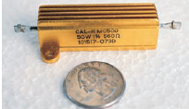



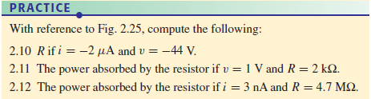

The Resistor

Slide 20
The Resistor
Practice

Slide 21
THANKS

