Slide 1
Anomaly Detection in
Data Center Telemetry
LSTM autoencoder experiments and a working monitoring demo
Rishabh Srivastava 2430010149
Mitul Seth 2430010099
Madhav Mittal 2430010096
Deep Learning Section B 12 October 2026
Notes:
The final project evaluates general server-health alerts using thermal, fan and power features. It does not establish cooling-specific fault diagnosis.

Slide 2
Problem and project objective
Temperature, fan speed and power change together during server operation.
The model learns normal relationships and scores unusual telemetry.
The objective is measured anomaly detection with an inspectable demo.
Reference labels are general server-health alerts from Nagios.
2
Notes:
Dataset: https://zenodo.org/records/7541722
Paper: https://www.nature.com/articles/s41597-023-02174-3

Slide 3
Dataset and study scope
Field | Actual project setup
Source | M100 rack 0 time-aggregated telemetry
Subset | 9 nodes from 16 available node files
Readings | 751,363
Cadence | 15-minute sensor aggregations
Feature sets | 22 base features and 33 enhanced features
Time range | 2020-03-09 to 2022-09-28
3
Notes:
Dataset: https://zenodo.org/records/7541722
Paper: https://www.nature.com/articles/s41597-023-02174-3

Slide 4
Preprocessing and chronological splits
Sort each node by timestamp and fill short gaps causally.
Use 70% training, 10% validation and 20% test rows per node.
Fit scaling on finite normal training rows only.
Keep complete windows inside one split and train on normal windows.
Missing periods reset filling and alarm streaks. Unknown labels are excluded from evaluated windows.
4
Notes:
Experiment source: results/submission_evidence.json. Settings are selected on validation data. Test recordings were inspected during earlier project development; results remain exploratory.

Slide 5
LSTM autoencoder architecture
Stage | Representation
Input | 8 readings by 22 features
LSTM encoder | 64 hidden values
Linear bottleneck | 16 latent values
Repeated latent input | 8 readings by 16 values
LSTM decoder and linear output | Reconstructed sensor sequence
Training objective: mean squared reconstruction error. Selected model: 45,990 parameters.
5
Notes:
Architecture follows a normal-sequence reconstruction approach. Related work: https://arxiv.org/abs/1607.00148
Experiment source: results/submission_evidence.json. Settings are selected on validation data. Test recordings were inspected during earlier project development; results remain exploratory.

Slide 6
Training behaviour
base8: Adam 0.001, batch 512, seed 42, up to 30 epochs, early-stopping patience 5.
6
Notes:
Experiment source: results/submission_evidence.json. Settings are selected on validation data. Test recordings were inspected during earlier project development; results remain exploratory.

Slide 7
Correct incident evaluation
Quantity | Original six-hour cohort
Positive overlapping windows | 761
CRITICAL at the scored timestamp | 432
Raw timestamped incidents | 34
Incidents with scoring opportunities | 22
An alarm counts as a detection only when its timestamp falls inside an original CRITICAL interval.
Incident totals retain missed coverage. Alarm bursts break at missing timestamps.
7
Notes:
Experiment source: results/submission_evidence.json. Settings are selected on validation data. Test recordings were inspected during earlier project development; results remain exploratory.

Slide 8
Controlled experiment comparisons
Experiment | History | Features | Validation F1
base24 | 24 readings | Base 22 | 0.0275
base48 | 48 readings | Base 22 | 0.0144
base8 | 8 readings | Base 22 | 0.0750
enhanced24 | 24 readings | Enhanced 33 | 0.0645
robust24 | 24 readings | Base 22 robust | 0.0163
Each run evaluates both score definitions, three percentiles, global or node thresholds, and persistence.
8
Notes:
Experiment source: results/submission_evidence.json. Settings are selected on validation data. Test recordings were inspected during earlier project development; results remain exploratory.

Slide 9
Test results at scored endpoints
Experiment | AP | Precision | Recall | F1 | Incidents
base24 | 0.096 | 1.9% | 70.8% | 0.037 | 16/34
base48 | 0.145 | 5.3% | 61.7% | 0.098 | 11/34
base8 | 0.103 | 2.1% | 72.3% | 0.041 | 17/34
enhanced24 | 0.048 | 2.6% | 65.9% | 0.050 | 15/34
isolation_forest | 0.447 | 1.6% | 61.8% | 0.030 | 14/34
robust24 | 0.481 | 1.3% | 53.7% | 0.025 | 16/34
Selected by validation: base8. Different widths change retained scoring cohorts.
9
Notes:
Experiment source: results/submission_evidence.json. Settings are selected on validation data. Test recordings were inspected during earlier project development; results remain exploratory.

Slide 10
Ranking quality and alarm quality
Selected LSTM
17/34 incidents caught
0.692 false bursts
per scored node-day
Ranking performance and a chosen alarm threshold answer different questions. The comparison is mixed.
10
Notes:
Experiment source: results/submission_evidence.json. Settings are selected on validation data. Test recordings were inspected during earlier project development; results remain exploratory.
Average precision definition: https://scikit-learn.org/stable/modules/generated/sklearn.metrics.average_precision_score.html

Slide 11
Persistence and false alarm bursts
Original LSTM at q99 | Incidents detected | False bursts
Immediate alarm | 13 of 34 | 479
Two consecutive high readings | 13 of 34 | 364
24.0% fewer false bursts at this fixed threshold
This is a retrospective sensitivity check. Persistence can increase delay and miss brief alerts.
11
Notes:
Experiment source: results/submission_evidence.json. Settings are selected on validation data. Test recordings were inspected during earlier project development; results remain exploratory.
Fixed retrospective policy comparison from results/original_audit/alarm_sensitivity.csv. This is not validation-selected performance.

Slide 12
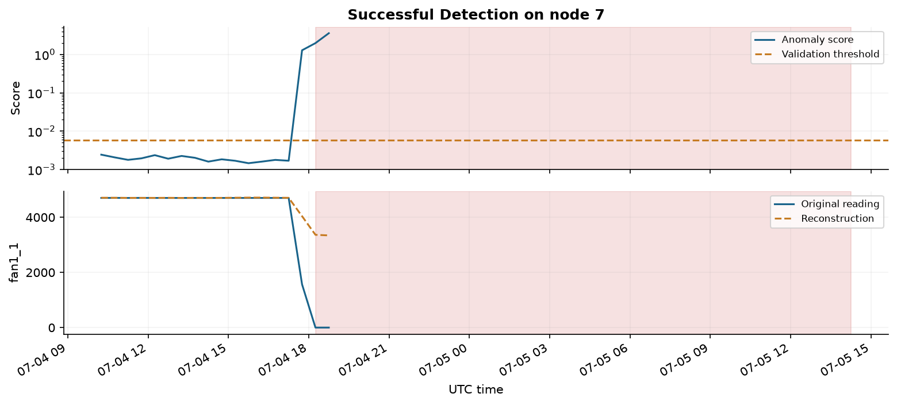
A successful detection
Node 7: alarm occurs inside the original interval. First delay: 0 minutes.
12
Notes:
Experiment source: results/submission_evidence.json. Settings are selected on validation data. Test recordings were inspected during earlier project development; results remain exploratory.

Slide 13
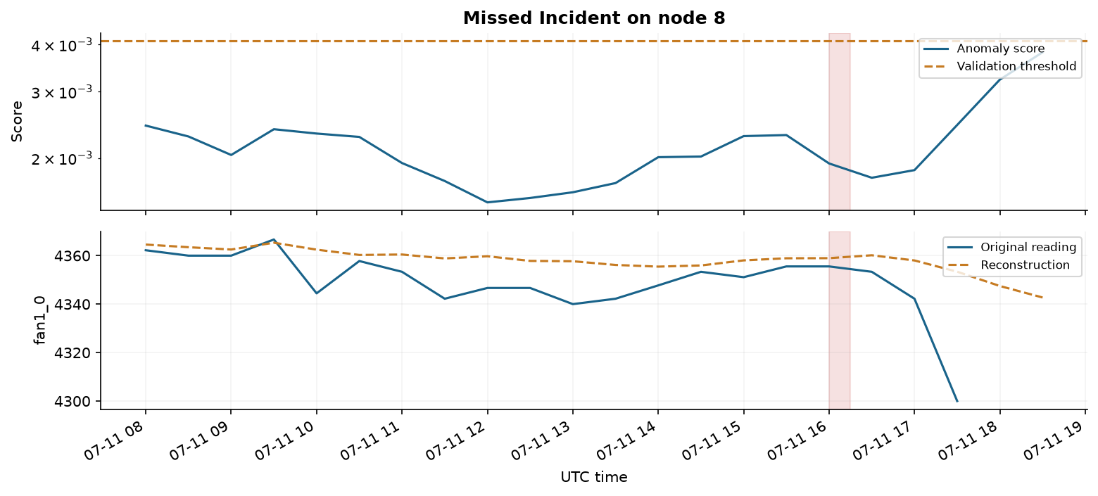
An observable missed incident
Node 8: scoring is available, but the alarm rule misses the original interval.
13
Notes:
Experiment source: results/submission_evidence.json. Settings are selected on validation data. Test recordings were inspected during earlier project development; results remain exploratory.

Slide 14
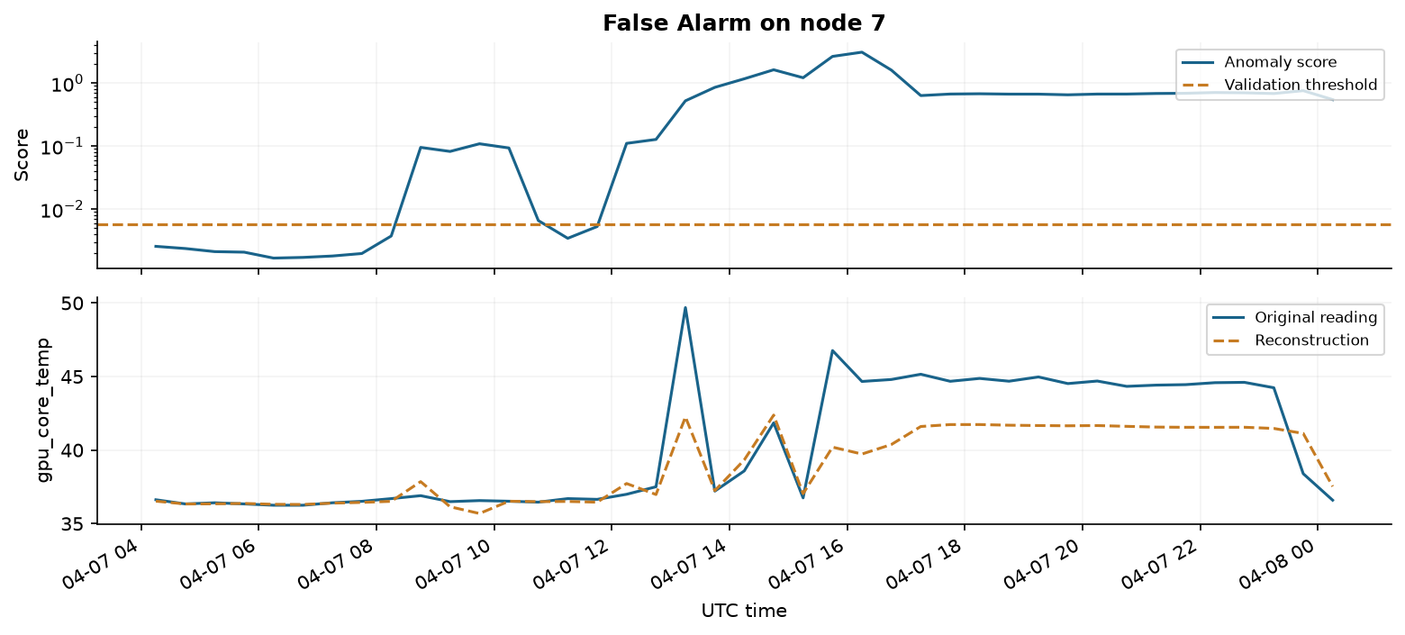
A false alarm burst
Node 7: the alarm burst overlaps no raw CRITICAL interval. Sensor error does not prove a fault cause.
14
Notes:
Experiment source: results/submission_evidence.json. Settings are selected on validation data. Test recordings were inspected during earlier project development; results remain exploratory.

Slide 15
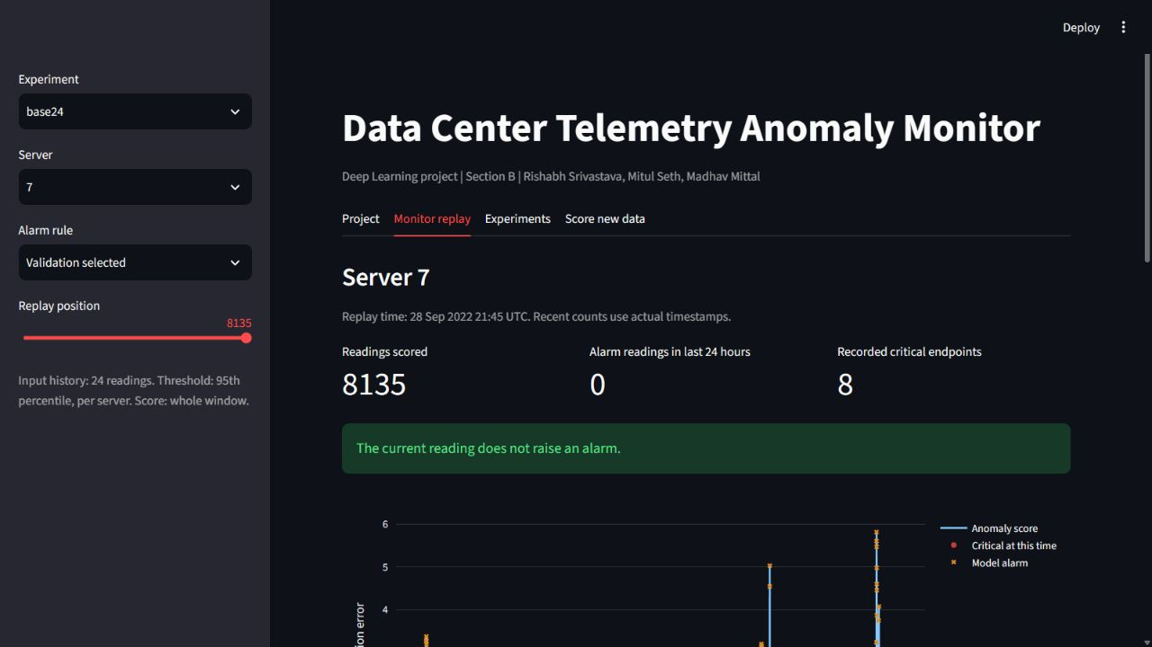
Working demo and saved model
Recorded replay
Timestamp-aware alarms
Sensor reconstructions
Experiment comparison
Fresh CSV inference
15
Notes:
Experiment source: results/submission_evidence.json. Settings are selected on validation data. Test recordings were inspected during earlier project development; results remain exploratory.

Slide 16
Limitations and conclusion
The selected LSTM is base8; the experiment comparison is metric dependent.
False alarms and unobservable incidents limit practical usefulness.
General server-health labels cannot establish cooling-specific diagnosis.
Next steps are alert-specific labels, later data, more nodes and repeated seeds.
16
Notes:
Experiment source: results/submission_evidence.json. Settings are selected on validation data. Test recordings were inspected during earlier project development; results remain exploratory.
Dataset: https://zenodo.org/records/7541722
Paper: https://www.nature.com/articles/s41597-023-02174-3

Slide 17
References and reproducibility
Hochreiter and Schmidhuber, Long Short-Term Memory, 1997.
Malhotra et al., LSTM-based Encoder-Decoder for Multi-sensor Anomaly Detection, 2016.
Borghesi et al., M100 ExaData, Scientific Data, 2023.
M100 aggregated dataset, Zenodo DOI 10.5281/zenodo.7541722.
Submission includes source, a clean notebook, trained models, scalers, histories, scores and incident records.
17
Notes:
Dataset: https://zenodo.org/records/7541722
Paper: https://www.nature.com/articles/s41597-023-02174-3
Related work: https://www.bioinf.jku.at/publications/older/2604.pdf
https://arxiv.org/abs/1607.00148
Baseline docs: https://scikit-learn.org/stable/modules/generated/sklearn.ensemble.IsolationForest.html

