Slide 1
Cooling Equipment
Sensor Fault Detection
LSTM classification from 30-minute sensor histories
Rishabh Srivastava | Mitul Seth | Madhav Mittal
Deep Learning Project - Section B
14 October 2026
Notes:
Primary task: sensor-bias detection in one simulated AHU. Dataset https://data.openei.org/submissions/910. Student IDs: 2430010149, 2430010099, 2430010096. Do not describe this as validation of datacenter deployment.

Slide 2
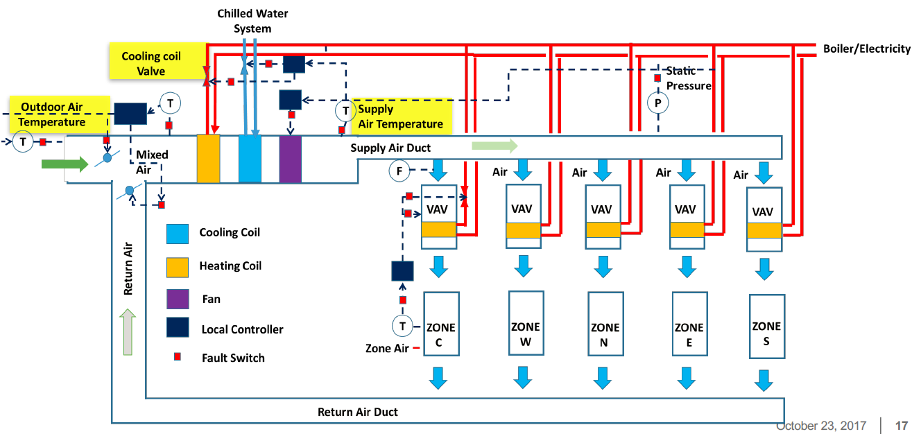
Air-handling-unit sensor faults
Author-defined outdoor-air sensor biases: ±1, ±2 and ±4 °C
One simulated AHU; current condition classification while occupied and running
Cooling equipment sensor-fault detection | Simulation benchmark
2
Notes:
https://data.openei.org/submissions/910; source_inventory.pdf pages 3-7, Figure 1-2 on page 4. Source image extracted unchanged. Input temperatures are Fahrenheit; imposed bias magnitudes are Celsius.

Slide 3
M100 source-label audit
The published M100 preparation selects the batch-client scheduler-state check.
Feature removal, supervised classifiers and richer physical inputs still missed the false-alarm targets.
The equipment benchmark uses documented sensor-fault scenarios. Its labels are retained from the authors; no temperature threshold creates a target.
The M100 negative study remains in the repository as supporting research.
Cooling equipment sensor-fault detection | Simulation benchmark
3
Notes:
Supporting sources: results/task5_recovery_v1/REPORT.md; LABEL_AND_SENSOR_AUDIT.md; https://gitlab.com/ecs-lab/exadata/-/blob/main/parquet_dataset/node_aggregated_data/step2.py. Different datasets have different outcomes and prevalence; do not compare their accuracy as a matched improvement.

Slide 4
Whole-season separation
Partition | Seasons | Raw days | Scored days | Endpoints
Training | Winter + spring | 91 | 77 | 61,187
Validation | Summer | 49 | 42 | 33,432
Test | Autumn | 49 | 42 | 33,432
Windows contain 30 consecutive occupied, fan-on minutes. They never cross a source day or gap.
Scenario blocks and source days stay within one partition; no shuffled overlapping-window split
Cooling equipment sensor-fault detection | Simulation benchmark
4
Notes:
https://data.openei.org/submissions/910; results/hvac_v1/experiment_plan.json and *_cohort.csv. Metadata inspected before fitting. Source local timestamps have unspecified timezone.

Slide 5
Sensor inputs and causal cleaning
13 raw sensors and control signals
Temperatures, fan/damper/valve commands and duct pressure
6 consistency differences + 13 missing indicators = 32 input channels
Five-minute forward fill; resets at days and gaps. Training-only medians and scaling preserve missing information. Negative outdoor temperatures remain valid.
Labels, dates, seasons, scenario IDs and imposed bias levels are excluded from model inputs
Cooling equipment sensor-fault detection | Simulation benchmark
5
Notes:
Source inventory Table 1-1, page 6; src/dccad/hvac.py; preprocessing_audit.json. Damper command is a proxy, not measured mixing fraction.

Slide 6
LSTM architecture and training
Component | Fixed setting
History | 30 minutes × 32 channels
Encoder | LSTM, hidden size 32
Head | 16 units, ReLU, dropout 0.2, one logit
Optimization | Adam 0.001; batch 512; gradient clip 1
Loss / stopping | Weighted BCE; max 30 epochs; AP patience 6
Replicates | Seeds 7, 42, 123; seed 42 declared primary
Tree baseline uses latest, mean, standard deviation and slope from the same input history
Cooling equipment sensor-fault detection | Simulation benchmark
6
Notes:
src/dccad/supervised.py; scripts/train_hvac.py; experiment_plan.json. Positive weight is normal/fault training endpoint ratio, about 1/6; evaluation prevalence is unchanged.

Slide 7
Validation stability across training seeds
All three LSTM seeds pass the validation policy gate
AP mean 0.9820; sample SD 0.0027. Seed 42 remains primary before the test season.
Cooling equipment sensor-fault detection | Simulation benchmark
7
Notes:
results/hvac_v1/validation_summary.json and validation_model_comparison.csv. AP differs from trapezoidal PR-AUC. The y axis is explicitly restricted to show small AP variation.

Slide 8
Frozen alarm policy
Two high scores in three consecutive scored minutes
Logit threshold 6.967112; state resets at days and gaps
Primary validation measure | Result
Precision / reading recall | 100% / 48.66%
False-positive rate / false bursts | 0% / 0
Observable fault days detected | 36 / 36
A single uploaded window gives one score and cannot establish persistent confirmation
Cooling equipment sensor-fault detection | Simulation benchmark
8
Notes:
frozen_model.json and validation_policy_specs.json. Primary selected at validation only. Empirical zero FPR on 4,776 summer normal readings is not a deployment guarantee.

Slide 9
Independent autumn performance
FPR 1.44% exceeds the original 1% goal; the final policy stays unchanged
Cooling equipment sensor-fault detection | Simulation benchmark
9
Notes:
test_summary.json; primary model lstm_seed_42 selected before final evaluation. 33,432 endpoints; fault prevalence 85.71%. All-fault baseline accuracy 85.71%, FPR 100%.

Slide 10
Confusion counts and fault-day coverage
Author label / prediction | Healthy | Fault
Healthy | 4,707 | 69
Fault | 2,332 | 26,324
69 false readings form one burst; false discovery ratio is 0.26%
35/36 observable fault days detected; 35/42 total fault days
Median delay: 392 min from midnight imposition, 2 min from the first eligible score
Cooling equipment sensor-fault detection | Simulation benchmark
10
Notes:
Primary frozen test_metrics.json; evidence_summary.json. Denominators: FPR=69/(69+4707), FDR=69/(69+26324). Delay includes midnight-to-operation downtime; no early warning established.

Slide 11
Deep learning and tree comparison
Model | Accuracy | Precision | Recall | FPR
LSTM 7 | 96.66% | 99.73% | 96.36% | 1.55%
LSTM 42 | 92.82% | 99.74% | 91.86% | 1.44%
LSTM 123 | 85.55% | 99.71% | 83.39% | 1.47%
boosting | 76.04% | 100.00% | 72.05% | 0.00%
The LSTM gains reading sensitivity; the tree has zero test false positives
Seed 42 was predeclared even though seed 7 has higher test accuracy
Cooling equipment sensor-fault detection | Simulation benchmark
11
Notes:
test_model_comparison.csv. All seeds reported under their frozen validation-selected policies. Seed 42 remains the primary; do not cherry-pick seed 7 on test.

Slide 12
A detected sensor-fault day
The report also retains the missed −1 °C day and the healthy false-alarm case
Cooling equipment sensor-fault detection | Simulation benchmark
12
Notes:
examples.json; lstm_seed_42/test_decisions.csv. Native chart uses sampled recorded logits every 20 scored readings for readability, not for metrics. Full output is retained in the repository.

Slide 13
Scope and remaining limitations
One simulated AHU and one sensor-fault family
Fault prevalence is experimental; healthy validation/test each cover one scenario week. Adjacent readings and days are correlated.
The 1.44% test FPR misses the 1% goal. No test-based threshold tuning repairs that result.
Future evidence needs separate physical units, additional fault families and new evaluation periods.
Cooling equipment sensor-fault detection | Simulation benchmark
13
Notes:
https://data.openei.org/submissions/910 and source_inventory.pdf, pages 3-7; experiment_plan.json; test_summary.json. No independence assumption across overlapping readings; no operational-prevalence or cross-equipment reliability guarantee.

Slide 14
Demonstration and reproducibility
Run Start Dashboard.bat
Replay healthy and faulted autumn days; upload a 30-minute sensor CSV; inspect the frozen model comparison.
Repository evidence includes native source labels, split manifests, model/preprocessing, training histories, saved decisions and failure examples.
Source: LBNL AFDD evaluation collection
DOI 10.25984/1824861 | data.openei.org/submissions/910
Cooling equipment sensor-fault detection | Simulation benchmark
14
Notes:
Data: https://data.openei.org/submissions/910. DOI 10.25984/1824861. Authors’ inventory pp. 3-7. Saved score/inference verification: results/hvac_v1/verification.json. Dataset switch authorized by the user; M100 studies preserved.

