Slide 1

Mental Health Chatbot for Loneliness and Depression
Title : Developing an AI-Powered Chatbot for Human-Like Conversations to Mitigate Loneliness and Depression
Name: Mitul Srivastava | ID: C00313606
MSc Data Science – South East Technological University
Supervisor: Dr. Joseph Kehoe

Slide 2




Introduction
Growing global mental health crisis 🌍
61% of adults report loneliness (Cigna, 2022)
280M people suffer from depression (WHO)
Aim: Develop an empathetic, safety-aware, and speech-enabled chatbot to support users experiencing loneliness and depression
Mental Health
Chatbot
Empathy
Accessibility

Slide 3
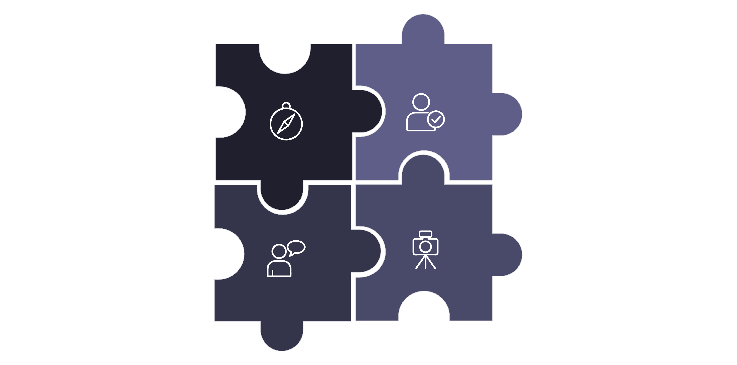




Research Question and Problem Statement
How effectively can a large language model-based (LLM) AI chatbot, fine-tuned on diverse conversational datasets and optimized using
cognitive behavioural therapy techniques, enhance conversational quality and emotional responsiveness to better address loneliness and depression?
Grounding
Empathy
Context
Variety
Empathy & emotional intelligence
Context retention in multi-turn chats
Variety (avoid repetitive outputs)
Grounding in real advice/resources
Ethical safeguards: hallucinations, safety, bias

Slide 4
Literature Review
Historical
1
ELIZA → Rule-based bots → LLM-based dialogue systems
2
Current therapy bots
Woebot, Wysa, Youper → shown to reduce depression/anxiety
Gap
3
Few integrate emotion detection + ABSA + safety + RAG in one pipeline

Slide 5

Methodology (Datasets + Architecture)
Datasets (130367 dialogue pairs) :
HOPE (coping strategies)
EmpatheticDialogues (emotional support)
CounselChat (therapeutic advice)
DailyDialog (variety)
Preprocessing: text cleaning, tokenization, balancing dialogue turns
Model: Fine-tuned DialoGPT with incremental training
Pipeline Modules: Emotion → ABSA → Safety Filter → Empathy & Variety → RAG → Duplicate Response → Voice (STT + TTS)
Emotion Detection and ABSA
Safety Filtering and Empathy & variety management
RAG and Duplicate response management
Text & Speech input and output

Slide 6







Key Innovations / Contributions
ABSA + Emotion pipeline
Empathy & Variety Manager
RAG (Retrieval-Augmented Generation)
→ tone & aspect detection
→ avoids repetition
→ grounded responses
Voice Input & Output 🎤🔊
Safety Filtering + Crisis Detection
Duplicate Response Management
→ multimodal interaction
→ prevents harmful replies
→ fresh conversations
Incremental Fine-Tuning
→ domain adaptation

Slide 7







Evaluation Metrics with targets
Perplexity
Diversity (Distinct-N)
Appropriateness
→ fluency (lower = better) (<100)
→ variety of replies (>0.3)
→ contextual fit (>0.6)
Conversational Depth
Emotional Intelligence
Efficiency
→ multi-turn consistency (>0.5)
→ empathy alignment (>0.3)
→ response time (<6s) & memory (<5GB)
Avg Response Length
→ engagement balance (8-14 words)

Slide 8
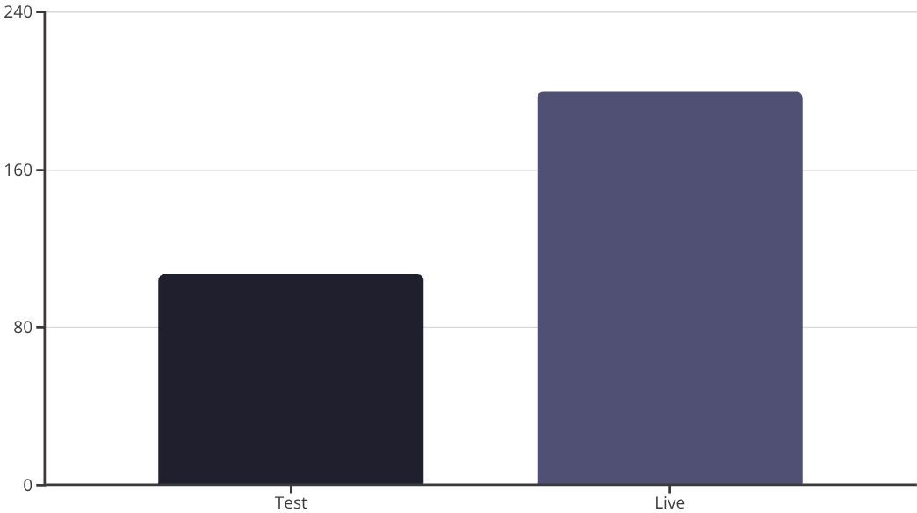
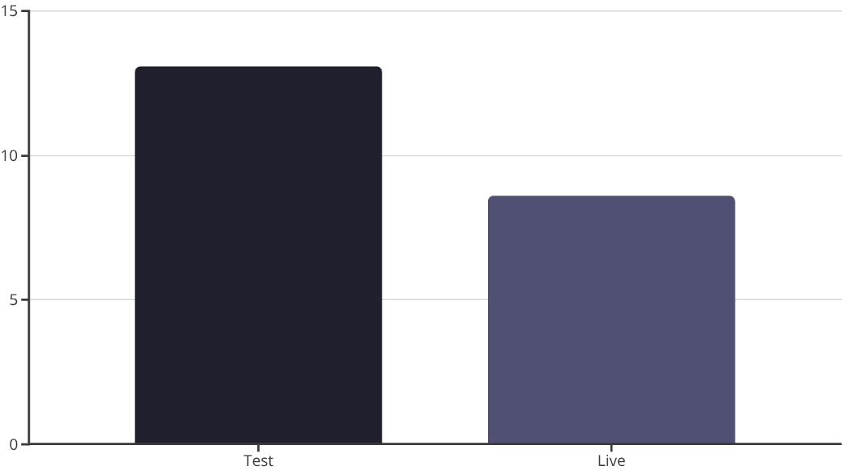
Results (Test vs Live Chat)
Perplexity:
Average Response Length:
Other Metrics (Test → Live):
Test = 107.06
Test = 13.1 words
Diversity: 0.5842 → 0.5186
Live = 199.38
Live = 8.6 words
Appropriateness: 0.1296 → 0.2956
Depth: 0.7908 → 0.6000
Emotional Intelligence: 0.2379 → 0.6000
Response Time: 0.328s → 0.564s

Slide 9
Conclusion & Future Work
Achievements:
Limitations:
Integrated Emotion, ABSA, RAG
Fluency & appropriateness still limited
Improved empathy & variety
Evaluated in controlled & live chat
Future Work:
RLHF (Reinforcement Learning with Human Feedback)
Multimodal inputs (voice + facial expression)
Long-term memory for personalization
Integration with helplines for crisis support

Slide 10

Acknowledgments & Q&A
Supervisor: Dr. Joseph Kehoe
MSc Data Science Faculty – SETU
Thanks to peers, family & friends for support

