Slide 1

EDA ON GLOBAL TERRORISM
PATEL AYUSH – 202318036
MITUL DUDHAT -- 202318024

Slide 2

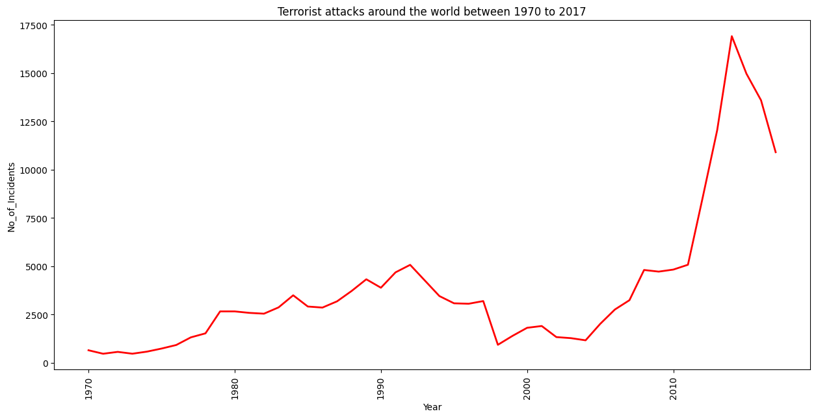
INTRODUCTION
Our project delves into the intricate landscape of global terrorism from 1970 to 2017, employing a comprehensive Exploratory Data Analysis (EDA) approach.
Emphasizing the pivotal role of EDA, we uncover nuanced patterns and trends, providing valuable insights into the evolution of terrorist activities worldwide.
- Leveraging the power of Python, our analysis is driven by the efficiency and versatility it offers. Specifically, we utilize essential libraries such as pandas, matplotlib, folium and seaborn, empowering us to conduct a robust exploration of the Global Terrorism Database (GTD).

Slide 3

METHODOLOGY
STEP 1
IMPORTING REQUIRED LIBRARIES
IMPORTING DATASET
STEP 2
DATA CLEANING
HANDLING MISSING VALUES
STEP 3
DATA SELECTION AND FILTERING
STEP 4
DATA ANALYSIS
STEP 6
INTERPRET RESULTS
STEP 7
DRAW CONCLUSIONS
DATA VISUALIZATION
STEP 5

Slide 4
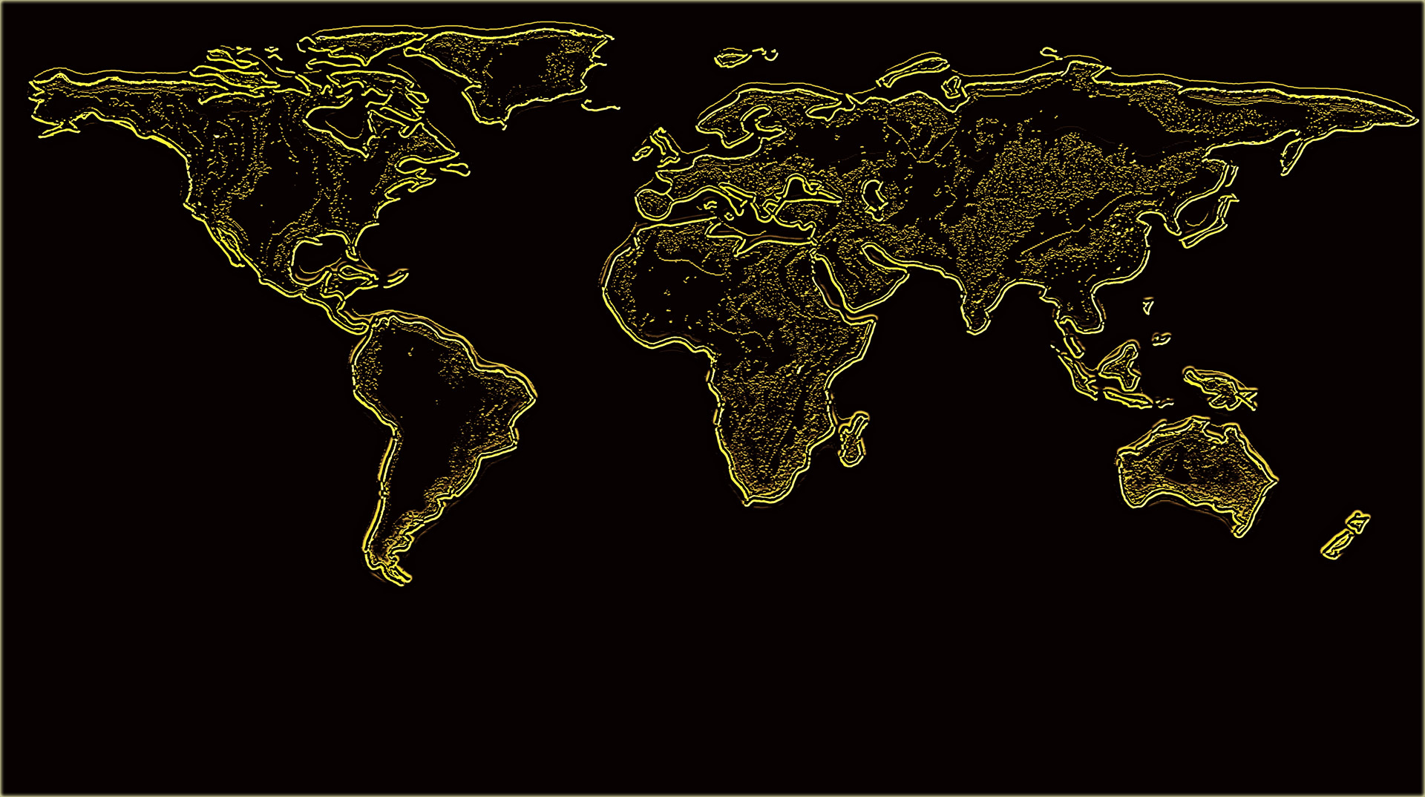
OBJECTIVES
This project aimed to enhance comprehension of the threat level and attributes of the most dangerous terrorist organizations currently operating, contributing to the recent surge in violent terrorism globally.
This project aims to address the following inquiries :
What is the current threat level globally?
Which groups are responsible for the sudden increase in threat level?
What type of weapons do specific group prefer the most?
How Target Type Trend Change From Region to Region?
Why Transportation Is A Top Terrorist Target Type In East Asia Region?

Slide 5

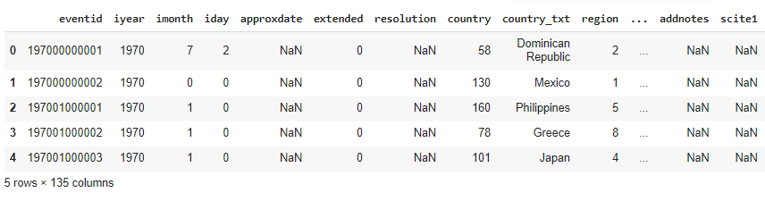
DATASET
The Global Terrorism Database (GTD) is an open-source database including information on terrorist attacks around the world from 1970 through 2017. The GTD includes systematic data on domestic as well as international terrorist incidents that have occurred during this time period and now includes more than 180,000 attacks. The database is maintained by researchers at the National Consortium for the Study of Terrorism and Responses to Terrorism (START), headquartered at the University of Maryland.

Slide 6
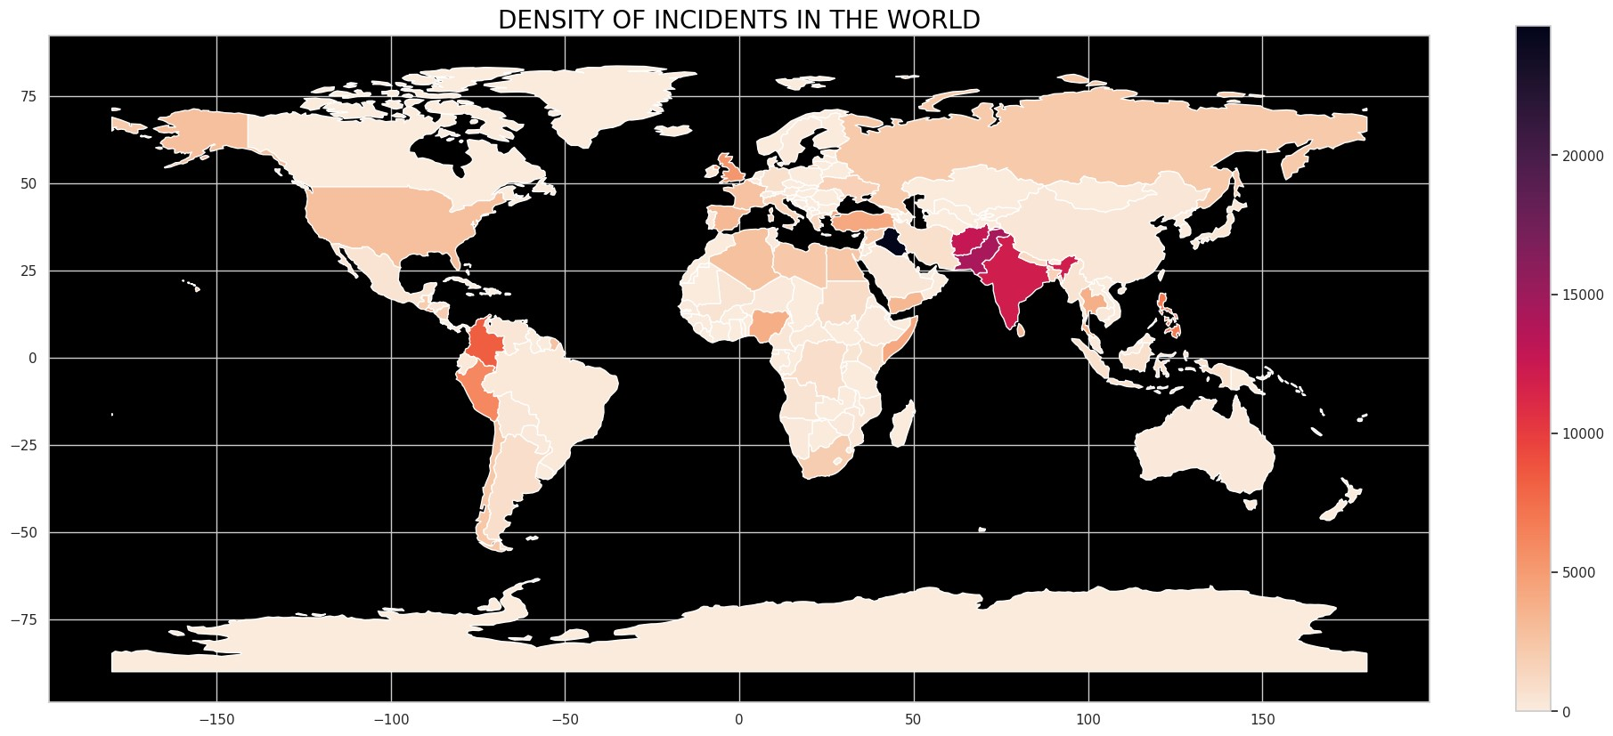

Slide 7
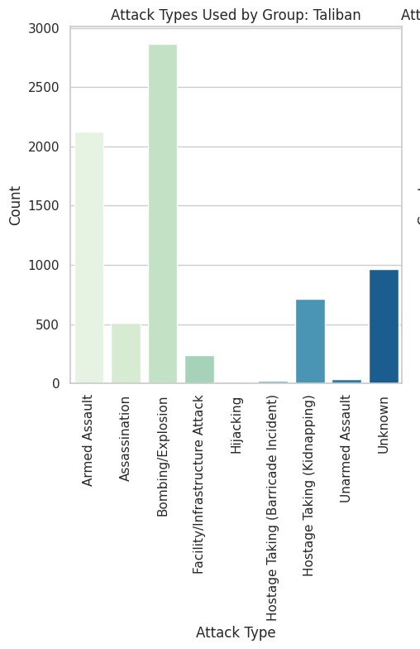
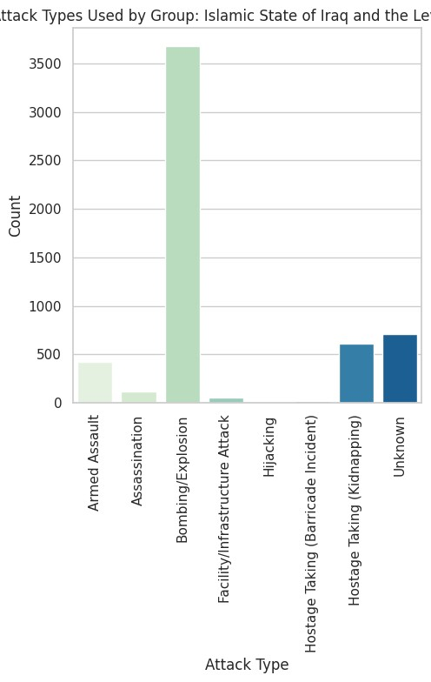
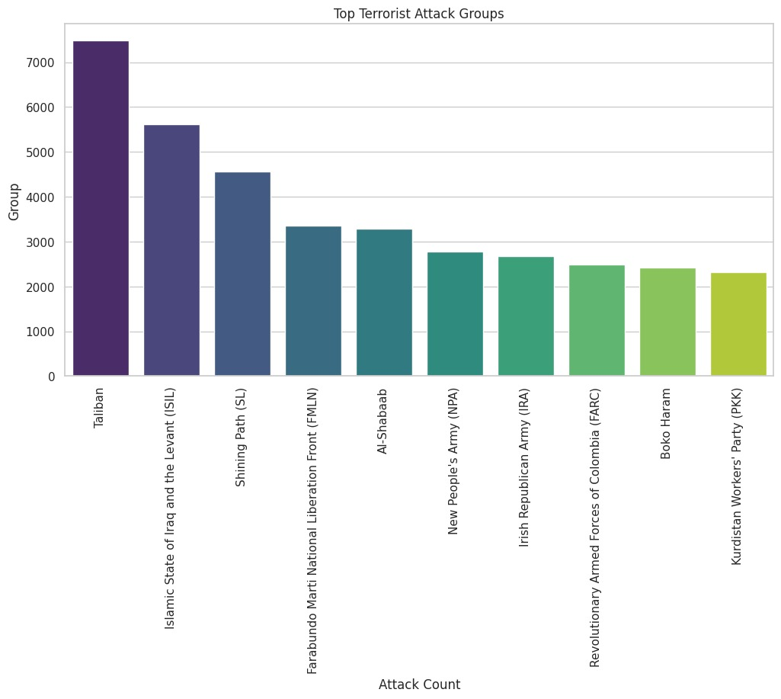
Which groups are responsible for the sudden increase in threat level?
Taliban:
Over the years, the Taliban's terrorist activities have shown a consistent upward trend, indicating potential for major events globally.
ISIL (Islamic State of Iraq and the Levant):
In 2016, ISIL emerged as the deadliest group, experiencing a more than 100 percent increase in deaths compared to its previous peak in 2015.

Slide 8
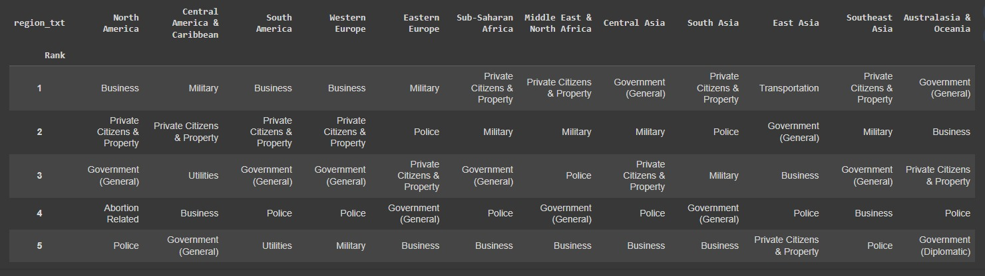
How Target Type Trend Change From Region to Region?​

Slide 9
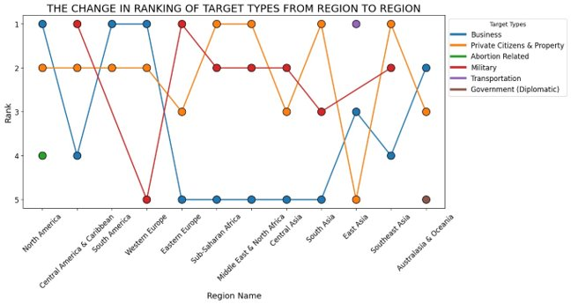
The blue line shows the priority for the 'Business' target type in regions with developed economies
The red line shows the priority for the 'Military' target type in regions that are inherently politically and militarily unstable
The orange line represents for 'Private Citizens & Property' target type which is usually get high rank because it ranked 1st in overall

Slide 10
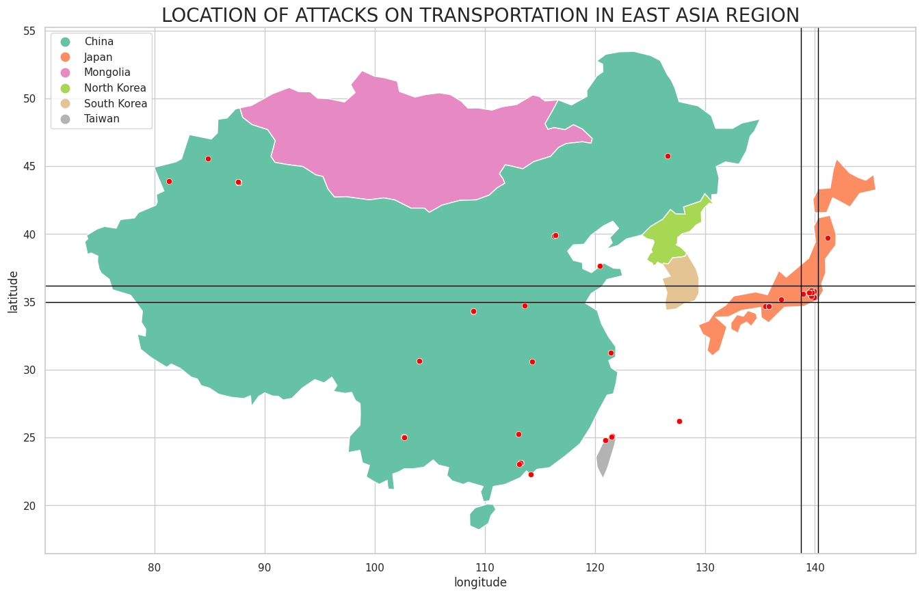
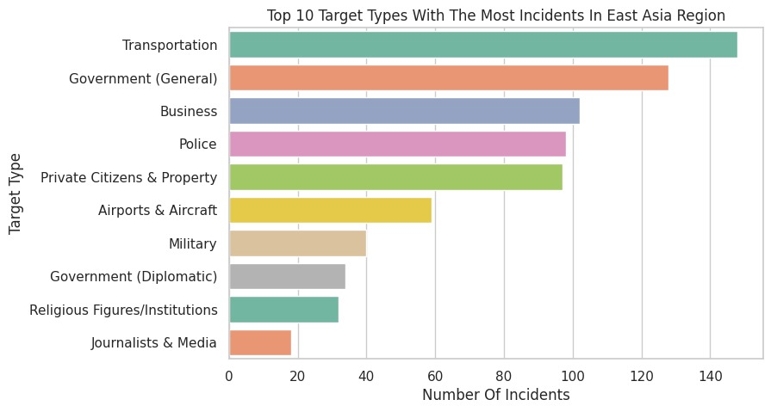
Why Transportation Is A Top Terrorist Target Type In East Asia Region?

Slide 11
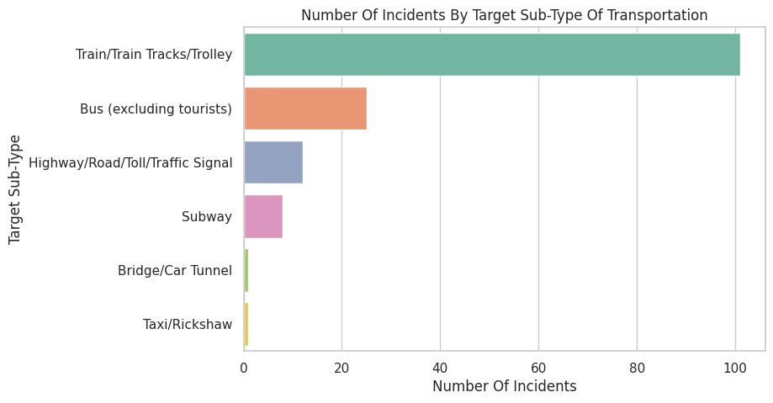
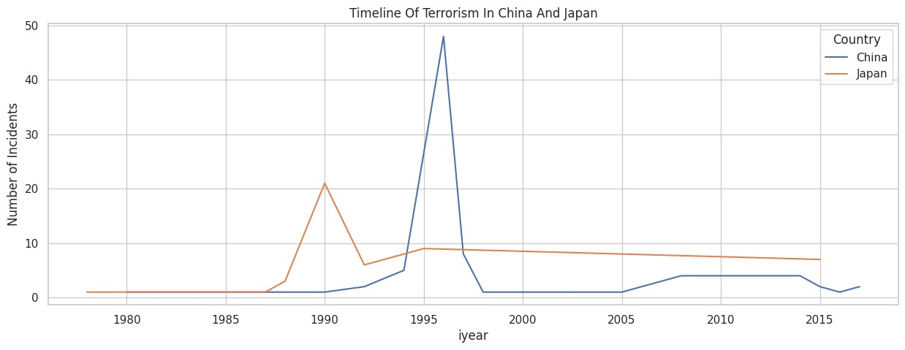
In China, a notable spike in terrorist attacks is observed around the year 2000, potentially linked to political unrest or large-scale attacks.
Japan, in contrast, demonstrates a more consistent, lower level of incidents, reflecting differing levels of terrorist activity or successful counter-terrorism efforts.
The Tokyo subway attack of 1995 by the AUM Shinrikyo religious group is a significant historical event, resulting in 13 deaths and over 5,500 injuries.

Slide 12
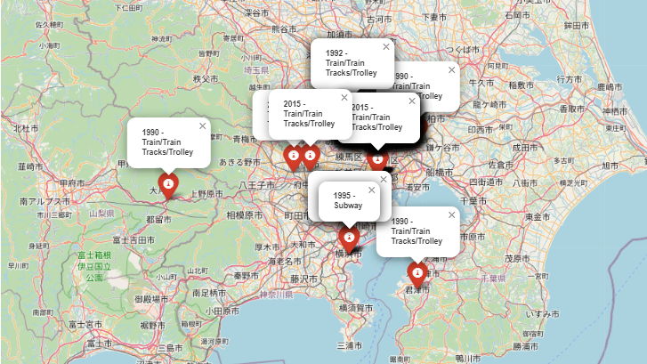

Slide 13
THANK YOU!

