Slide 1

PIMA Indian Diabetes Data Analysis
> Group 5:
Mitul Shah
Siddharth Muthe
Yuvraj Tomar

Slide 2
Introduction
Data Cleaning
Collected by National Institute of Diabetes and Digestive and Kidney Diseases.
Objective is to study the high rate of Diabetes in PIMA Indian women.
All patients under study are females with at least 21 years old.
Imputing 0 values in dataset with mean w.r.t Outcome 0 or 1.
Convert Outcome to factor from integer.
Making the data normal by taking natural log.

Slide 3
Dataset Description
Pregnancies: Number of times pregnant
Glucose: Plasma glucose concentration over 2 hours in an oral glucose tolerance test (mg/dL)
BloodPressure: Diastolic blood pressure (mm Hg)
SkinThickness: Triceps skin fold thickness (mm)
Insulin: 2-Hour serum insulin (mu U/ml)
BMI: Body mass index (weight in kg/(height in m)2)
DiabetesPedigreeFunction: Diabetes pedigree function (a function which scores likelihood of diabetes based on family history)
Age: Age (years)
Outcome: Class variable (0 if non-diabetic, 1 if diabetic)

Slide 4
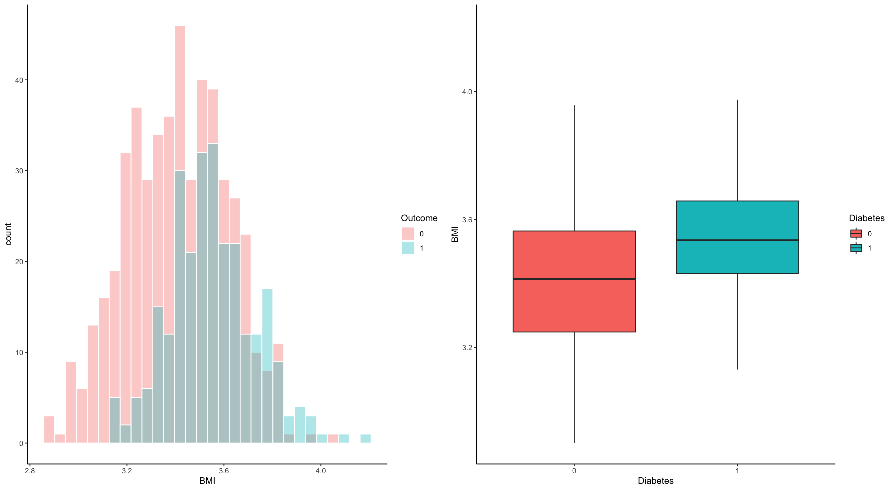
Checking Distribution
We can see that BMI is pretty much normal, so we didn’t take log of BMI.
1. Log of glucose, blood pressure, BMI, age and pregnancy was taken.
2. Log of skin thickness, insulin, diabetes pedigree function and outcome was not taken.
We take log of those variables whose histogram and box-plots indicate that the variable is not normal.

Slide 5
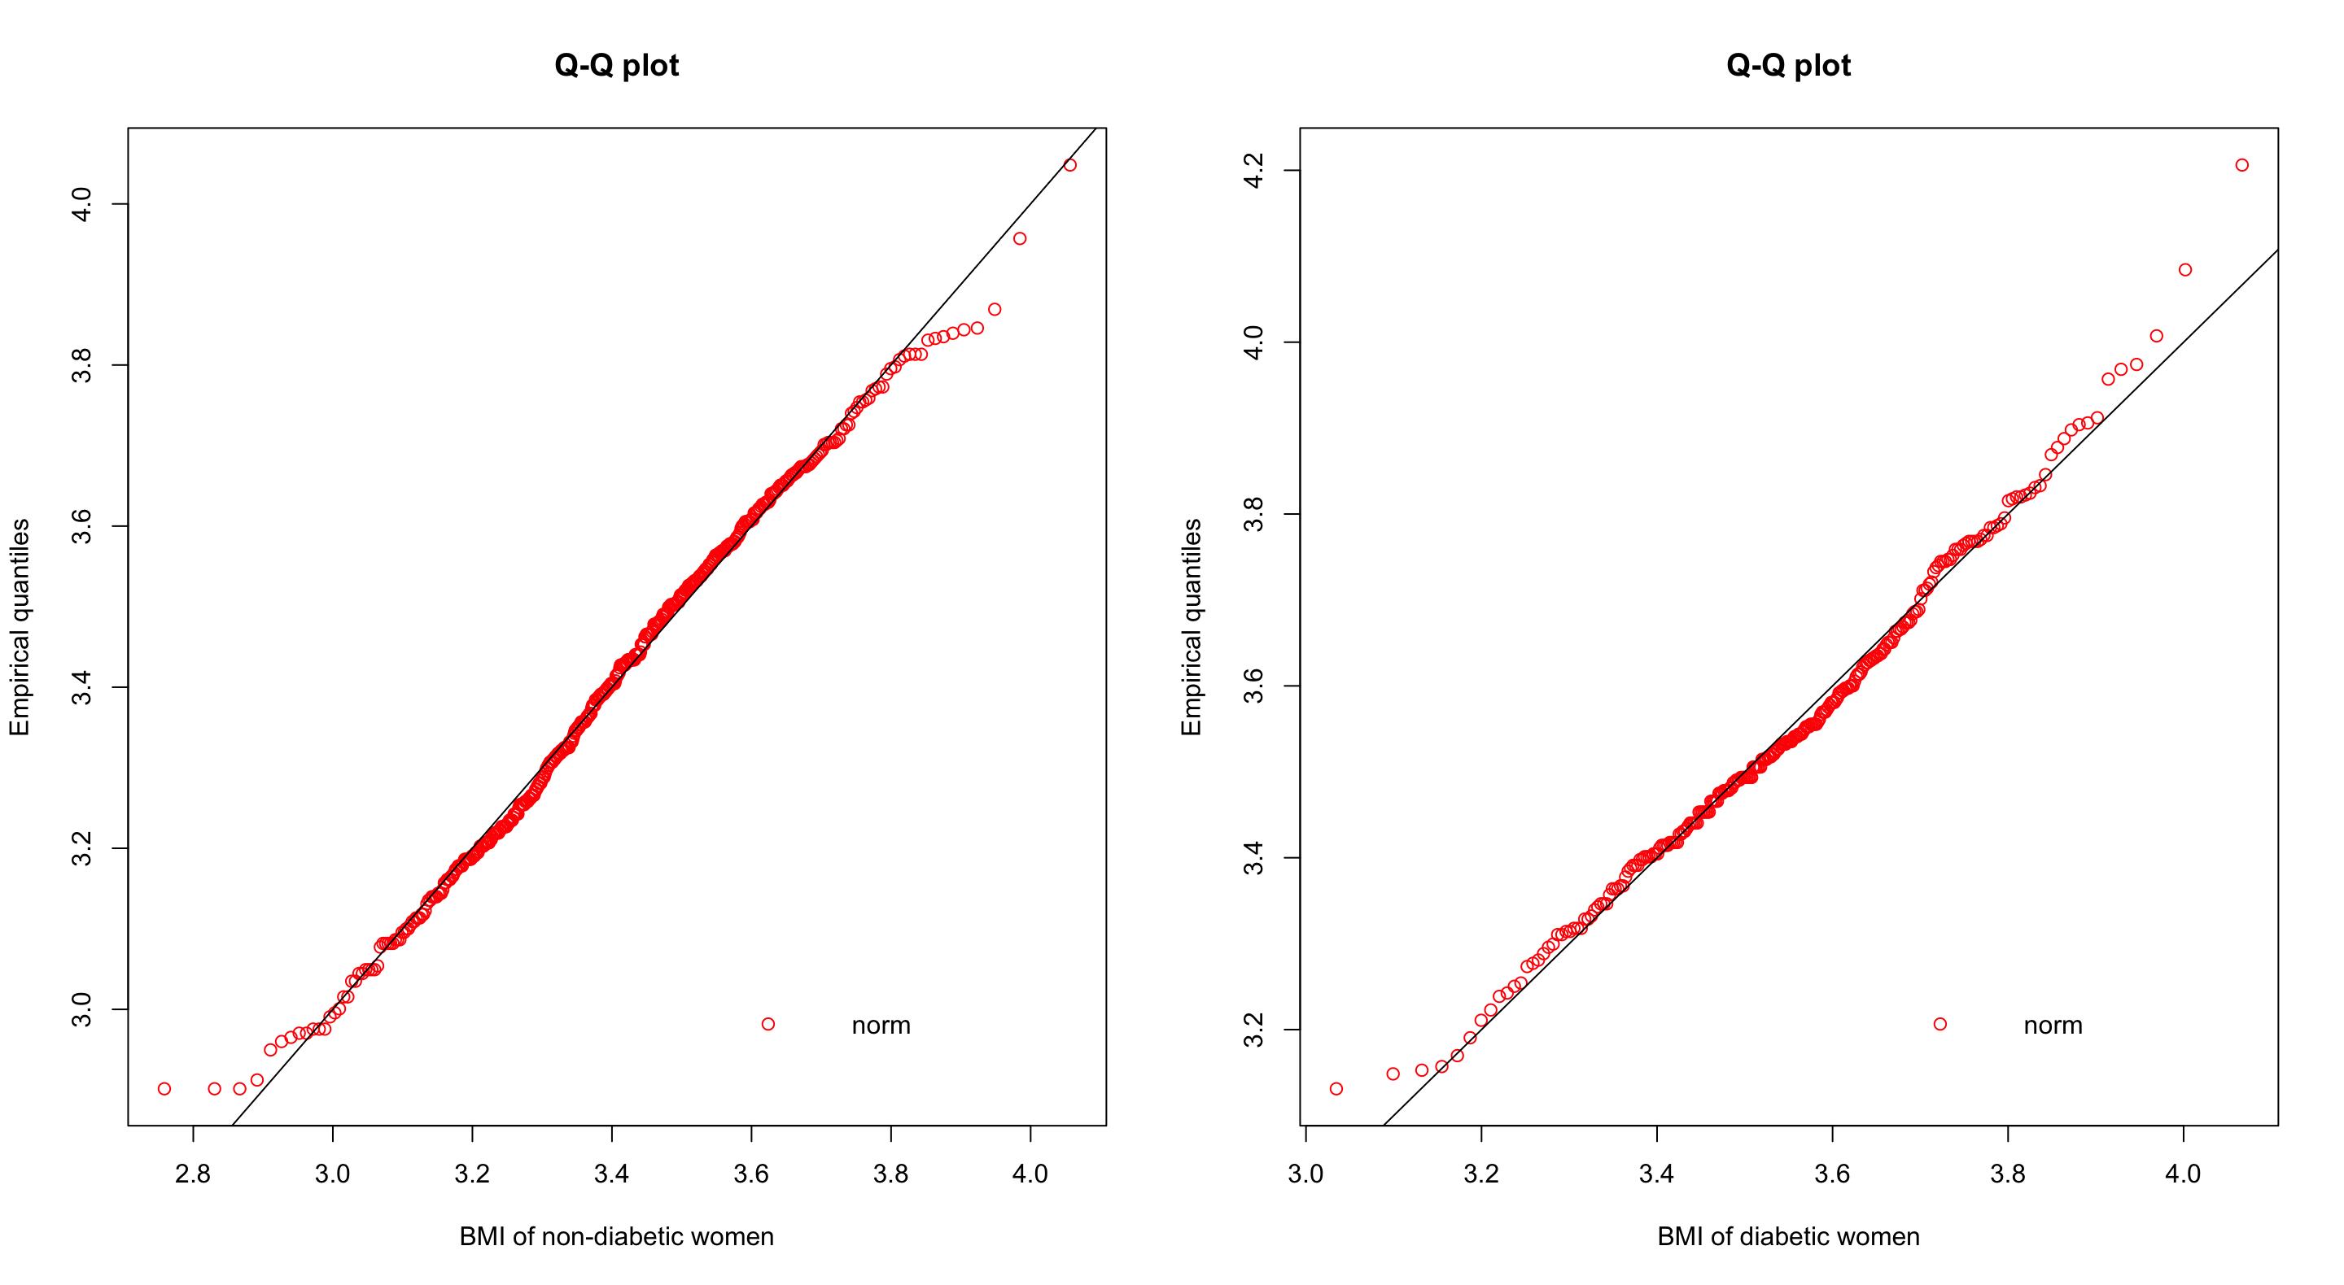
Normality Check
For checking the normality of a variable QQ-Plot for Outcome 0 and 1 were plotted.
We can see that BMI is pretty much normal.
Similarly, results for other variables are:
1. Age – Not Normal
2. Pregnancies – Not Normal
3. DPF – Normal
4. Skin Thickness - Normal
5. Blood Pressure - Normal
6. Insulin - Normal
7. Glucose - Normal
From the above result we neglect age and pregnancies for further analysis.

Slide 6
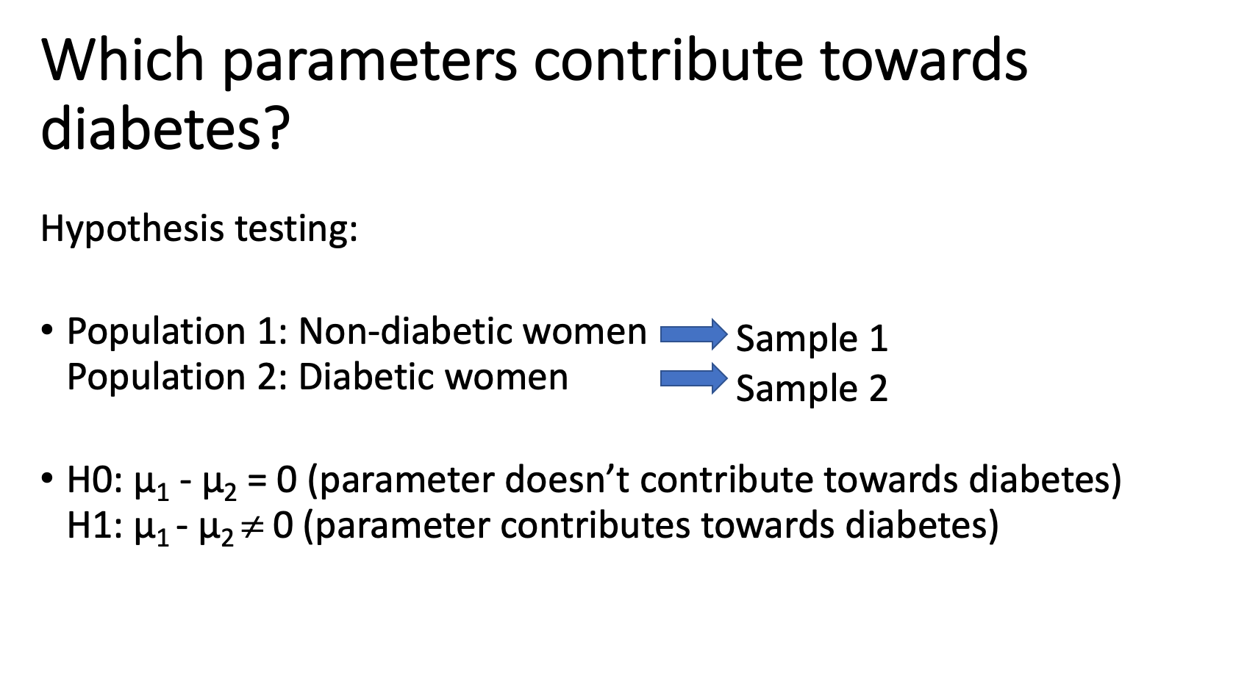

Slide 7
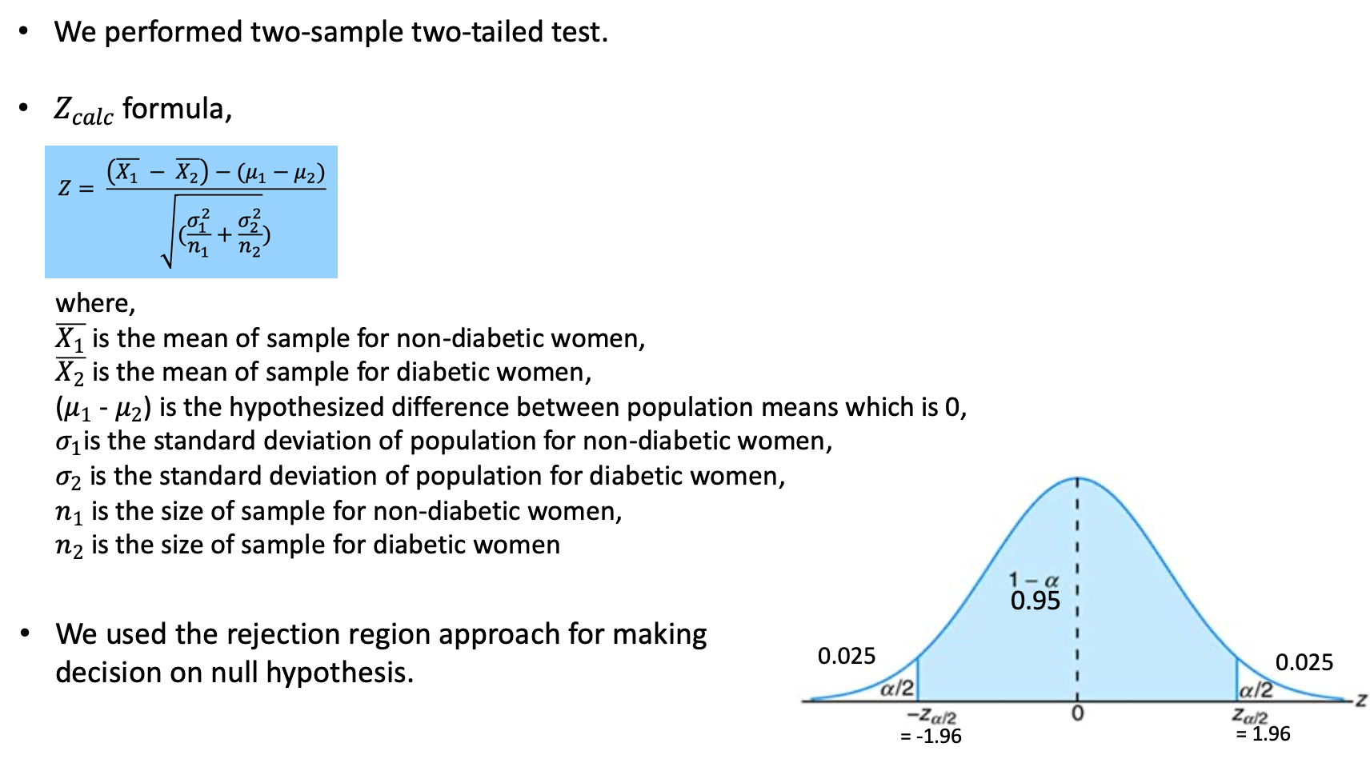

Slide 8
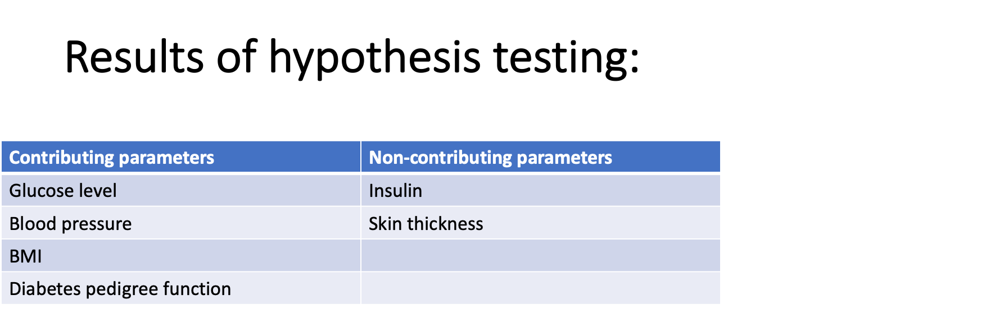

Slide 9
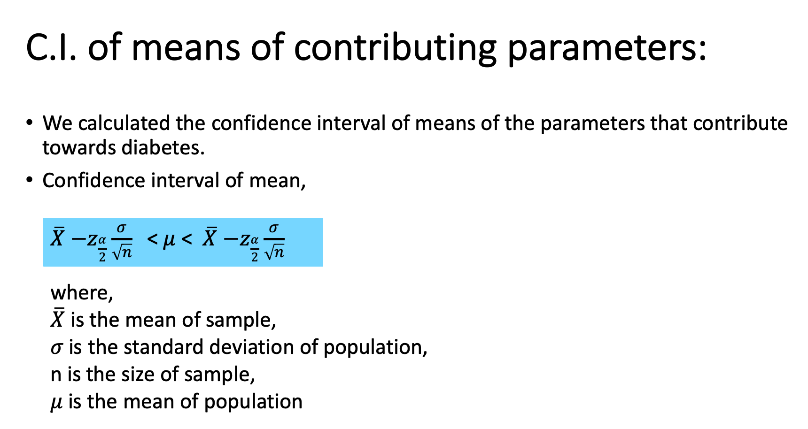

Slide 10
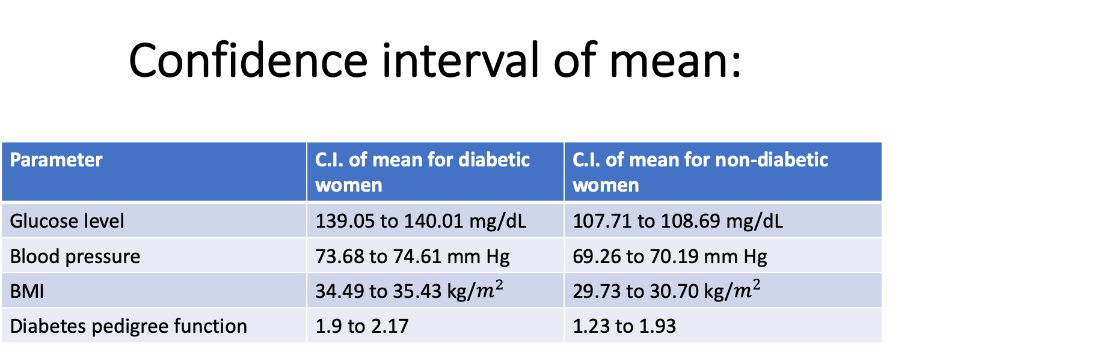

Slide 11
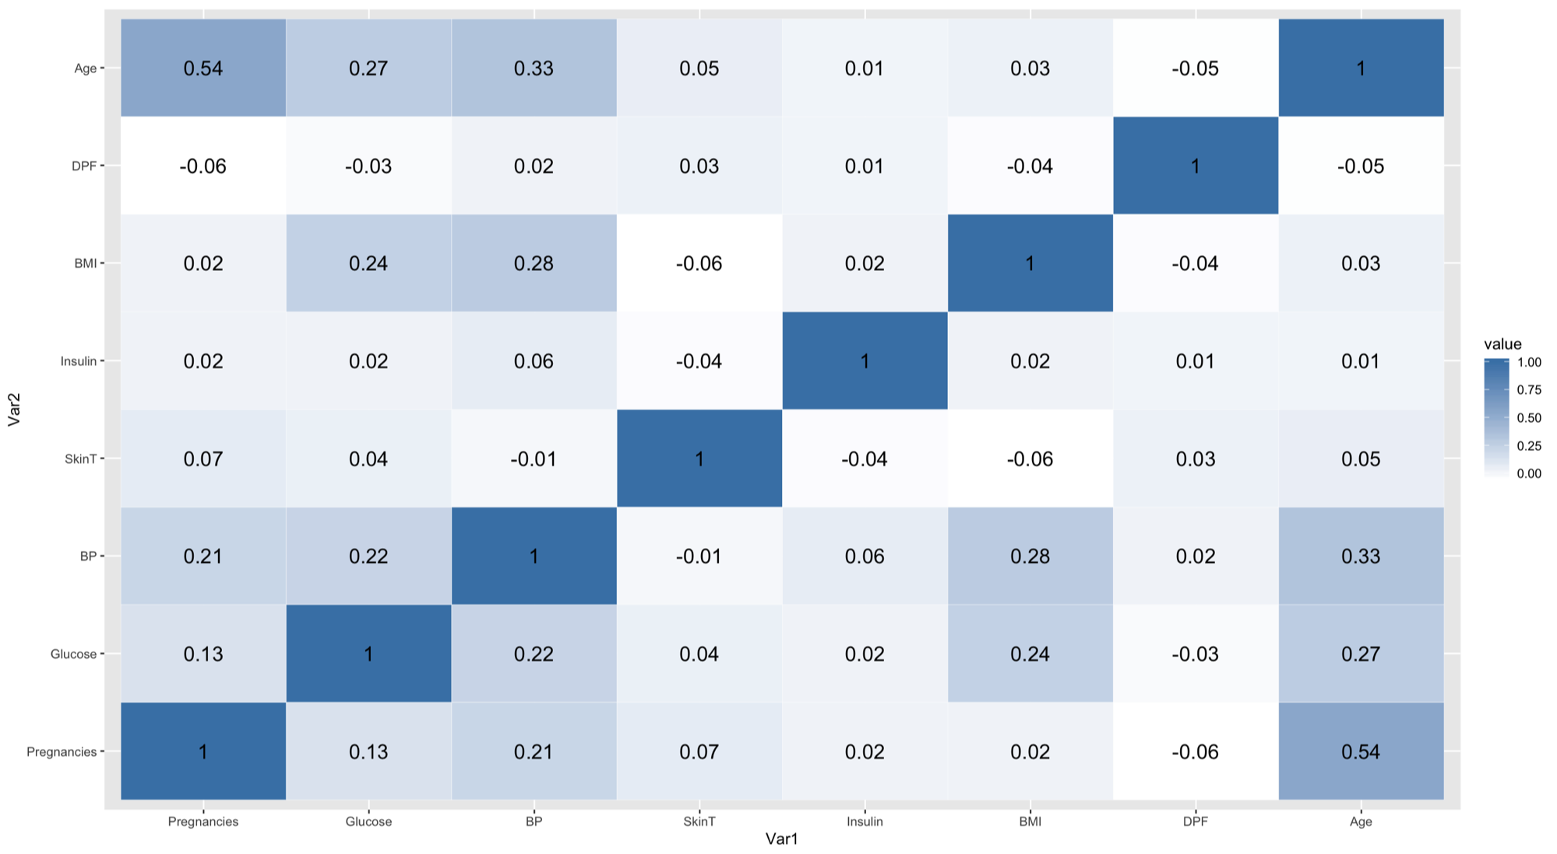
Correlation Heatmap
No 2 factors have strong linear relationship.
Age & pregnancies have moderate positive linear relationship.
We conclude that our variables are pretty much independent and suitable for building a Logistic regression model.

Slide 12
Logistic Regression
Used for predicting or modelling dependent variable is categorical and independent variables are continuous and discrete
Steps:
1. First we build a LR model for all variables and apply the step function.
2. The step function eliminates Skin Thickness based on AIC criteria.
3. Then we again build a LR model excluding skin thickness (Iteration 1) . After summarizing the newly LR model we see that Insulin and Age have p-value > 0.05 . Therefore, we exclude them from further iteration.
4. Finally, we build a LR model after omitting variables from above steps (Iteration 2). After summarizing the newly LR model we see that all the 5 remaining variables (Pregnancies + Glucose + Blood Pressure + BMI + Diabetes Pedigree Function ) have a p-value < 0.05 .
The 5 variables achieved at the end of 2nd iteration show that these variables when combined and built a LR model, can produce the outcome together.

Slide 13
CONCLUSION
Statistical validation was done using hypothesis testing for each parameter.
Parameters that are responsible for diabetes were identified and then the interval of the mean of those values was calculated.
The interval of these dependent parameters was calculated separately for diabetic and non-diabetic women.
The result from the hypothesis testing showed that the major contributing factors for diabetes of PIMA Indian women are BMI, glucose level, blood pressure, and diabetes pedigree function.
The analysis also included studying the bivariate relationships between variables using correlation and heat maps. It was found that there is a moderate correlation between pregnancy and BMI and weak correlation between the rest of them. So, all the parameters are independent.
The results of statistical analysis were verified using logistic regression. It was found that even with logistic regression the major contributing factors were the same as that were found using statistical analysis. Both statistical analysis and classification models yielded the same result.
The order of importance from statistical analysis is –Glucose – BMI – Pregnancies – Diabetes Pedigree Function – Blood Pressure
The order of importance from Logistic Regression is Glucose – BMI – Pregnancies – Blood Pressure – Diabetes Pedigree Function
The order of importance from both analysis almost match and thus cross validate each other.

Slide 14

Please Rate us!!

