Slide 1


OBJECT ORIENTED PROGRAMMING
(23EN1202)
UNIT-2: INTRODUCTION TO OOP AND PYTHON
STRINGS

Slide 2
UNIT – II 5 Hours
FUNCTIONS AND MODULES:
Need for functions, Function definition, Function call, Scope, Return statement, Lambda functions, Recursive functions, Modules.
(Chapter 5: 5.1 to 5.11)
PYTHON STRINGS:
String operations, Immutable, string formatting operator, built-in string methods, string slices, membership operator, comparing strings, Iterating strings.
(Chapter 6: 6.1 to 6.9)

Slide 3
Unit-2 Python Strings
Python string datatype is a sequence made up of one or more individual characters where characters are letters, digits, whitespaces or any other symbol.
Python treats strings as contiguous series of characters delimited by single,double or triple quotes.
Python has built in string class “str”.
We can declare a string in several ways
Eg: name=“India”
Country= name
graduate=‘N’
nationality=str(“Indian”)

Slide 4
Introduction
Indexing:
Individual characters in a string are accessed using subscript [ ] operator.
The expression in brackets is called index.
The index specifies a member of an ordered set and here it specifies the character we want to access from given set of characters in a string.
The index of first character is 0 and last is n-1 where n is number of characters in a string.
If you try tom exceed bounds that is below 0 and above n-1 the error occurs.

Slide 5
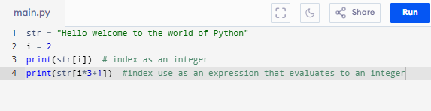
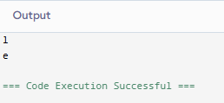
Traversing
A string traversing is done by accessing characters from one index to another.

Slide 6
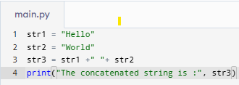

Concatenating, Appending and Multiplying String
The word concatenating means to join together.
In python concatenation of two strings can be done using “+” operator.

Slide 7
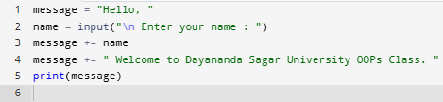
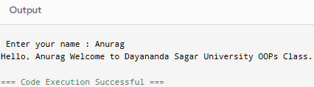
Appending
If you want to add one string at the end of another string then we will use “+=“ .

Slide 8


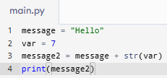

Multiplying String
“*” operator can be used to repeat a string n number of times.
The str() function is used to convert values of any other type into string type.
This helps the programmer to concatenate a string with any other datatype data.

Slide 9


Contd…
Print statement prints one or more literals or values in a newline.
If you don’t want in newline then we can use “end=‘ ‘ ”.

Slide 10
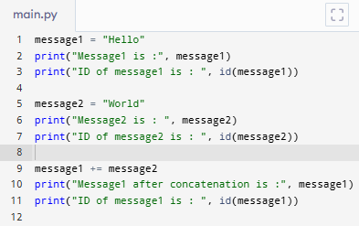
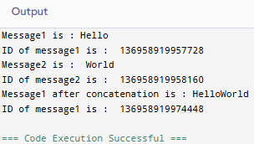
Immutable
Python strings are immutable which means that once created they cannot be changed.
Whenever you try to modify an existing string variable a new string is created.
Every object in python is stored in memory.
We can check whether two object is referring to same object or not by using Id().
Id() returns memory address of that object.

Slide 11

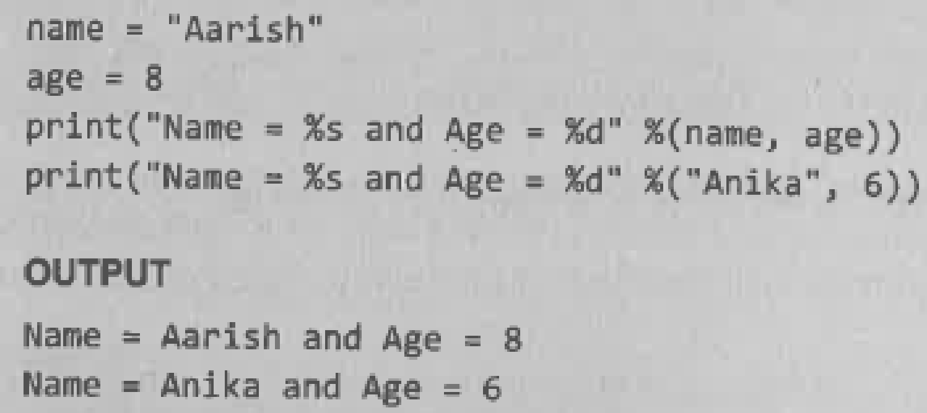
String Formatting Operator
The ‘%’ operator takes a format string on left and the corresponding values in a tuple on the right.
It allows users to construct string replacing part of string with the data stored in variables.
The syntax for string formatting operation is
The statement begins with a format string
Consisting of a sequence of character and Conversion specifications.
Common Format Codes
%s → String
%d → Integer (decimal)
%f → Floating-point
%.nf → Floating-point with n decimal places

Slide 12


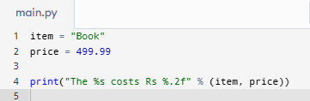

Contd..
Floating-point Formatting
Multiple Values

Slide 13
Built in string Methods and Function
String is an example of python objects.
Python supports many built in methods to manipulate strings.
A method is just like function.
Method is invoked or called on an object.

Slide 14
Function | Syntax | Usage | Example
capitalize() | string.capitalize() | Converts the first character to upper case | txt = "hello, and welcome to my world." x = txt.capitalize() print (x)
casefold() | string.casefold() | Converts string into lower case | txt = "Hello, And Welcome To My World!" x = txt.casefold() print(x)
center() | string.center(length, character) | Returns a centered string | txt = "banana" x = txt.center(20) print(x)
count() | string.count(value, start, end) | Returns the number of times a specified value occurs in a string | txt = "I love apples, apple are my favorite fruit" x = txt.count("apple") print(x)
endswith() | string.endswith(value, start, end) | Returns true if the string ends with the specified value | txt = "Hello, welcome to my world." x = txt.endswith(".") print(x)

Slide 15
Function | Syntax | Usage | Example
find() | s.find(substring, start, end)) | Searches the string for a specified value and returns the position of where it was found | txt = "Hello, welcome to my world." x = txt.find("welcome") print(x)
isascii() | string.isascii() | Returns True if all characters in the string are ascii characters | txt = "Company123" x = txt.isascii() print(x)
isnumeric() | string.isnumeric() | Returns True if all characters in the string are numeric | txt = "565543" x = txt.isnumeric() print(x)
isupper() | string.isupper() | Returns True if all characters in the string are upper case | txt = "THIS IS NOW!" x = txt.isupper() print(x)
split() | string.split(separator, maxsplit) | Splits the string at the specified separator, and returns a list | txt = "welcome to the jungle" x = txt.split() print(x)

Slide 16
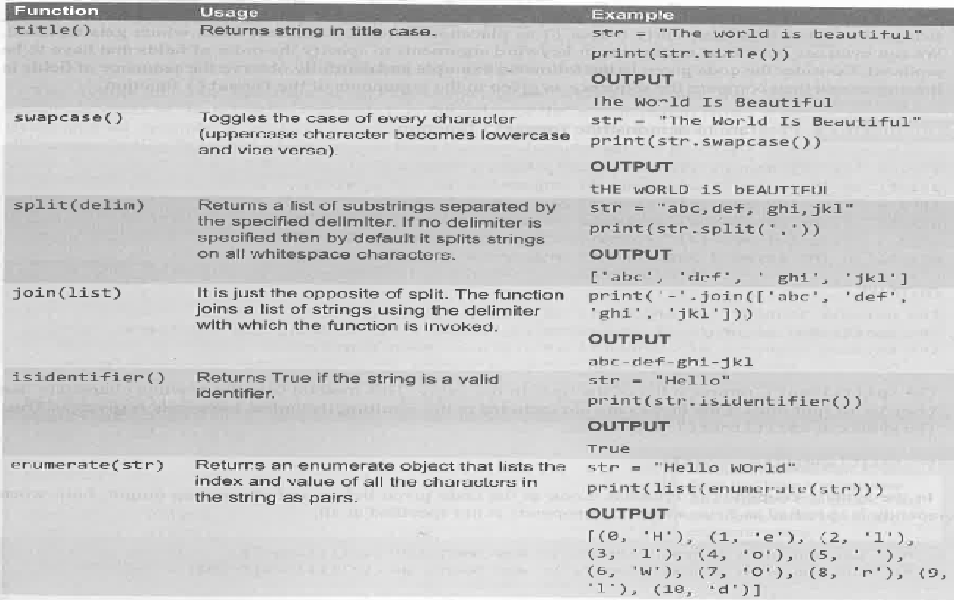

Slide 17
Format()
It is used for formatting strings
Format strings have curly braces {} as placeholders or replacement fields which gets replaced.
We can use positional arguments or keyword arguments to specify the order of fields that have to be replaced.

Slide 18
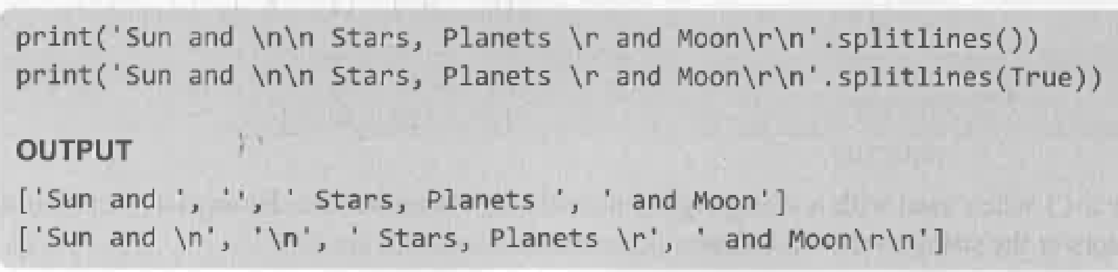
Multiplying String
It returns a list of lines in the string
It uses the newline characters such as \r and \n to split lines.
Linebreaks are not included unless keepends are True.
Syntax :
str.splitlines(Keepends)

Slide 19
Slice Operation
A substring of a string is called a slice.
Slice operation is used to refer to the sub-parts of sequences and strings.
We can take a subset of a string from the original string by using [ ] operator also known as slicing operator.
Syntax of slice operation is : s[start: end] where start indicates beginning index of the substring and end-1 is the index of the last character.
Omitting either start or end index by default takes start or end of the string. Omitting both means the entire string.
Python gives flexibility to access the string either from the first or the last character.
If we are accessing the string from first character then we can use zero as index value,when doing it backward index starts with -1.

Slide 20
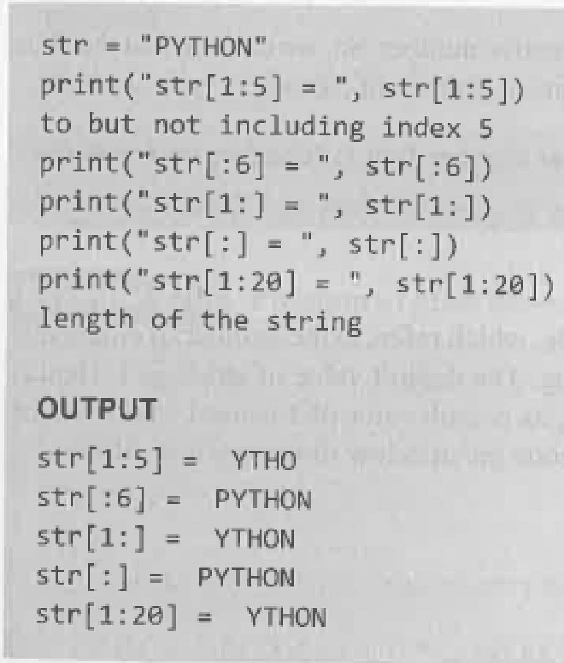
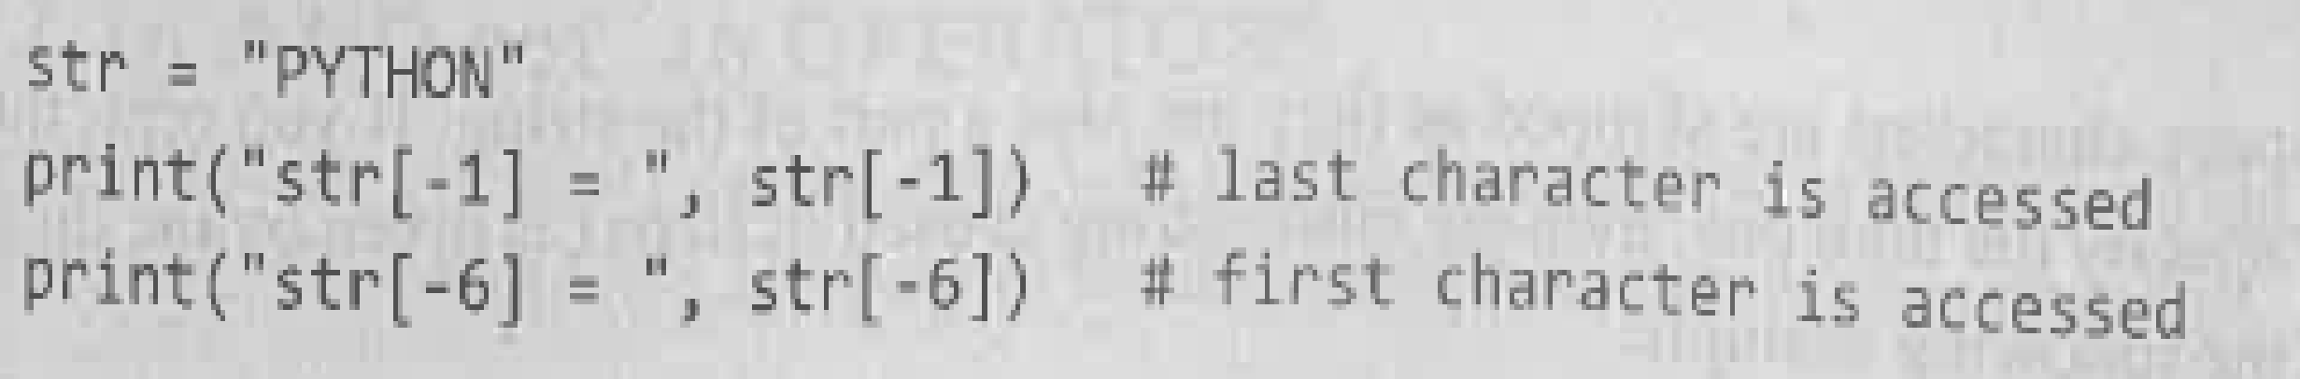
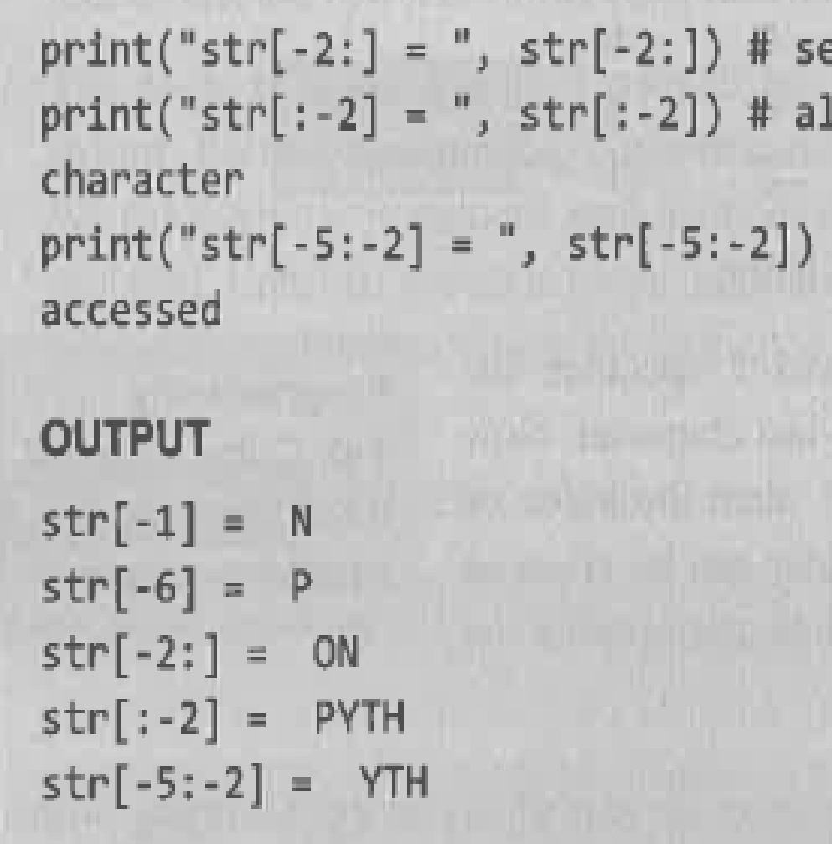

Slide 21
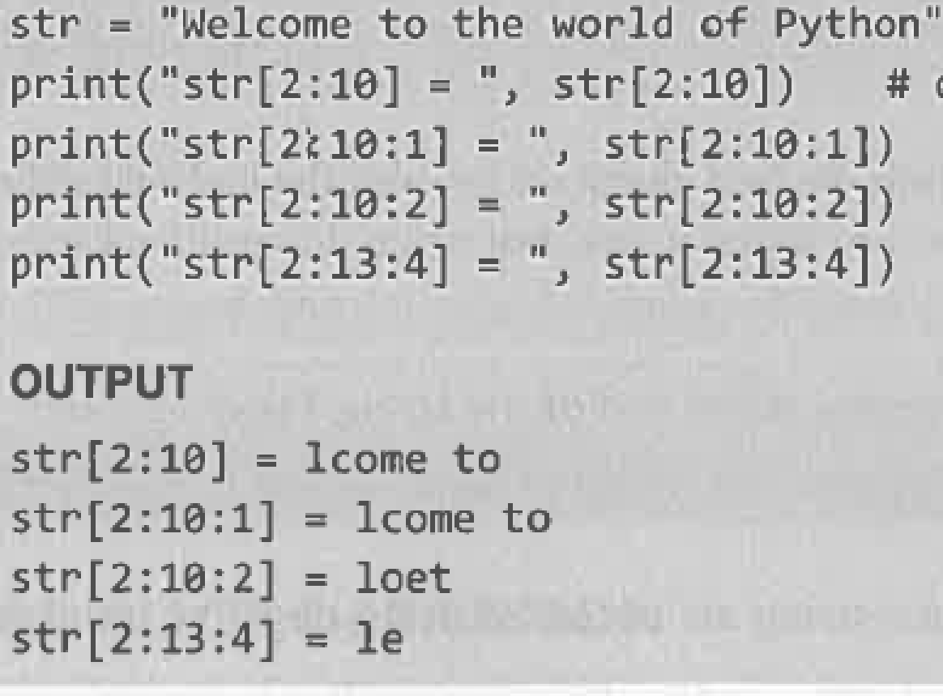
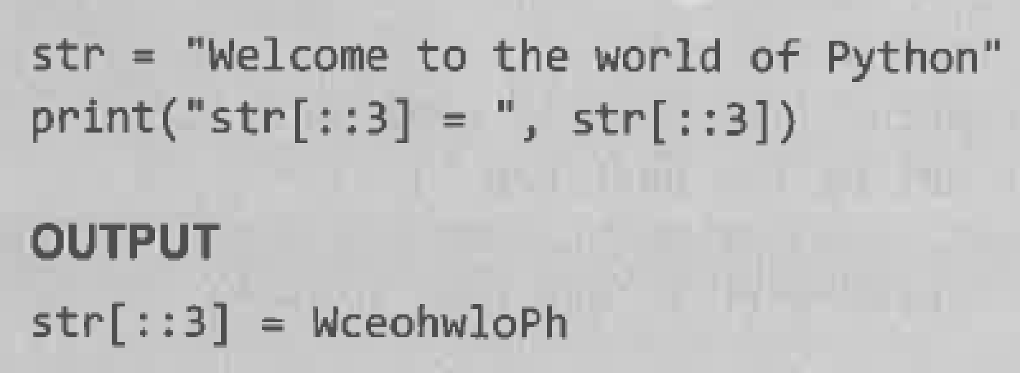
Specifying stride/stepsize while slicing the string
In slice operation we have the option to specify stride as third argument, which refers to umber of characters to move forward after the first character is retrieved from the string.
The default value of the stride is 1.
Even whitespace characters are also skipped because
they are part of a string.

Slide 22
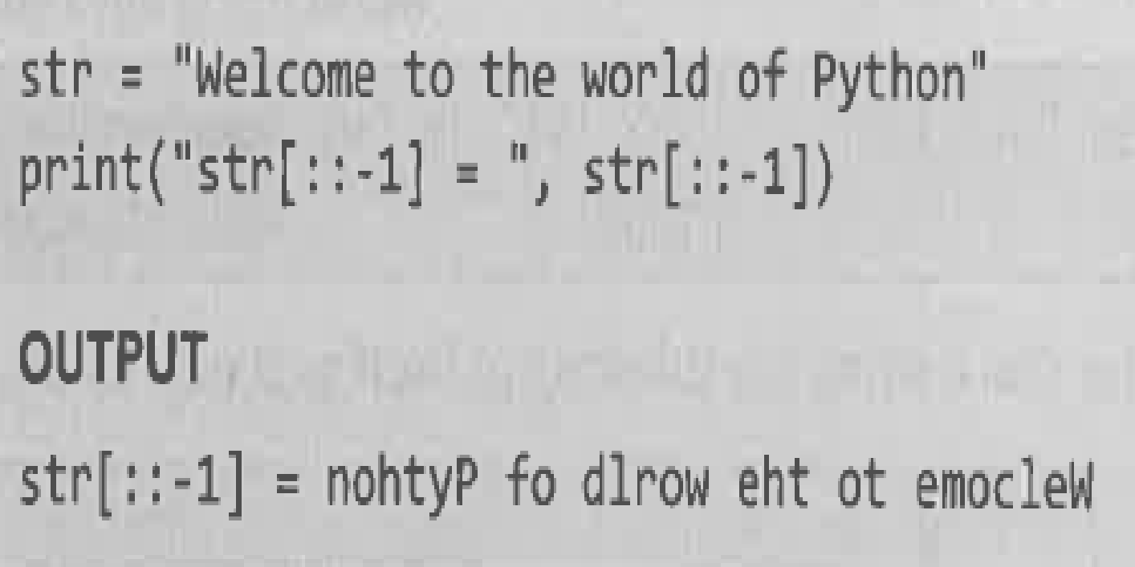
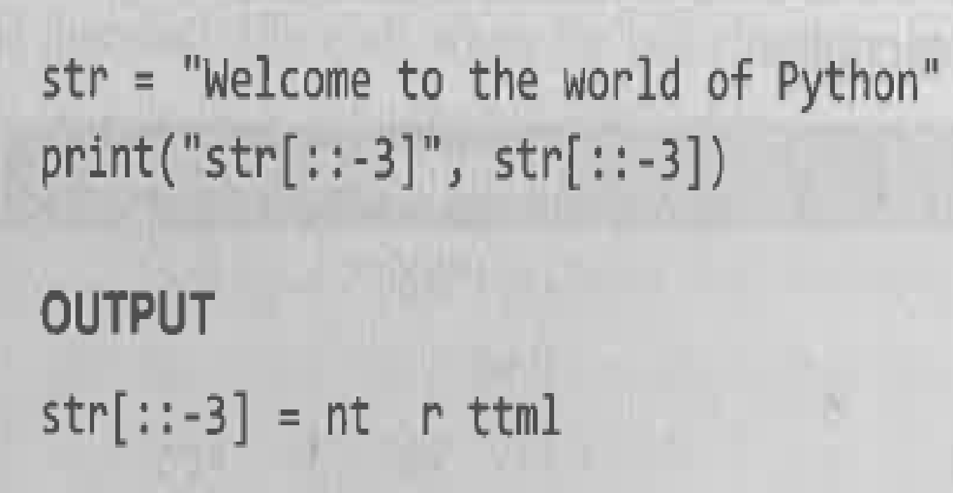
Contd..
Negative value can be also used as stride value.
With -3.we have skipped every third letter of the string str.

Slide 23
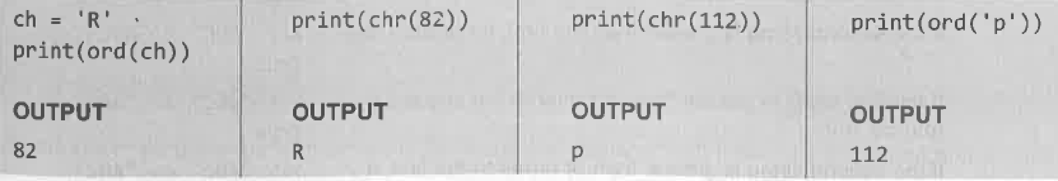
ord() and chr() functions
The ord( ) function returns the ASCII code of the character.
chr( ) function returns character represented by the ASCII number.

Slide 24
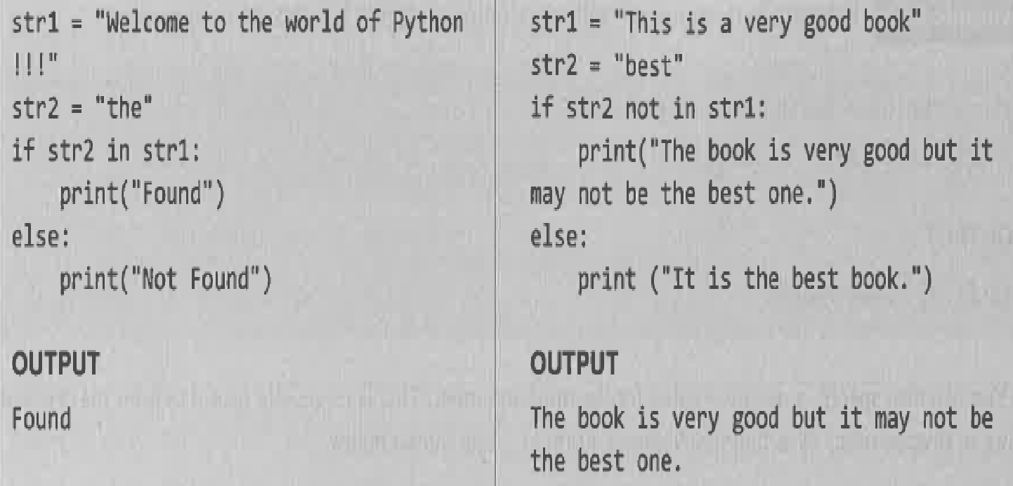
In() and not in() operator – Membership Operator
In() and not in() are used in string to determine whether a string is present in another string.
They are also known as membership operator.

Slide 25
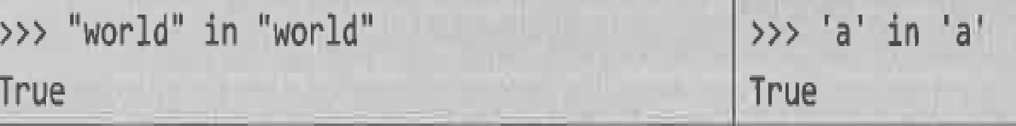
Contd…
In() and not in() can be used to check whether a character is present in a word.

Slide 26
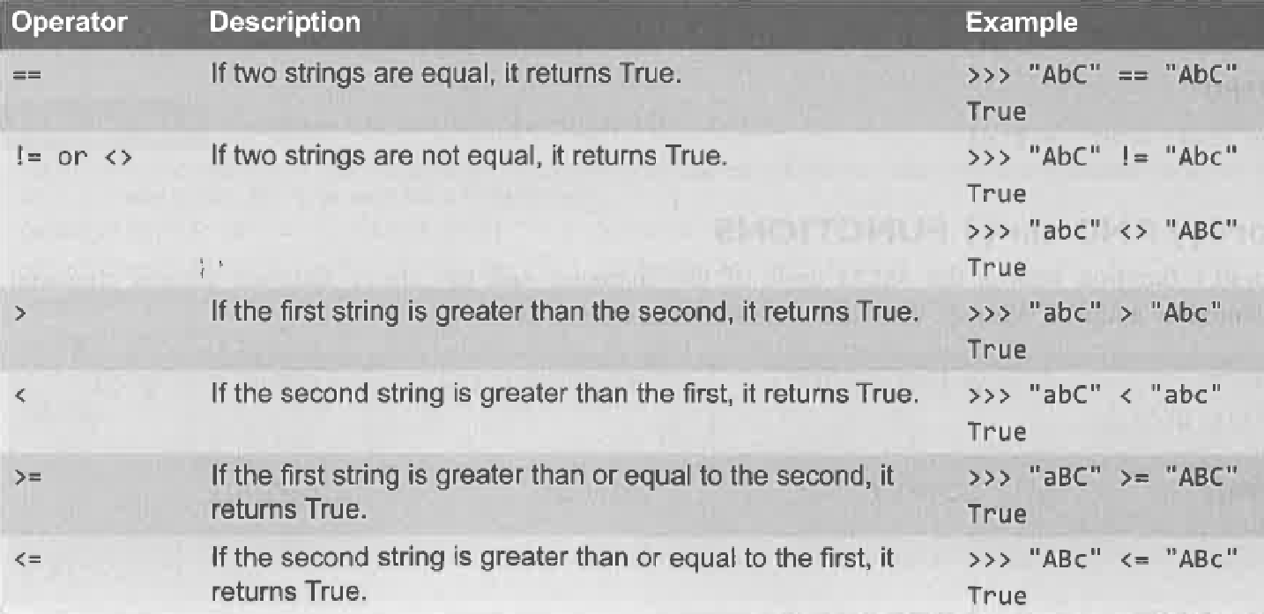
Comparing Strings
Python allows you to compare the strings using relational or comparison operators such as <,>,<=,>= etc.

Slide 27
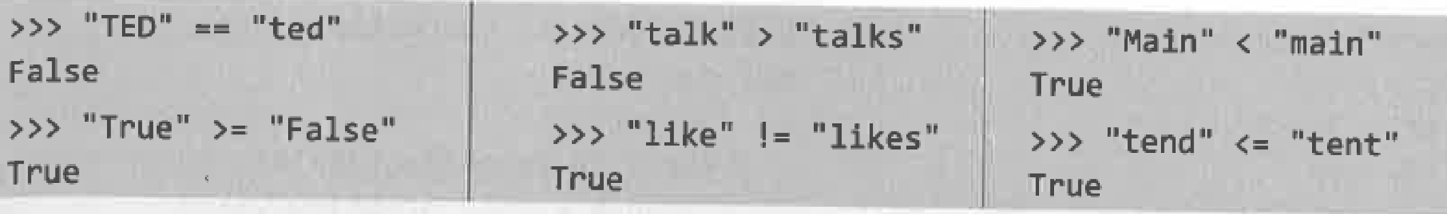
Contd…
These operators compares the string by using lexicographical order i.e using ASCII value of the character.
The ASCII value of A-Z is 65-90 and ASCII code of a-z 97-122.

Slide 28
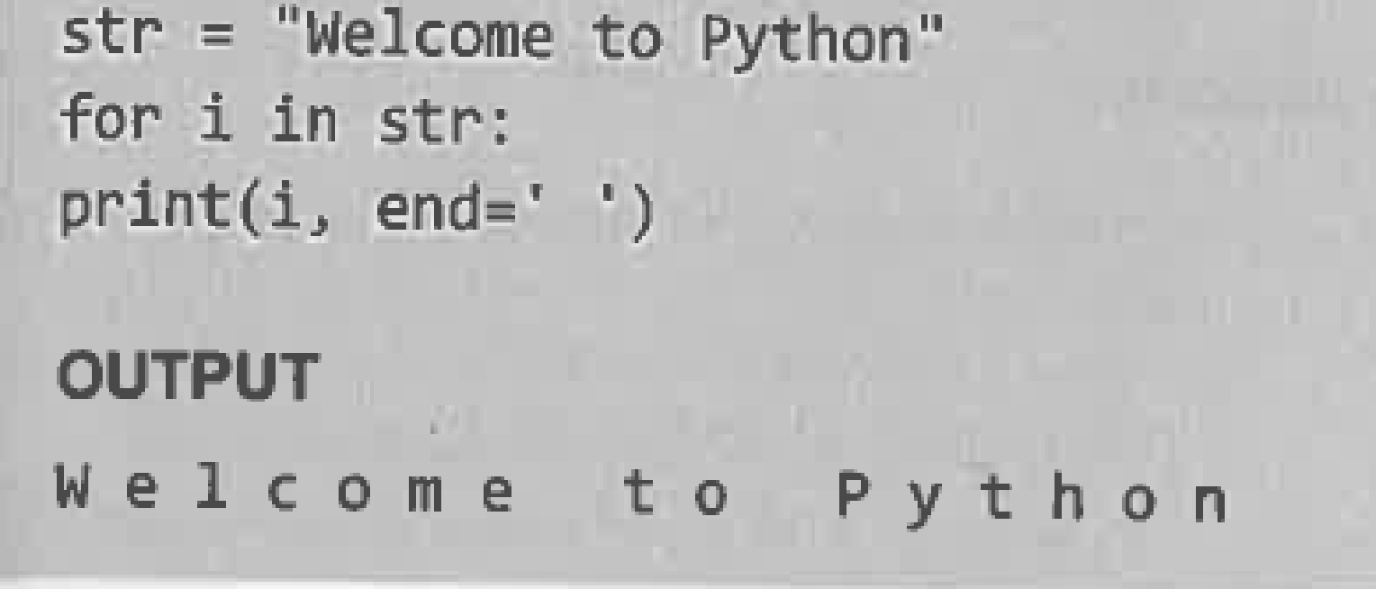
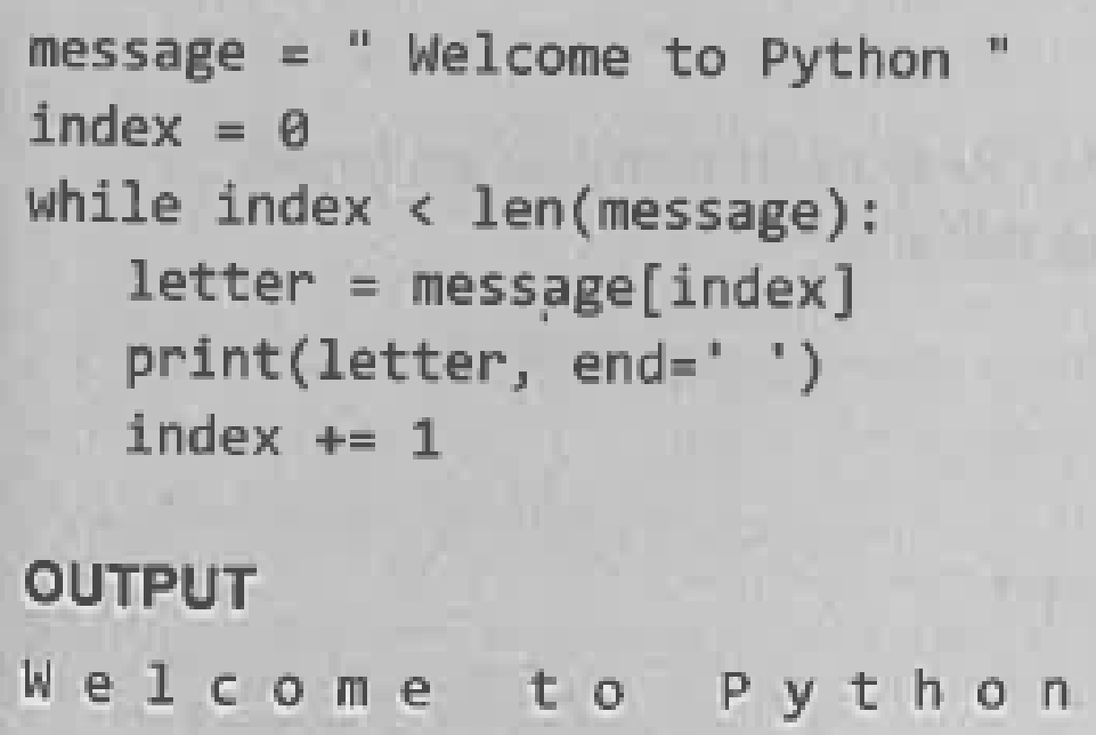
Iterating String
String is a sequence type(sequence of characters).
We can iterate through strings using for loop or while loop.

