Slide 1
Computer Vision Hackathon 2021

Slide 2
The problem
Company
Context
Problem statement
A textile company
Defect detection in Fabric:
Incurs approximately 5% of wastage in fabric.
Cut down the wastage by detection of defects.
As AI enthusiast you are responsible for coming up with a solution where the images of the fabric is being classified into good and defected and in case of a defected image the position of the defect is being captured in the form of a bounding box.

Slide 3
Our
Approach
We have incorporated YOLO, an algorithm that uses neural networks to provide real-time object detection, to solve the problem..

Slide 4
Implementation

Slide 5
EDA
Training
Testing
Defects.zip containing images which has defect(s) + text file containing coordinates of defect(s)
Bad_seg.py to segregate images having defects.
classes.txt having single class: Defect.
Upload on google drive to be used for training
Yolo -v3 for making model
Google colab for training.
Mounted google drive
Unzipped Defect.zip
Cloned darknet github
Changes to certain files
Training: batch size of 16 and max batches 2000
Few hours to train
Testing: batch size of 1 and subdivisions 1.
Testing

Slide 6
To improve accuracy...
In the training data, coordinates of the centre of the bounding boxes were provided, not the bottom left corner as mentioned in the instructions pdf.
We verified this by making the boxes taking (x, y) as the centre coordinates.
Correspondingly in the submission file we have entered (x, y) coordinates as the center of the bounding boxes.

Slide 7
Further improvement
Data collection: Larger amounts of data is the key strength of neural networks involved in image processing and hence to improve the accuracy of our model, collecting more data is certainly the next step.
Hyper-parameter tuning: Tuning the parameters and comparing multiple models simultaneously to extract the best possible model.

Slide 8
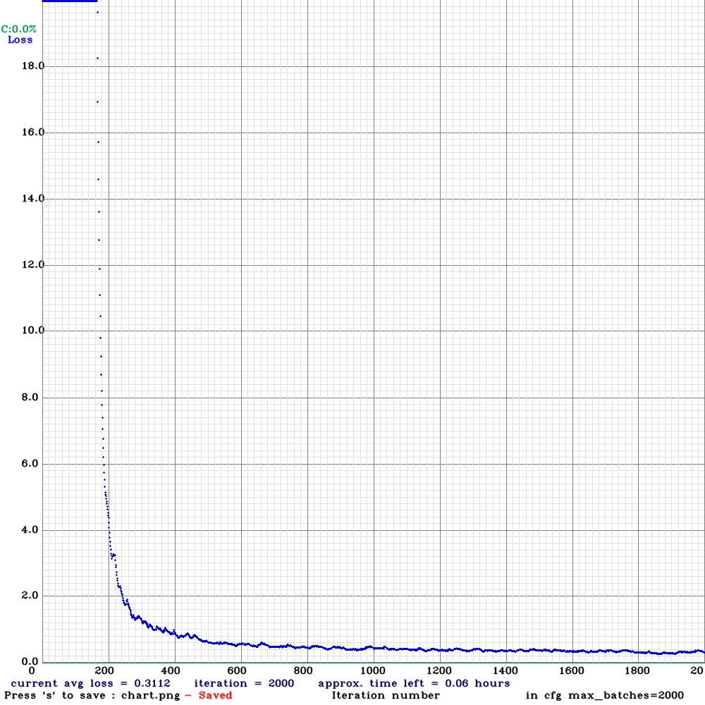
Training Loss Chart

Slide 9
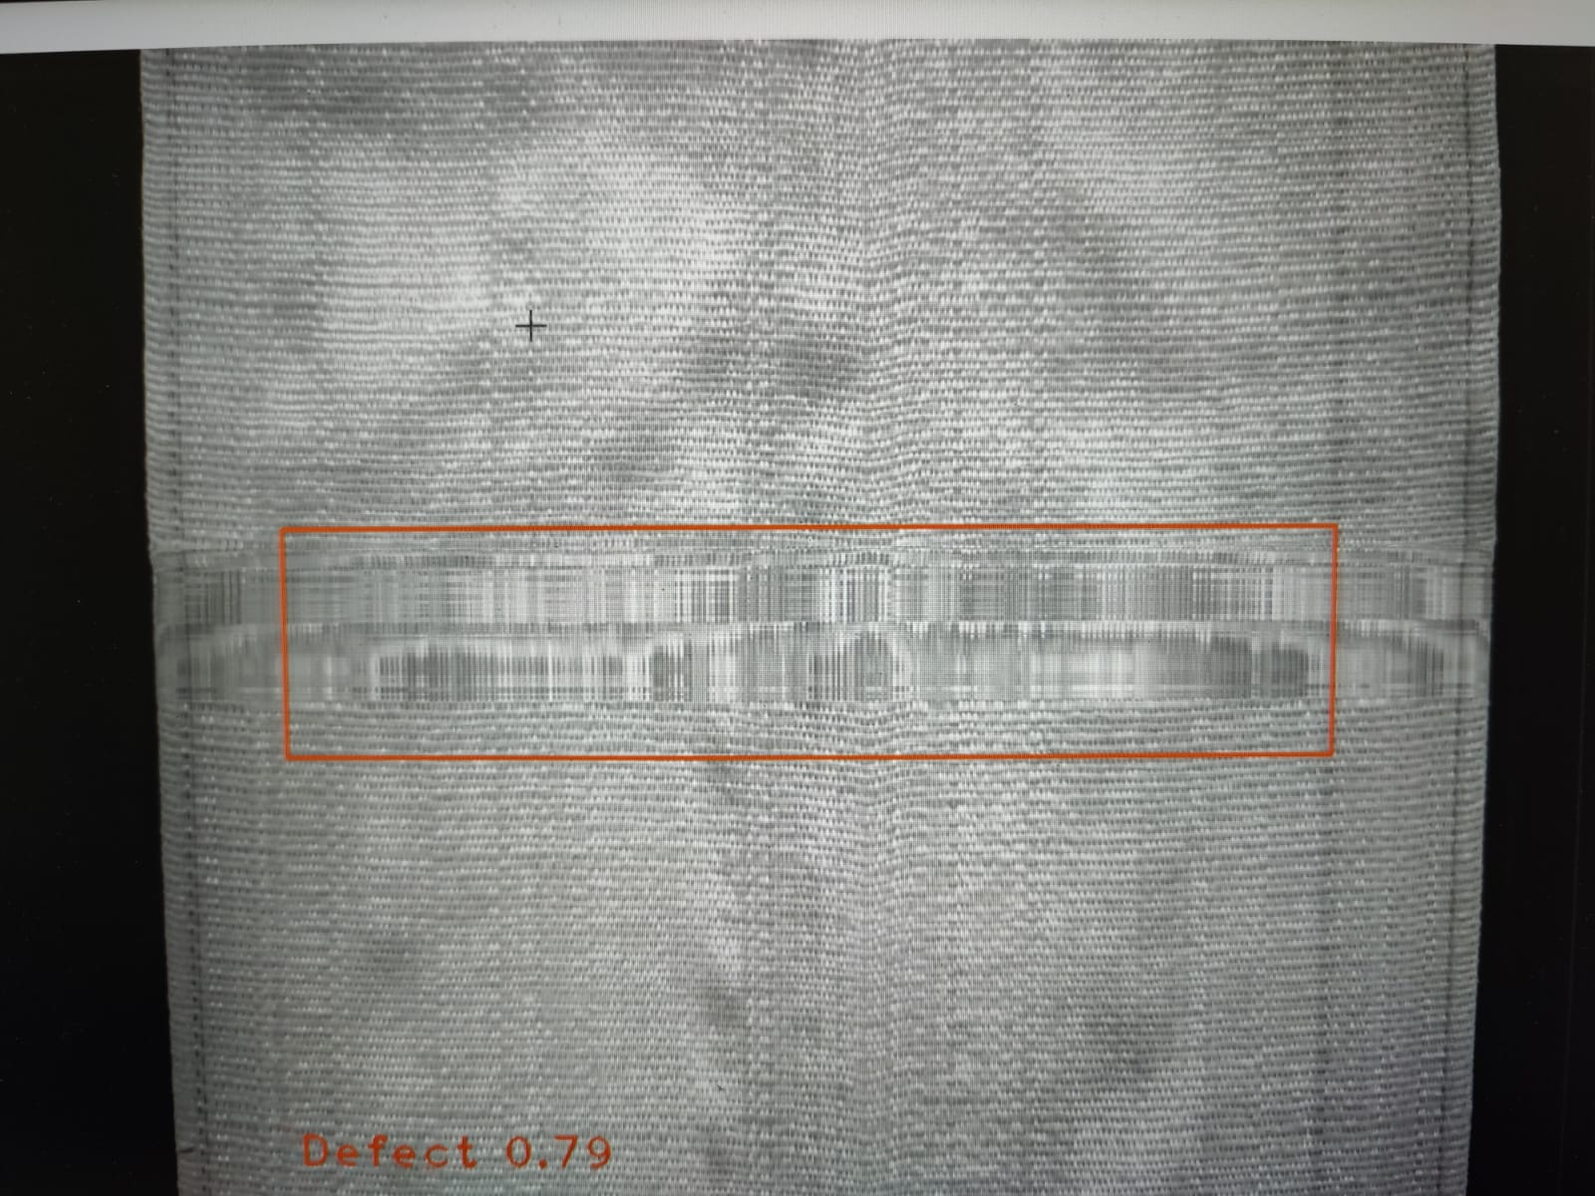
Testing Sample

Slide 10
The team
Navlika Singh (B20AI025)
Mitul Agarwal
(B20AI021)
Piyush Arora
(B20AI028)
Artificial Intelligence and Data Science
Artificial Intelligence and Data Science
Computer Science and Engineering

Slide 11
Thank You

