Slide 1
LIFEFLOW
Blood Donation Network
A Modern Responsive Website for Connecting Donors
with Real-Time Blood Stock & Registration
Web Development Practical • HTML5 + CSS3 • October 2026
LifeFlow • Blood Donation Network • HTML5 + CSS3 Project • October 2026

Slide 2
Agenda
01
Project Overview & Objectives
02
Technologies Used
03
Website Features & Sections
04
Live Screenshots & Testing
05
Key Code Highlights
06
Conclusion & Future Scope
LifeFlow • Blood Donation Network • HTML5 + CSS3 Project • October 2026

Slide 3
Project Overview
LifeFlow is a single-page responsive website that helps people become blood donors and check regional blood stock levels in real time.
Goal
Responsive
Connect voluntary donors with local blood banks through a clean, modern interface.
Fully usable on desktop and mobile using Flexbox, Grid and media queries.
Impact
Deliverable
Highlight critical shortages (O-, A+) and encourage immediate registration.
Working website + Project Report (Word) + this PPT.
LifeFlow • Blood Donation Network • HTML5 + CSS3 Project • October 2026

Slide 4
Technologies Used
HTML5
CSS3
Font Awesome
VS Code
Semantic structure
nav, header, section, form
Variables, Flexbox, Grid
Animations, Media Queries
Modern icons for
droplet, heart, map, user
Editor + Live Server
Integrated Browser testing
LifeFlow • Blood Donation Network • HTML5 + CSS3 Project • October 2026

Slide 5
Website Features
1
Sticky Navigation
2
Hero Section
3
Blood Stock Cards
Logo + smooth-scroll links + Register button
Impactful headline + dual CTAs + pulsing heart animation
O- / A+ / B+ / AB- with progress bars & status colors
4
3-Step Workflow
5
Registration Form
6
Responsive Layout
Register → Find Camps → Donate Life
Name, Blood Type, Phone, Location + success alert
Media query @768px for mobile-friendly stacking
LifeFlow • Blood Donation Network • HTML5 + CSS3 Project • October 2026

Slide 6
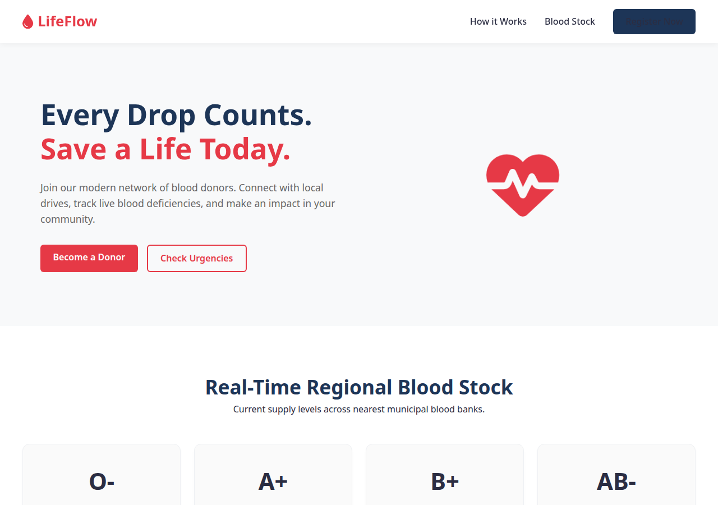
Output – Hero Section
LifeFlow • Blood Donation Network • HTML5 + CSS3 Project • October 2026

Slide 7
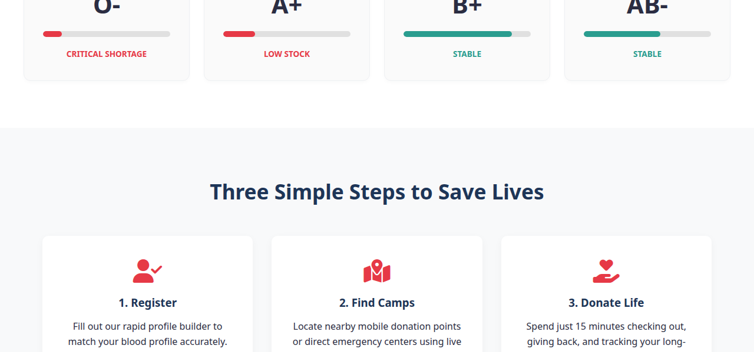
Output – Blood Stock Dashboard
LifeFlow • Blood Donation Network • HTML5 + CSS3 Project • October 2026

Slide 8
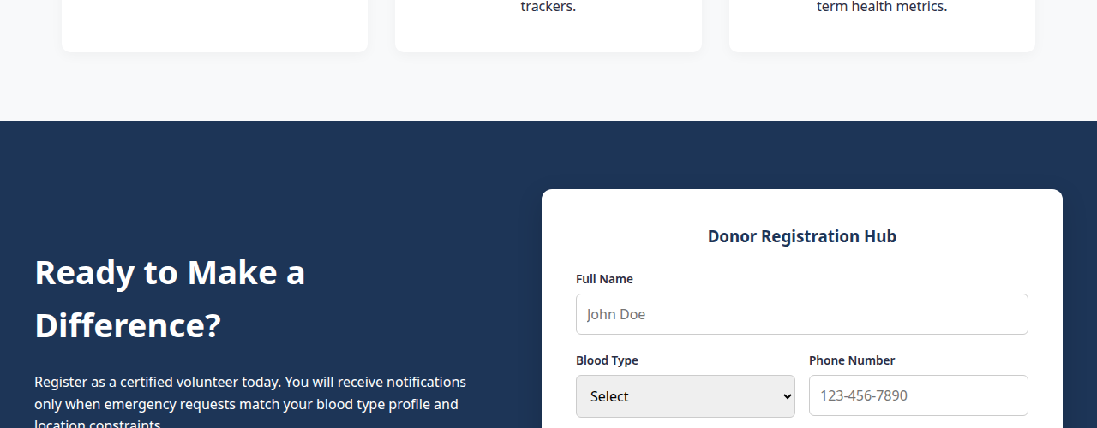
Output – Three Simple Steps
LifeFlow • Blood Donation Network • HTML5 + CSS3 Project • October 2026

Slide 9
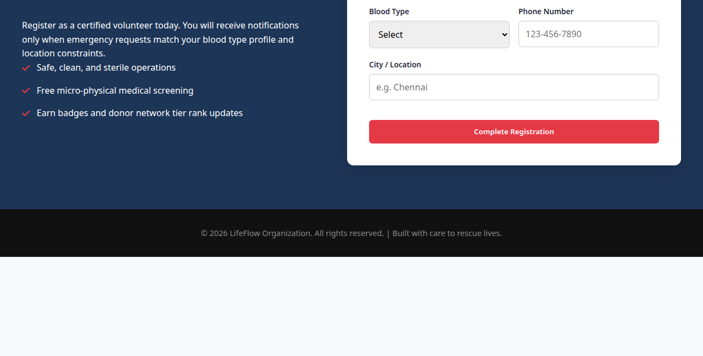
Output – Registration Form
LifeFlow • Blood Donation Network • HTML5 + CSS3 Project • October 2026

Slide 10
Key Code Highlights
CSS Variables + Animation
Responsive Media Query
:root {
--primary-color: #e63946;
--secondary-color: #1d3557;
--success-color: #2a9d8f;
}
@keyframes heartbeat {
0%, 100% { transform: scale(1); }
25% { transform: scale(1.12); }
}
@media (max-width: 768px) {
.hero {
flex-direction: column-reverse;
text-align: center;
}
.nav-links { display: none; }
.form-container {
flex-direction: column;
}
}
LifeFlow • Blood Donation Network • HTML5 + CSS3 Project • October 2026

Slide 11
Testing Summary
Test Case
Section
Result
Notes
TC-01
Hero & Nav
Pass
Sticky nav, pulse animation working
TC-02
Stock Cards
Pass
Progress bars & colors correct
TC-03
Feature Cards
Pass
Icons + hover lift effect
TC-04
Registration
Pass
Form submits → success alert
TC-05
Responsiveness
Pass
Mobile layout stacks cleanly
LifeFlow • Blood Donation Network • HTML5 + CSS3 Project • October 2026

Slide 12
Conclusion & Future Scope
What we achieved
Future enhancements
▸ Complete responsive single-page website
▸ Backend for real donor data storage
▸ Real-time styled blood stock dashboard
▸ Geolocation for nearby donation camps
▸ Interactive donor registration form
▸ SMS / email notifications for urgent needs
▸ Clean modern UI with CSS animations
▸ Progressive Web App (offline support)
▸ Full documentation (Report + PPT)
▸ Admin dashboard for blood banks
Thank You
Every Drop Counts. Save a Life Today.
LifeFlow • Blood Donation Network • HTML5 + CSS3 Project • October 2026

