Slide 1
LEA & Judiciary Interactive Case Management System
Team Leader :
Vikash V
Team Members :
Swathi Lakshmi M
Vinod Kumar H
Ashwin B
Kamachi S
Manikandan S
Team Name : Stratosphere
Problem Statement ID : rk61
MENTORS:
Mr. Ramesh P N
MR. Arul Kumar v p

Slide 2
PROBLEM STATEMENT
Smart and efficient Judiciary Interactive System: We often come across scenarios where stakeholders for a particular event (presentation, meeting, discussion, etc.) are at remote location. In such cases, we observe many problems in flawless conduction of presentation or meeting, etc. We are looking for software solution for smart and efficient judiciary interactive system. It should cover (1) facility for presentation to all the attendees (2) facility for discussion between Judiciary panel. Additional useful features are welcomed text

Slide 3
MEETING
The Idea is to develop Online Conferencing Application which provides Video Conferencing, desktop sharing, chat and Sharing of documents. The Application allows multiple meetings with highly secured virtual private rooms to be held at the same time.The Admin can create meeting for all the attendees at any remote location. Admin(Judge) can monitor the cases in a well-organized manner. The application also allows the discussion between the Judiciary Panel.

Slide 4
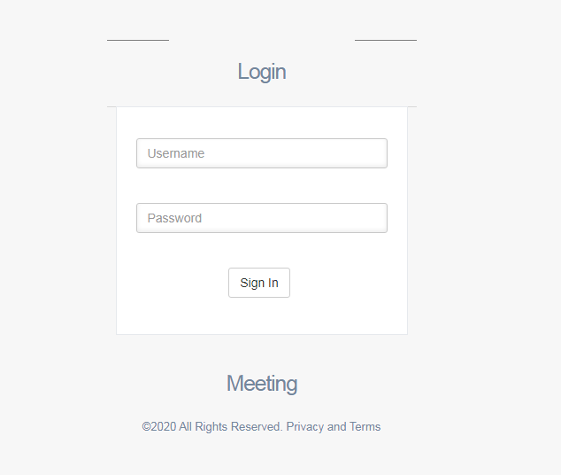
LOGIN

Slide 5
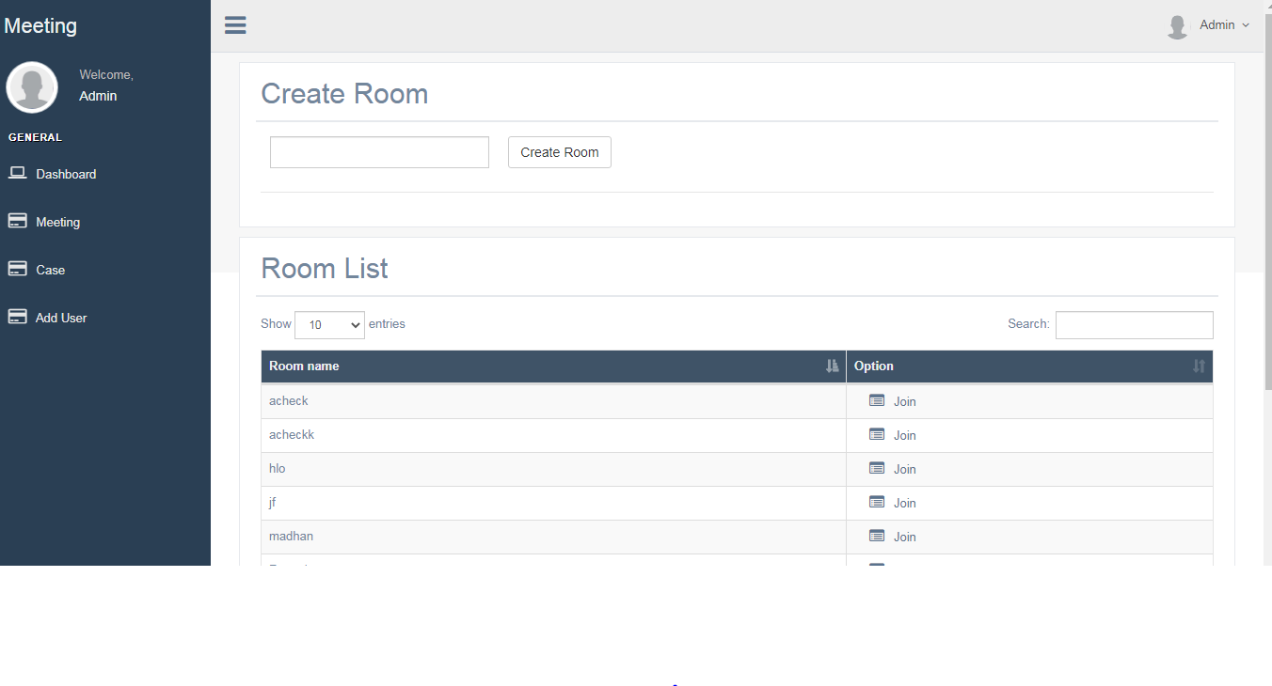
WORKING SPACE OF JUDGE

Slide 6
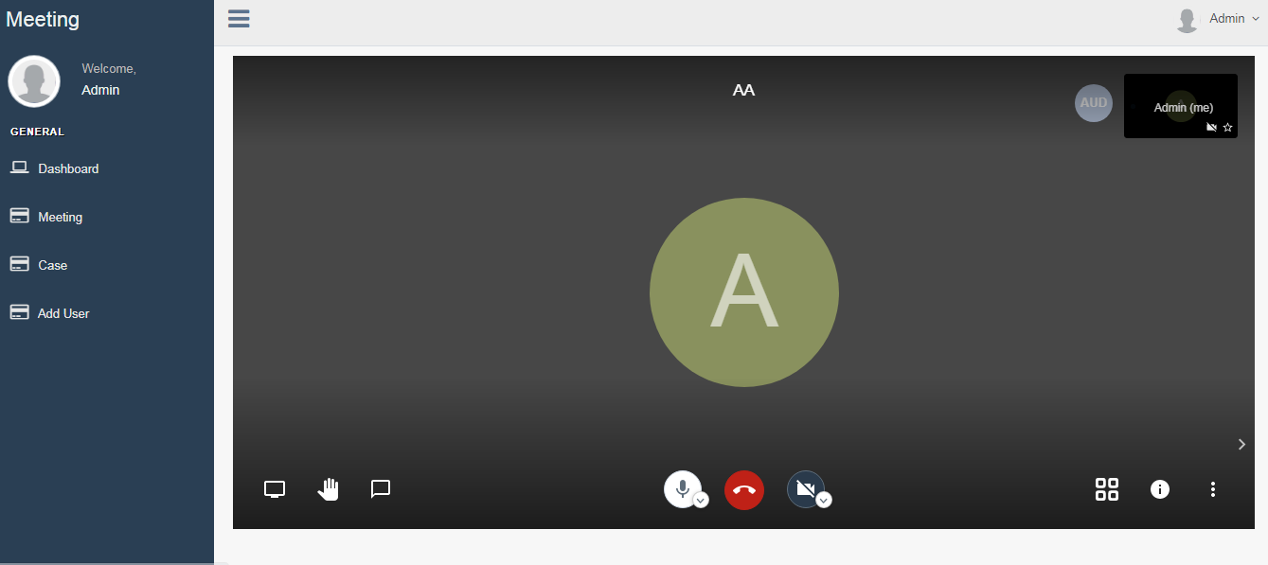
CONFERENCE

Slide 7


USERS
The Users of this application are,
Judge(Admin)
Lawyers
Government Lawyers
Police Officers
Victim
Office Staffs

Slide 8


ADMIN ACCESS
Case
Create/Update/Delete
Create/Update/Delete
Hearing
Assign/Remove
JUDGE
Members

Slide 9
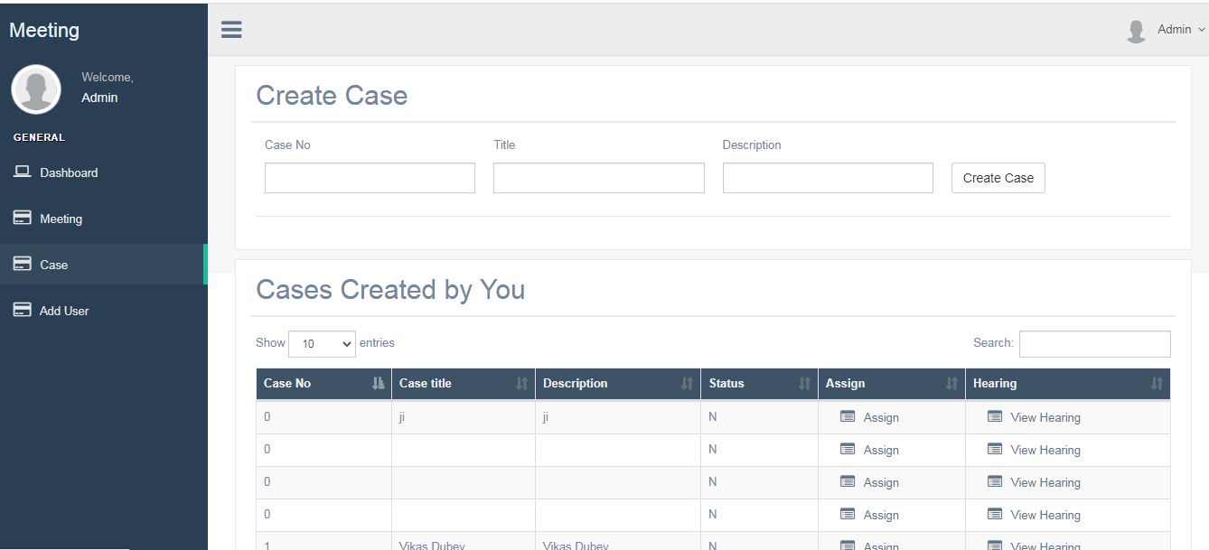

Slide 10
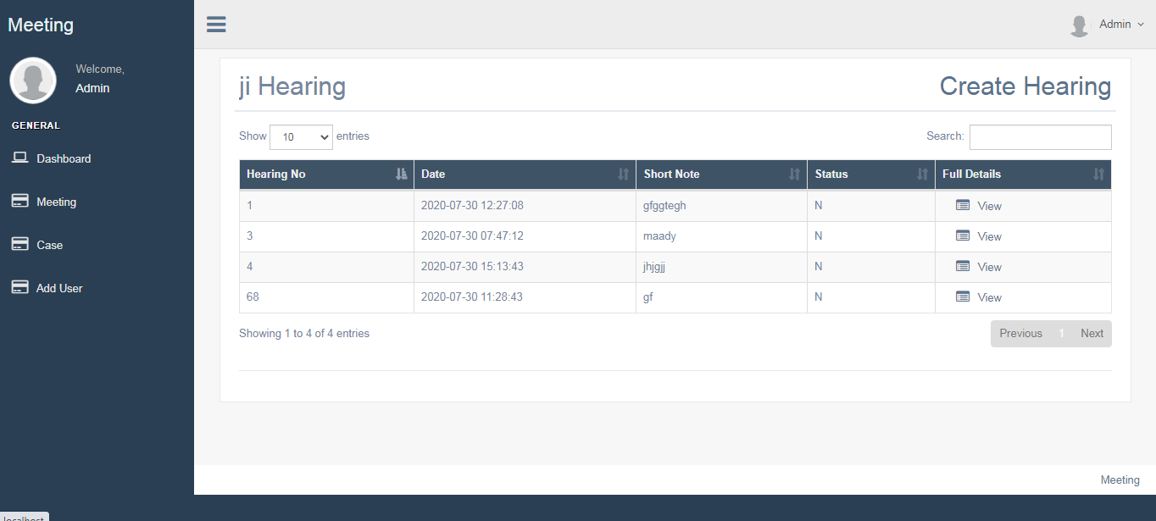
HEARING DETAILS

Slide 11

OTHER USERS
The Users are allowed to view the Case assigned to them.
Attend the meeting through Sharable link.
Other Users(Lawyers, Government Lawyers, Police, Victim etc.,)
Upload the files related to their case.

Slide 12
JITSI
API
START TIME
END TIME
NO.OF.PARTICIPANTS
DURATION
DEVICE SESSION ID
PARTICIPANTS NAME
MEETING NAME
YOUTUBE STREAMING
DESKTOP SHARING
RAISE YOUR HAND
CHATTING
CONTROLLERS(MUTE,VOLUME CONTROL,SPEAKER STATS)
DATABASE

Slide 13
CREATE/UPDATE/DELETE CASE
CREATE/UPDATE/DELETE HEARING
VIEW CASE DETAILS
ASSIGN MEMBERS
JUDGE
PRINT HEARING
PRINT CASE
VIEW CASE DETAILS
DATABASE
LAWYERS
POLICE OFFICERS
GOVERNMENT LAWYERS
VICTIM
PUBLIC PROSECUTOR
STAFFS

Slide 14
THANK YOU!!

