Slide 1

College of Technology
Silver Oak Collage of Engineering and Technology Bachelor of Technology
Department of Computer Engineering
Crowdfunding
Group Members
Meet Amipara
Meet Gami
Internal Faculty Guide
Prof. Naimish Patel

Slide 2
1. Abstract
Summary of the Project: An overview of the crowdfunding platform developed using React.js for the frontend, Node.js for the backend, and MongoDB as the database. This platform allows users to create campaigns to raise funds and backers to contribute through an integrated Stripe payment system.
Goals: To provide an intuitive and secure platform for campaign creation, management, and funding.
Main Features: User-friendly interfaces for campaign creation and contribution, real-time updates on funding progress, and secure payment processing.

Slide 3
2. Introduction
Purpose: To build a scalable web-based crowdfunding application for raising funds and supporting various projects.
Scope: The application facilitates the creation of campaigns by users, contributions by backers, and detailed tracking of campaign progress.
Motivation: Addressing the limitations of traditional fundraising by offering a digital, accessible, and transparent system.

Slide 4
3. Literature Survey
Study of Current System:
  Existing crowdfunding platforms like Kickstarter and GoFundMe provide a broad range of project fundraising but often have limitations such as high fees and less personalized management.
Problems/Weaknesses/Improvements Needed:
  High platform fees
  Limited control over campaign customizations
  Difficulties with seamless payment integration and updates on fund usage
Features of the Proposed System:
  Simple and intuitive user interface for campaign creation and management.
  Efficient handling of payments using Stripe for secure transactions.
  Real-time updates on fundraising progress.
  Direct contact options between backers and campaign creators for better communication.

Slide 5
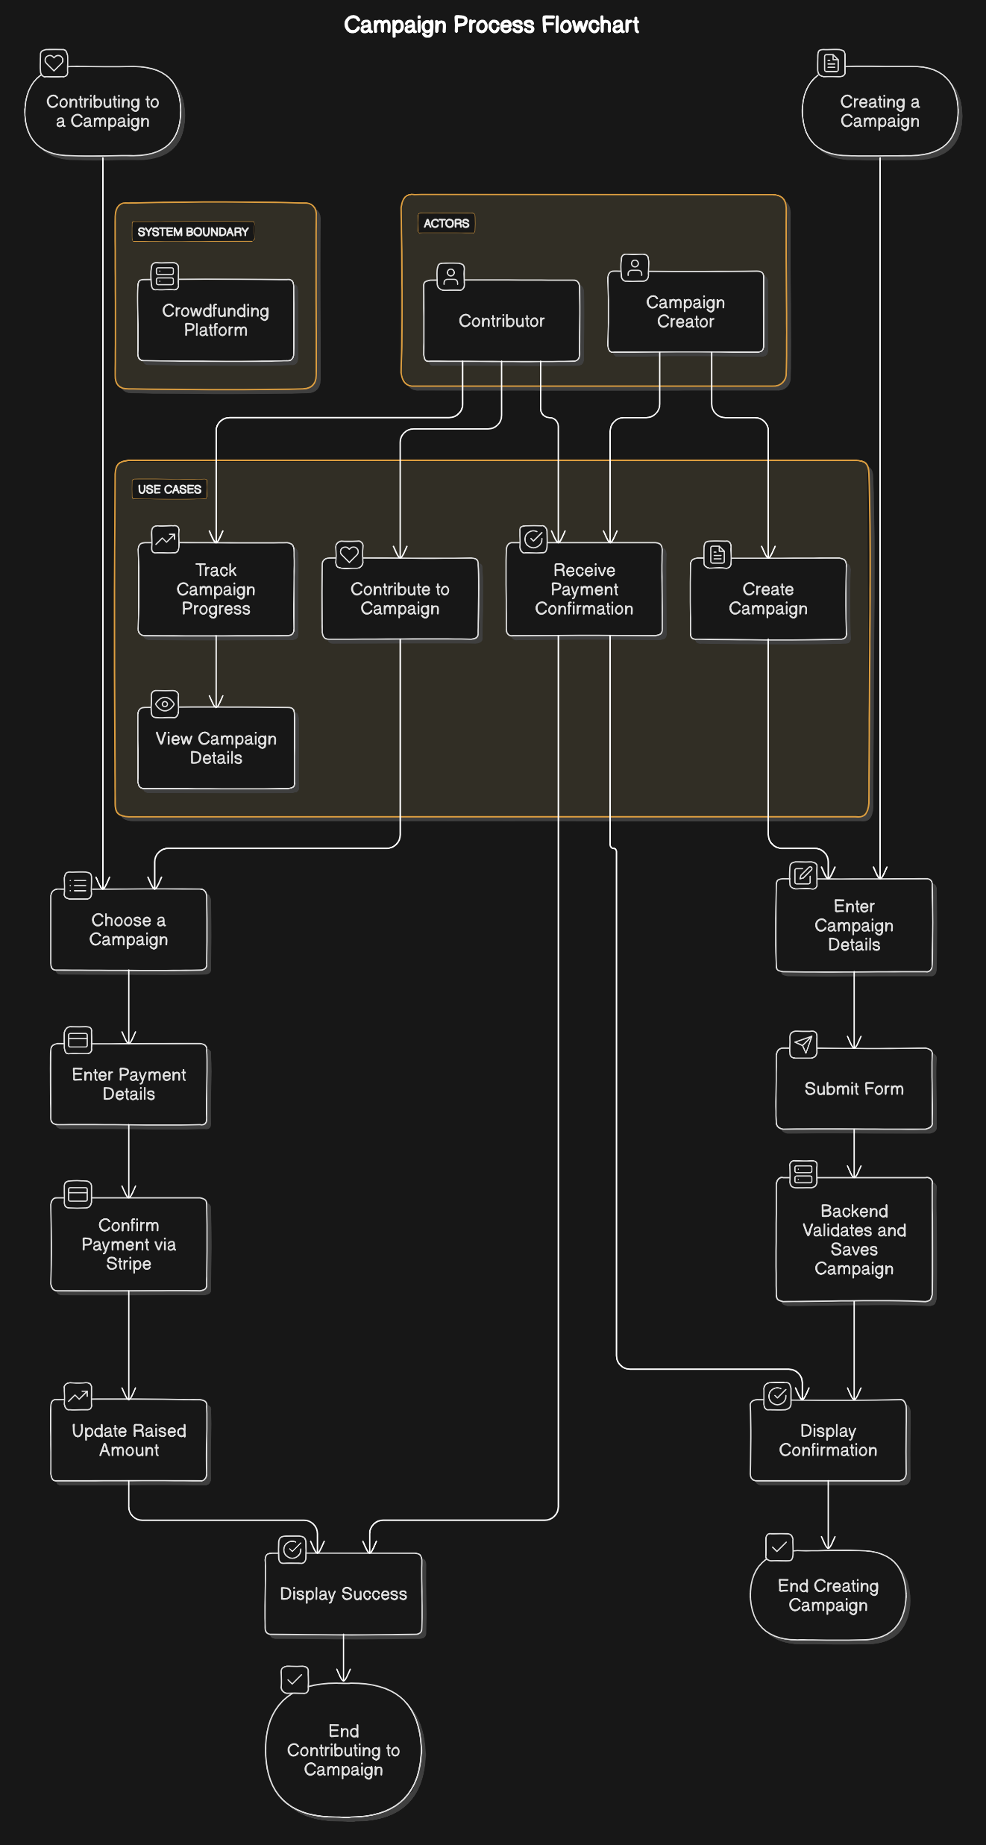
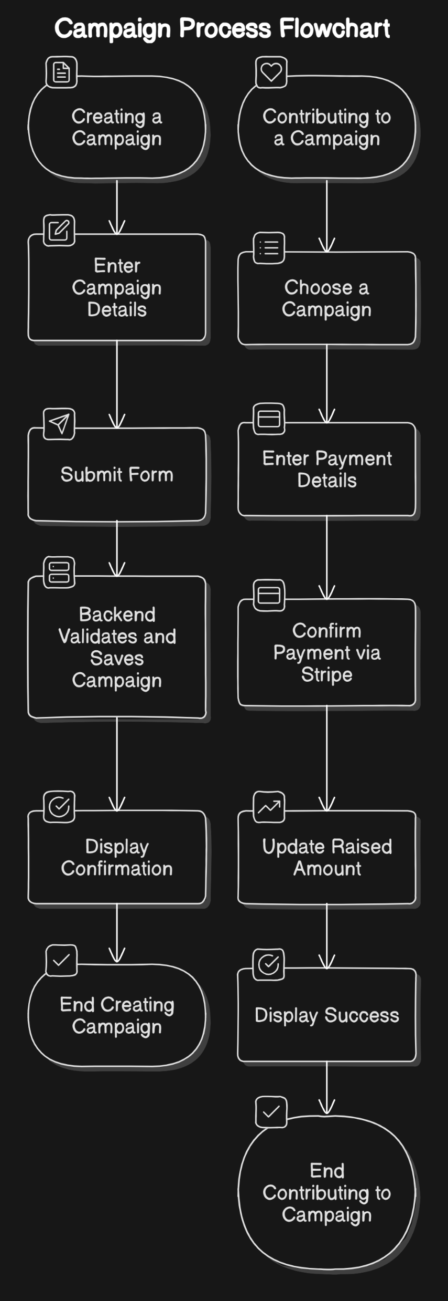
Use Case Diagram
4. Object Oriented Diagram
Activity Diagram

Slide 6
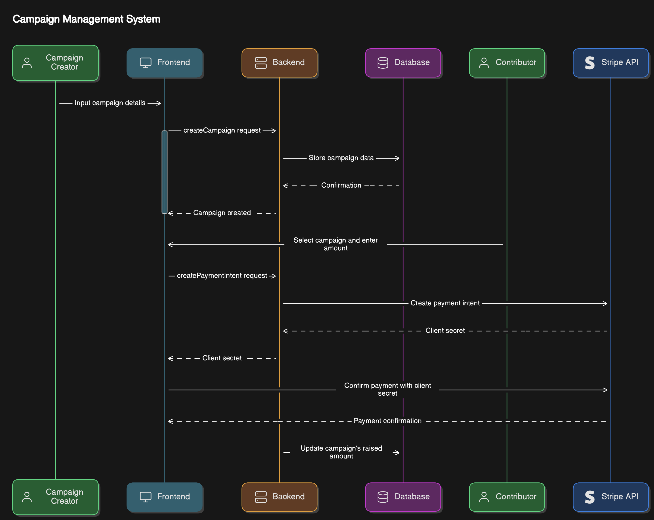
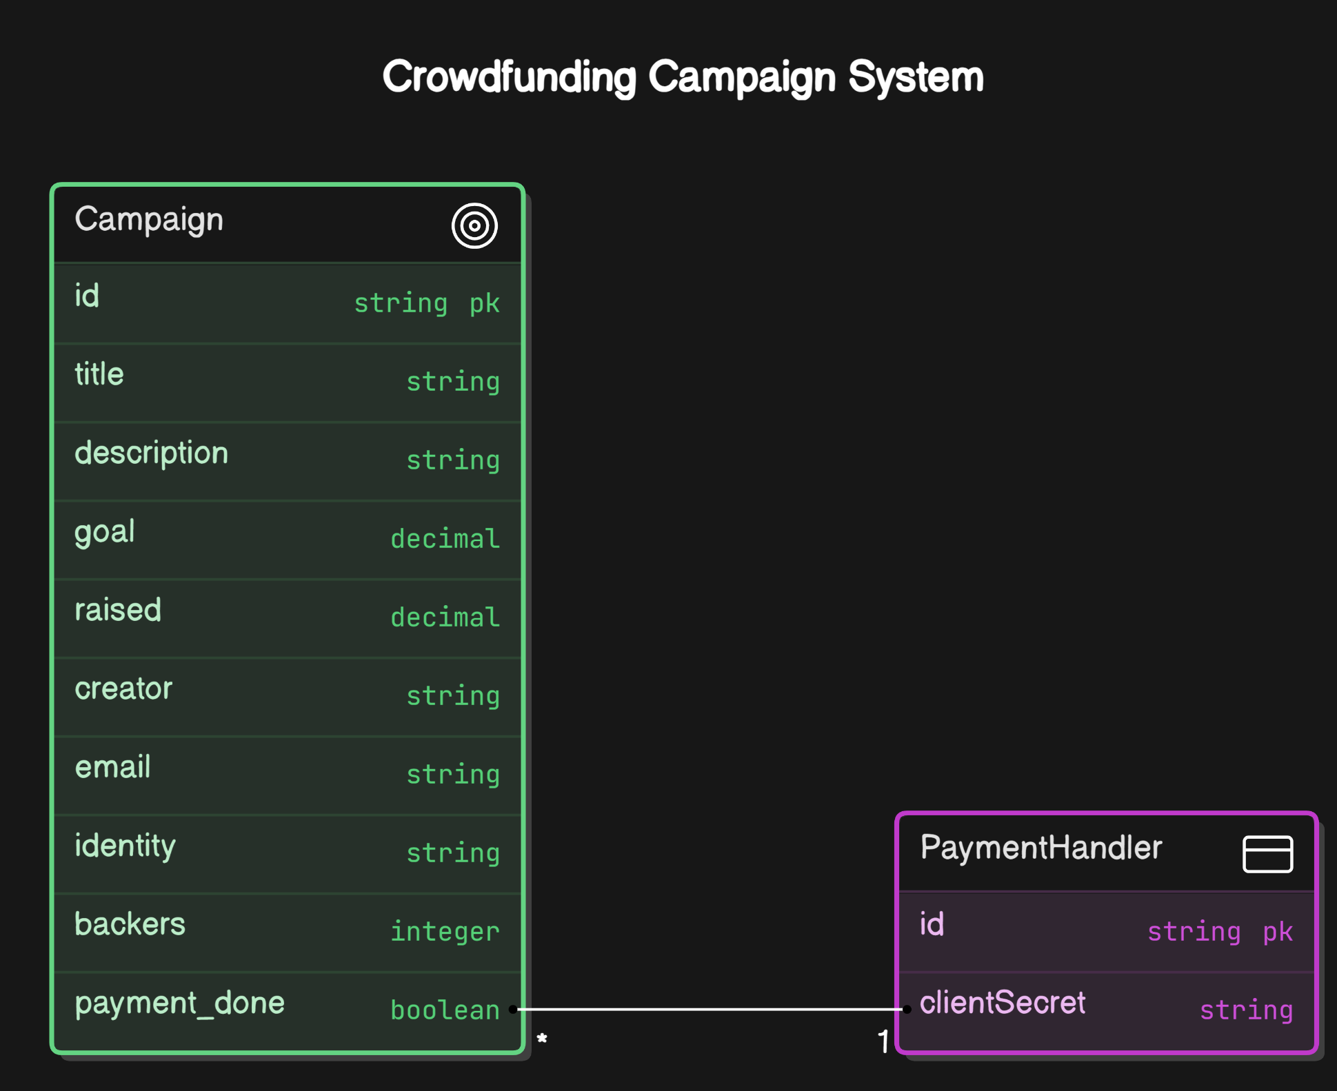
Sequence Diagram
4. Object Oriented Diagram
Class Diagram

Slide 7
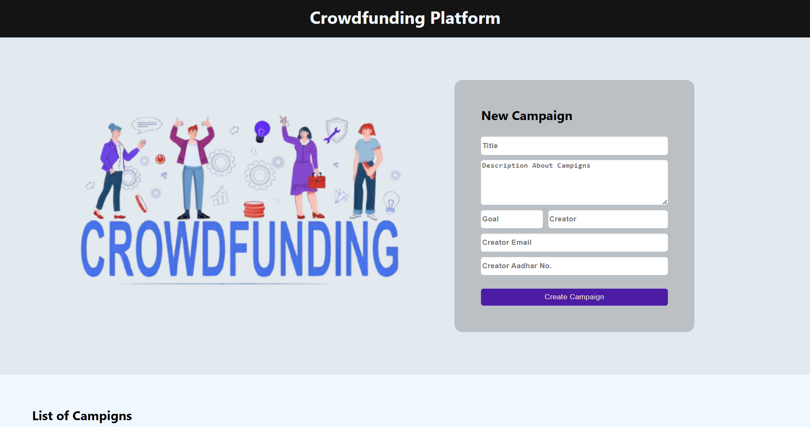
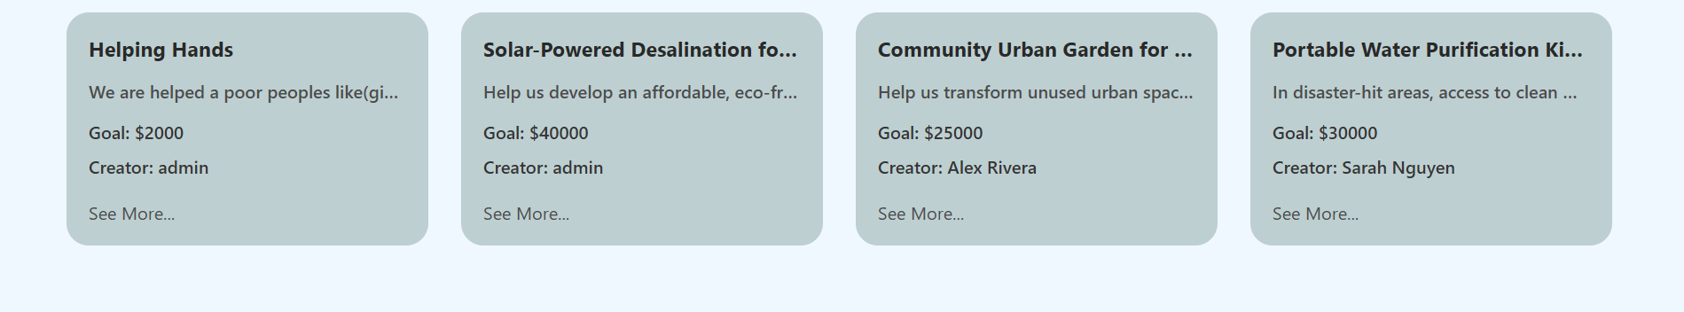
5.Wireframe

Slide 8
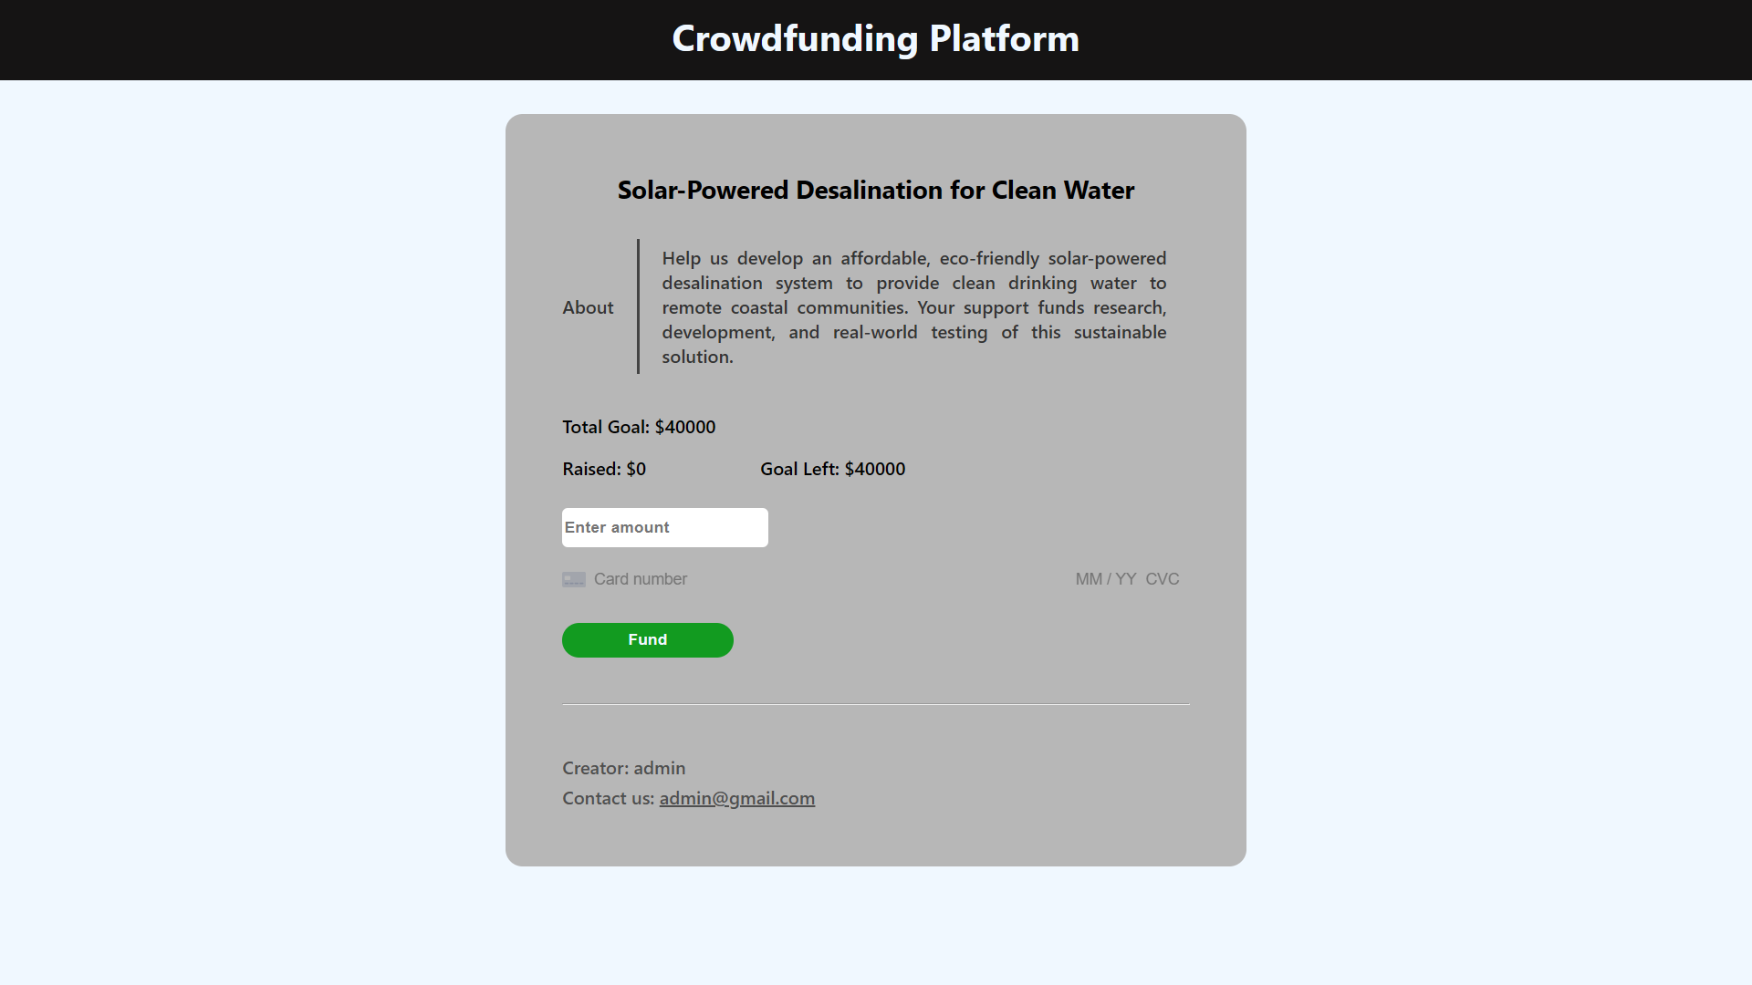
5.Wireframe

Slide 9
6.Tools and technologies used
Frontend: React.js for building user interfaces and handling client-side routing.
Backend: Node.js and Express.js for server-side logic.
Database: MongoDB for data storage and management.
Payment Integration: Stripe for processing secure payments.
Other Tools: Axios for HTTP requests, React Router for routing, and Mongoose for MongoDB object modeling.

Slide 10
7.Work Carried Out Till Date
Frontend Development :
  Developed components for campaign listing, creation, and individual campaign view with payment functionality.
  Integrated Stripe for payment handling.
Backend Development:
  Created RESTful API endpoints for handling campaigns and payment processing.
  Set up MongoDB for data storage with a Campaign model.
Integration:
  Connected the backend API with frontend components for seamless data flow.

Slide 11
8.Timeline Chart(Gantt Chart)
Week 1: Requirement analysis and initial project setup.
Week 2-3: Backend API development.
Week 4-5: Frontend development (core components).
Week 6: Integration of frontend with backend and Final touches, styling, and deployment.

Slide 12
9.Future Work
Advanced Features:
  Adding user authentication for better security.
  Implementing a system for campaign updates by creators.
Optimization:
  Performance enhancements and scalability considerations.

Slide 13
10.Conclusion
Achievements: Successfully built a functional crowdfunding platform with campaign management and payment integration.
Impact: Provides users a reliable and easy-to-use platform for launching and supporting campaigns.
Lesson Learned: Understanding the integration of frontend and backend with payment services and handling real-time data updates.

Slide 14
11.Reference
Documentation and Tutorials:
  Official React.js and Node(Express.js) documentation
  MongoDB and Mongoose documentation
  Stripe API documentation
Research Articles:
  Analysis of current crowdfunding platforms and emerging trends: Crowdfunding and Its Benefits
  Best practices for building scalable full-stack web applications: Full-Stack Development Best Practices

Slide 15
Thank You

