Slide 1
Task Scheduler using Min Heap in C
A Real-Time Task Management System with Auto-Completion

Slide 2
Introduction
A Task Scheduler helps manage and execute tasks efficiently.
This project implements a real-time scheduler that:
Adds and manages tasks.
Automatically completes tasks after a time limit.
Allows updating, canceling, or marking tasks manually.
The scheduling logic is based on a Min Heap data structure.

Slide 3
Objective
1
2
3
Implement an efficient task scheduling system in C.
Handle automatic task completion based on real-time tracking.
Support manual operations like update, cancel, and serve.

Slide 4

Features
task scheduler
Add new tasks with ID, time, and description.
View all tasks with their status (Pending/Completed).
Automatically mark tasks as completed after a time.
Manually mark or cancel tasks.
Update submission time for any existing task.
Menu-driven, real-time console interface.

Slide 5
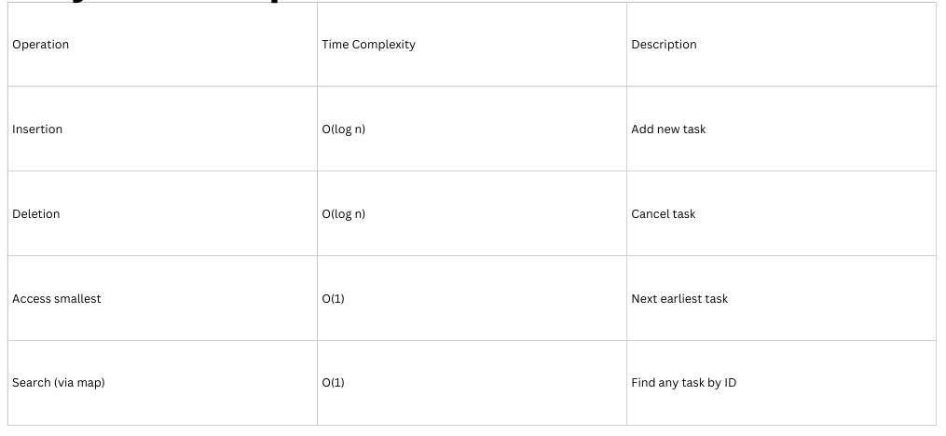
Why Min Heap?
Min Heap ensures tasks are managed in increasing order of submission time.

Slide 6
System Architecture
01
02
02
03
main.c → User interface & menu
scheduler.c → Heap operations & task logic.
scheduler.h → Structure & function declarations.

Slide 7
Data Structures Used
1️⃣ Task Structure
typedef struct {
int taskId;
int submissionTime;
char details[100];
int completed;
time_t startTime;
} Task;
2️⃣ Min Heap Structure
typedef struct {
Task **arr;
int size;
int capacity;
int *indexMap;
} MinHeap

Slide 8
Working Principle
Step 1: Add a task → stored in heap.
Step 2: Timer starts (startTime).
Step 3: Every few seconds, system checks elapsed time.
Step 4: If elapsed ≥ submissionTime → marked Completed.
note : User can also manually complete, update, or cancel tasks.

Slide 9
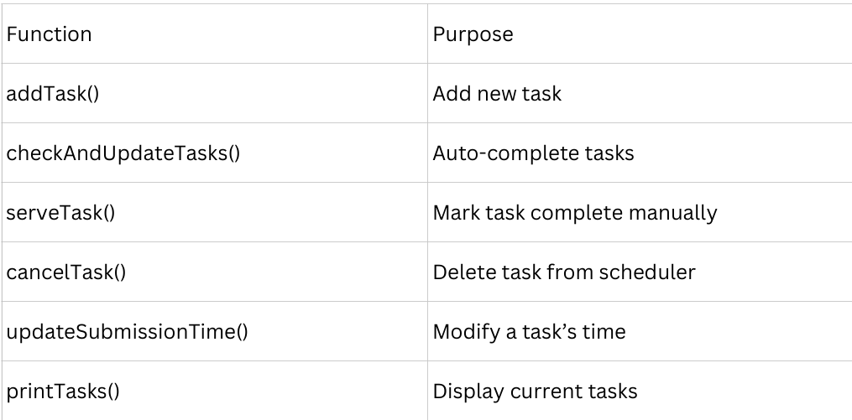
Major Functions

Slide 10

Advantages
Efficient due to Min Heap (logarithmic operations)
Real-time task tracking using time.h
User-friendly interface
Dynamic — supports add/update/delete
Demonstrates modular programming in C

Slide 11
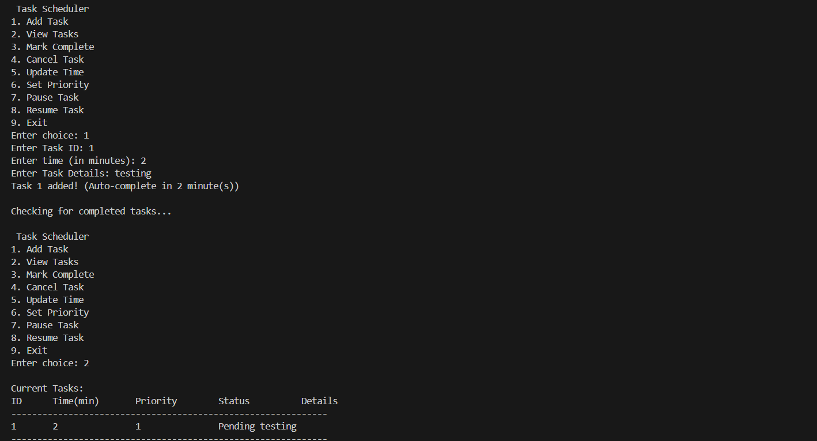
Input/Output screenshots

Slide 12
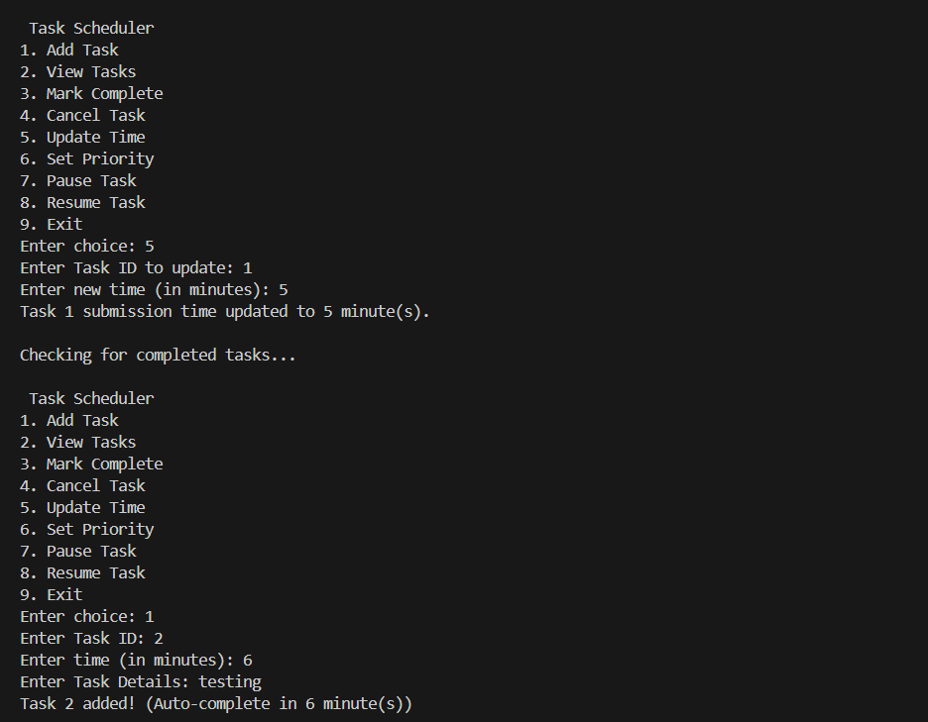
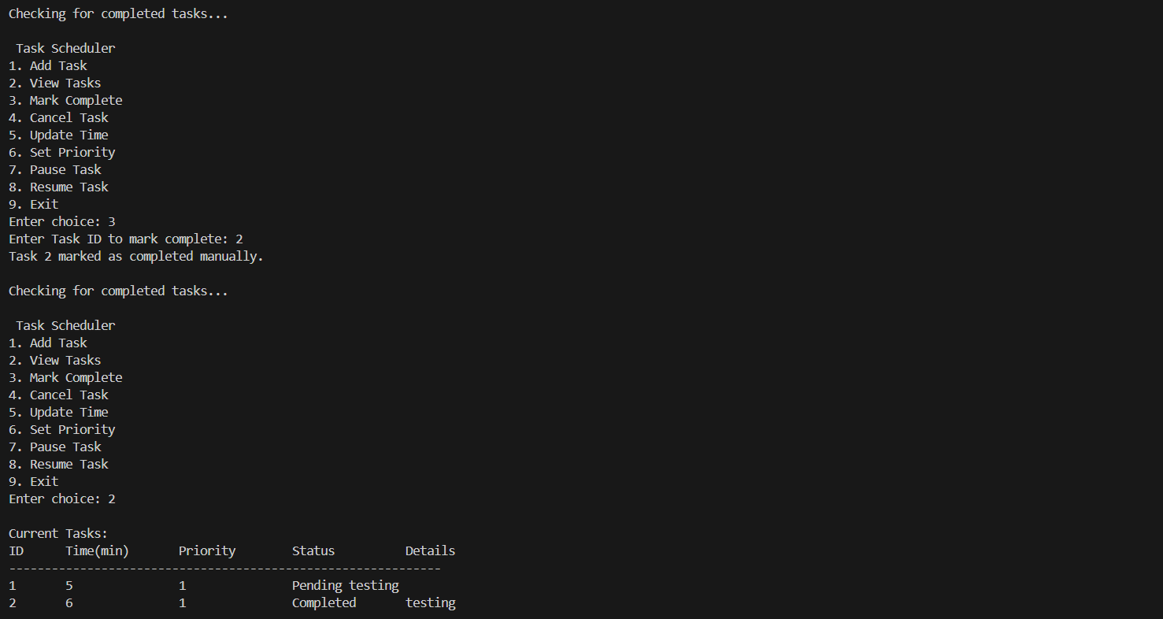

Slide 13
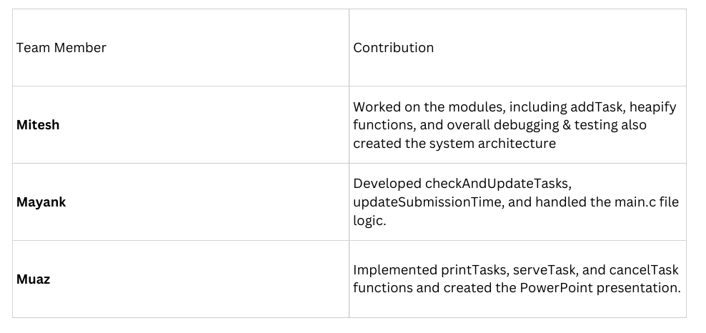
Division of Work

Slide 14
Conclusion
01
The project successfully demonstrates:
03
Real-time scheduling
04
Heap-based task management
05
Efficient time-based automation
06
Provides a strong foundation for more complex schedulers or OS-level task systems.

