Slide 1

Attribute-based encryption (ABE)
Dr. Youcef Imine(youcef.imine@uphf.fr)

Slide 2
Plan
Introduction
Attribute based encryption scheme
Architecture
Main idea
Security requirements
Background
Key-Policy Attribute-Based Encryption
Goyal et al. KP-ABE scheme
Ciphertext-Policy Attribute-Based Encryption
Bethencourt et al. CP-ABE scheme
Decentralized Attribute-Based Encryption
Lewko et al. scheme
Conclusion

Slide 3
Introduction

Slide 4
History
The concept of attribute-based encryption was first proposed by Amit Sahai and Brent Waters. [Sahai, Amit, and Brent Waters. "Fuzzy identity-based encryption." Annual international conference on the theory and applications of cryptographic techniques. Springer, Berlin, Heidelberg, 2005.]
This concept allows to deploy a cryptosystem for fine-grained sharing of encrypted data.
Later by Vipul Goyal, Omkant Pandey, Amit Sahai, Brent Waters and John Bethencourt have proposed two different versions of attribute based encryption schemes. [Goyal, Vipul, et al. "Attribute-based encryption for fine-grained access control of encrypted data." Proceedings of the 13th ACM conference on Computer and communications security. 2006.] [Bethencourt, John, Amit Sahai, and Brent Waters. "Ciphertext-policy attribute-based encryption." 2007 IEEE symposium on security and privacy (SP'07). IEEE, 2007.]
Both versions allow to define access policies during the encryption.
After that, several researchers have further proposed attribute-based encryption with multiple authorities who jointly generate users' private keys.

Slide 5
Attribute-based Encryption
Attribute-based encryption (ABE) is a public-key cryptographic method in which the users’ keys and the ciphertext depend on attributes.
In ABE system, we usually consider the following architecture:
The authority is the entity responsible for security management in an attribute-based security scheme. It is responsible for the configuration of security parameters, the attributes used in its context and the generation keys for cryptographic operations.
The users share data in the architecture. They can be either data owners or simple users in this system. If a user is a data owner, he is responsible for data encryption under a set of attributes. On the other hand, a simple user needs to perform a data decryption for each data access event.
Storage server mainly responsible for storage of encrypted data as well as answering data access requests coming from users

Slide 6
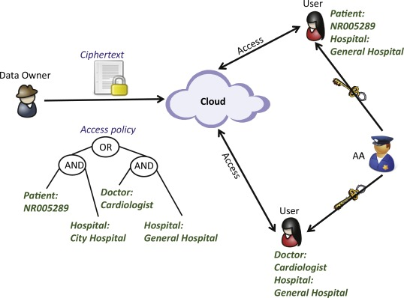
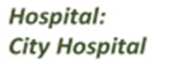




Illustrative example of ABE scheme
User 2
Attributes
Storage server
User 1
Hospital Authority
Doctor:
General practitioner
Hospital:
City Hospital
Access

Slide 7
Security requirements
Confidentiality: only users in possession of attributes satisfying the access policy can decrypt data.
Forward secrecy: any user who drops an attribute should be prevented from accessing the plaintext of the subsequent data exchanged after he loses the attribute, unless the other valid attributes that he is holding satisfy the access policy.
Backward secrecy: any user who comes to hold an attribute, (that satisfies the access policy), should be prevented from accessing the plaintext of the data exchanged before he holds the attribute.
Collusion resistance: no group of users should be able to combine their keys in such a way that they can decrypt a ciphertext that none of them alone could.

Slide 8
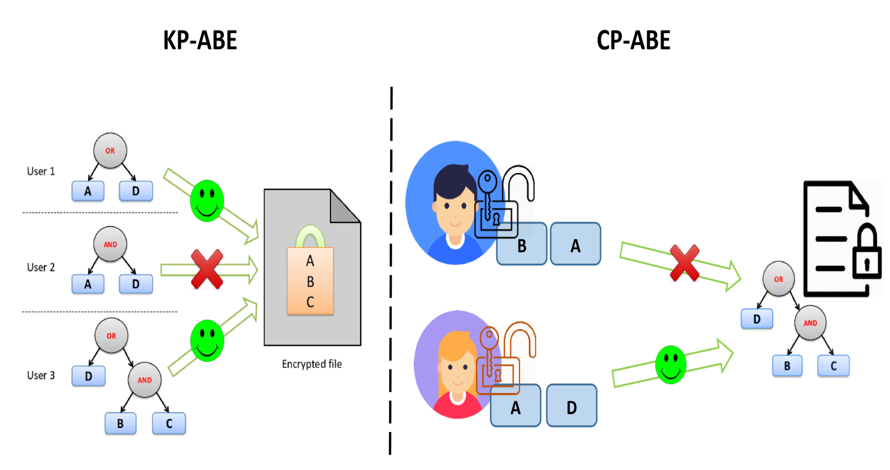
Attribute-Based encryption
In Attribute-based encryption systems, we find two main approaches:
Key-policy attribute based encryption (KP-ABE)
Ciphertext-policy attribute based encryption (CP-ABE).
KP-ABE and CP-ABE have initially been proposed in a centralized architecture. However CP-ABE has been extended to a decentralized architecture.

Slide 9

Background
Bilinear map:
Let $G_{0}$and $G_{1}$ be two multiplicative cyclic groups of prime order $p$.
Let $g$ be a generator of $G_{0}$ and $e′$ be a bilinear map, $e′:G_{0}×G_{0}→G_{1}$
The bilinear map $e′$ has the following properties:
Bi-linearity: for all $u,v∈G_{0}$ and $a,b∈Z_{p}$, we have: $e^{′}\left(u^{a},v^{b}\right)=e^{′}{\left(u,v\right)}^{ab}$
Non-degeneracy: $e^{′}\left(u,v \right)≠1$
Discrete logarithm problem (DL):
Let $G$ be a cyclic group of prime order $p$ and $g$ a generator of $G,$ given $g$and $g^{a}∈G,$ find $a ∈Z_{p}$
Computational Diffie-Helman problem
Given $g,g^{a},g^{b}$compute $g^{ab}$
Decisional Diffie-Helman problem
Given $g,g^{a},g^{b},g^{c}$ decide whether $ab=c$

Slide 10
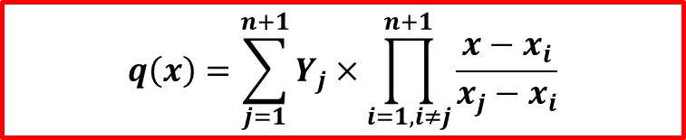
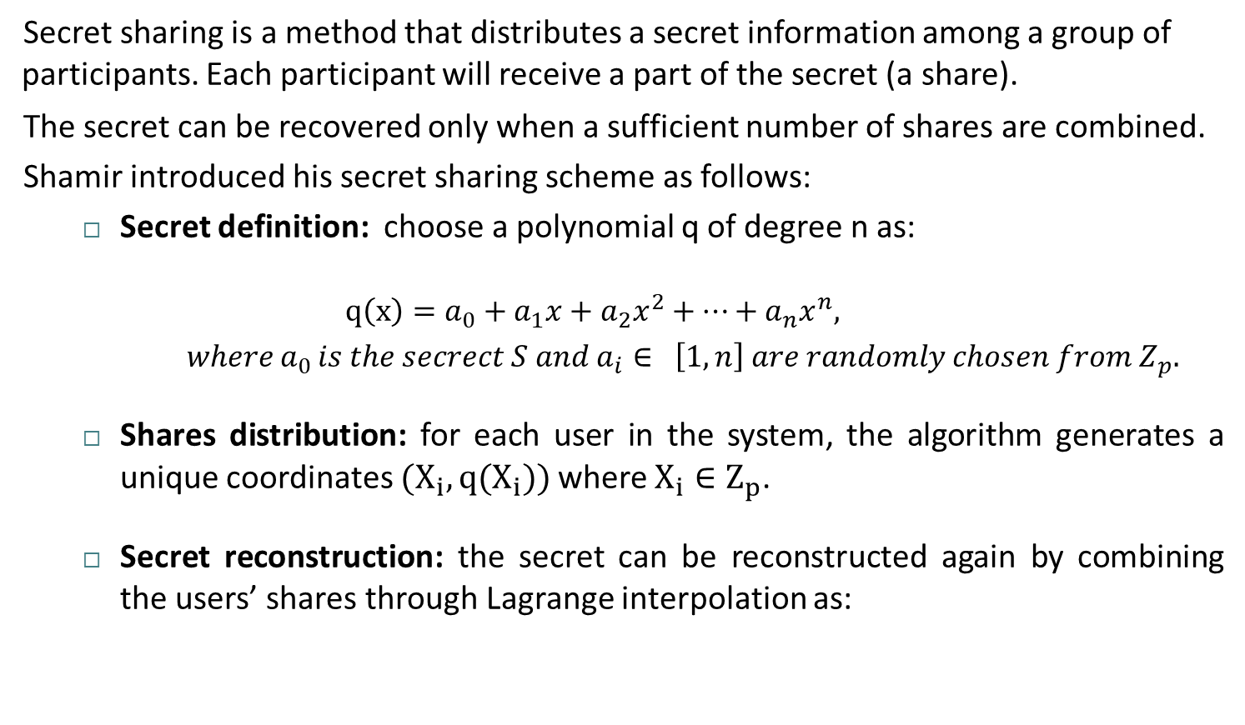
Background (Shamir’s secret sharing)
Secret sharing is a method that distributes a secret information among a group of participants. Each participant will receive a part of the secret (a share).
The secret can be recovered only when a sufficient number of shares are combined.
Shamir introduced his secret sharing scheme as follows:
Secret definition: choose a polynomial q of degree n as:
$$q\left(x\right)=a_{0}+a_{1}x+a_{2}x^{2}+…+a_{n}x^{n},$$
$where{ a}_{0 }is the secrect S and a_{i}∈ \left[1,n\right] are randomly chosen from Z_{p}.$
Shares distribution: for each user in the system, the algorithm generates a unique coordinates ${(X}_{i},q(X_{i}))$where $X_{i}∈Z_{p}$.
Secret reconstruction: the secret can be reconstructed again by combining the users’ shares through Lagrange interpolation as:
$$q\left(x\right)=\sum_{j=1}^{n+1}{Y_{j}×\prod_{i=1, i≠j}^{n+1}{\frac{x−x_{i}}{x_{j}−x_{i}}}}$$

Slide 11
Key-Policy Attribute-based encryption
(KP-ABE)

Slide 12
KP-ABE
Key-Policy Attribute based encryption (KP-ABE) is a cryptosystem for fine-grained sharing of encrypted data.
KP-ABE has been proposed in 2006 by Goyal et al. [Goyal, Vipul, et al. "Attribute-based encryption for fine-grained access control of encrypted data." Proceedings of the 13th ACM conference on Computer and communications security. 2006.’]
In KP-ABE we have:
Ciphertexts that are labeled with sets of attributes,
A Boolean formula called Access structure defines which attributes are granted to access to resources,
Private keys that are associated with the access structure that controls which ciphertexts a user is able to decrypt.

Slide 13

KP-ABE
Key-Policy Attribute based encryption (KP-ABE) consists of four algorithms:
$Setup\left(λ, A\right)→(Pub, MSK)$: this algorithm takes as input a security parameter $λ$ as well as a set of attributes $A=\left\{A_{1},A_{2},…,A_{n}\right\}$. It outputs the public parameters $(Pub)$ and the master secret key $(MSK)$
$KeyGen\left(MSK,AP\right)→SK:$ this algorithm takes as input the master secret key as well as an access policy $(AP)$ and outputs the decryption key $(SK)$
$Encrypt\left(Pub, Attributes, M\right)→CT$: this algorithm takes as input the public parameters, a set of attributes (that will associated to the ciphertext) and a message to encrypt. It outputs a ciphertext
$Decrypt\left(SK, CT\right)→M:$ this algorithm takes as input a secret key and a ciphertext $CT$. It outputs the message $M$if the attributes associated with $CT$ satisfy the access policy defined in $SK$.

Slide 14

KP-ABE (security model)
KP-ABE considers the Selective-Set model of security, expressed through the following security game:
$Init:$ the adversary declares the set of attributes $Att$, that he wishes to be challenged upon
$Setup:$ the challenger runs the Setup algorithm of KP-ABE and provides the public parameters to the adversary
$Phase 1:$ the adversary is allowed to issue queries for private keys for many access structures $AP_{j}$, where $∀ j, Att∉AP_{j}$
$Challenge:$
The adversary submits two equal length messages $M_{0}$ and $M_{1},$
The challenger flips a random coin $b$, and encrypts $M_{b}$ with $Att,$
Finally, the ciphertext is passed to the adversary.
$Phase 2:$ repeat phase 1
$Guess:$ the adversary outputs a guess $b′$ of $b$

Slide 15

KP-ABE (access structure definition)
Let $T$ a tree representing an access policy $AP$. $T$ contains:
Non-leaf nodes: represented as a threshold gate and described by its children as well as a threshold value.
Let $num_{x}$ be the number of children of a non-leaf node $x$ and $k_{x}$ is its threshold value, we have:
$0 <k_{x}≤ num_{x}$
If $k_{x} = 1$, the threshold gate is an $OR$ gate
if$k_{x} = num_{x}$the threshold gate is an $AND$ gate.
Leaf nodes: each leaf node $x$ of the tree is described by an attribute and a threshold value $k_{x}=1$
we also define a set of functions used to manipulate $T:$
$parent\left(x\right):$ returns the parent a node $x$ in $T$
$index(x)$: returns a number associated with a node $x$
$attr(x)$: defined only if $x$ is a leaf node and returns the attribute associated to $x$
$threshold\left(x\right):$ returns the threshold value associated with node $x$

Slide 16
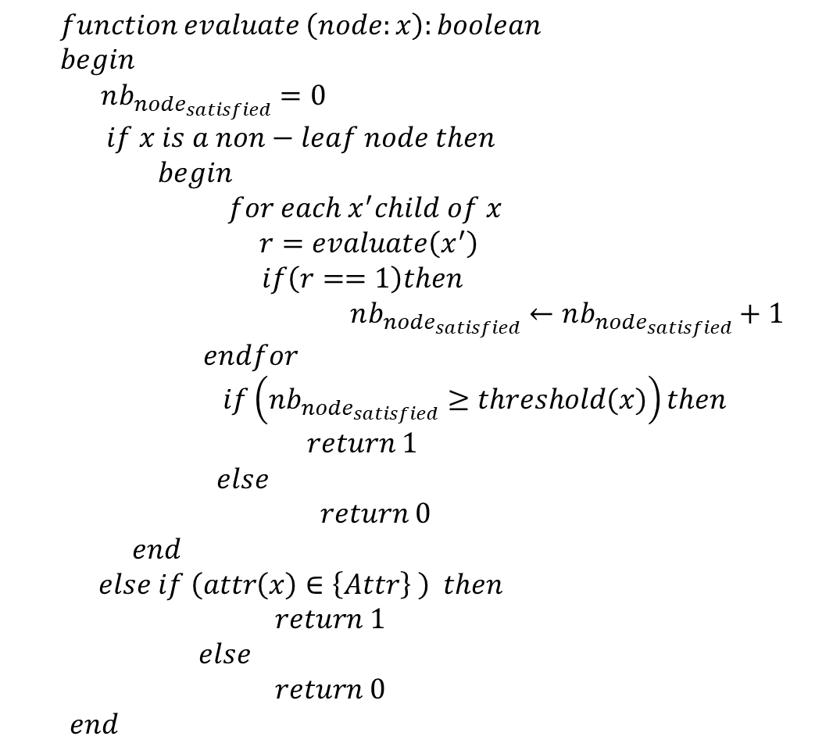
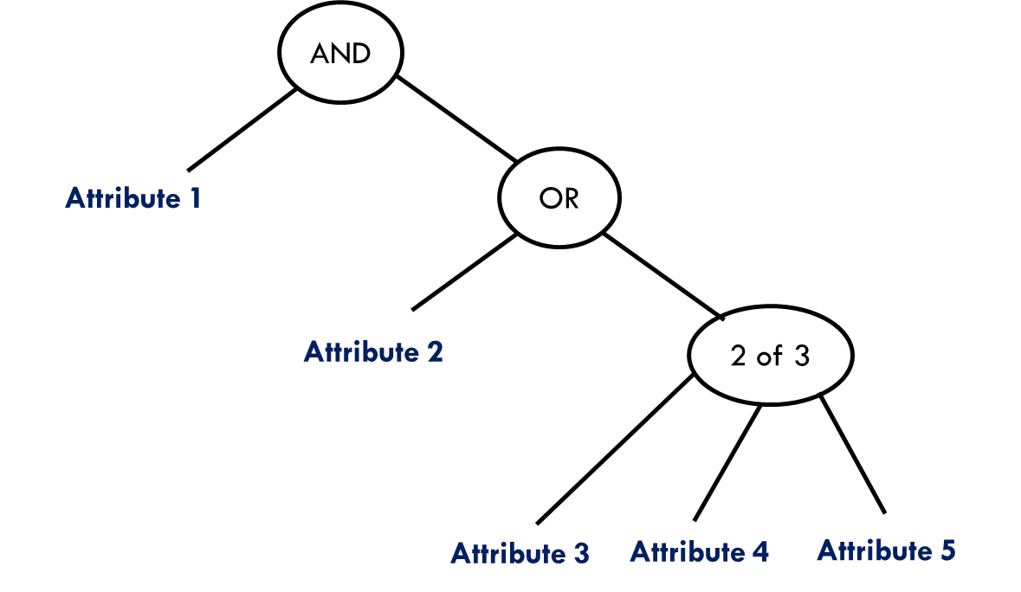
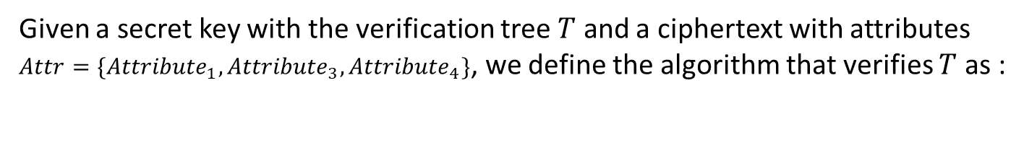

KP-ABE (access structure definition)
Given a secret key with the verification tree $T$ and a ciphertext with attributes
$Attr=\{{Attribute}_{1},{Attribute}_{3},{Attribute}_{4}\}$, we define the algorithm that verifies $T$ as :
R
N1
N2
$$Evaluate\left(R\right)$$
$evaluate\left(N1\right)$
$return 1$
$evaluate \left(N2\right)$
$evaluate\left(N3\right)$
$return 0$
$evaluate \left(N4\right)$
$evaluate \left(N5\right)$
$return 1$
$evaluate \left(N6\right)$
$return 1$
$evaluate\left(N7\right)$
$return 0$
$nb_{node_{satisfied}}=2≥threshold \left(N4\right)$
$retrun 1$
$nb_{node_{satisfied}}=1≥threshold\left(N2\right)$
$return 1$
$nb_{node_{satisfied}}=2≥threshold\left(R\right)$
$return 1$
N4
N3
N5
N6
N7

Slide 17

Goyal et al. KP-ABE scheme
$Setup\left(λ, A\right)→(Pub, MSK)$ :
Let $G_{1}$ be a bilinear group of prime order $p$, and $g$ the generator of $G_{1}$
Let $e:G_{1}×G_{1}→G_{2}$ be a bilinear map
Let $λ$ be a security parameter
Define a set of all attributes used in the system as $A=\left\{A_{1},A_{2},…,A_{n}\right\}$, where $n=|A|$
For each attribute $A_{i}∈A$ choose a random number $t_{i}∈Z_{p}^{∗}$
Choose a random number $y∈Z_{p}^{∗}$
The master key $MSK$ is:
$$MSK=(t_{1},…,t_{n},y)$$
Compute the public parameters $Pub$ as:
$Pub=(T_{1}=g^{t_{1}},…,T_{n}=g^{t_{n}}, Y=e{\left(g,g\right)}^{y})$

Slide 18

Goyal et al. KP-ABE scheme
$KeyGen\left(MSK,AP\right)→SK$:
Choose a polynomial $q_{x}$ for each node $x$ in $AP$ (including the leaves). These polynomials are chosen starting from the root node $r$.
For each node $x$ in $AP$ set $d_{x}=k_{x}−1$, where $k_{x}$ is the threshold value of node $x$
For the root node r set:
$q_{r}(0) = y$ and $d_{r}$ other points of the polynomial $q_{r}$ are randomly chosen to define it completely.
For any other node $x$ in $AP:$
set $q_{x}\left(0\right) = q_{parent}(x)(index(x))$ and choose $d_{x}$ other points randomly to completely define $q_{x}$
Once the polynomials have been defined, for each leaf node x, set the secret value:
$D_{x} = g^{\frac{q_{x}\left(0\right)}{t_{i}}}$, where $i =attr(x)$
Set the decryption key $SK$ as:
$SK=\left\{D_{x}\right\},$ where $x∈AP$

Slide 19

Goyal et al. KP-ABE scheme
$Encrypt\left(Pub, Attributes, M\right)→CT$:
Given the public parameters
$$Pub=(T_{1}=g^{t_{1}},…,T_{n}=g^{t_{n}}, Y=e{\left(g,g\right)}^{y})$$
Let $M∈G_{2}$ be the message to encrypt
Choose a random value $s∈Z_{p}^{∗}$
Compute the ciphertext as:
$CT=\left(Attributes, C^{′}=MY^{s},{\{C}_{i}^{′}=T_{i}^{s}\right\},$ where $i∈Attributes)$

Slide 20
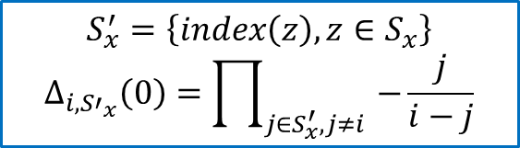
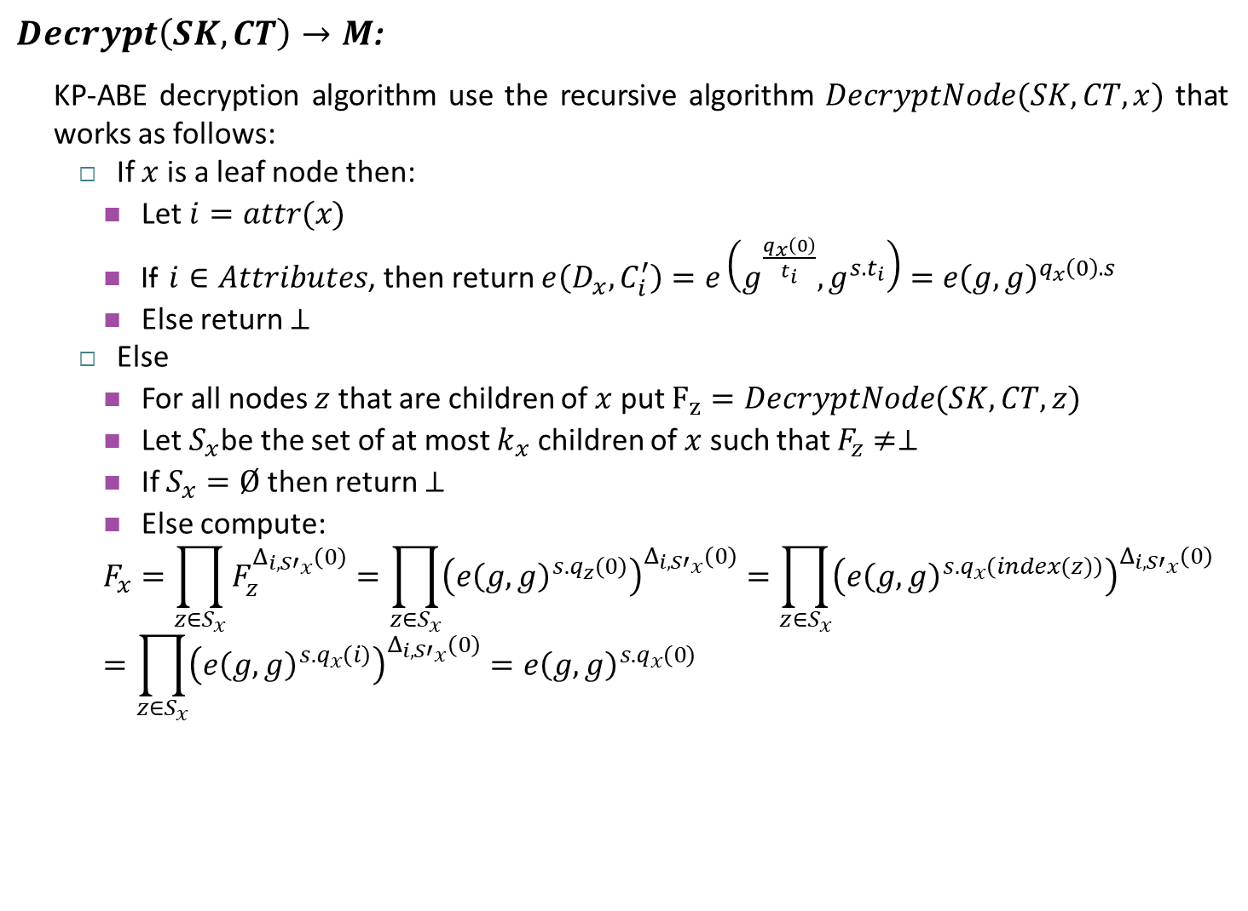
Goyal et al. KP-ABE scheme
$Decrypt\left(SK, CT\right)→M$:
KP-ABE decryption algorithm use the recursive algorithm $DecryptNode(SK,CT,x)$ that works as follows:
If $x$ is a leaf node then:
Let $i=attr(x)$
If $i∈Attributes$, then return $e\left(D_{x},C_{i}^{′}\right)=e\left(g^{\frac{q_{x}\left(0\right)}{t_{i}}},g^{s.t_{i}}\right)=e{\left(g,g\right)}^{q_{x}\left(0\right).s}$
Else return $⊥$
Else
For all nodes $z$ that are children of $x$ put $F_{z}=DecryptNode(SK,CT,z)$
Let $S_{x}$be the set of at most $k_{x}$ children of $x$ such that $F_{z}≠⊥$
If $S_{x}=Ø$ then return $⊥$
Else compute:
$$F_{x}=\prod_{z∈S_{x}}{F_{z}^{Δ_{i,{S′}_{x}}\left(0\right)}}=\prod_{z∈S_{x}}{{\left(e{\left(g,g\right)}^{s.q_{z}\left(0\right)}\right)}^{Δ_{i,{S′}_{x}}\left(0\right)}}=\prod_{z∈S_{x}}{{\left(e{\left(g,g\right)}^{s.q_{x}\left(index(z)\right)}\right)}^{Δ_{i,{S′}_{x}}\left(0\right)}}=\prod_{z∈S_{x}}{{\left(e{\left(g,g\right)}^{s.q_{x}\left(i\right)}\right)}^{Δ_{i{,S′}_{x}}\left(0\right)}}=e{\left(g,g\right)}^{s.q_{x}\left(0\right)}$$
$$S_{x}^{′}=\left\{index\left(z\right), z∈S_{x}\right\}$$
$$Δ_{i{,S′}_{x}}\left(0\right)=\prod_{j∈S_{x}^{′},j≠i }{−\frac{j}{i−j}}$$

Slide 21
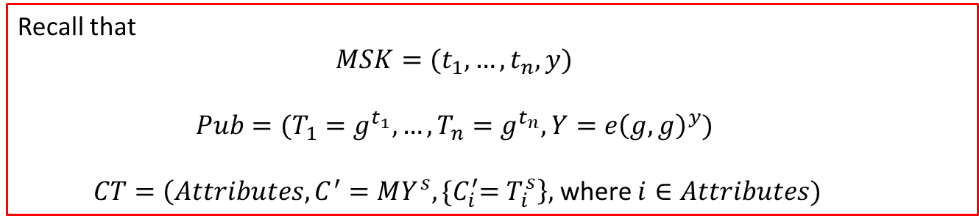

Goyal et al. KP-ABE scheme
$Decrypt\left(SK, CT\right)→M$:
The get the Message $M$, we need to call $DecryptNode(SK,CT,r)$, where $r$ is the root of the access policy.
If the attributes in $CT$ satisfies the access policy, we will have:
$$DecryptNode\left(SK,CT,r\right)=e{\left(g,g\right)}^{s.q_{r}\left(0\right)}=e{\left(g,g\right)}^{s.y}=Y^{s}$$
Therefore $M=\frac{C^{′}}{Y^{s}}$
Recall that
$$MSK=(t_{1},…,t_{n},y)$$
$$Pub=(T_{1}=g^{t_{1}},…,T_{n}=g^{t_{n}}, Y=e{\left(g,g\right)}^{y})$$
$CT=\left(Attributes, C^{′}=MY^{s},{\{C}_{i}^{′}=T_{i}^{s}\right\},$ where $i∈Attributes)$

Slide 22
Ciphertext-Policy Attribute-based encryption
(CP-ABE)

Slide 23
CP-ABE
Ciphertext-Policy Attribute based encryption (CP-ABE) is another cryptosystem for fine-grained sharing of encrypted data.
CP-ABE has been proposed in 2007 by Bethencourt et al. [Bethencourt, John, Amit Sahai, and Brent Waters. "Ciphertext-policy attribute-based encryption." 2007 IEEE symposium on security and privacy (SP'07). IEEE, 2007.]
In CP-ABE we have:
Decryption keys are labeled with sets of attributes,
A Boolean formula called Access structure defines which attributes are granted to access to resources,
The ciphertext is associated with the access structures that control which private key is able to decrypt it.

Slide 24

CP-ABE
Ciphertext-Policy Attribute based encryption (CP-ABE) consists of five algorithms:
$Setup()→(PK, MK)$: this algorithm takes no input. It outputs the public parameters $(PK)$ and the master secret key $(MK)$.
$KeyGen\left(MK,S\right)→SK:$ this algorithm takes as input the master secret key as well as a set of attributes $(S)$ and outputs the decryption key $(SK)$.
$Encrypt\left(PK, A, M\right)→CT$: this algorithm takes as input the public parameters, an access policy $A$ and a message to encrypt. It outputs a ciphertext $CT$ that only a decryption key associated with a set of attributes satisfying $A$ can retrieve.
$Decrypt\left(PK,SK, CT\right)→M:$ this algorithm takes as input the public parameters $PK$, a secret key and a ciphertext $CT$. It outputs the message $M$if the attributes associated with $SK$ satisfy the access policy defined in $CT$.
$Delegate\left(SK, S′\right)→SK′:$ The delegate algorithm takes as input a secret key SK for some set of attributes $S′⊆S$. It output a secret key $SK′$ for the set of attributes$S′$.

Slide 25

CP-ABE (security model)
CP-ABE considers a model of security, expressed through the following security game:
$Setup:$ the challenger runs the Setup algorithm of CP-ABE and provides the public parameters $PK$ to the adversary
$Phase 1:$ the adversary makes repeated queries to ask for private keys for different set of attributes $S_{1},…,S_{q}$
$Challenge:$
The adversary submits two equal length messages $M_{0}$ and $M_{1},$ and a challenge access policy $A$ (with the condition that no $S_{i},i∈[1,q]$ satisfies $A$)
The challenger flips a random coin $b$, and encrypts $M_{b}$ under $A,$
Finally, the ciphertext is passed to the adversary.
$Phase 2:$ repeat phase 1
$Guess:$ the adversary outputs a guess $b′$ of $b$

Slide 26

Bethencourt et al. CP-ABE scheme
$Setup()→(PK, MK)$ :
Let $G_{1}$ be a bilinear group of prime order $p$, and $g$ the generator of $G_{1}$
Let $e:G_{1}×G_{1}→G_{2}$ be a bilinear map
Let $λ$ be a parameter that determines the size of the groups
Let $H:{\left\{0,1\right\}}^{∗}→G_{1}$ be a hash function that maps any attribute described as a binary string to an element in the group $G_{1}$
Choose two random values $α,β∈Z_{p}^{∗}$
The master key $MK$ is:
$$MK=(β,g^{α})$$
Set the public parameters $PK$ as:
$PK=(G_{1},g,h=g^{β},f=g^{\frac{1}{β}}, e{\left(g,g\right)}^{α})$

Slide 27

Bethencourt et al. CP-ABE scheme
$KeyGen\left(MK,S\right)→SK$:
Choose a random $r∈Z_{p}^{∗}$
For each node $j$ in $S$ choose a random $r_{j}∈Z_{p}^{∗}$
Compute the secret key as:
$$SK=(D=g^{\frac{α+r}{β}}, ∀ j∈S:D_{j}=g^{r}.H{\left(j\right)}^{r_{j}},D_{j}^{′}=g^{r_{j}})$$
$$Delegate\left(SK, S′\right)→SK′:$$
Given $S′⊆S$, choose random values $r′$and $r_{k}^{′} ∀k∈S′$.
Compute a new secret key as :
$$SK^{′}=(D^{\text{\sim }}=D.f^{r^{′}}, ∀ k∈S^{′}:D_{k}^{\text{\sim }}=D_{k}.g^{r^{′}}.H{\left(k\right)}^{r_{k}^{′}},{D_{k}^{\text{\sim }}}^{′}=D_{k}^{′}.g^{r_{k}^{′}})$$

Slide 28

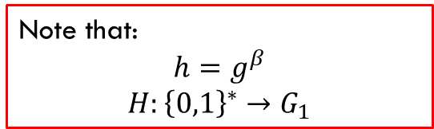
Bethencourt et al. CP-ABE scheme
$$Encrypt\left(PK, A, M\right)→CT:$$
Choose a polynomial $q_{x}$ for each node $x$ in $A$ (including the leaves). These polynomials are chosen starting from the root node $r$.
For each node $x$ in $A$ set $d_{x}=k_{x}−1$, where $k_{x}$ is the threshold value of node $x$
For the root node r:
Choose a random value $s∈Z_{p}^{∗}$
Set $q_{r}(0) =s$ and choose $d_{r}$ other random points for the polynomial $q_{r}$ to define it completely.
For any other node $x$ in $A:$
set $q_{x}\left(0\right) = q_{parent}(x)(index(x))$ and choose $d_{x}$ other random points to completely define $q_{x}$
Let $Y$ be the set of leaf nodes in $A$, set the ciphertext as:
$CT=(A, C=Me{\left(g,g\right)}^{αs},C^{′}=h^{s}, ∀ y∈Y, C_{y}=g^{q_{y}\left(0\right)},C_{y}^{′}=H{\left(attr\left(y\right)\right)}^{q_{y}\left(0\right)})$
Note that:
$$h=g^{β}$$
$$H:{\left\{0,1\right\}}^{∗}→G_{1}$$

Slide 29
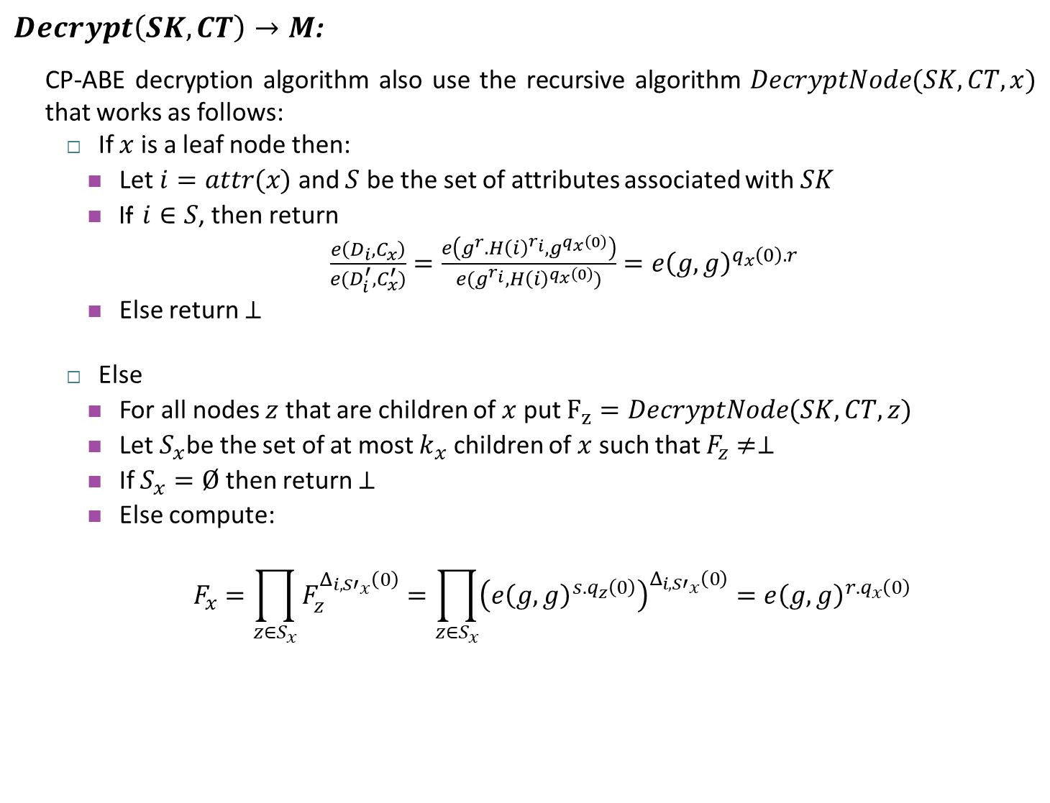
Bethencourt et al. CP-ABE scheme
$Decrypt\left(SK, CT\right)→M$:
CP-ABE decryption algorithm also use the recursive algorithm $DecryptNode(SK,CT,x)$ that works as follows:
If $x$ is a leaf node then:
Let $i=attr(x)$ and $S$ be the set of attributes associated with $SK$
If $i∈S$, then return
$\frac{e\left(D_{i},C_{x}\right)}{e(D_{i}^{′},C_{x}^{′})}=\frac{e\left(g^{r}.H{\left(i\right)}^{r_{i}},g^{q_{x}\left(0\right)}\right)}{e(g^{r_{i}},H{\left(i\right)}^{q_{x}\left(0\right)})}=e{\left(g,g\right)}^{q_{x}\left(0\right).r}$
Else return $⊥$
Else
For all nodes $z$ that are children of $x$ put $F_{z}=DecryptNode(SK,CT,z)$
Let $S_{x}$be the set of at most $k_{x}$ children of $x$ such that $F_{z}≠⊥$
If $S_{x}=Ø$ then return $⊥$
Else compute:
$$F_{x}=\prod_{z∈S_{x}}{F_{z}^{Δ_{i,{S′}_{x}}\left(0\right)}}=\prod_{z∈S_{x}}{{\left(e{\left(g,g\right)}^{s.q_{z}\left(0\right)}\right)}^{Δ_{i,{S′}_{x}}\left(0\right)}}=e{\left(g,g\right)}^{r.q_{x}\left(0\right)}$$

Slide 30

Bethencourt et al. CP-ABE scheme
$Decrypt\left(SK, CT\right)→M$:
The get the Message $M$, we need to call $DecryptNode(SK,CT,r)$, where $r$ is the root of the access policy.
If the attributes in $SK$ satisfies the access policy, we will have:
$$A=DecryptNode\left(SK,CT,r\right)=e{\left(g,g\right)}^{r.q_{r}\left(0\right)}=e{\left(g,g\right)}^{r.s }$$
The message can be decrypted by computing
$$M=\frac{C}{e(C,D)/A}=\frac{C}{e(h^{s},g^{\frac{α+r}{β}})/e{\left(g,g\right)}^{r.s}}=\frac{C}{e(h^{s},g^{\frac{α+r}{β}})/e{\left(g,g\right)}^{r.s}}$$
$$=\frac{C}{e(g^{β.s},g^{\frac{α+r}{β}})/e{\left(g,g\right)}^{r.s}}=\frac{C}{e{\left(g,g\right)}^{α.s+r.s}/e{\left(g,g\right)}^{r.s}}=\frac{M.e{\left(g,g\right)}^{α.s}}{e{\left(g,g\right)}^{α.s}}$$

Slide 31
Decentralized Attribute-based encryption

Slide 32
Decentralized ABE
Decentralized Attribute based encryption, also known as Multi-Authority Attribute base encryption (MA-ABE) is a decentralized version of ABE cryptosystem.
In MA-ABE:
any party can become an authority,
there is no central authority and no requirement for any global coordination other than the creation of an initial set of common reference parameters,
a party can simply act as an ABE authority by creating a public key and issuing private keys to different users that reflect their attributes,
a user can encrypt data in terms of any boolean formula over attributes issued from any chosen set of authorities.
A fully MA-ABE has been proposed in 2011 by Lewko et al. [Lewko, Allison, and Brent Waters. "Decentralizing attribute-based encryption." Annual international conference on the theory and applications of cryptographic techniques. Springer, Berlin, Heidelberg, 2011.]

Slide 33

Decentralized ABE
Decentralized Attribute based encryption consists of five algorithms:
$Global setup(λ)→GP$: this algorithm takes as input a security parameter $λ$ and outputs global parameters of the cryptosystem.
$Authority setup (GP)→PK,MSK:$ each authority in the system runs this algorithm taking as input the global parameters to generate own public key and master secret key.
$KeyGen(GID,i, MSK,GP)→SK_{i,GID}$: this algorithm takes as input an identity $GID$, the global parameters, an attribute $i$ belonging to some authority, and the master secret key $MSK$ for this authority. It produces as output a key $K_{i,GID}$ for the pair (attribute, identity).
$Encrypt(PK, (A,ρ), M)→CT:$ this algorithm takes as input a message $M$, an access matrix $(A, ρ)$, the set of public keys for relevant authorities, and the global parameters. It outputs a ciphertext $CT$.
$Decrypt(CT, GP, \{K_{i,GID}\}) → M:$ This algorithm takes as input the global parameters, the ciphertext, and a set of keys of the same fixed identity $GID$. It outputs the message $M$ when the set of attributes $i$ satisfies the access matrix in $CT$.

Slide 34

Decentralized ABE (security model)
MA-ABE considers the following security game:
$Setup:$ the global setup algorithm is run. The attacker specifies a set $S′⊆ S$ of corrupt authorities. For non-corrupt authorities, the challenger runs the authority setup algorithm, and gives the public keys to the attacker.
$Phase 1:$ the attacker makes key queries by submitting pairs $(i, GID)$ to the challenger, where $i$ is an attribute belonging to a non-corrupt authority and $GID$ is a global identity. The challenger responds by giving the attacker the corresponding key $(K_{i,GID})$.
$Challenge:$
The adversary submits two equal length messages $M_{0}$ and $M_{1},$ and a challenge access matrix $(A,ρ)$ (with the condition that the set of attributes $i$ queried during phase 1 does not satisfy $A$),
The adversary must provide public keys to the challenger for each corrupted authority,
The challenger flips a random coin $b$, and encrypts $M_{b}$ under $A,$
Finally, the ciphertext is passed to the adversary.
$Phase 2:$ repeat phase 1
$Guess:$ the adversary outputs a guess $b′$ of $b$

Slide 35

Lewko et al. decentralized ABE scheme
$$Global setup(λ)→GP$$
Let $G$ be a bilinear group of prime order $N=p_{1}p_{2}p_{3}$, and $g_{1}$ the generator of $G_{p_{1}}$
Let $H:{\left\{0,1\right\}}^{∗}→G$ be a hash function that maps a global identity to an element in the group $G$
Let $e:G×G→G_{T}$ be a bilinear map
Set the global parameters $GP$ as:
$GP=(G,g_{1},H,e)$
$$Authority setup (GP)→PK,MSK$$
For each attribute $i$ belonging to an Authority $j$ choose two random values $α_{i},y_{i}∈Z_{N}$
Set the public key and the master key as:
$PK_{j}=\left\{e{\left(g_{1},g_{1}\right)}^{α_{i}},g_{1}^{y_{i}} ∀i\right\}, MSK=\{α_{i},y_{i} ∀i\}$

Slide 36

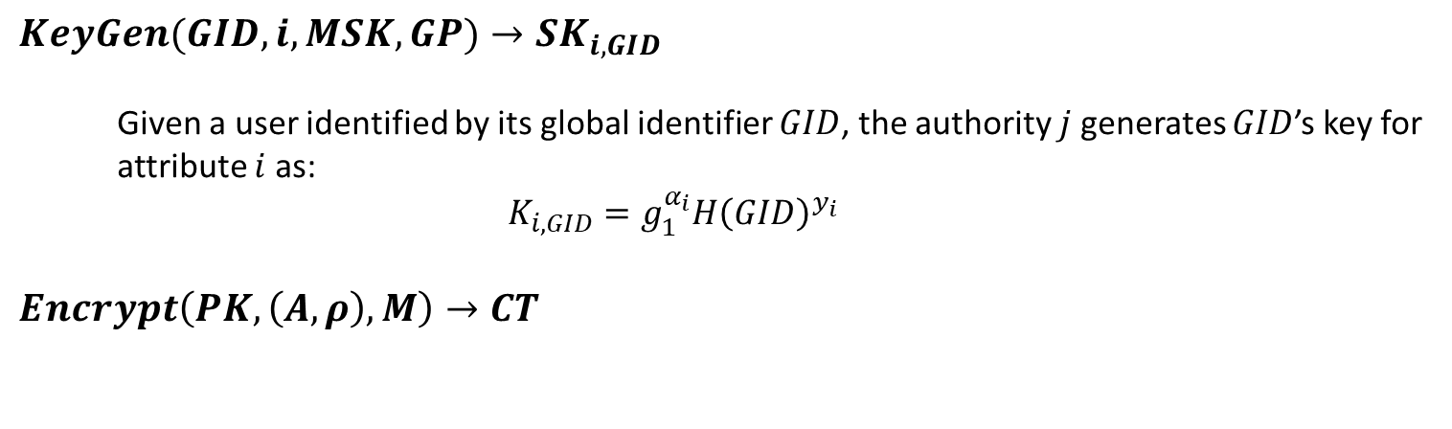


Lewko et al. decentralized ABE scheme
$$KeyGen(GID,i, MSK,GP)→SK_{i,GID}$$
Given a user identified by its global identifier $GID$, the authority $j$ generates $GID$’s key for attribute $i$ as:
$$K_{i,GID}=g_{1}^{α_{i}}H{\left(GID\right)}^{y_{i}}$$
$$Encrypt\left(PK, \left(A,ρ\right), M\right)→CT$$
C=1 (1)
AND
0 -1
1 1
1 1
$ρ$(1)= INSA Student
(0,-1)
(1,1)
A=
$ρ$(2)= First year
INSA Student
C=2
OR
$ρ$(3)= Second year
C=2
First year
Second year
(1,1)
(1,1)

Slide 37

Lewko et al. decentralized ABE scheme
$$Encrypt\left(PK, \left(A,ρ\right), M\right)→CT$$
Given $A$ an $(n×l)$ access matrix:
Choose a random $s∈Z_{N}$ and a random vector $v∈Z_{N}^{l}$ with $s$ as a first entry
Let $λ_{x}=A_{x}.v$, where $A_{x}$ is the row $x$ of $A$
Choose a random vector $w∈Z_{N}^{l}$ with $0$ as a first entry
Let $w_{x}=A_{x}.w$
For each row $x$ in $A$ choose a random value $r_{x}$
Compute the ciphertext as:
$$CT=(C_{0}=Me{\left(g_{1},g_{1}\right)}^{s}, C_{1,x}=e{\left(g_{1},g_{1}\right)}^{λ_{x}}e{\left(g_{1},g_{1}\right)}^{α_{ρ\left(x\right)}r_{x}},$$
$$C_{2,x}=g_{1}^{r_{x}},C_{3,x}=g_{1}^{y_{ρ\left(x\right)}r_{x}}g_{1}^{w_{x}} ∀x)$$

Slide 38

Lewko et al. decentralized ABE scheme
$$Decrypt(CT, GP, \{K_{i,GID}\}) → M$$
Let $S$ be a subset of rows $x$ in $A$ such that $(1,0,0…,0)$ is in their span
For each row $x$ in $A$compute:
$$C_{1,x}.\frac{e\left(H\left(GID\right),C_{3,x}\right)}{e(K_{ρ\left(x\right),GID},C_{2,x})}=e{\left(g_{1},g_{1}\right)}^{λ_{x}}e{\left(H\left(GID\right),g_{1}\right)}^{w_{x}}$$
Choose constants $c_{x}∈Z_{N}$ such that:
$$\sum_{x}{c_{x}.A_{x}=(1,0,0,…,0)}$$
Compute:
$$\prod_{x}{{\left(e{\left(g_{1},g_{1}\right)}^{λ_{x}}e{\left(H\left(GID\right),g_{1}\right)}^{w_{x}}\right)}^{c_{x}}=e{\left(g_{1},g_{1}\right)}^{s}}$$
Then, the message $M$ will be:
$$M=\frac{C_{0}}{e{\left(g_{1},g_{1}\right)}^{s}}$$

Slide 39
Conclusion
Attribute-based encryption is a public key encryption scheme that:
defines users keys based on a set of attributes.
defines access policies describing attributes allowing to decrypt data ‘’fine-grained cryptographic access control’’.
There are mainly two centralized version for attribute-based encryption (KP-ABE and CP-ABE)
CP-ABE has been extended in a decentralized version where:
any party can become an authority
any requirement for any global coordination other than the creation of an initial set of common reference parameters is needed
Users managed by different authorities can securely share and control the access to data.

