Slide 1




curAHack 2025
Challenge 4:
“Intercellular Communication in Cardiovascular Disease: Annotating and Explaining Group-Specific Differences Through Knowledge Integration”
by Didar, Kathan, Max, Manuela
Supervisors:

Slide 2
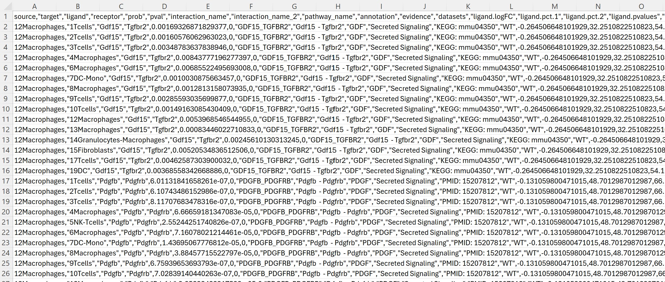
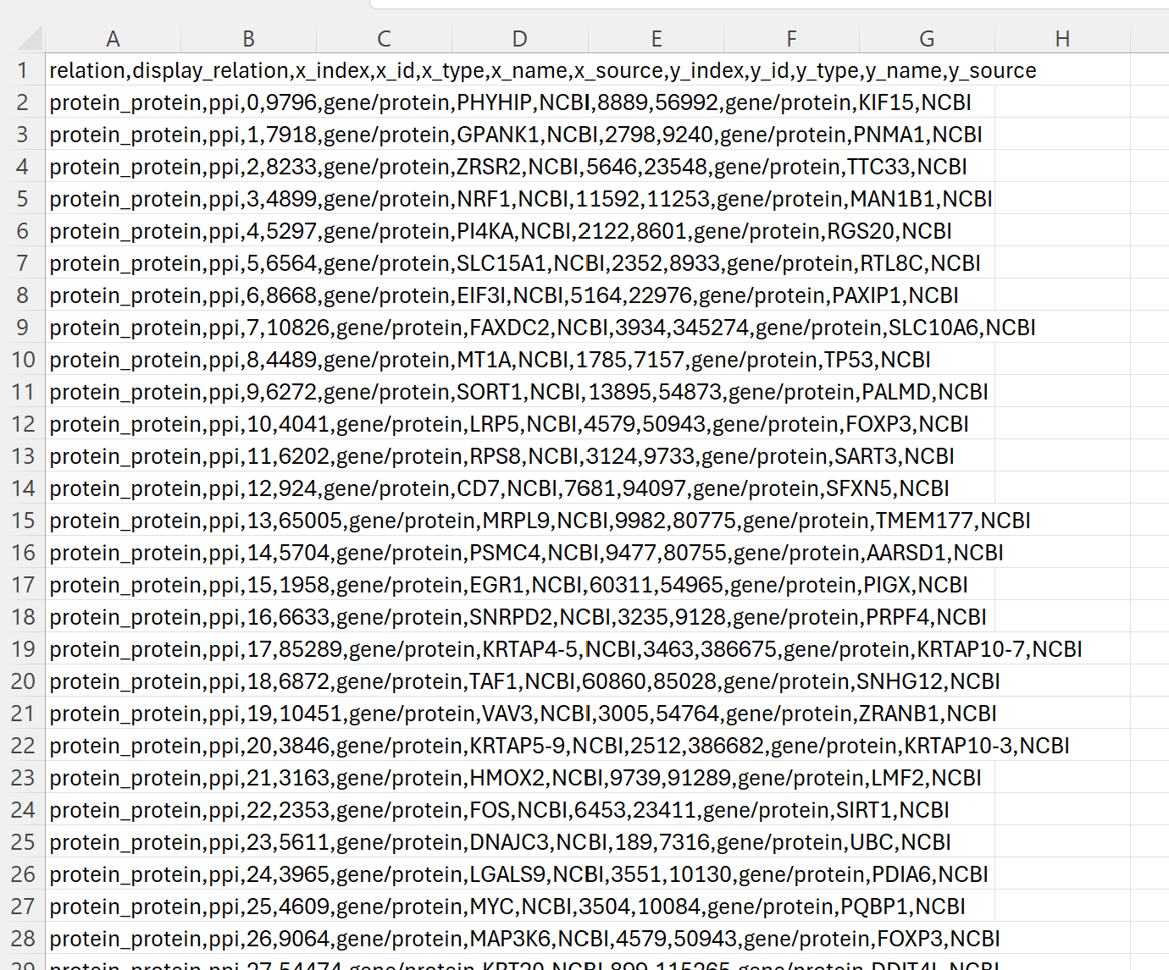
Challenges and data
Challenge I: Database enrichment with curated ligand-receptor networks
Challenge II: Innovative method for interpretation of complex data
data: 4 .csv files: „net.downLigand_Cellchat.csv„ „net.downReceptor_Cellchat.csv“ „net.upLigand_Cellchat.csv“ „net.upReceptor_Cellchat.csv “
data: a .csv file: „prime_kg.csv“

Slide 4
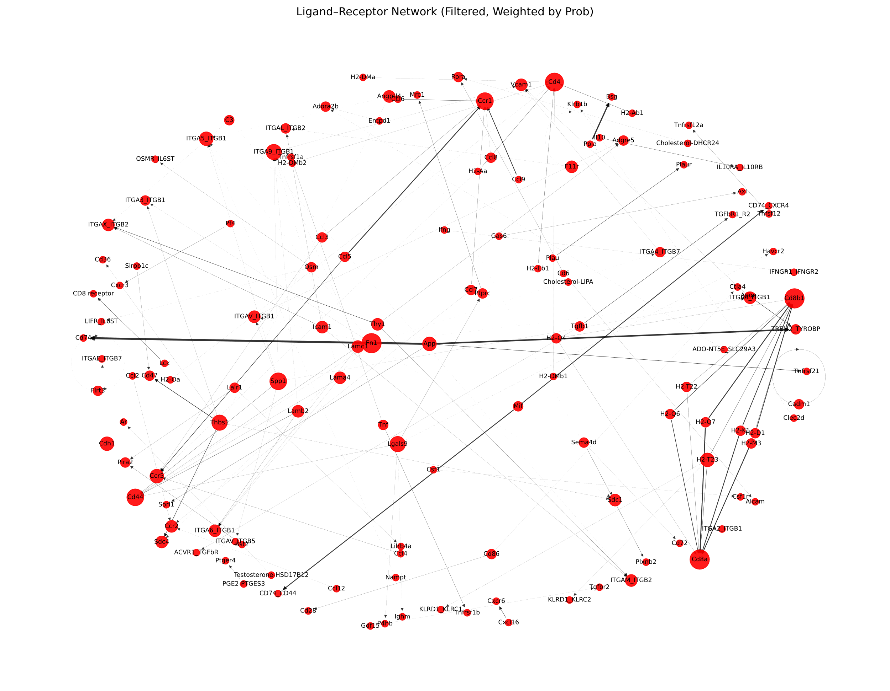
Ligand-receptor network (Up-regulated)
Intensity of edges show weights by probability
After filtering p-value <= 0.05

Slide 5
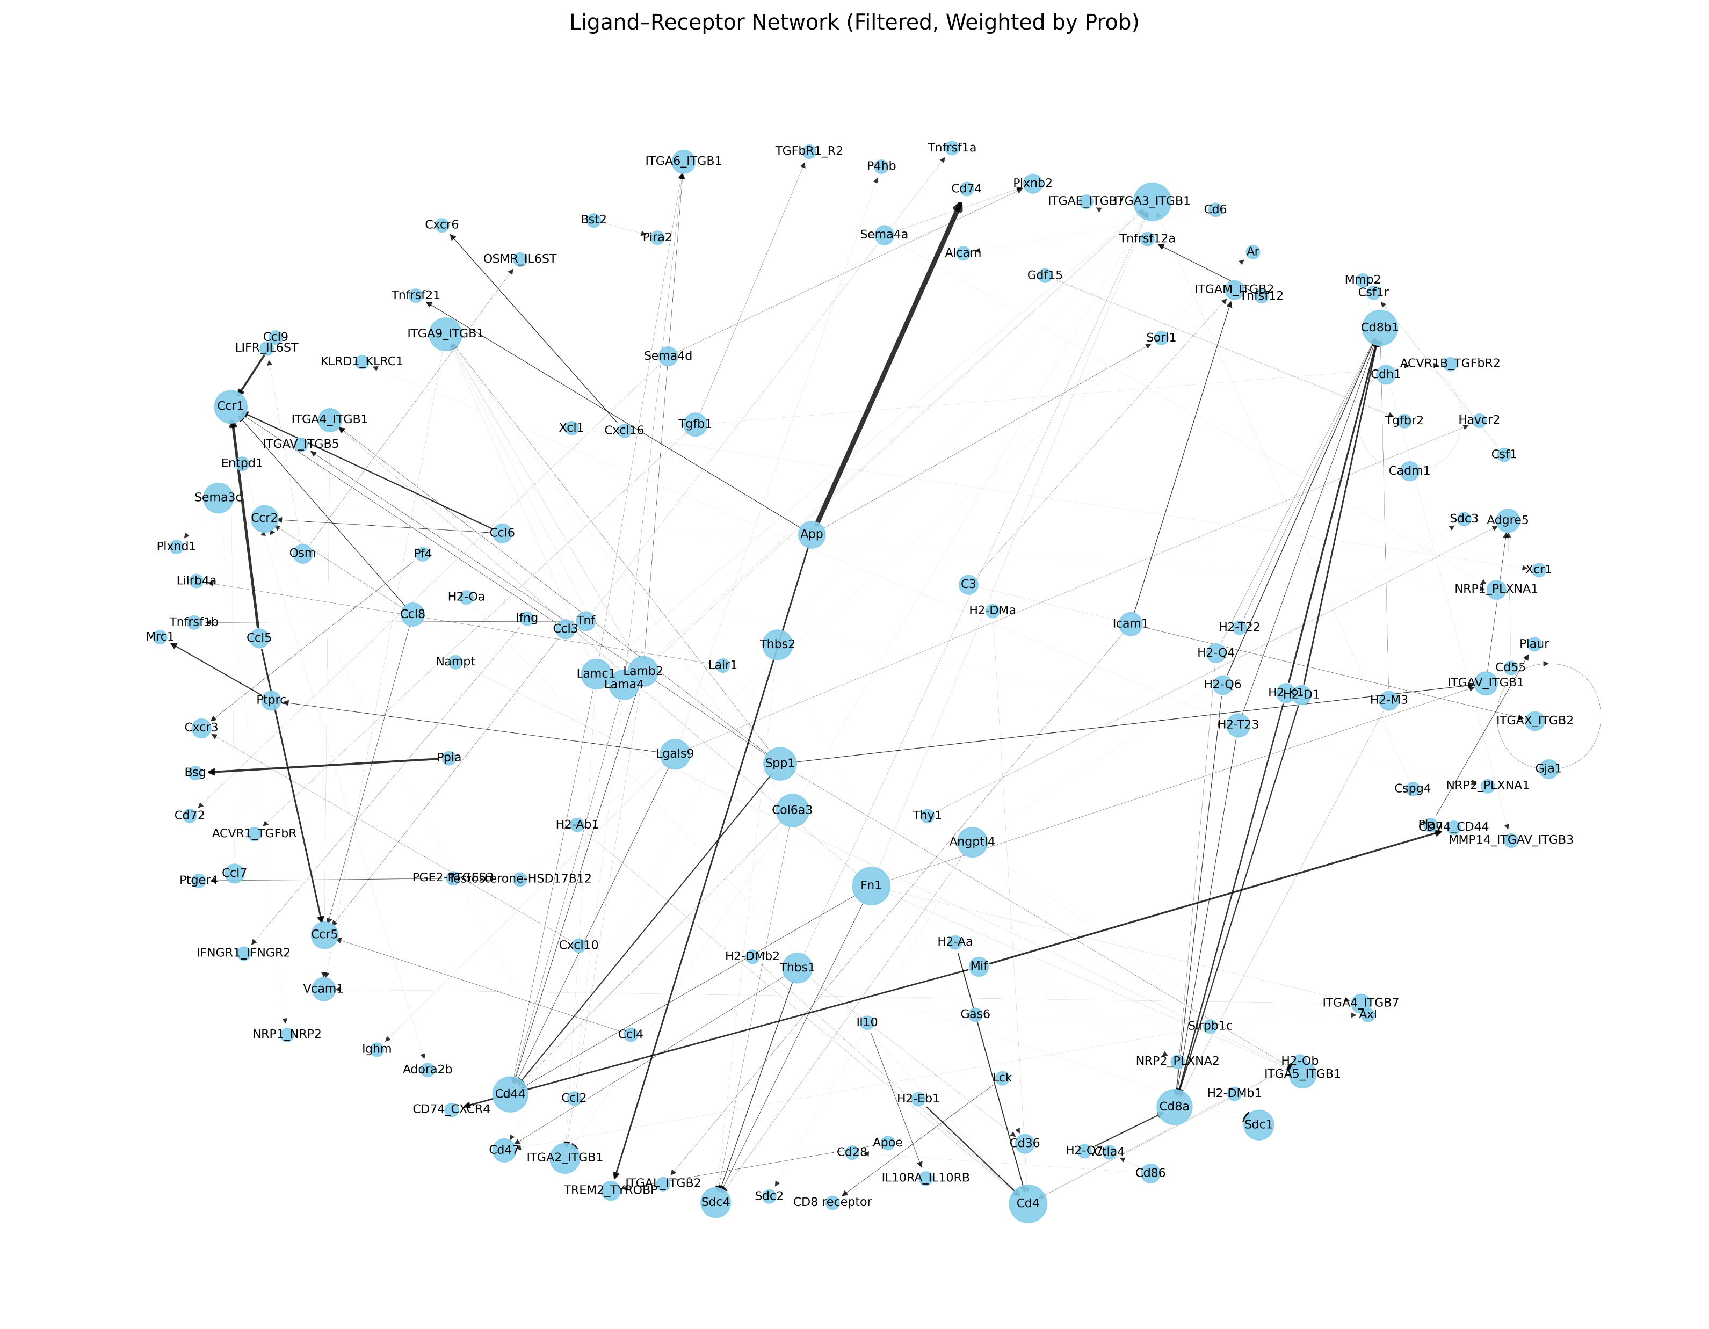
Ligand-receptor network (Down-regulated)
Intensity of edges show weights by probability
After filtering p-value <= 0.05

Slide 6
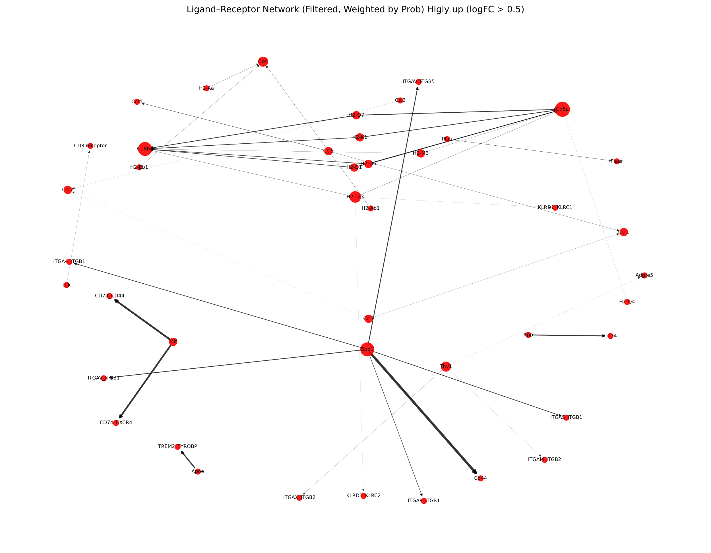
Ligand-receptor network (Down-regulated)
Intensity of edges show weights by probability
After filtering for high logFC (threshold > 0.5)

Slide 7
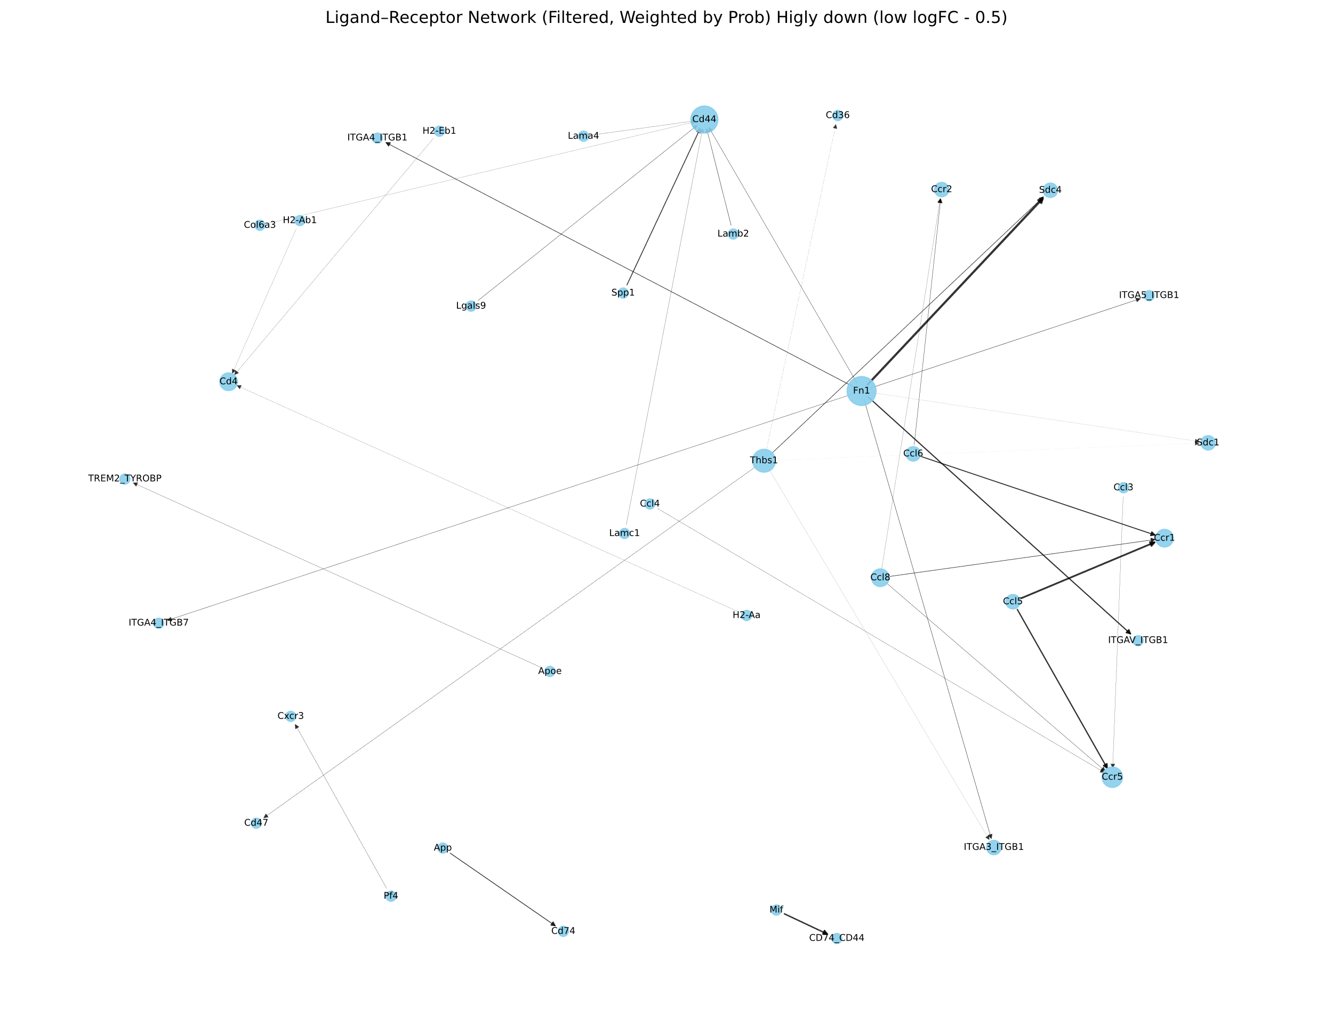
Ligand-receptor network (Down-regulated)
Intensity of edges show weights by probability
After filtering for low logFC (threshold < - 0.5)

