Slide 1

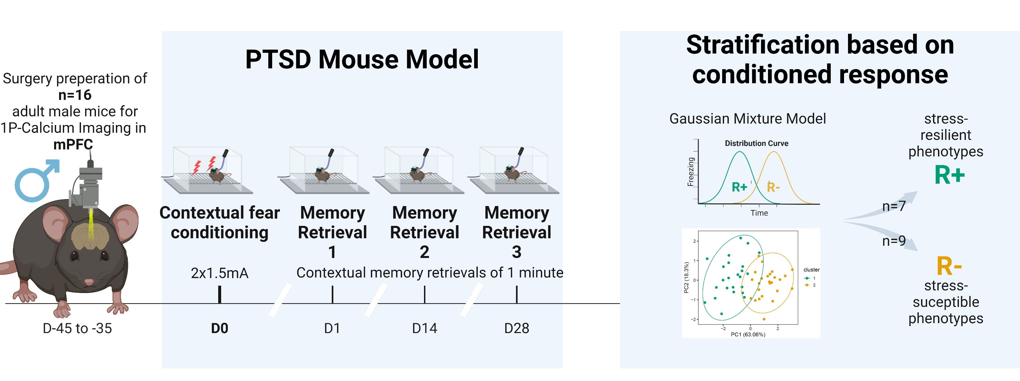
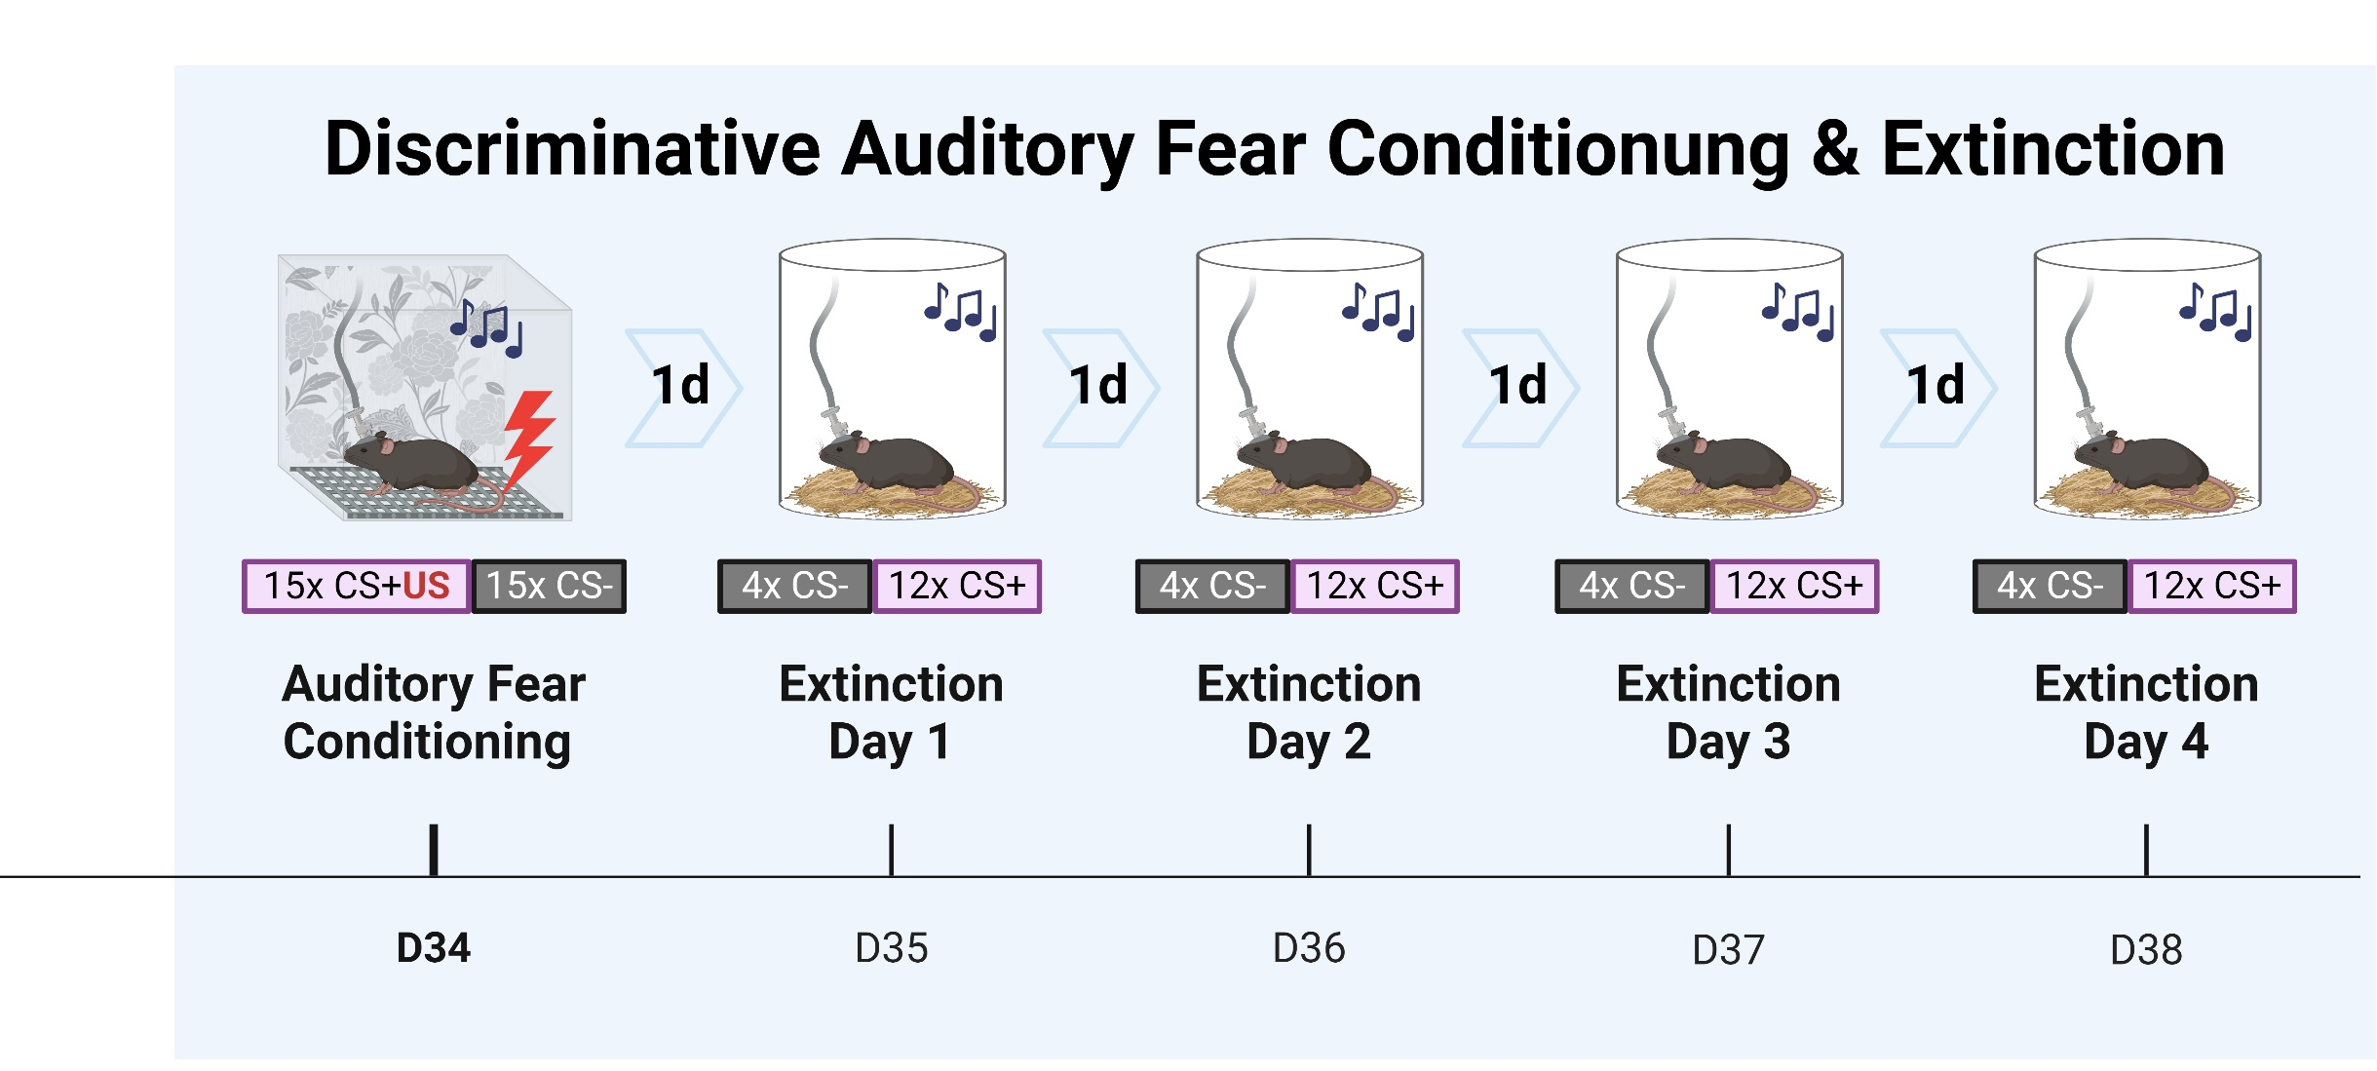
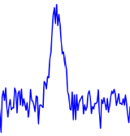

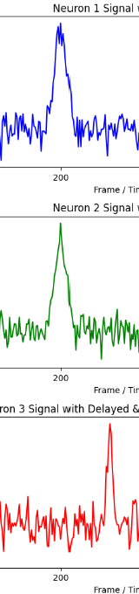
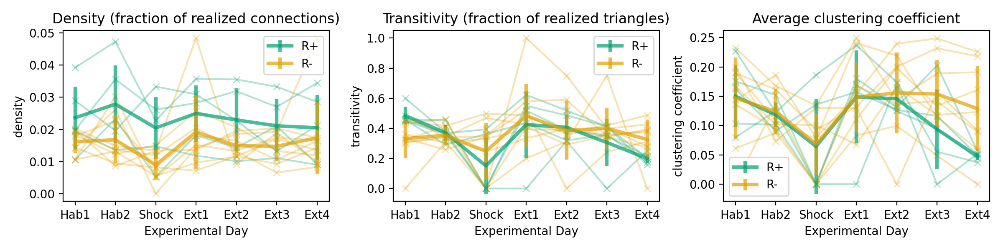

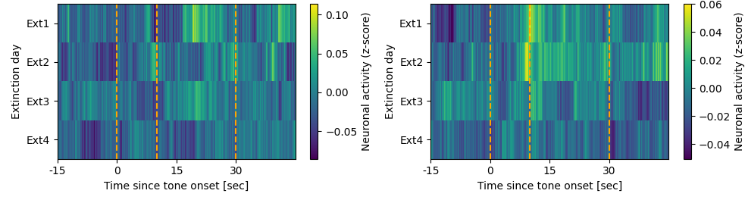


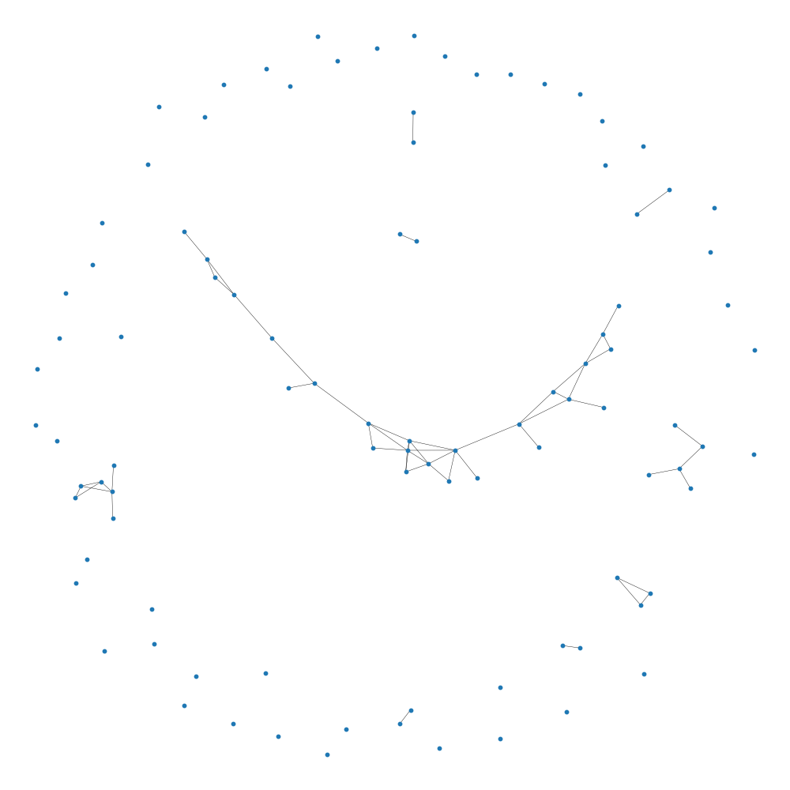
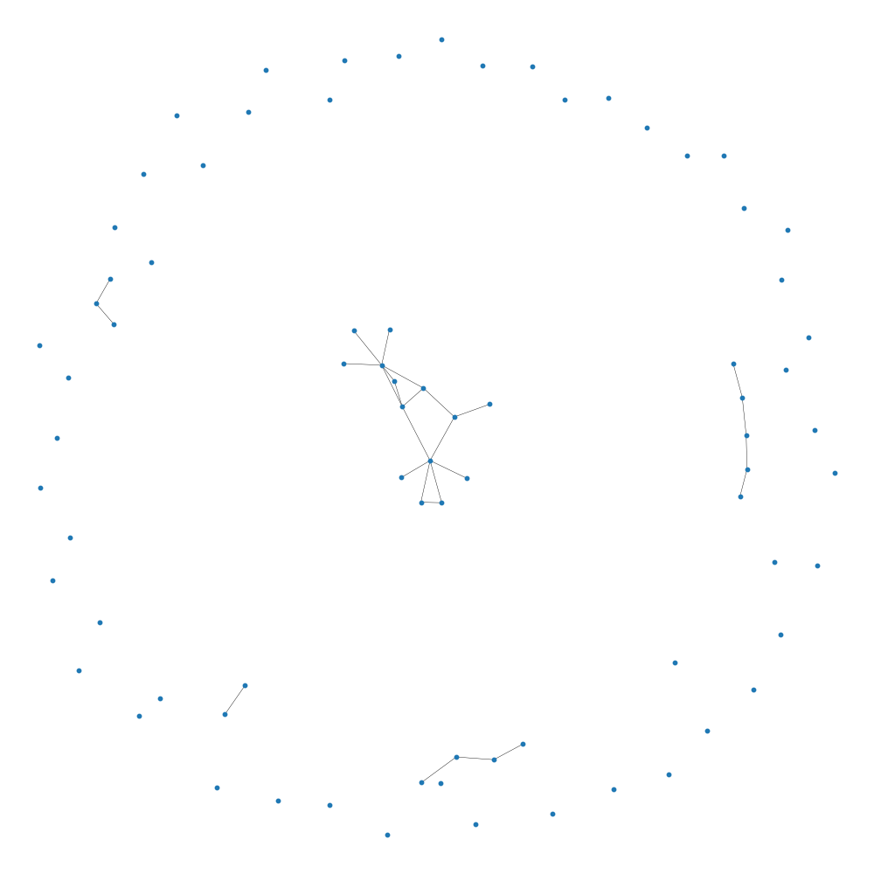
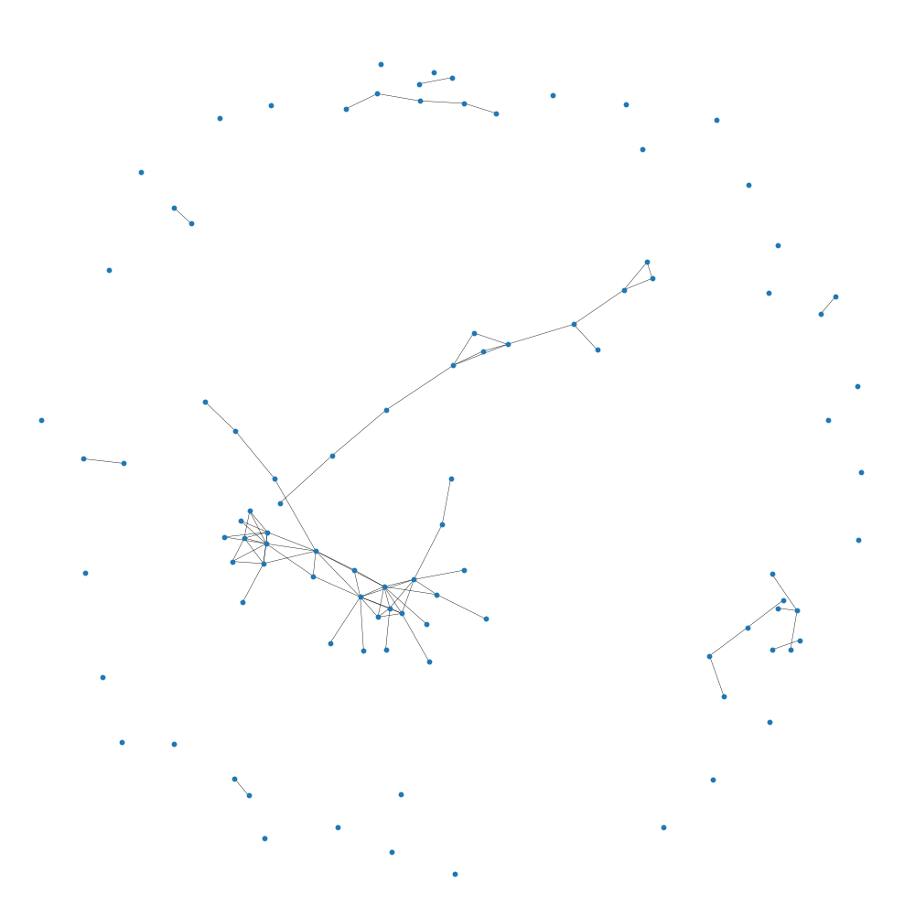
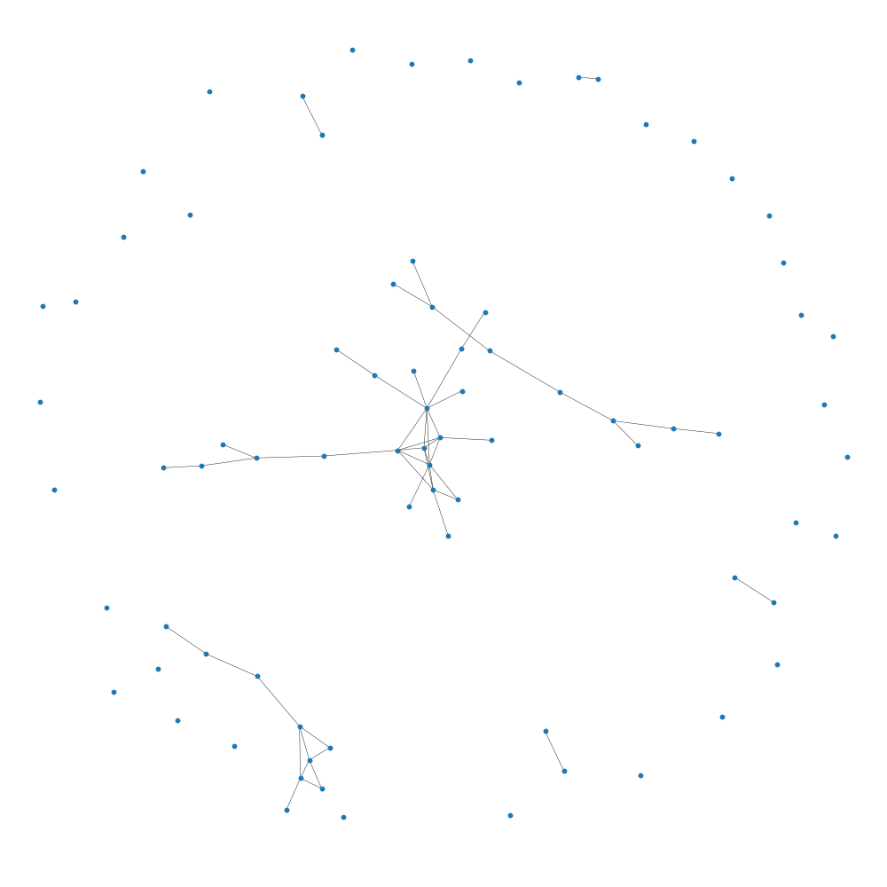
Differential adaptive regulation of fear extinction: Insights from behavioral and neuronal network analysis in trauma-induced stress resilient and susceptible phenotypes
Larglinda Islami¹, Manuela A. Beyer², Janina Hesse², Beat Lutz¹
¹Group Molecular and Cellular Mechanisms of Resilience, Leibniz Institute for Resilience Research, Mainz, Germany ²Group Computational Resilience Research, Leibniz Institute for Resilience Research, Mainz, Germany
BACKGROUND
Following a traumatic event, stress-susceptible individuals may develop post-traumatic stress disorder (PTSD), which is characterized by intrusive re-experiencing of the fearful event, impaired fear-safety learning, and altered cognition. These changes are primarily driven by dysregulation in the medial prefrontal cortex (mPFC).
Despite extensive research on fear extinction learning and its underlying neural mechanisms, there remains a limited understanding of how stress resilience and susceptibility are reflected in dynamic brain networks and how these networks shape (mal)adaptive behavioral responses.
In this study, we utilized a PTSD mouse model and performed data-driven stratification to classify resilient and susceptible phenotypes.
By employing calcium imaging in freely moving animals, we explored the role of mPFC prelimbic pyramidal cells in stress-induced neural and behavioral alterations during fear extinction training.
EXPERIMENTAL TIMELINE
CALCIUM IMAGING: Neural Extinction Patterns in R+ vs. R- Animals
NETWORK METRICS DURING EXTINCTION TRAINING
In the analysis, density remains relatively constant for both R+ (resilient) and R- (susceptible) networks, with R+ showing slightly higher density, though R- networks have more nodes overall. Transitivity and the average clustering coefficient decrease more in R+ over time, indicating a greater reduction in network cohesion and the average number of triangles connected to a node, particularly in the R+ group. R+ shows a stronger decrease during extinction, compared to R-.
Networks are constructed for individual animals (R+ left, R- right) with a threshold of 0.2 to access connectivity. Extinction Day 1 and 4 are visualized.
connected
In calcium imaging, luminescence heatmaps are used to visualize quantitative neural activity by displaying fluorescence intensities that correspond to changes in intracellular calcium levels, serving as indicators of neuronal activation.
Luminance plot for Extinction Day 1 to 4 showing mean luminance (z-score normalized) in the time interval preceding, during and following the CS+ event.
The mean luminance for all animals was plotted, with R+ (resilient) and R- (susceptible) groups shown separately. Dark colors indicate low or no neuronal activity, while lighter colors show high neuronal activity.
The data represents the average across all neurons and CS+ tone presentations after Auditory Fear Conditioning. Three vertical lines mark 1.) the onset of the tone, 2.) the expected shock timing, and 3.) the tone's end. Shown data suggest that R- animals display a stronger response to the expected shock timing, especially on days 1 and 2, with this response diminishing over time, indicating extinction.
Density and transitivity are key metrics for interpreting a network mathematically. Density represents the ratio of actual to possible edges, indicating how interconnected the network is. Transitivity measures the likelihood that two neighbors of a node are also connected, reflecting the network's tendency to form closely connected communities or groups. Another prominent metric is average clustering, which quantifies the tendency of nodes to form tightly linked clusters by measuring the average probability that a node’s neighbors are interconnected.
Neuronal activity
Luminance traces illustrating functional connectivity of neurons based on simultaneous activation.
Networks are constructed and analyzed based on this definition.
Time
Time
Time
not connected
R+
R-
Analysis for a network: Focus on Density
Analysis for a network: Focus on Transitivity
Extinction Day 1
Extinction Day 4
Extinction Day 1
Extinction Day 4
SUMMARY
Luminescence heatmaps revealed differences in neural activity between R+ (resilient) and R- (susceptible) groups following Auditory Fear Conditioning. While R- animals seem to maintain a constant level of network complexity, the R+ group exhibited a decrease in complexity as extinction progressed over subsequent days. Network metrics revealed a greater reduction in cohesion for R+ animals over time, indicating altered connectivity during extinction. Further analysis is needed to validate these preliminary findings.
REFERENCES
Busch, A. M., Kovlyagina, I., Lutz, B., Todorov, H., & Gerber, S. (2022). beeRapp: an R shiny app for automated high-throughput explorative analysis of multivariate behavioral data. Bioinformatics Advances, 2(1). https://doi.org/10.1093/bioadv/vbac082
Thurman, S. T., Guizar-Sicairos, M., & Fienup, J. R. (2008). Efficient subpixel image registration algorithms. Optics Letters, 33(2), 156–158. https://doi.org/10.1364/OL.33.000156
Zhou, P., Resendez, S. L., Rodriguez-Romaguera, J., Jimenez, J. C., Neufeld, S. Q., Giovannucci, A., Friedrich, J., Pnevmatikakis, E. A., Stuber, G. D., Hen, R., Kheirbek, M. A., Sabatini, B. L., Kass, R. E., & Paninski, L. (2018). Efficient and accurate extraction of in vivo calcium signals from microendoscopic video data. eLife, 7. https://doi.org/10.7554/eLife.28728
Sheintuch, L., Rubin, A., Brande-Eilat, N., Geva, N., Sadeh, N., Pinchasof, O., & Ziv, Y. (2017). Tracking the same neurons across multiple days in Ca2+ imaging data. Cell Reports, 21(4), 1102–1115. https://doi.org/10.1016/j.celrep.2017.10.013
Hagberg, A. A., Schult, D. A., & Swart, P. J. (2008). Exploring network structure, dynamics, and function using NetworkX. In Gäel Varoquaux, Travis Vaught, & Jarrod Millman (Eds.), Proceedings of the 7th Python in Science Conference (SciPy2008) (pp. 11–15). Pasadena, CA, USA.

