Slide 1

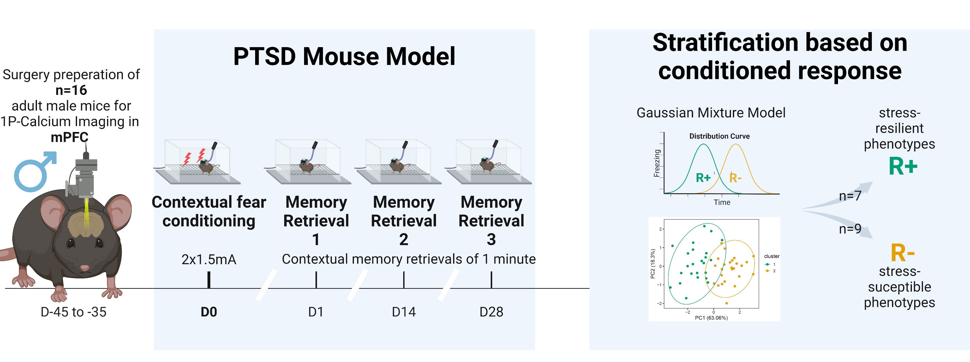
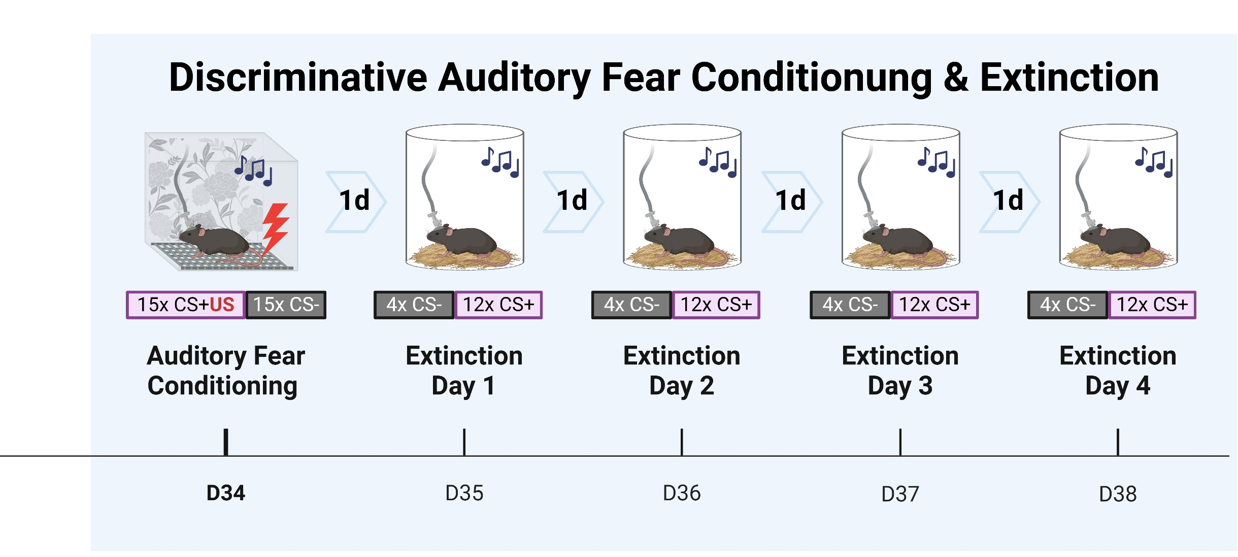
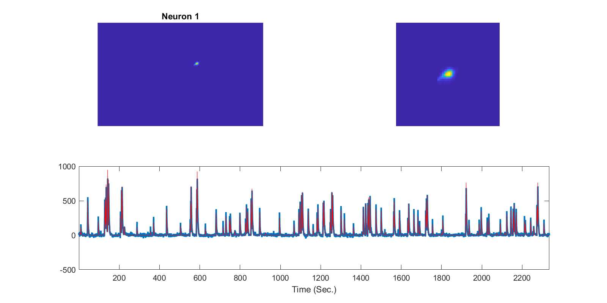
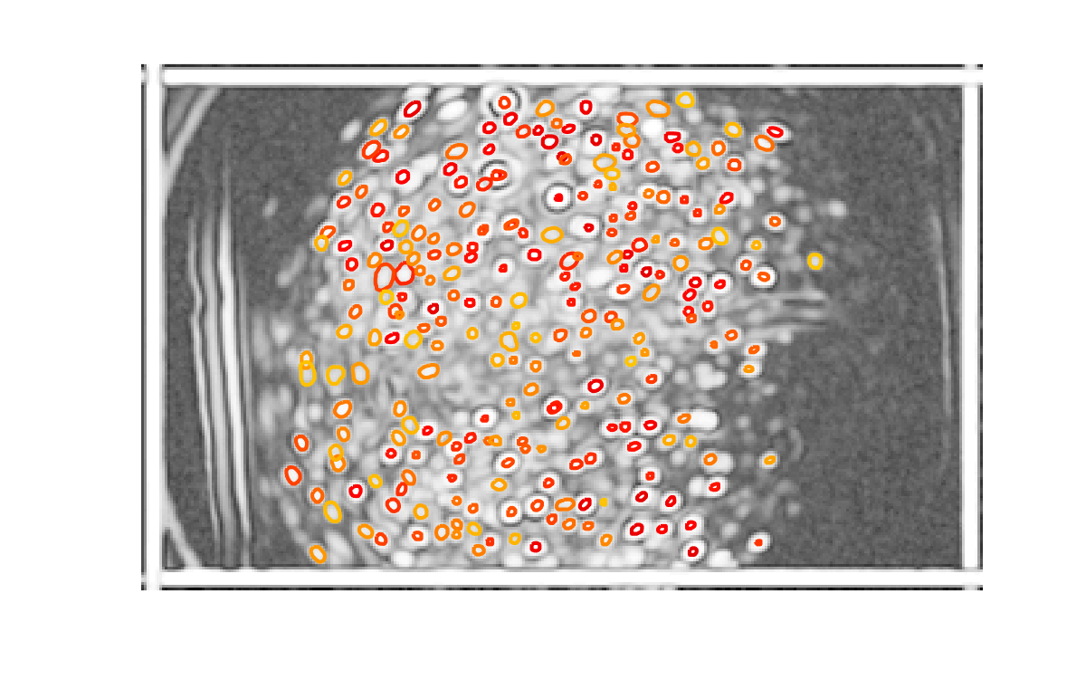
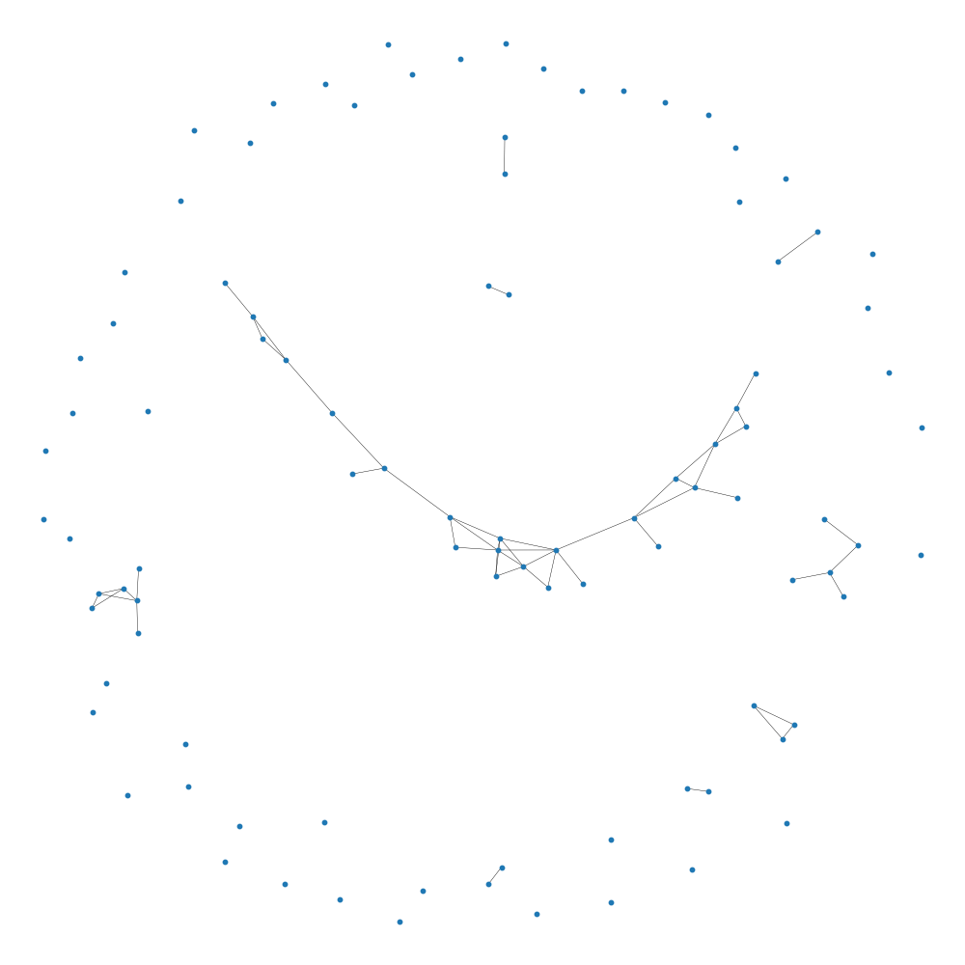
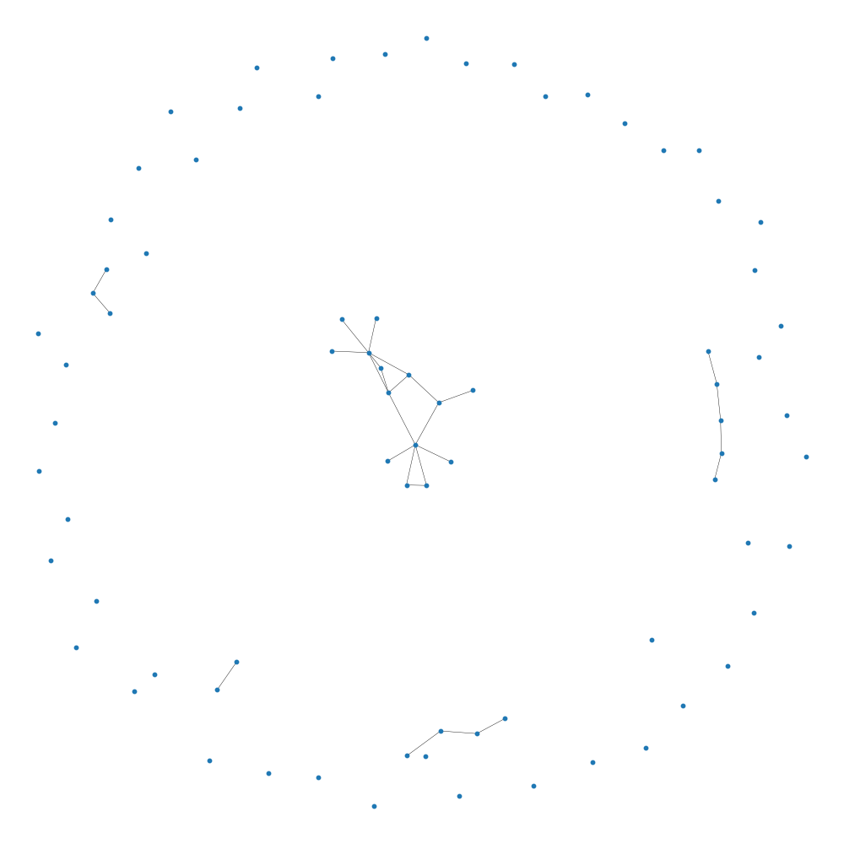
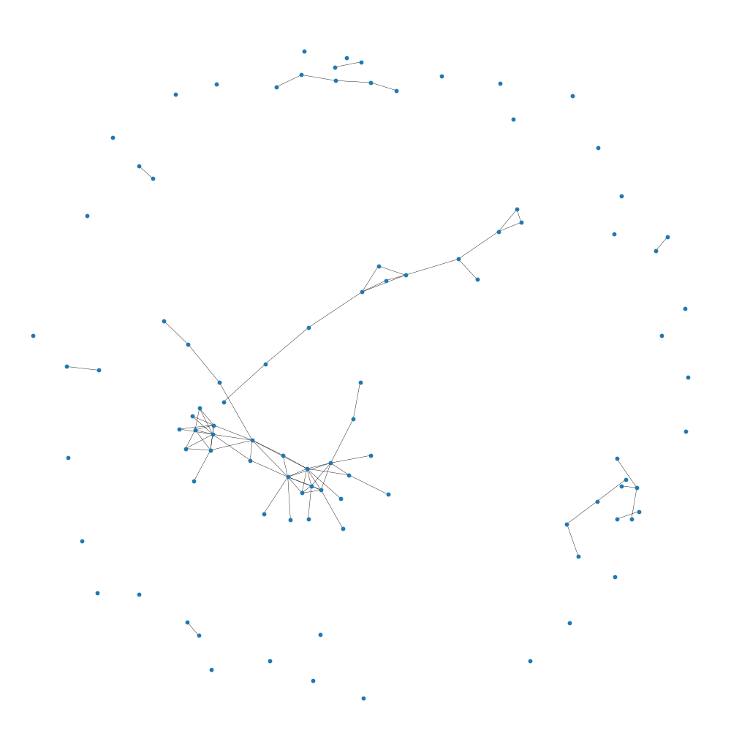
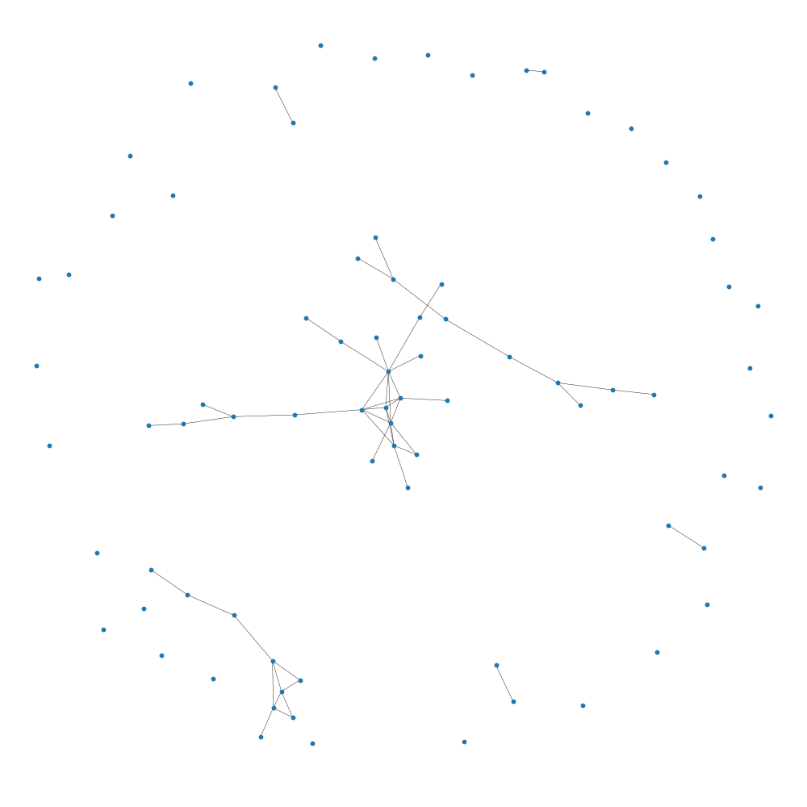
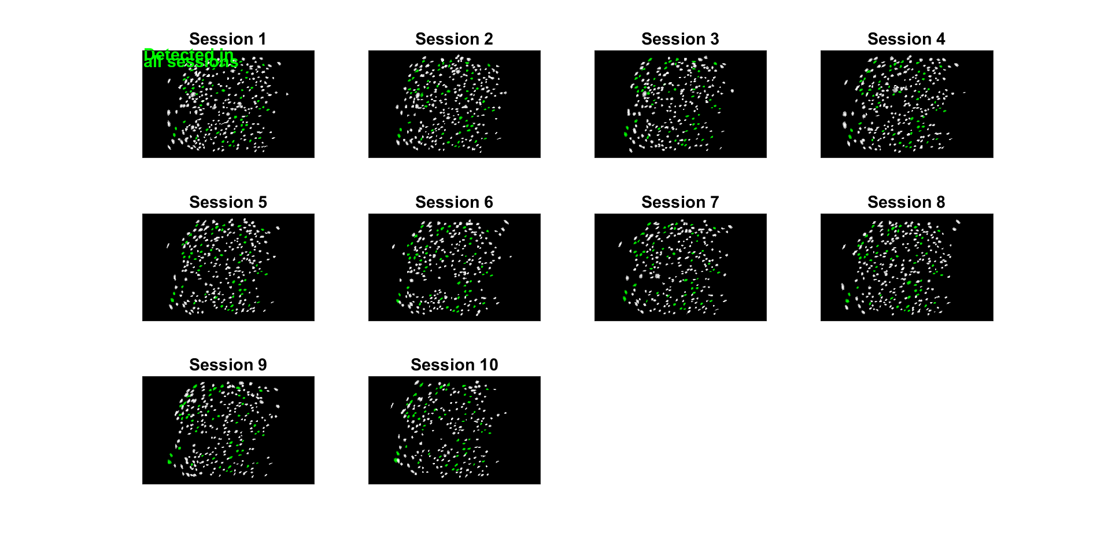
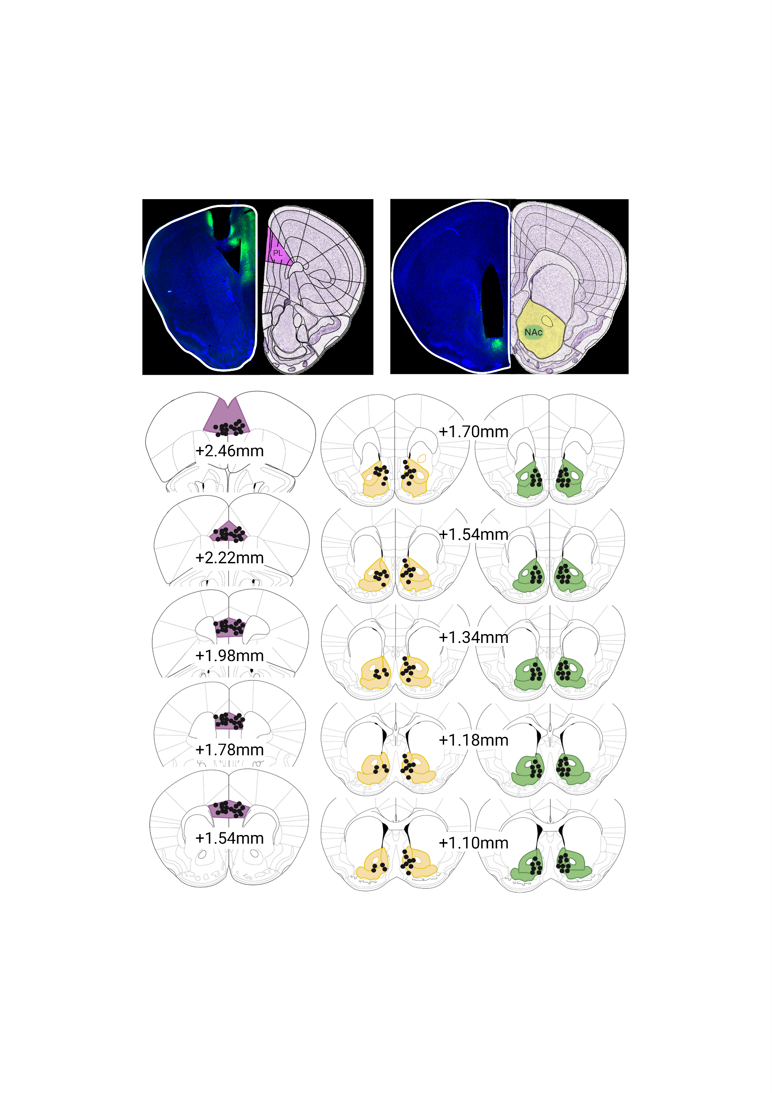
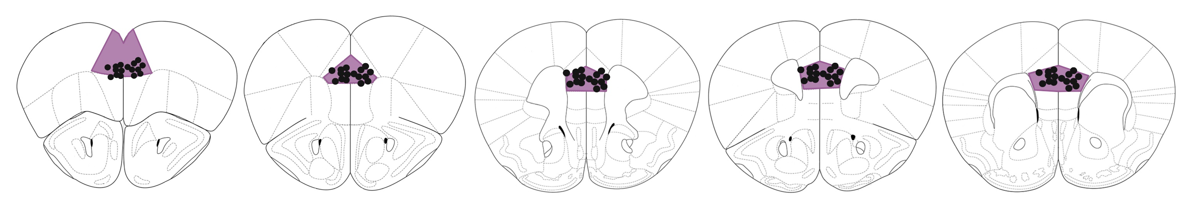
Differential adaptive regulation of fear extinction: Insights from behavioral and neuronal network analysis in trauma-induced stress resilient and susceptible phenotypes
Larglinda Islami¹, Manuela A. Beyer², Janina Hesse², Beat Lutz¹
¹Group Molecular and Cellular Mechanisms of Resilience, Leibniz Institute for Resilience Research, Mainz, Germany ²Group Computational Resilience Research, Leibniz Institute for Resilience Research, Mainz, Germany
BACKGROUND
Following a traumatic event, stress-susceptible individuals may develop post-traumatic stress disorder (PTSD), which is characterized by intrusive re-experiencing of the fearful event, impaired fear-safety learning, and altered cognition. These changes are primarily driven by dysregulation in the medial prefrontal cortex (mPFC).
Despite extensive research on fear extinction learning and its underlying neural mechanisms, there remains a limited understanding of how stress resilience and susceptibility are reflected in dynamic brain networks and how these networks shape (mal)adaptive behavioral responses.
In this study, we utilized a PTSD mouse model and performed data-driven stratification to classify resilient and susceptible phenotypes.
By employing calcium imaging in freely moving animals, we explored the role of mPFC prelimbic pyramidal cells in stress-induced neural and behavioral alterations during fear extinction training.
EXPERIMENTAL TIMELINE
CALCIUM IMAGING WORKFLOW
NETWORK DYNAMICS DURING EXTINCTION TRAINING
Network theory underlies the construction of networks to understand complex systems. It is widely used to model and analyze the interplay of various components within a system. The main tool to model networks is the theoretical construct of a graph, built from nodes and edges.
Nodes represent the basic elements of a network and serve as connection points. The edges in turn represent the connections between the individual nodes. The interpretation as a graph enables the application of a mathematical interpretation in the form of so-called metrics. Prominent metrics are Density and Transitivity. The density is the ratio between the edges present in the network and the total number of possible edges. It gives information about how interconnected the whole network is.
Transitivity is another metric that quantifies the probability that two neighbors of a particular node are also directly connected, meaning that three nodes in the graph form a ‘triangle’. It measures the tendency of a network to form closely connected communities or groups.
In the performed analysis, density remains relatively constant for both R+ (resilient) and R- (non-resilient) networks, with R+ having a slightly higher density, indicating more connections relative to the number of nodes. However, since R- networks contain significantly more nodes, caution is needed in interpreting these findings to ensure that observed effects are due to resilience rather than simply differences in network size.
In the analysis shown, the transitivity (the proportion of all possible triangles) decreases more for R+ than for R- over time, which is also true for the average clustering coefficient. This suggests that the average number of triangles connected to a given node decreases over time, emphasizing that both metrics are related and reflect a decrease in network cohesion, especially in the R+ group. //resilient susceptible
1. Motion correction via FFT registration for each recording session
2. Spatial and temporal extraction of neurons based on CNMFE
3. Manual post processing
4. Longitudinal alignment of neurons across extinction days
5. Post-Alignment verification
6. Prism grin lens location validation
Manually verified ROI based on shape and changes in Ca²⁺ fluorescence
Field of view under 1mm prism grin lens with verified neurons
Analysis for a network: Focus on Density
Analysis for a network: Focus on Transitivity
Extinction Day 1
Extinction Day 4
Extinction Day 1
Extinction Day 4
Extinction Day 1
Extinction Day 2
Extinction Day 3
Extinction Day 4
Aligned neurons across all sessions
Black dots mark lens location of n=16 operated animals in prelimbic cortex (PL) of mPFC
Bregma +2.46mm
+2.22mm
+1.98mm
+1.78mm
+1.54mm
AAV1-CamkIIa-GCaMP6f
anterior
posterior
SUMMARY
REFERENCES
Busch, A. M., Kovlyagina, I., Lutz, B., Todorov, H., & Gerber, S. (2022). beeRapp: an R shiny app for automated high-throughput explorative analysis of multivariate behavioral data. Bioinformatics Advances, 2(1). https://doi.org/10.1093/BIOADV/VBAC082
Thurman, S. T., Guizar-Sicairos, M., & Fienup, J. R. (2008). Efficient subpixel image registration algorithms. Optics Letters, Vol. 33, Issue 2, Pp. 156-158, 33(2), 156–158. https://doi.org/10.1364/OL.33.000156
Zhou, P., Resendez, S. L., Rodriguez-Romaguera, J., Jimenez, J. C., Neufeld, S. Q., Giovannucci, A., Friedrich, J., Pnevmatikakis, E. A., Stuber, G. D., Hen, R., Kheirbek, M. A., Sabatini, B. L., Kass, R. E., & Paninski, L. (2018). Efficient and accurate extraction of in vivo calcium signals from microendoscopic video data. ELife, 7. https://doi.org/10.7554/ELIFE.28728
Sheintuch, L., Rubin, A., Brande-Eilat, N., Geva, N., Sadeh, N., Pinchasof, O., & Ziv, Y. (2017). Tracking the Same Neurons across Multiple Days in Ca2+ Imaging Data. Cell Reports, 21(4), 1102–1115. https://doi.org/10.1016/J.CELREP.2017.10.013 Hagberg, A. A., Schult, D. A., & Swart, P. J. (2008). Exploring network structure, dynamics, and function using NetworkX. In Gäel Varoquaux, Travis Vaught, & Jarrod Millman (Eds.), Proceedings of the 7th Python in Science Conference (SciPy2008) (pp. 11–15). Pasadena, CA, USA.

