Slide 1

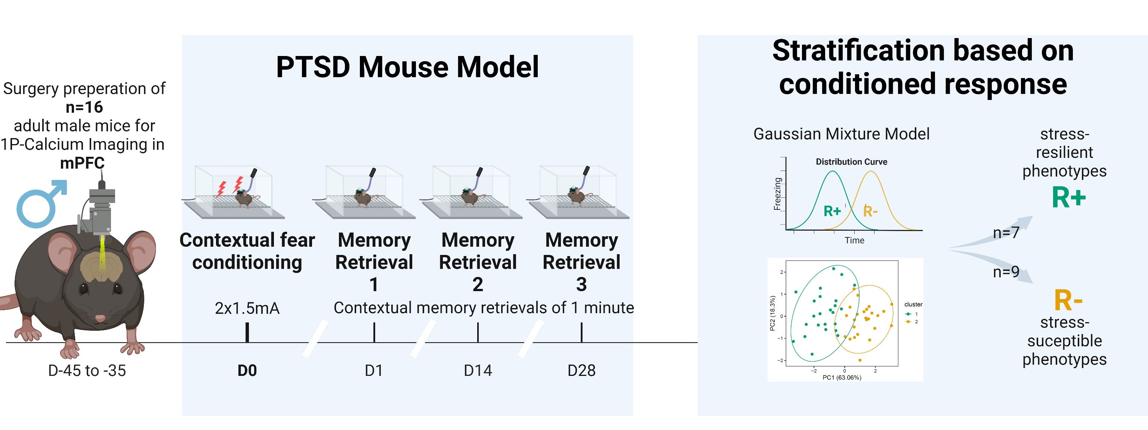
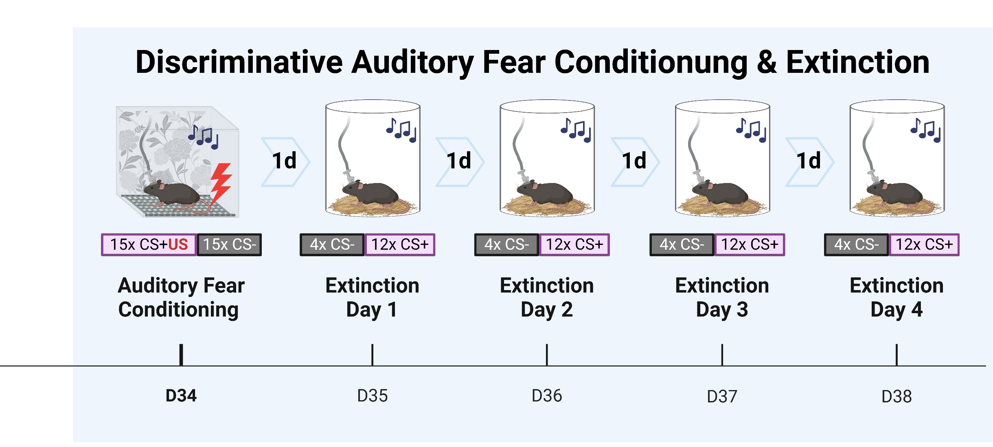

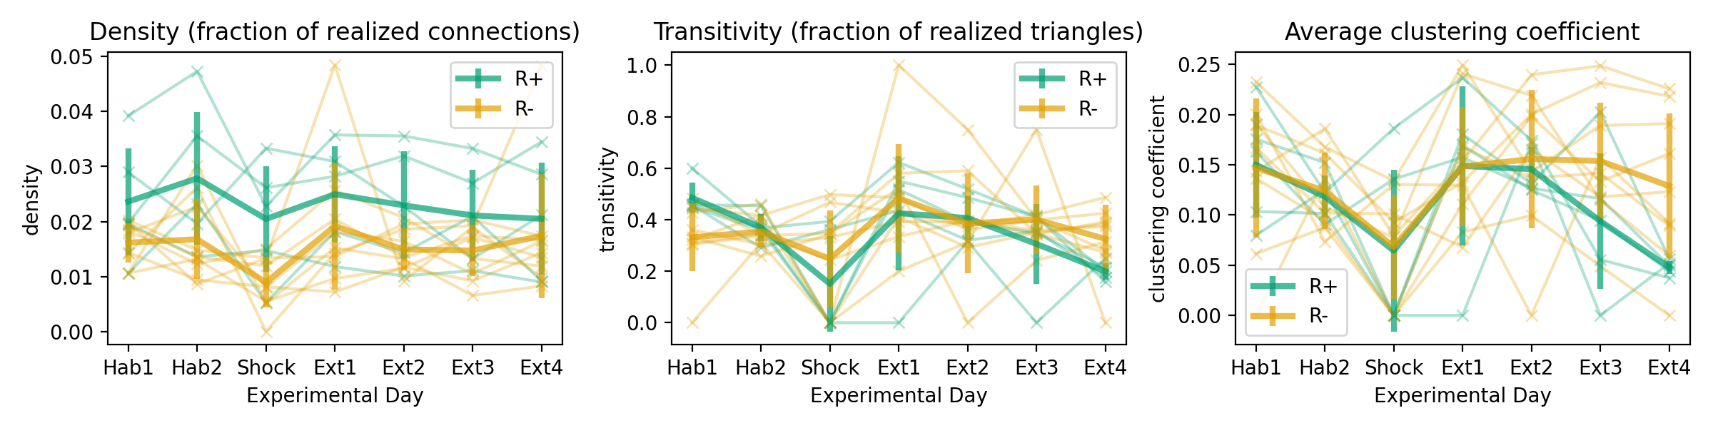
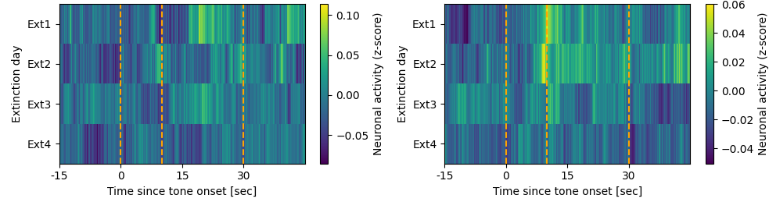


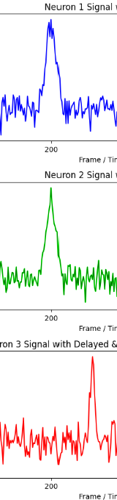

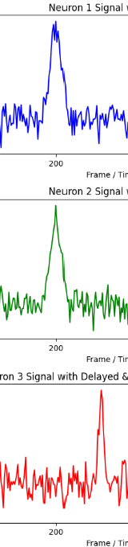
Differential adaptive regulation of fear extinction: Insights from behavioral and neuronal network analysis in trauma-induced stress resilient and susceptible phenotypes
Larglinda Islami¹, Manuela A. Beyer², Janina Hesse², Beat Lutz¹
¹Group Molecular and Cellular Mechanisms of Resilience, Leibniz Institute for Resilience Research, Mainz, Germany ²Group Computational Resilience Research, Leibniz Institute for Resilience Research, Mainz, Germany
BACKGROUND
Following a traumatic event, stress-susceptible individuals may develop post-traumatic stress disorder (PTSD), which is characterized by intrusive re-experiencing of the fearful event, impaired fear-safety learning, and altered cognition. These changes are primarily driven by dysregulation in the medial prefrontal cortex (mPFC).
Despite extensive research on fear extinction learning and its underlying neural mechanisms, there remains a limited understanding of how stress resilience and susceptibility are reflected in dynamic brain networks and how these networks shape (mal)adaptive behavioral responses.
In this study, we utilized a PTSD mouse model and performed data-driven stratification to classify resilient and susceptible phenotypes.
By employing calcium imaging in freely moving animals, we explored the role of mPFC prelimbic pyramidal cells in stress-induced neural and behavioral alterations during fear extinction training.
EXPERIMENTAL TIMELINE
CALCIUM IMAGING: Neural Extinction Patterns in R+ vs. R- Animals
NETWORK METRICS DURING EXTINCTION TRAINING
Neuronal activity can be measured by calcium imaging, with high luminance indicating high levels of neuronal activity.
Luminance plot for Extinction Day Ext1 to Ext4 showing neuronal activity as mean luminance across all neurons and CS+ tone presentations (z-score normalized) aligned to the CS+ event. Dark colors indicate low or no neuronal activity, while lighter colors show high neuronal activity (Preliminary results). Lines mark 1.) tone onset, 2.) expected shock timing, and 3.) tone's end.
The data suggest that following Auditory Fear Conditioning, R- animals display a stronger response to the expected shock timing than R+ animals, especially on days 1 and 2. This response diminishes over time, indicating extinction. In summary, mean neuronal activity differs for R+ and R- animals in response to CS+ tones.
FUNCTIONAL CONNECTIVITY OF NEURONS
NETWORK METRICS
Network metrics over Experimental Days, showing Density, Transitivity and Average clustering coefficient from Habituation (Hab1, Hab2) to Ext4.
In this preliminary analysis, density remains relatively constant for both R+ (resilient) and R- (susceptible) networks, with R+ showing slightly higher density, and R- networks have more nodes overall. Transitivity and the average clustering coefficient decrease more in R+ over time, indicating a greater reduction in and the average number of triangles connected to a node, particularly in the R+ group.. Overall, R+ shows a stronger decrease during extinction, compared to R-.
//Darker nodes, better visible NW – make clear one session, only active neurons
Examples for networks from metric analysis, which are constructed for individual animals (R+ left, R- right) for Days Ext1 and Ext4 with a correlation threshold of 0.2 to access connectivity. Comparing Day Ext1 and Ext4, the R+ animals show a decrease in transitivity, whereas the R- animals remain the same (similar transitivity over extinction days).
R+
?
R-
?
R+
R-
Ext1 Ext4 Ext1 Ext4
connected
Scheme regarding calcium activity, illustrating functional connectivity of neurons based on simultaneous activation.
Simultaneous activity is used subsequently to generate networks per animal and experimental session, where neurons are then functionally connected by activity.
Neuronal activity
Neuron 1 Neuron 2 Neuron 3
Time
Time
Time
PRELIMINARY SUMMARY
Luminescence heatmaps revealed differences in neural activity between R+ (resilient) and R- (susceptible) groups following Auditory Fear Conditioning, with R- showing more activation to the expected shock. While R- animals seem to maintain a constant level of network complexity, the R+ group exhibited a decrease in complexity as extinction progressed over subsequent days. These findings suggest that network activity is more coordinated in R+ than R- animals, and that extinction leads to a more linear, chain-like processing of information, that is reached faster in R+ compared to R- animals.
not connected
Density, transitivity and average clustering are key metrics for interpreting a network mathematically. Density represents the ratio of actual to possible connections, indicating how interconnected the network is. Transitivity represents the ratio of actual to possible triangles, while the average clustering coefficient measures the likelihood that two neighbors are also connected such that the neurons form a triangle. Both measures reflect the network’s tendency to form connected groups.
REFERENCES
Busch, A. M., Kovlyagina, I., Lutz, B., Todorov, H., & Gerber, S. (2022). beeRapp: an R shiny app for automated high-throughput explorative analysis of multivariate behavioral data. Bioinformatics Advances, 2(1). https://doi.org/10.1093/bioadv/vbac082
Hagberg, A. A., Schult, D. A., & Swart, P. J. (2008). Exploring network structure, dynamics, and function using NetworkX. In Gäel Varoquaux, Travis Vaught, & Jarrod Millman (Eds.), Proceedings of the 7th Python in Science Conference (SciPy2008) (pp. 11–15). Pasadena, CA, USA.

