Slide 1

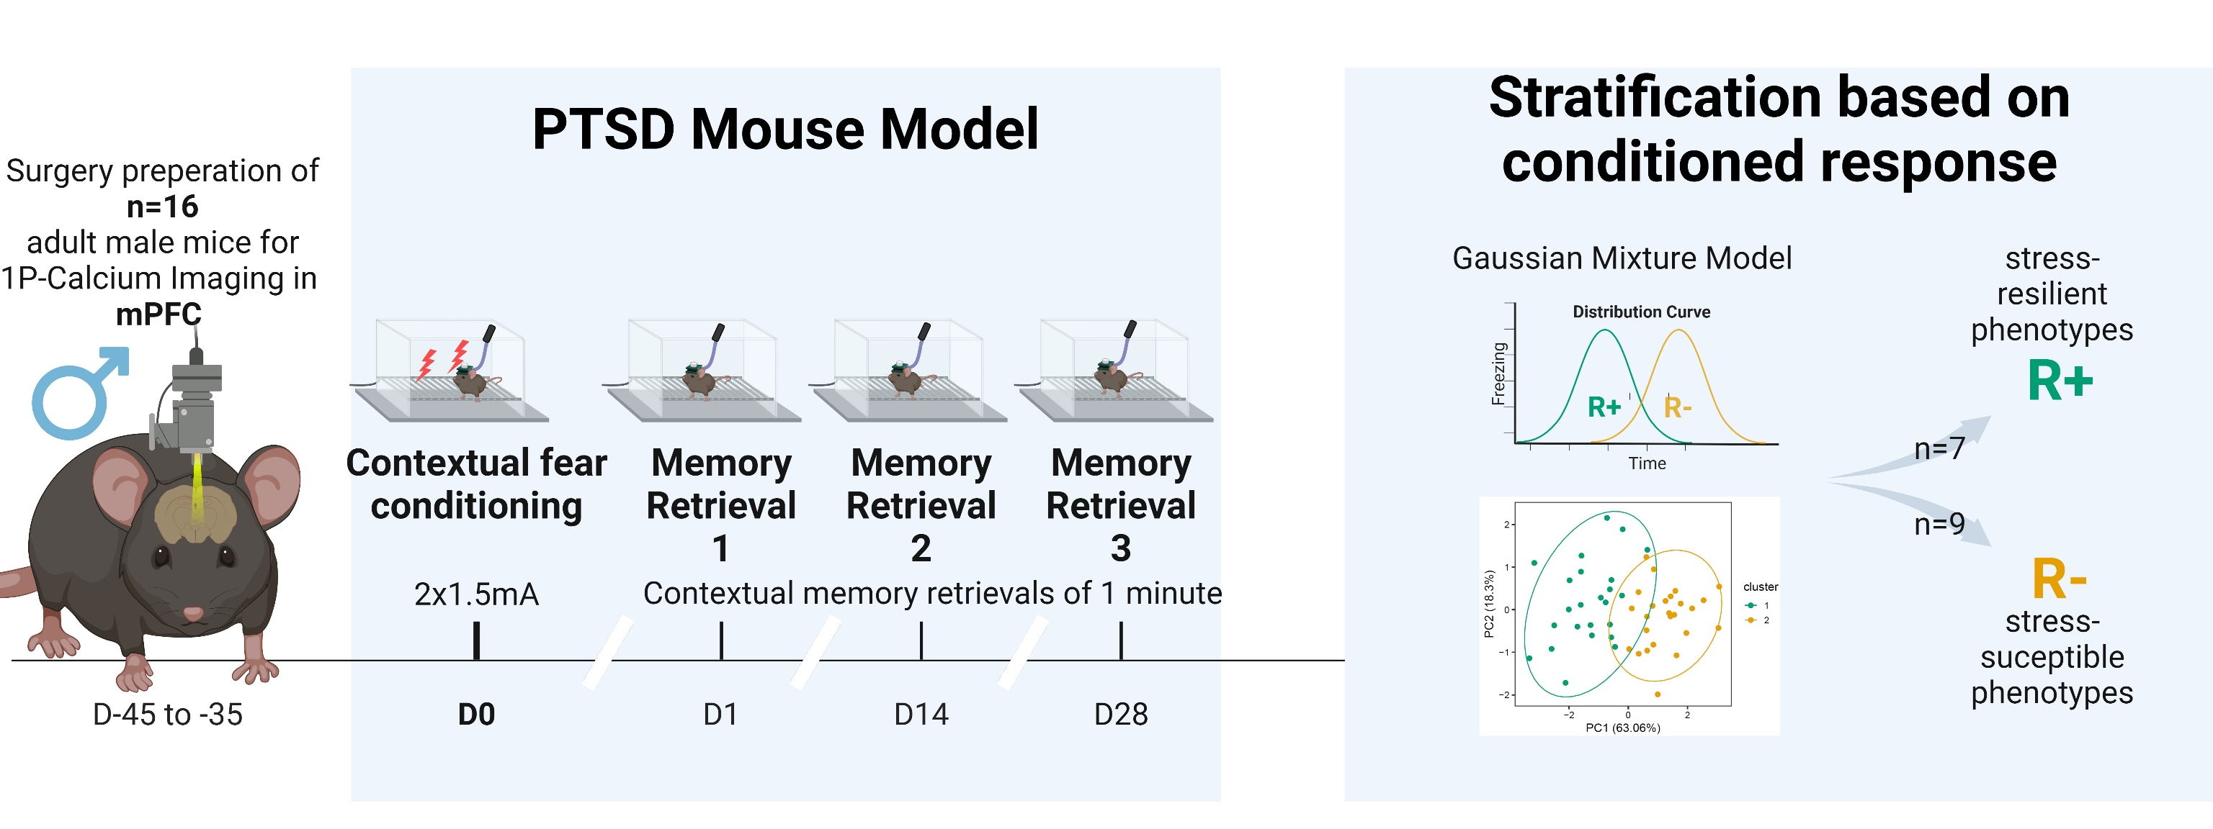
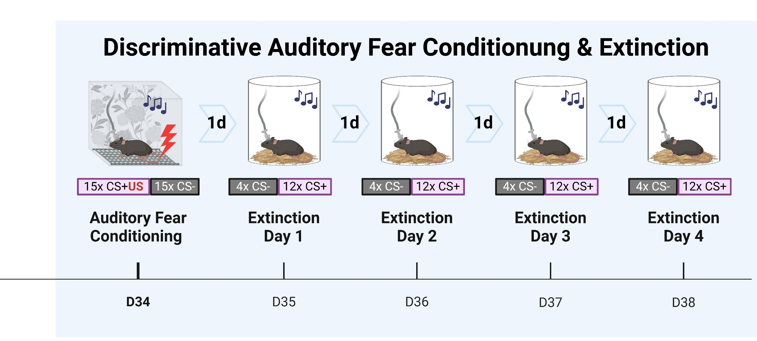

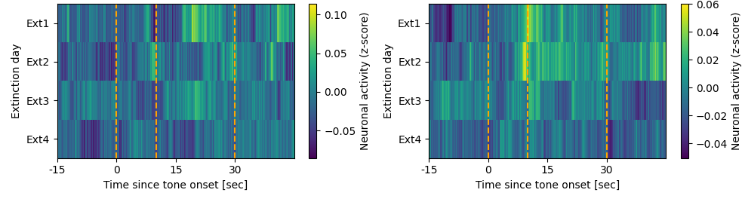
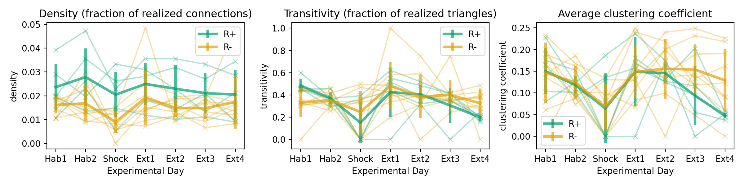


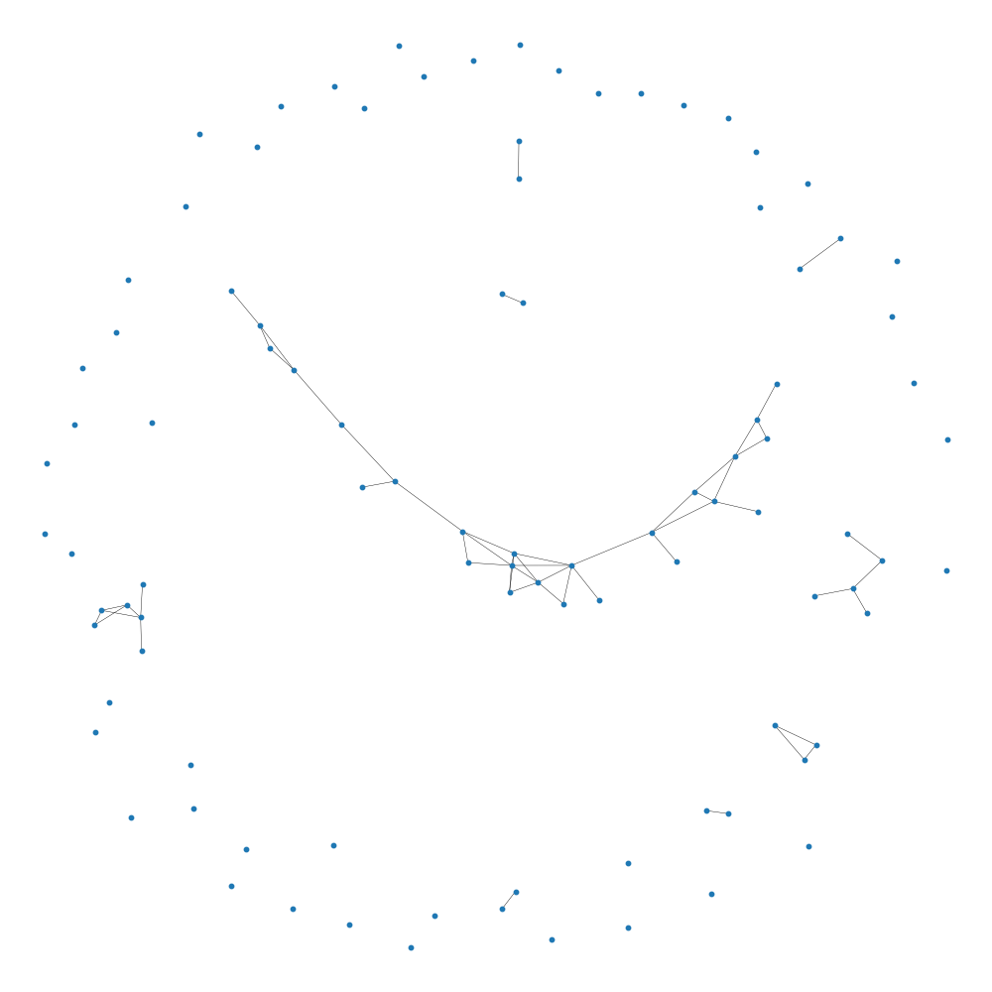
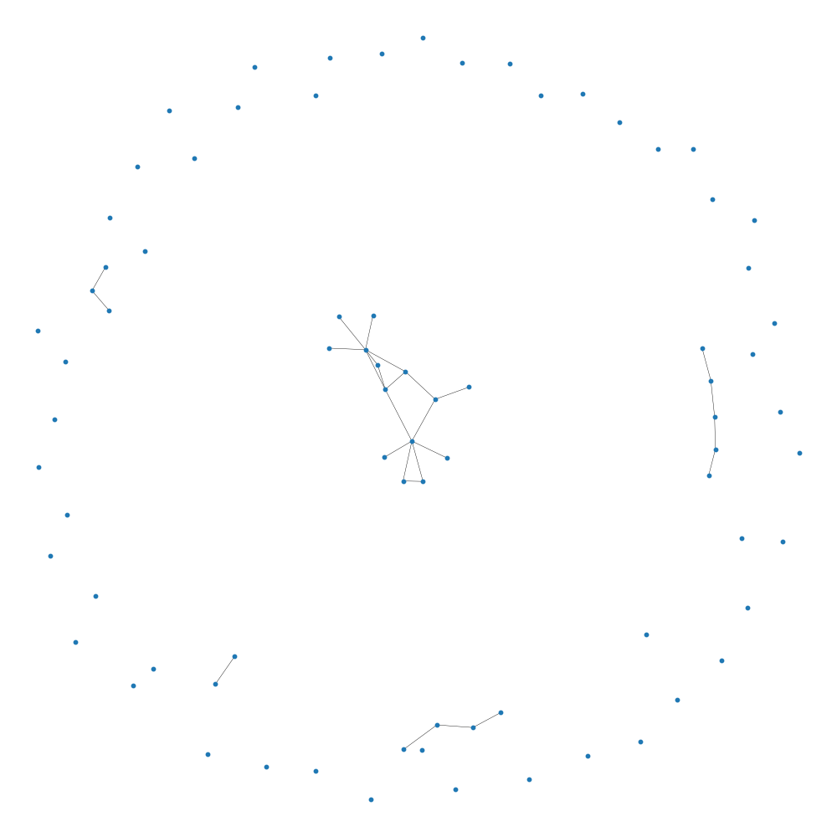
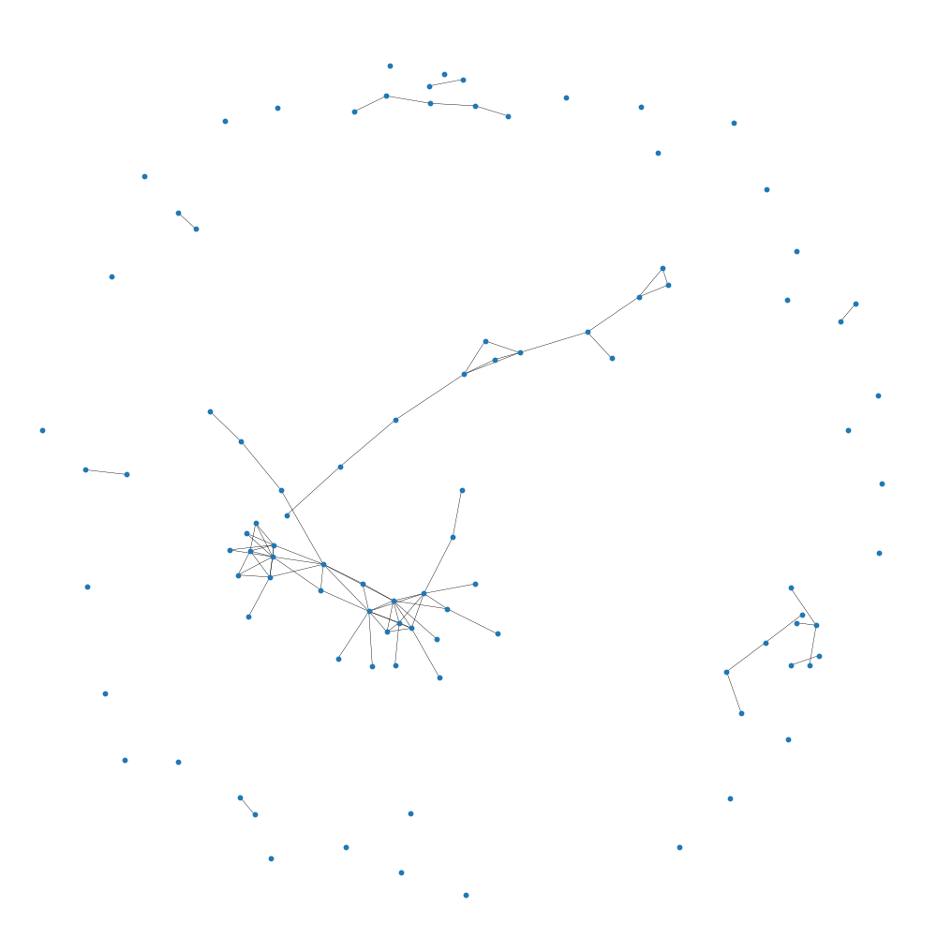
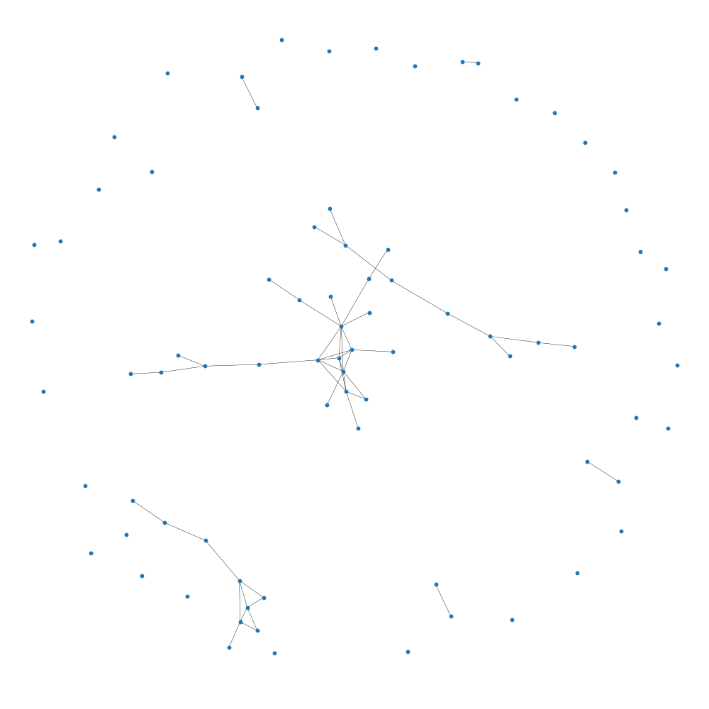
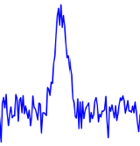

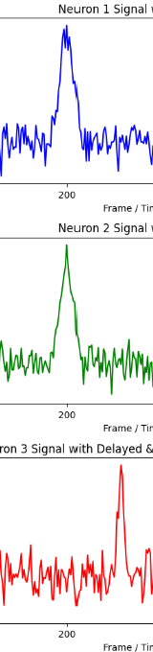
Differential adaptive regulation of fear extinction: Insights from behavioral and neuronal network analysis in trauma-induced stress resilient and susceptible phenotypes
Larglinda Islami¹, Manuela A. Beyer², Janina Hesse², Beat Lutz¹
¹Group Molecular and Cellular Mechanisms of Resilience, Leibniz Institute for Resilience Research, Mainz, Germany ²Group Computational Resilience Research, Leibniz Institute for Resilience Research, Mainz, Germany
BACKGROUND
Following a traumatic event, stress-susceptible individuals may develop post-traumatic stress disorder (PTSD), which is characterized by intrusive re-experiencing of the fearful event, impaired fear-safety learning, and altered cognition. These changes are primarily driven by dysregulation in the medial prefrontal cortex (mPFC).
Despite extensive research on fear extinction learning and its underlying neural mechanisms, there remains a limited understanding of how stress resilience and susceptibility are reflected in dynamic brain networks and how these networks shape (mal)adaptive behavioral responses.
In this study, we utilized a PTSD mouse model and performed data-driven stratification to classify resilient and susceptible phenotypes.
By employing calcium imaging in freely moving animals, we explored the role of mPFC prelimbic pyramidal cells in stress-induced neural and behavioral alterations during fear extinction training.
EXPERIMENTAL TIMELINE
CALCIUM IMAGING: Neural Extinction Patterns in R+ vs. R- Animals
NETWORK METRICS DURING EXTINCTION TRAINING
In this preliminary analysis, density remains relatively constant for both R+ (resilient) and R- (susceptible) networks, with R+ showing slightly higher density, though R- networks have more nodes overall. Transitivity and the average clustering coefficient decrease more in R+ over time, indicating a greater reduction in network complexity and the average number of triangles connected to a node, particularly in the R+ group. R+ shows a stronger decrease during extinction, compared to R-.
Networks are constructed for individual animals (R+ left, R- right) with a threshold of 0.2 to access connectivity. Extinction Day 1 and 4 are visualized. R+ shows a decrease in transitivity and complexity from day 1 to 4, whereas R- remains same (similar transitivity over extinction days)
Neuronal activity can be measured by calcium imaging, with high luminance indicating high levels of neuronal activity.
Luminance plot for Extinction Day 1 to 4 showing mean luminance (z-score normalized) in the time interval preceding, during and following the CS+ event. Dark colors indicate low or no neuronal activity, while lighter colors show high neuronal activity (Preliminary results).
The data represents the average across all neurons and CS+ tone presentations after Auditory Fear Conditioning. Three vertical lines mark 1.) the onset of the tone, 2.) the expected shock timing, and 3.) the tone's end. Shown data suggest that R- animals display a stronger response to the expected shock timing, especially on days 1 and 2, with this response diminishing over time, indicating extinction. Mean neuronal activity differs for R+ and R- animals in response to CS+ tones.
Density, transitivity and average clustering are key metrics for interpreting a network mathematically. Density represents the ratio of actual to possible connections, indicating how interconnected the network is. Transitivity measures the likelihood that two neighbors of a neuron are also connected, reflecting the network's tendency to form closely connected groups. Average clustering quantifies the tendency of nodes to form tight clusters by measuring the average probability that a node’s neighbors are interconnected.
R+
R-
R+
Extinction Day 1
Extinction Day 4
R-
Extinction Day 1
Extinction Day 4
connected
Luminance traces illustrate functional connectivity of neurons based on simultaneous activation.
Simultaneous activity is used subsequently to generate networks per animal and experimental session, where neurons are then functionally connected by activity.
Neuronal activity
Time
Time
Time
not connected
SUMMARY
Luminescence heatmaps revealed differences in neural activity between R+ (resilient) and R- (susceptible) groups following Auditory Fear Conditioning, with R- showing more activation to the expected shock. While R- animals seem to maintain a constant level of network complexity, the R+ group exhibited a decrease in complexity as extinction progressed over subsequent days. Network metrics revealed a greater reduction in complexity for R+ animals over time, indicating altered connectivity during extinction. Further analysis is needed to validate these preliminary findings.
REFERENCES
Busch, A. M., Kovlyagina, I., Lutz, B., Todorov, H., & Gerber, S. (2022). beeRapp: an R shiny app for automated high-throughput explorative analysis of multivariate behavioral data. Bioinformatics Advances, 2(1). https://doi.org/10.1093/bioadv/vbac082
Thurman, S. T., Guizar-Sicairos, M., & Fienup, J. R. (2008). Efficient subpixel image registration algorithms. Optics Letters, 33(2), 156–158. https://doi.org/10.1364/OL.33.000156
Zhou, P., Resendez, S. L., Rodriguez-Romaguera, J., Jimenez, J. C., Neufeld, S. Q., Giovannucci, A., Friedrich, J., Pnevmatikakis, E. A., Stuber, G. D., Hen, R., Kheirbek, M. A., Sabatini, B. L., Kass, R. E., & Paninski, L. (2018). Efficient and accurate extraction of in vivo calcium signals from microendoscopic video data. eLife, 7. https://doi.org/10.7554/eLife.28728
Sheintuch, L., Rubin, A., Brande-Eilat, N., Geva, N., Sadeh, N., Pinchasof, O., & Ziv, Y. (2017). Tracking the same neurons across multiple days in Ca2+ imaging data. Cell Reports, 21(4), 1102–1115. https://doi.org/10.1016/j.celrep.2017.10.013
Hagberg, A. A., Schult, D. A., & Swart, P. J. (2008). Exploring network structure, dynamics, and function using NetworkX. In Gäel Varoquaux, Travis Vaught, & Jarrod Millman (Eds.), Proceedings of the 7th Python in Science Conference (SciPy2008) (pp. 11–15). Pasadena, CA, USA.

