Slide 1

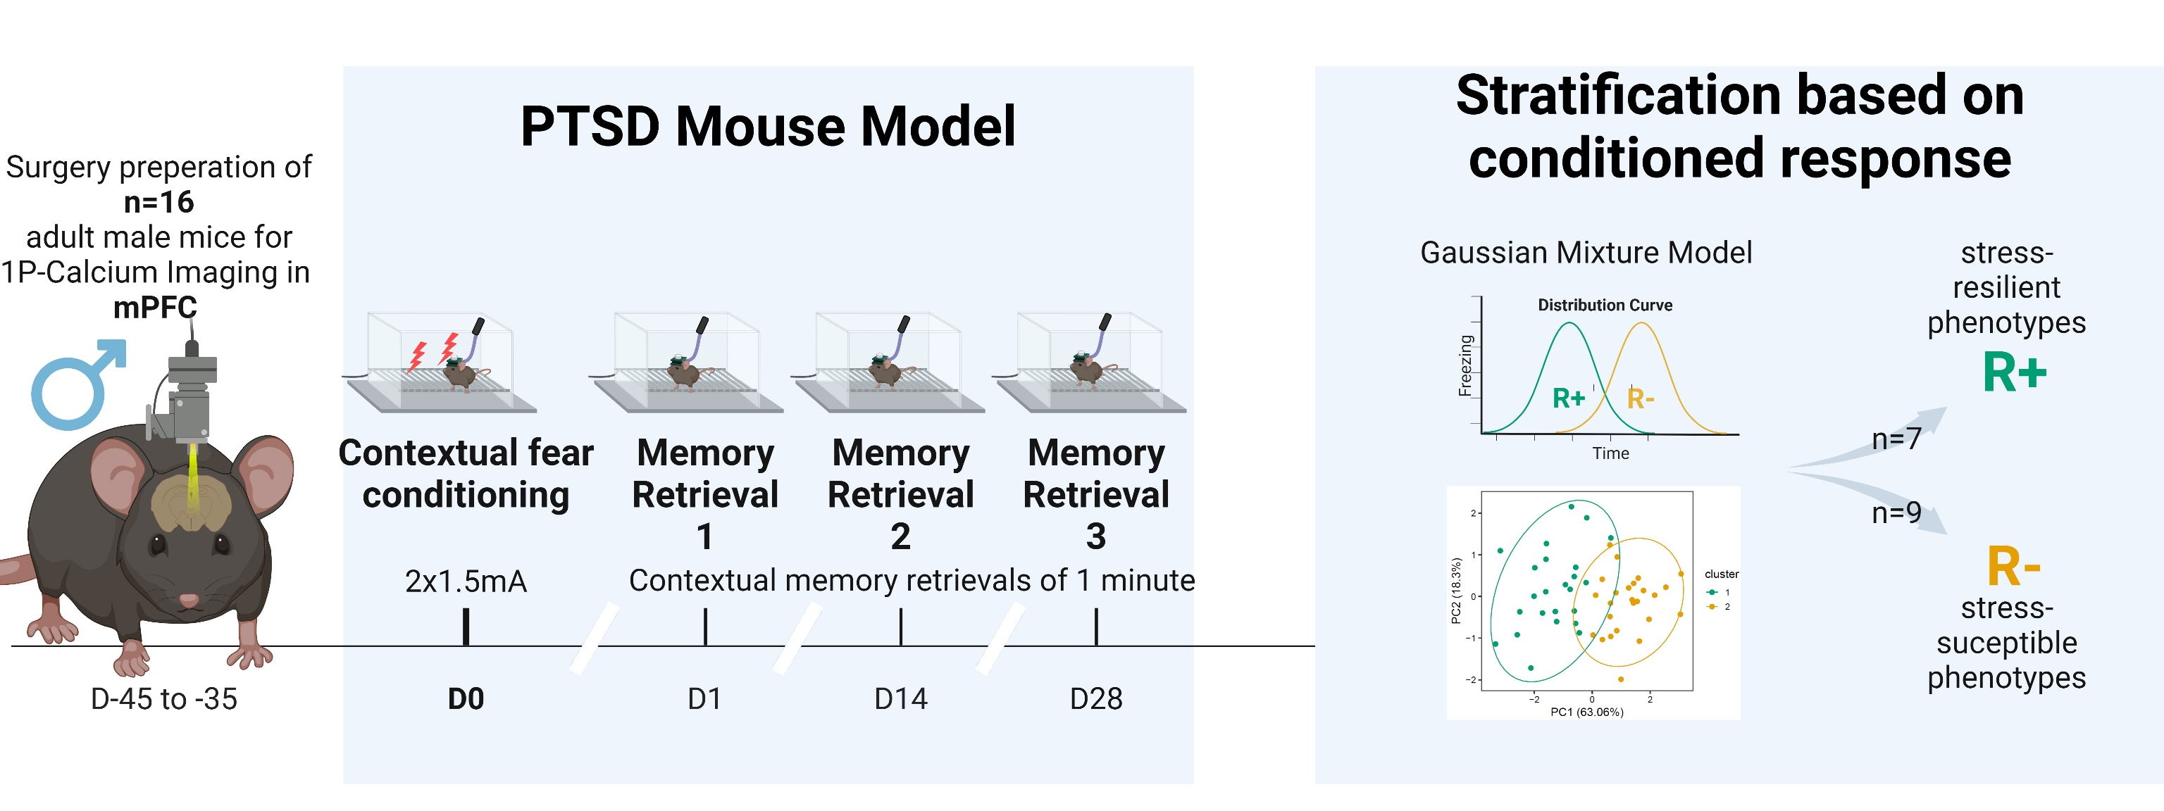
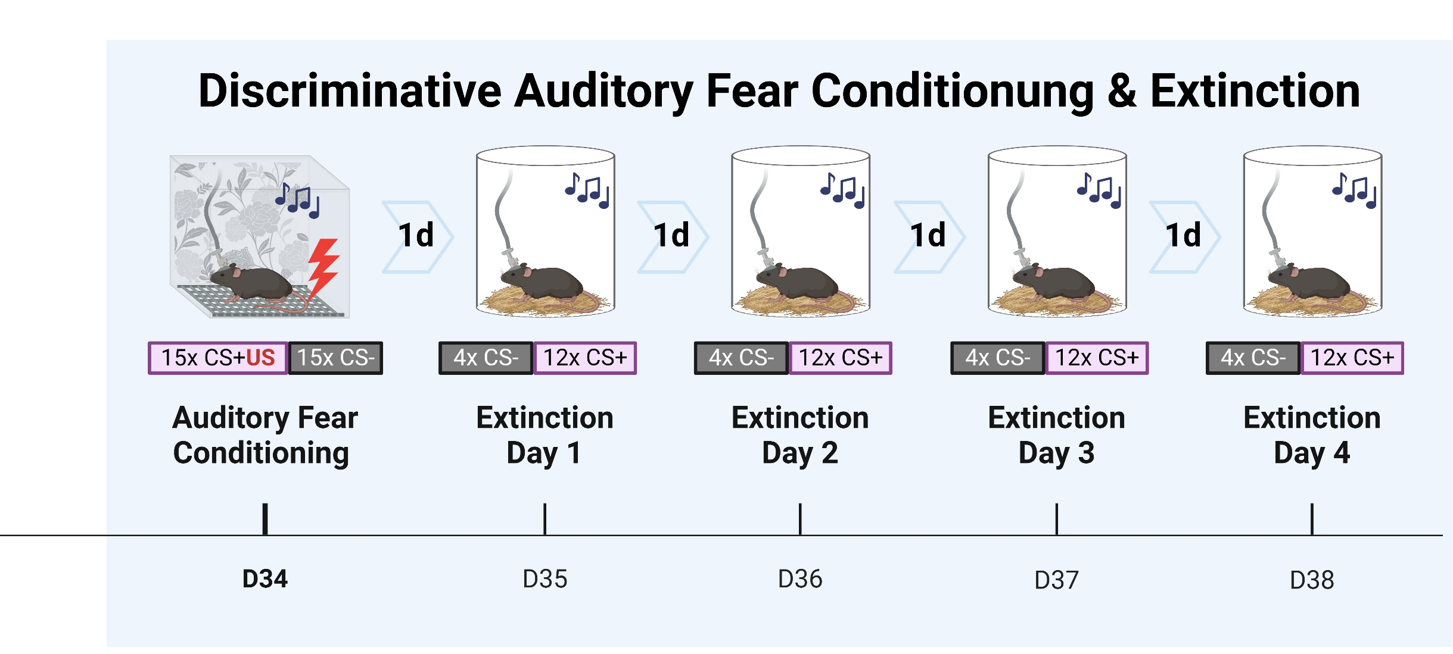

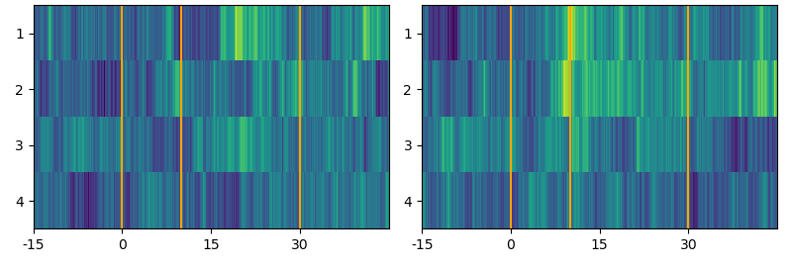
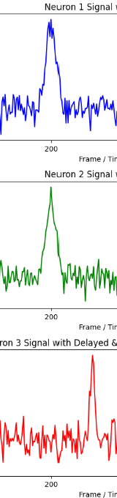


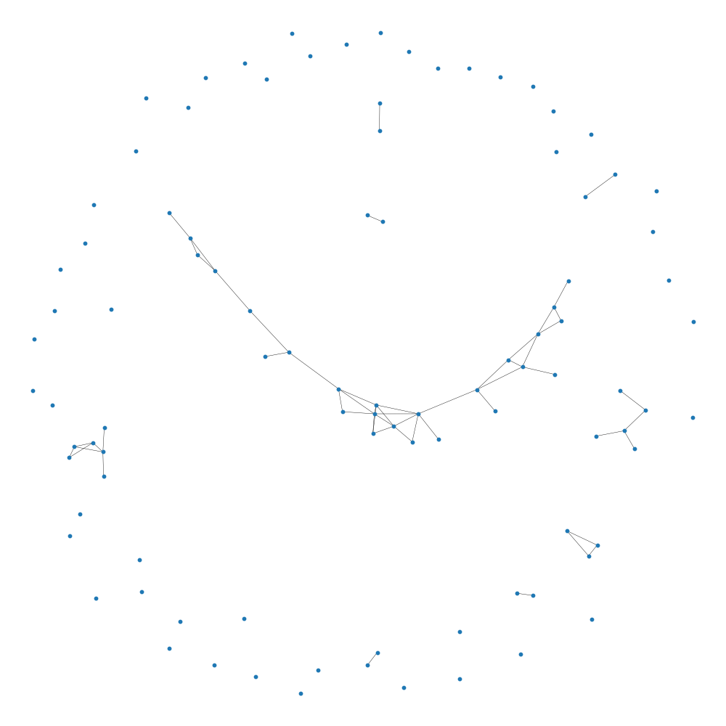
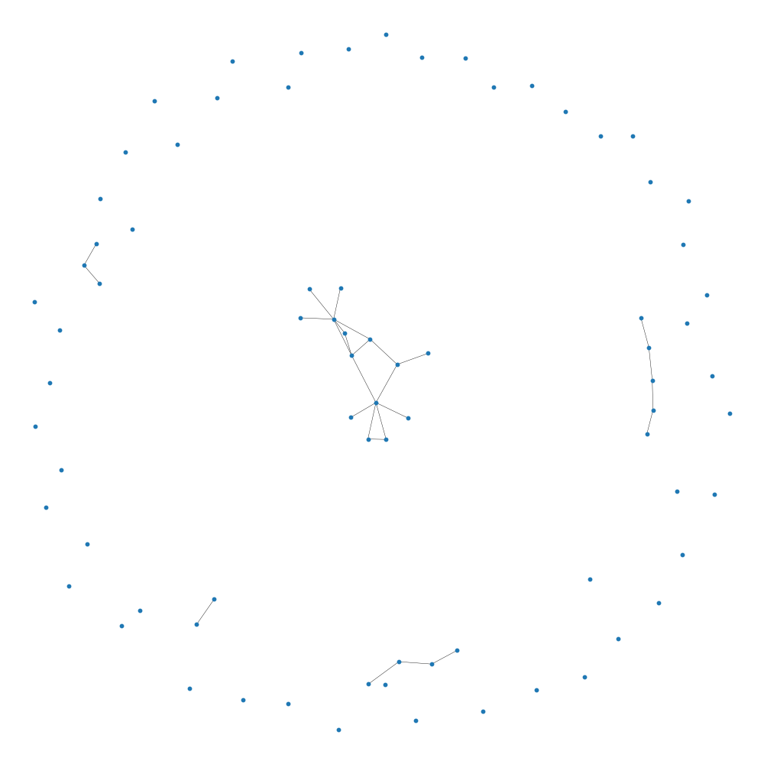
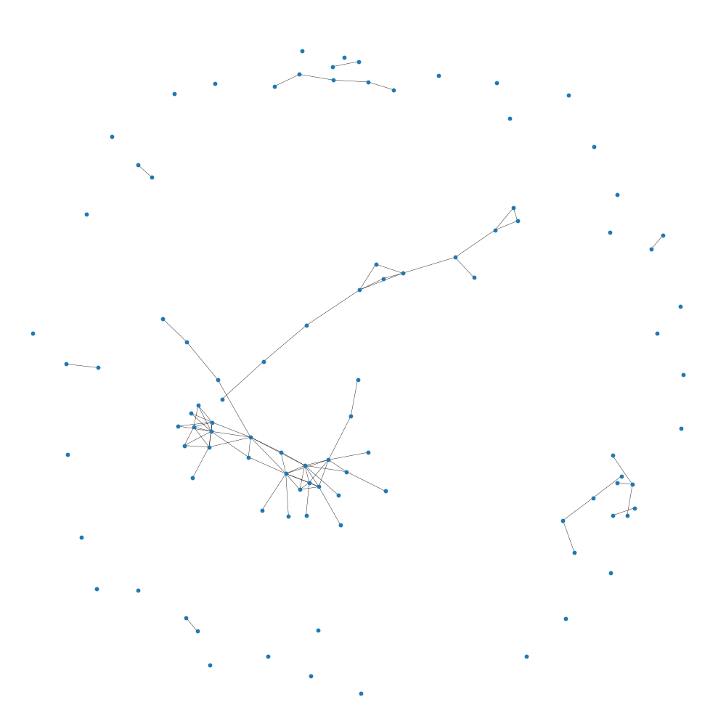
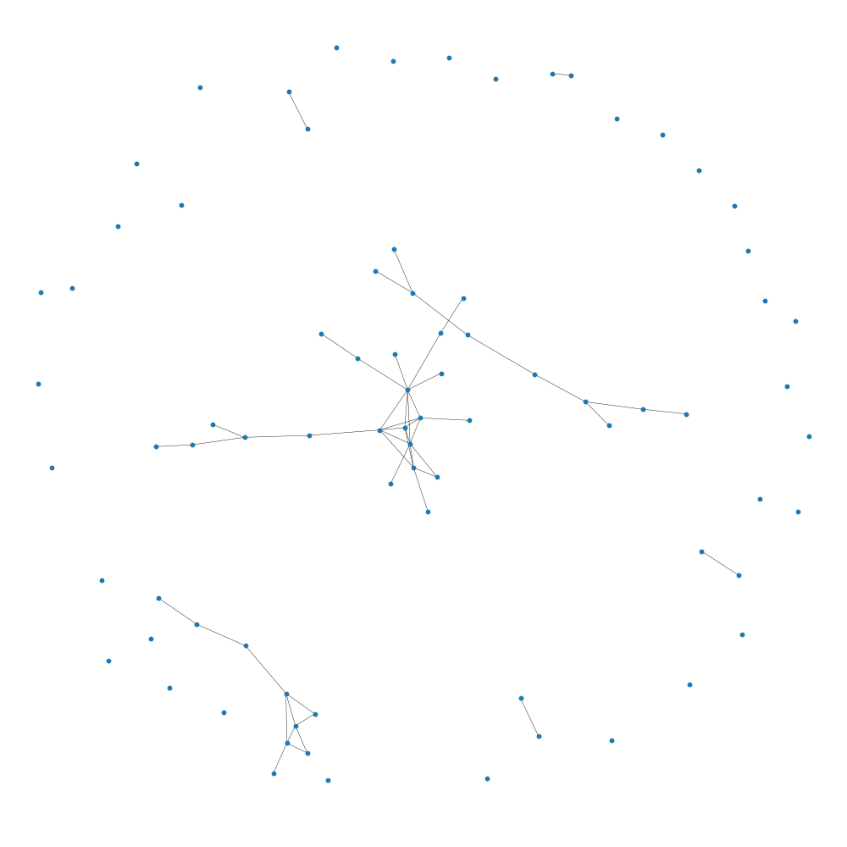
Differential adaptive regulation of fear extinction: Insights from behavioral and neuronal network analysis in trauma-induced stress resilient and susceptible phenotypes
Larglinda Islami¹, Manuela A. Beyer², Janina Hesse², Beat Lutz¹
¹Group Molecular and Cellular Mechanisms of Resilience, Leibniz Institute for Resilience Research, Mainz, Germany ²Group Computational Resilience Research, Leibniz Institute for Resilience Research, Mainz, Germany
BACKGROUND
Following a traumatic event, stress-susceptible individuals may develop post-traumatic stress disorder (PTSD), which is characterized by intrusive re-experiencing of the fearful event, impaired fear-safety learning, and altered cognition. These changes are primarily driven by dysregulation in the medial prefrontal cortex (mPFC).
Despite extensive research on fear extinction learning and its underlying neural mechanisms, there remains a limited understanding of how stress resilience and susceptibility are reflected in dynamic brain networks and how these networks shape (mal)adaptive behavioral responses.
In this study, we utilized a PTSD mouse model and performed data-driven stratification to classify resilient and susceptible phenotypes.
By employing calcium imaging in freely moving animals, we explored the role of mPFC prelimbic pyramidal cells in stress-induced neural and behavioral alterations during fear extinction training.
EXPERIMENTAL TIMELINE
CALCIUM IMAGING: Neural Extinction Patterns in R+ vs. R- Animals
NETWORK DYNAMICS DURING EXTINCTION TRAINING
The connections between nodes can be formed based on structural connectivity, meaning the physical, anatomical connections between nodes (e.g. neurons), while functional connectivity represents the statistical dependencies or correlations in activity between nodes, regardless of whether there is a direct physical connection. As this analysis strives to understand the functional relationship, the connections in the shown networks rely on functional connectivity to quantify dependencies independent of anatomy.
Network theory underlies the construction of networks to understand complex systems. It is widely used to model and analyze the interplay of various components within a system. The main tool to model networks is the theoretical construct of a graph, built from nodes and edges.
Nodes represent the basic elements of a network and serve as connection points. The edges in turn represent the connections between the individual nodes. The interpretation as a graph enables the application of a mathematical interpretation in the form of so-called metrics. Prominent metrics are Density and Transitivity. The density is the ratio between the edges present in the network and the total number of possible edges. It gives information about how interconnected the whole network is.
Transitivity is another metric that quantifies the probability that two neighbors of a particular node are also directly connected, meaning that three nodes in the graph form a ‘triangle’. It measures the tendency of a network to form closely connected communities or groups.
In the performed analysis, density remains relatively constant for both R+ (resilient) and R- (non-resilient) networks, with R+ having a slightly higher density, indicating more connections relative to the number of nodes. However, since R- networks contain significantly more nodes, caution is needed in interpreting these findings to ensure that observed effects are due to resilience rather than simply differences in network size.
In the analysis shown, the transitivity (the proportion of all possible triangles) decreases more for R+ than for R- over time, which is also true for the average clustering coefficient. This suggests that the average number of triangles connected to a given node decreases over time, emphasizing that both metrics are related and reflect a decrease in network cohesion, especially in the R+ group. //resilient susceptible
In calcium imaging, luminescence heatmaps are used to visualize quantitative neural activity by displaying fluorescence intensities that correspond to changes in intracellular calcium levels, serving as indicators of neuronal activation.
Luminance plot for Extinction Day 1 to 4 showing mean luminance (z-score normalized) in the time interval preceding, during and following the CS+ event.
The mean luminance for all animals was plotted, with R+ (resilient) and R- (susceptible) groups shown separately. Dark colors indicate low or no neuronal activity, while lighter colors show high neuronal activity. The data represents the average across all neurons and CS+ tone presentations after Auditory Fear Conditioning. Three vertical lines mark 1.) the onset of the tone, 2.) the expected shock timing (from the PTSD paradigm), and 3.) the tone's end. Shown data suggest that R- animals display a stronger response to the expected shock timing, especially on days 1 and 2, with this response diminishing over time, indicating extinction.
R+
R-
connected
not connected
Analysis for a network: Focus on Density
Analysis for a network: Focus on Transitivity
Extinction Day 1
Extinction Day 4
Extinction Day 1
Extinction Day 4
SUMMARY
Preliminary conclusion:
As extinction progresses on subsequent days, the complexity of the network decreases in the R+ animals, while the R- animals maintain a constant level of complexity.
REFERENCES
Busch, A. M., Kovlyagina, I., Lutz, B., Todorov, H., & Gerber, S. (2022). beeRapp: an R shiny app for automated high-throughput explorative analysis of multivariate behavioral data. Bioinformatics Advances, 2(1). https://doi.org/10.1093/BIOADV/VBAC082
Thurman, S. T., Guizar-Sicairos, M., & Fienup, J. R. (2008). Efficient subpixel image registration algorithms. Optics Letters, Vol. 33, Issue 2, Pp. 156-158, 33(2), 156–158. https://doi.org/10.1364/OL.33.000156
Zhou, P., Resendez, S. L., Rodriguez-Romaguera, J., Jimenez, J. C., Neufeld, S. Q., Giovannucci, A., Friedrich, J., Pnevmatikakis, E. A., Stuber, G. D., Hen, R., Kheirbek, M. A., Sabatini, B. L., Kass, R. E., & Paninski, L. (2018). Efficient and accurate extraction of in vivo calcium signals from microendoscopic video data. ELife, 7. https://doi.org/10.7554/ELIFE.28728
Sheintuch, L., Rubin, A., Brande-Eilat, N., Geva, N., Sadeh, N., Pinchasof, O., & Ziv, Y. (2017). Tracking the Same Neurons across Multiple Days in Ca2+ Imaging Data. Cell Reports, 21(4), 1102–1115. https://doi.org/10.1016/J.CELREP.2017.10.013 Hagberg, A. A., Schult, D. A., & Swart, P. J. (2008). Exploring network structure, dynamics, and function using NetworkX. In Gäel Varoquaux, Travis Vaught, & Jarrod Millman (Eds.), Proceedings of the 7th Python in Science Conference (SciPy2008) (pp. 11–15). Pasadena, CA, USA.

