Slide 1
Machine Learning Trends and Potential in Higher Education
A look at the Use cases and data
By Mandy Wallace

Slide 2
Machine Learning at UNBC
Continuing Studies partnership with RoboGarden
Learning Machine Learning at UNBC
Other uses for machine learning at UNBC

Slide 3
What is Machine Learning?
Logistical Regression
KNN Regression
Decision Tree Regression
R2 Score = 0.663
Mean Squared Error = 0.138
Root Mean Squared Error = 0.371
Mean Absolute Error = 0.23
R2 Score = 0.840
Mean Squared Error = 0.065
Root Mean Squared Error = 0.256
Mean Absolute Error = 0.090
R2 Score = 0.839
Mean Squared Error = 0.065
Root Mean Squared Error = 0.256
Mean Absolute Error = 0.059
Random Forest Regression
SVR Regression
ANN Regression
R2 Score = 0.906
Mean Squared Error = 0.038
Root Mean Squared Error = 0.196
Mean Absolute Error = 0.067
R2 Score = 0.837
Mean Squared Error = 0.066
Root Mean Squared Error = 0.258
Mean Absolute Error = 0.123
R2 Score = 0.889
Mean Squared Error = 0.045
Root Mean Squared Error = 0.213
Mean Absolute Error = 0.086

Slide 4
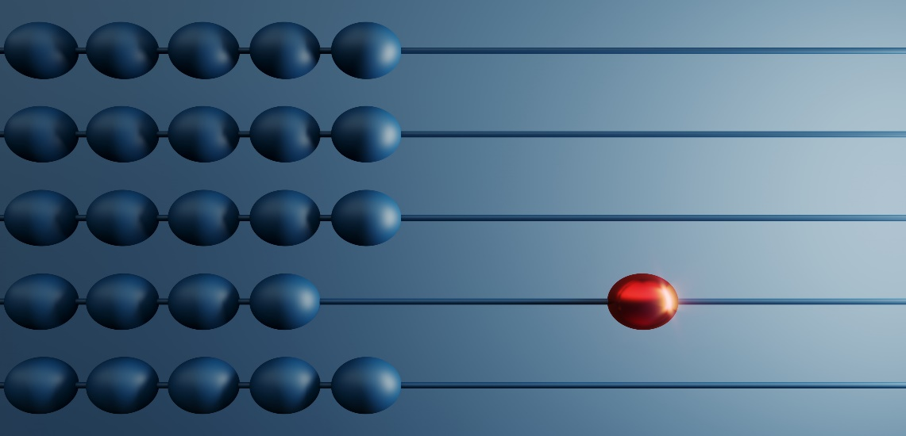
Machine Learning Trends
My aim in this project is putting together pieces of ML analyzing, data cleaning, and modelling that can be re-used in other projects
Learning to move from a single notebook version to an object-oriented reusable project for the future
Solidify and grow what we have learned so far with ML, AI networks and python coding to put it all together as a package

Slide 5
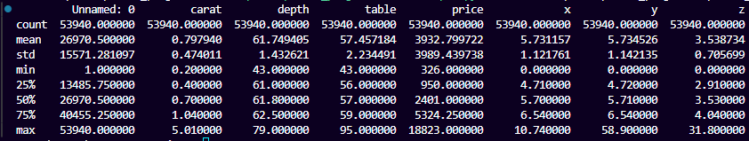
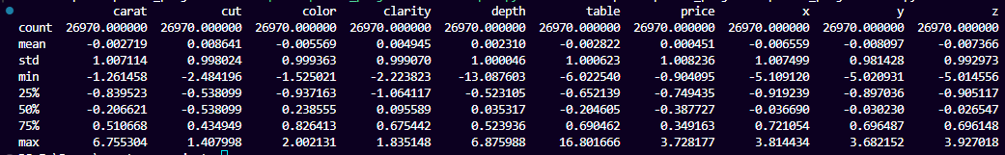
Data Used to find the Trends and how we can use Machine Learning to FIND the Trends
Before cleanup/preprocessing
Beginning Columns: 11, 3 categorical, 6 float, 2 int
Beginning Rows: 53940
Beginning Column names: Unnamed: 0, carat, cut, color, clarity, depth, table, price, x, y, z
After cleanup/preprocessing
Remaining Columns: 10, Shuffled and sampled 50%
Remaining Rows: 26970
Removed any empty, column Unnamed 0, encoded, standardized
Train 80% test 10% Val 10%

Slide 6
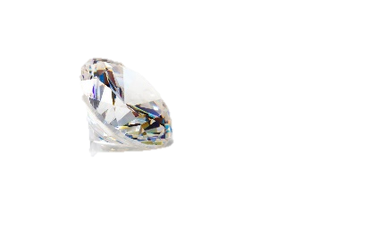
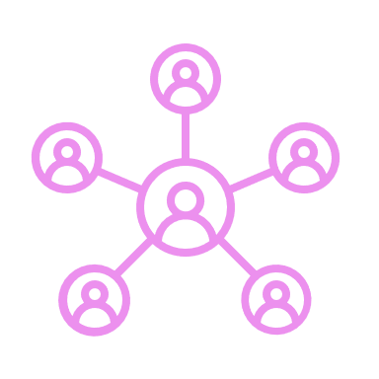
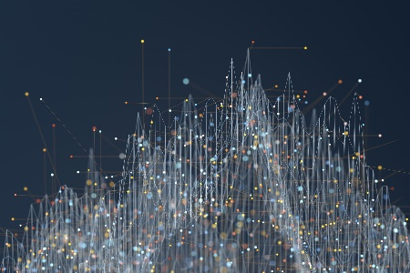
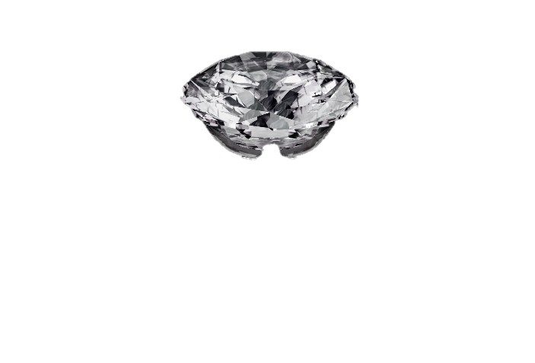
Machine Learning uses in Higher Education
There’s 3 problems we want to be able to solve essentially that add up to predicting Diamond Valuation as a whole
OR
Clustering, who is most likely to purchase based on what features and who do we therefore target?
Classification, how do features relate to overall clarity/quality?
Regression, how much does each feature influence the price/value?

Slide 7

Data Exploration and Uses
Information about the data
Description of Data
Data Visualizations
Heatmap
Pairplot
Histogram
Box plot

Slide 8
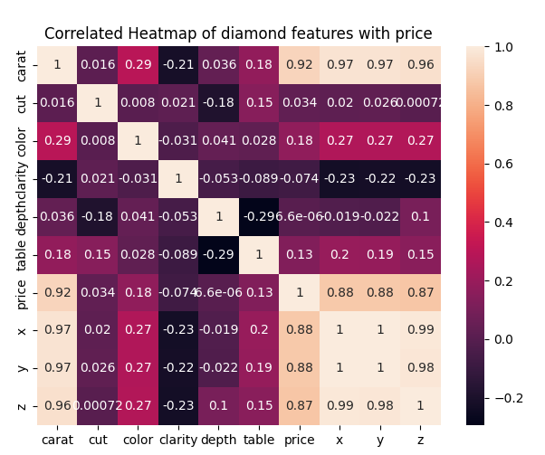
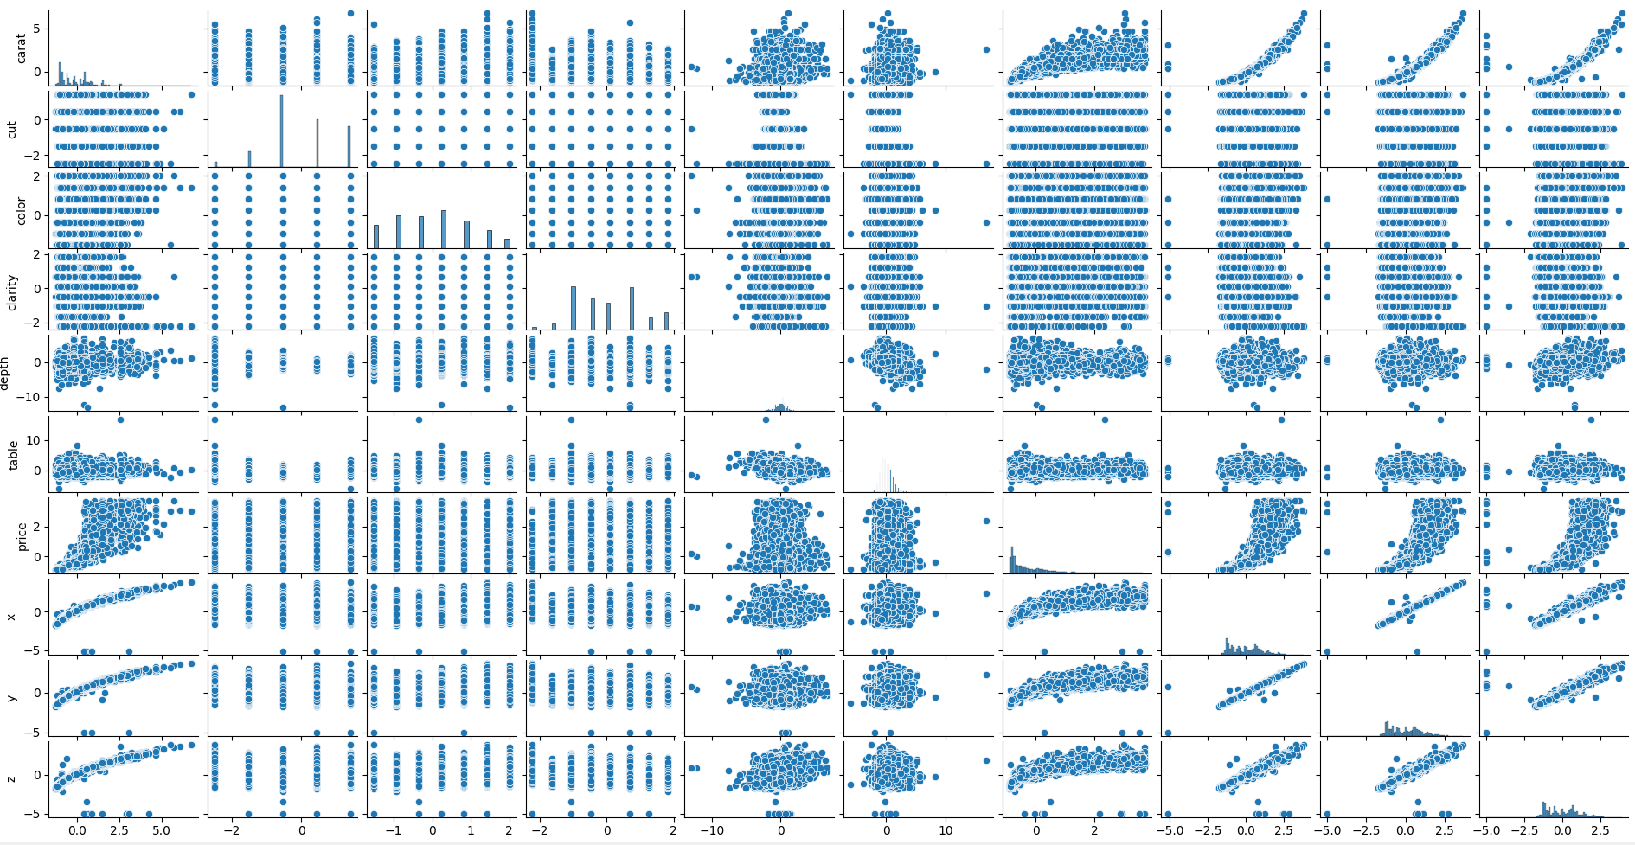
The future of Machine Learning
Heatmap
Pair Plot

Slide 9
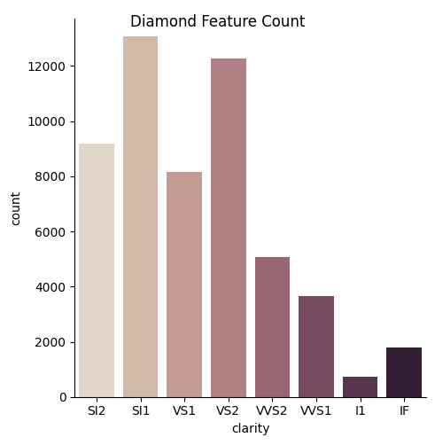
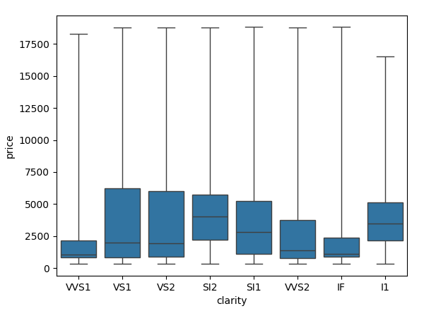
Other Possibilities for Machine Learning
Histogram
Box Plot

Slide 10


Summary
Summary
Best Model for Classification?
Very close between Random Forest and ANN, I would focus on improving those 2 further
Best model for Regression?
Again Random Forest and ANN are the best performers with Random Forest being a bit better.
Best model for Clustering?
Haven’t compared metrics yet worked more on visualization first
So much learned and so much more to grow!
Thank you to all our instructors this has been one of the best hands-on instructions, I really appreciated the format, and everyone's patience and willingness to help us to learn!

Slide 11
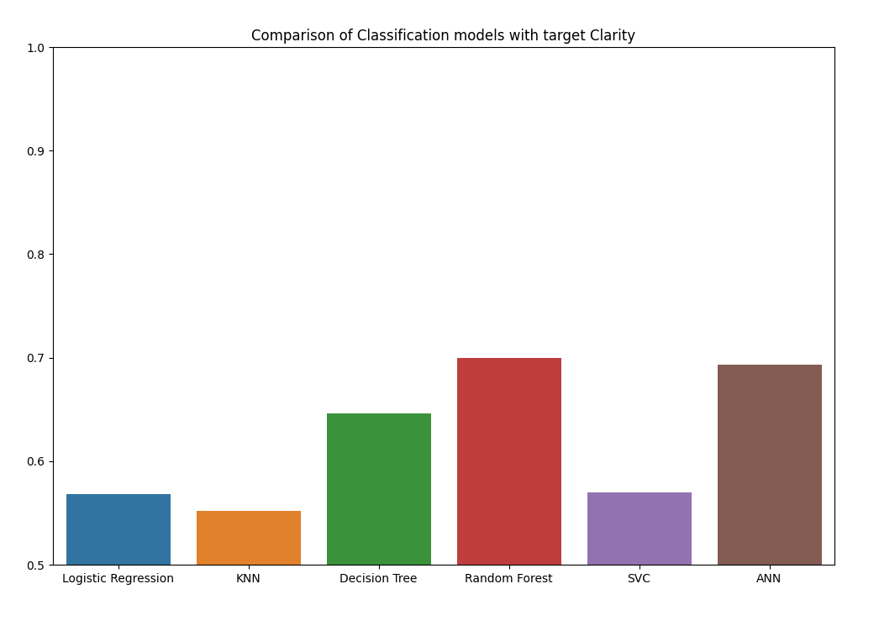
Classification Model Results
Accuracy Scores
Logistic Regression: 0.568
KNN: 0.551
Decision Tree0.646
Random Forest: 0.699
SVC: 0.569
ANN 0.692

Slide 12
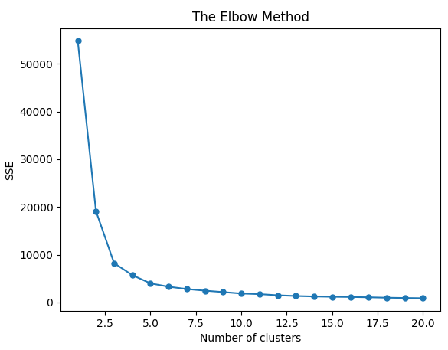
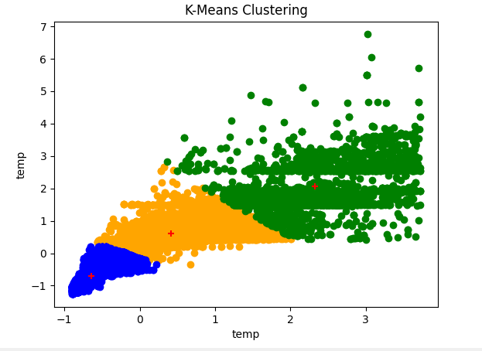
Clustering Model Results
K-Means
Cluster Visualization
Based on Elbow curve I chose n_clusters = 3
In progress – I also wanted to see the clusters visualized but have some more refining to do

Slide 13
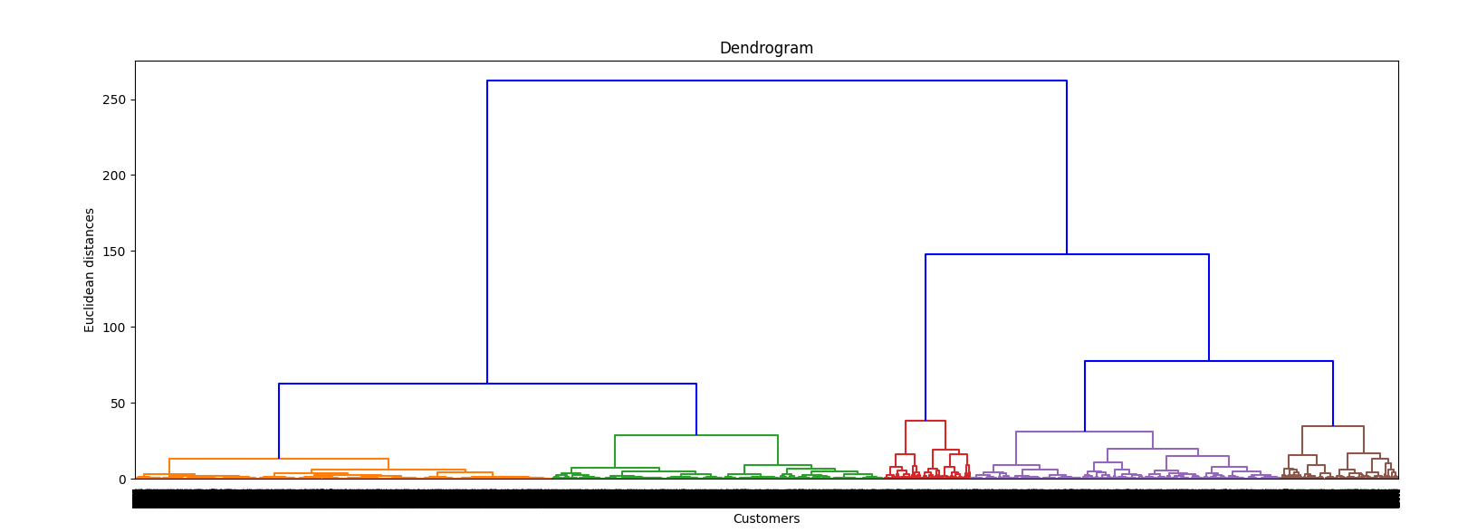
Clustering Model Results
Mean SHift
Running and clustering – haven’t yet added visualization for yet
Hierarchal agglomerative
In progress – I also wanted to see the clusters visualized so I’ve added a dendogram – using same metric – Euclidean and linkage- ward

Slide 14

Challenges and Thoughts during Project
Visualizations could use some tweaking, missing one histogram to be added (but have a base for a group one to use in future projects that works)
I struggled a bit with switching from all-in-one notebook/py file to object oriented and could definitely grow more there still and will work on that – felt like my biggest challenge at the end
Could definitely hypertune more parameters for the networks but wanted to have the whole project completed so may be a work in progress to get them even better but did meet the requirements
Making sure I’m using the right target for each section as they have different targets! I forgot initially when testing.
Very satisfying to see it all coming together as a package and lots of “Aha!” moments

