Slide 1



Capstone energy use case
Star team: Klim Mikhailov, Josie Harrison

Slide 2

Project goals
Help PyTown forecast energy demand (weekly / quarterly)
Prevent energy blackouts by balancing energy supply with energy consumption

Slide 3
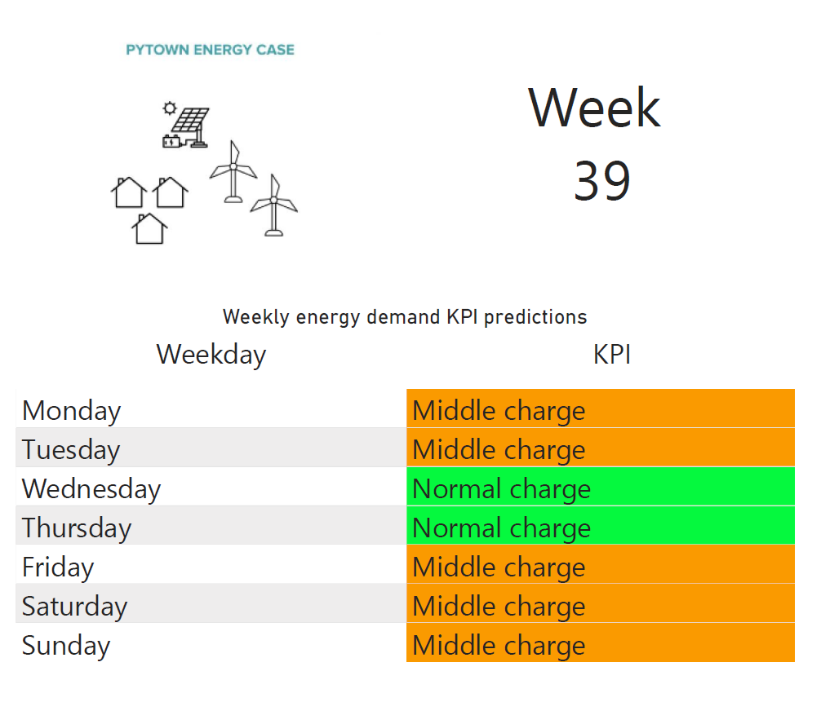
Batch (weekly) monitoring dashboard
Daily average demand prediction
Linear regression with seasonal features
Batch inference pipeline on Azure
Every week on Monday at 4:00 CEST
Data processing in batches
(96 x 7 = 672 data points)
Demand KPI classification based on three quantiles of the energy demand distribution

Slide 4
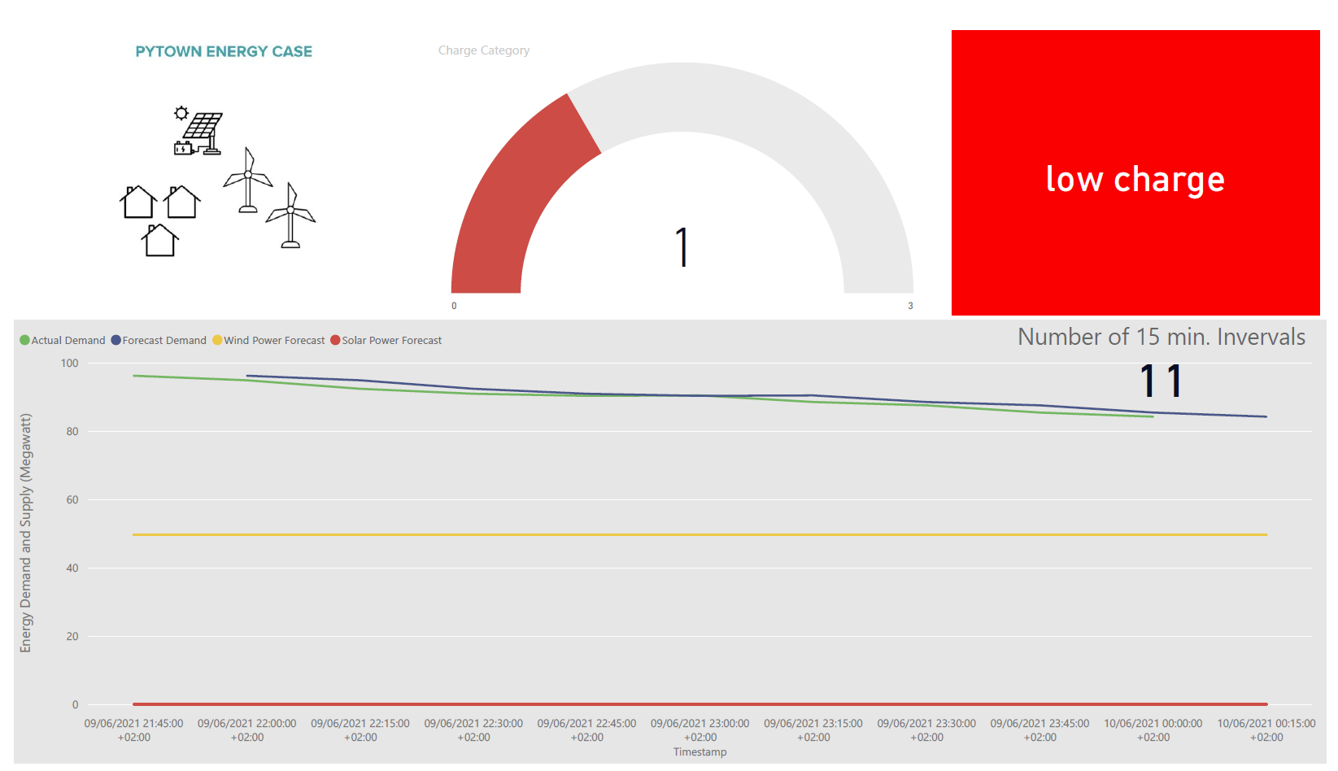
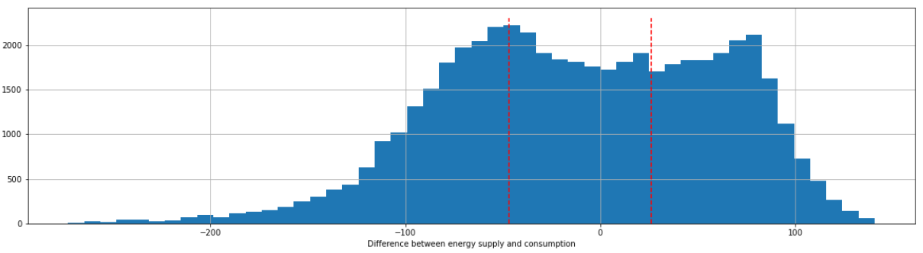
Real-time monitoring dashboard
Prediction every 15 minutes
Naive forecast
Blob-triggered Azure function
Demand KPI classification based on moving average of the difference between energy demand and energy supply (solar + wind)

Slide 5
Lessons learned
Deal with “bad” data first, then deploy
Always check for missing dependencies in your environments
Test locally, use monitoring tools
Be creative in the development of KPI, use business knowledge
Discuss your obstacles with others, they may have valuable suggestions
MLOps is great for energy use cases!

Slide 6
Thank you for attention!

