Slide 1
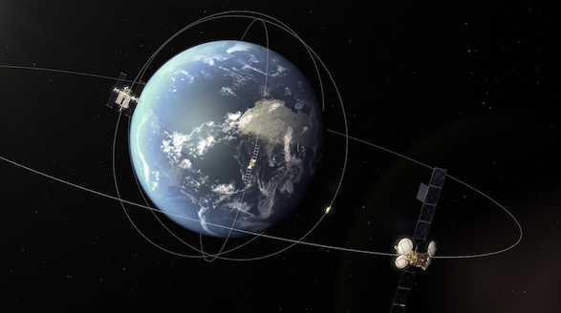

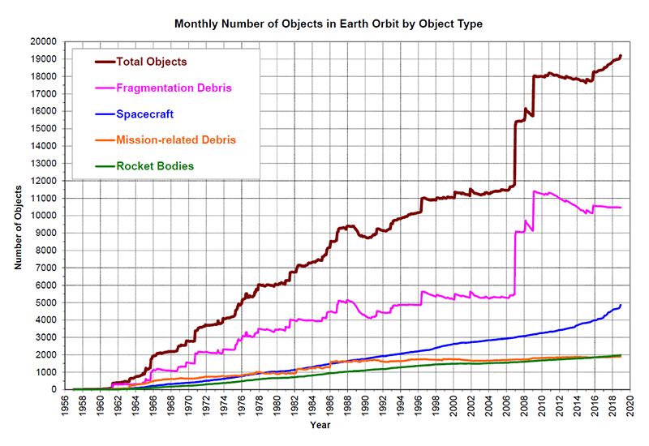
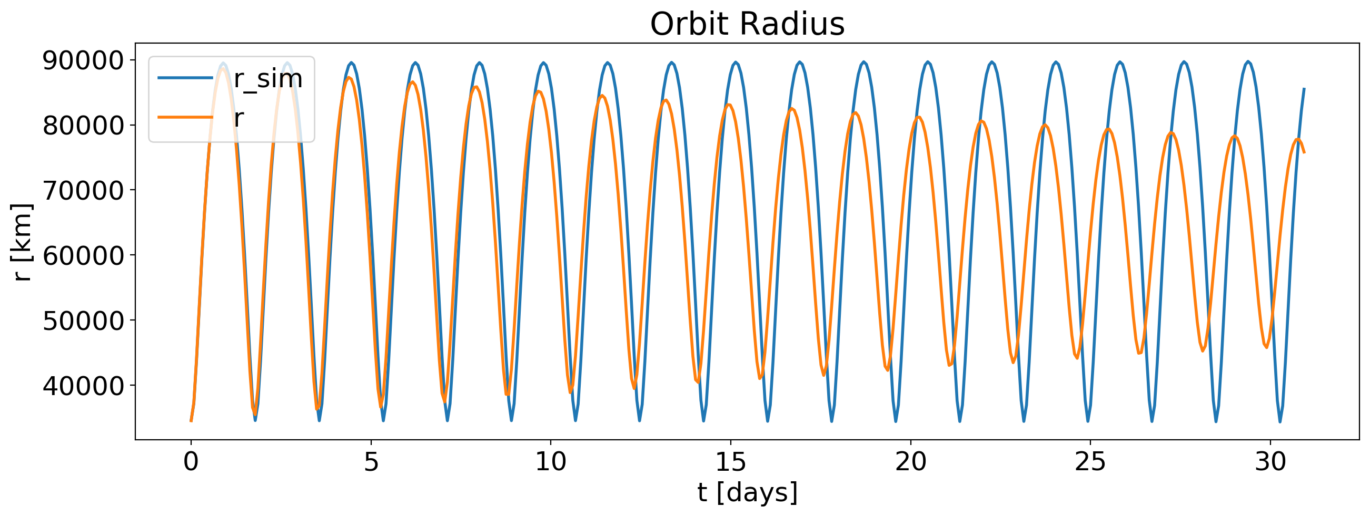
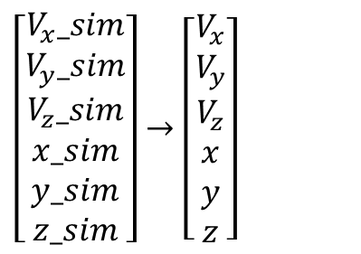
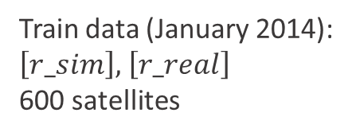
Problem statement:
Inaccurate prediction of the Earth satellite orbits can lead to dangerous collisions
Task : predict real coordinates from simulated values
$\left[\begin{aligned}V_{x}_sim \\ V_{y}_sim \\ V_{z}_sim \\ x_sim \\ y_sim \\ z_sim\end{aligned}\right]→$ $\left[\begin{aligned}V_{x} \\ V_{y} \\ V_{z} \\ x \\ y \\ z\end{aligned}\right]$
Train data (January 2014):
$\left[r_sim\right],$ $\left[r_real\right]$
600 satellites
Images: isa.int, nasa.gov

Slide 2
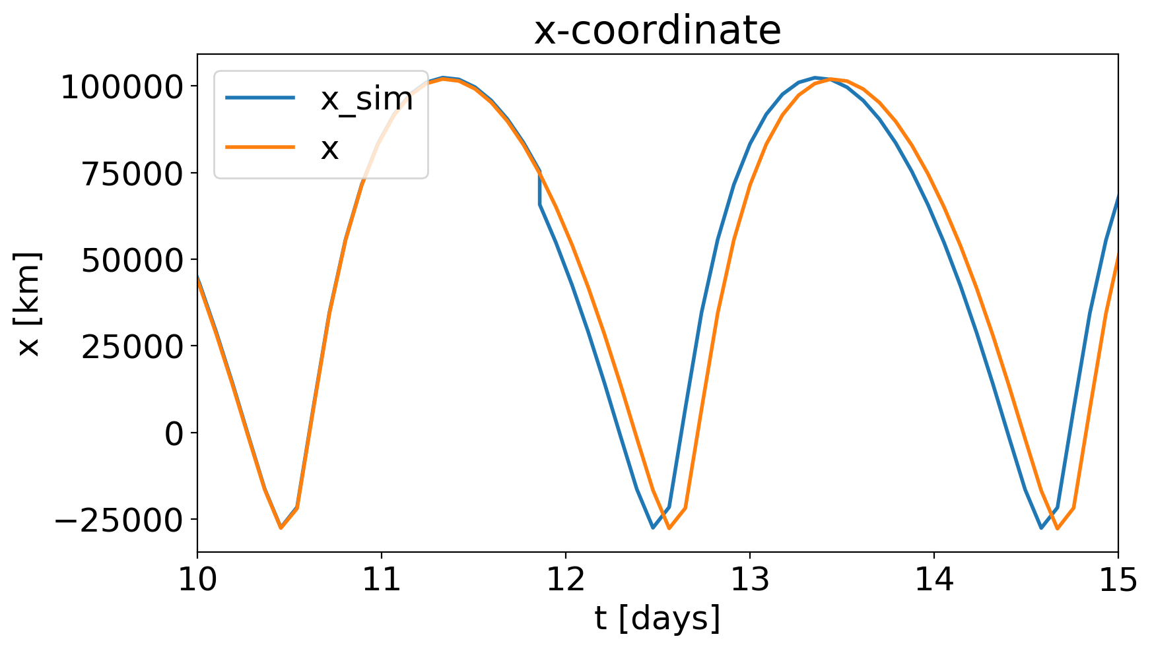
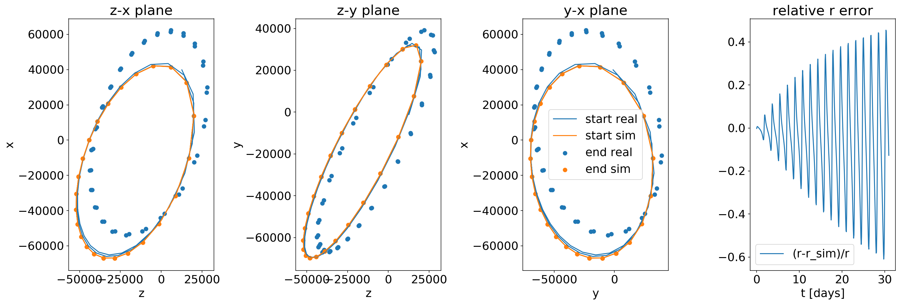
Problem statement:
Remove sudden jumps in simulated signal due to nonuniform time grid
↓
Mapping signal to the nonuniform time grid using interpolation
Address gradual dephasing and slow orbit precession
↓
Nonlinear alignment
Challenge: finding uniform approach for all satellite

Slide 3
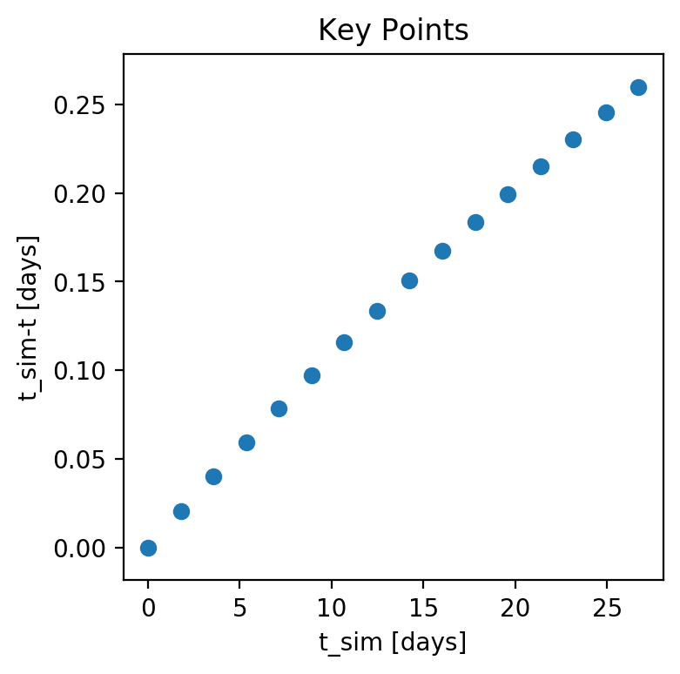
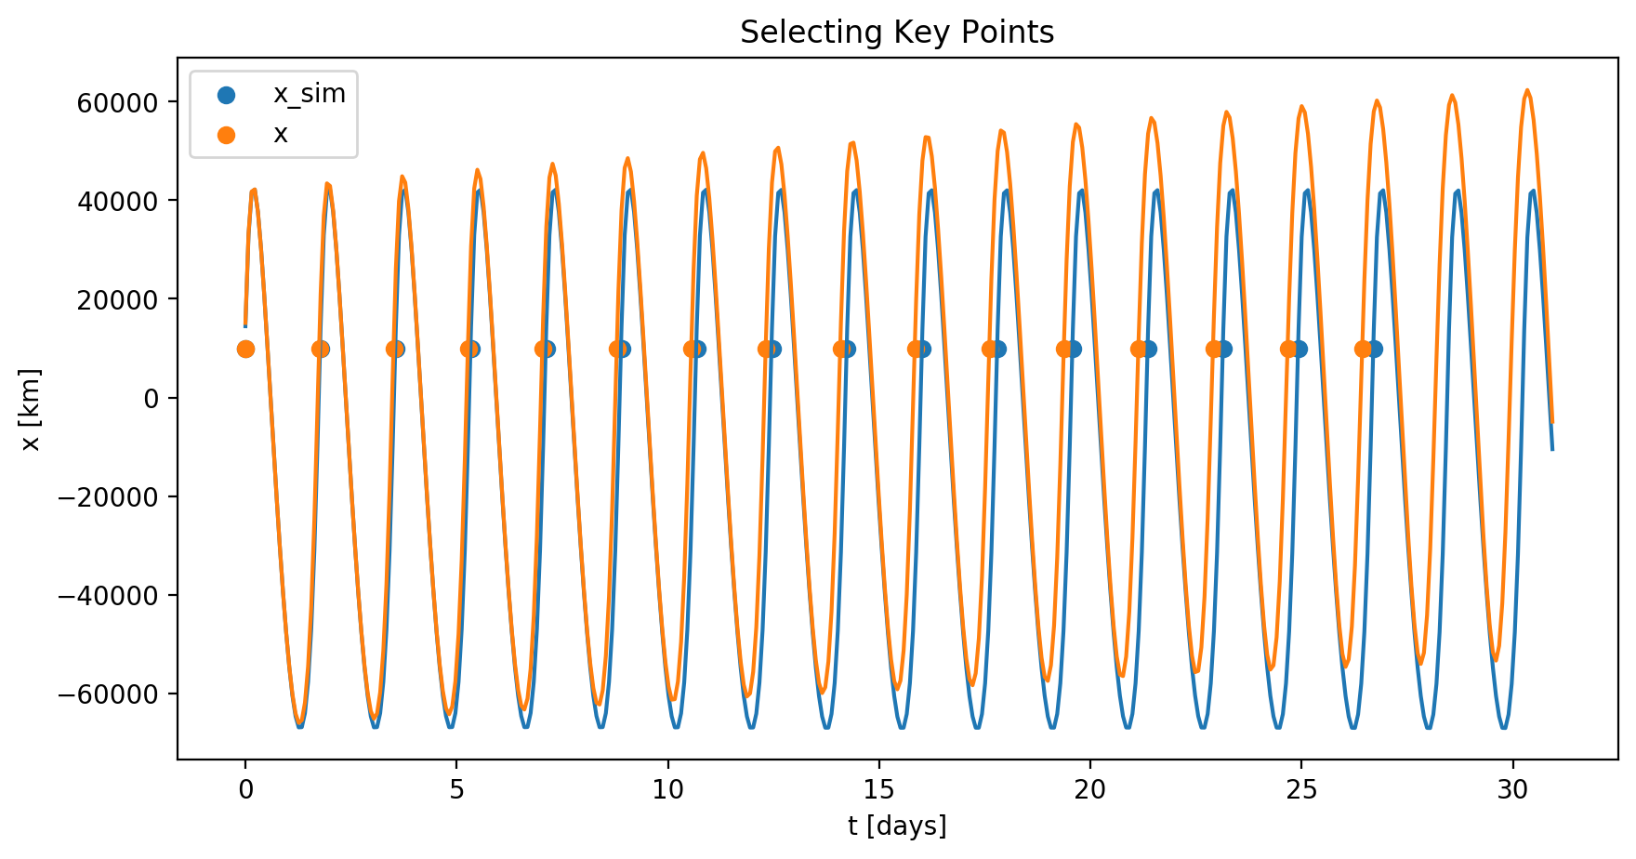
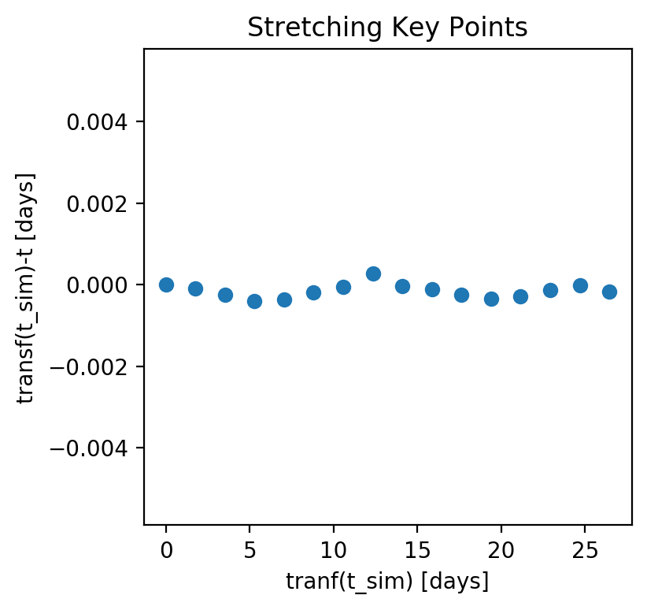

Nonlinear alignment: matching key time points
$$A∙sin\left(ax+b\right)+Bx+C$$

Slide 4
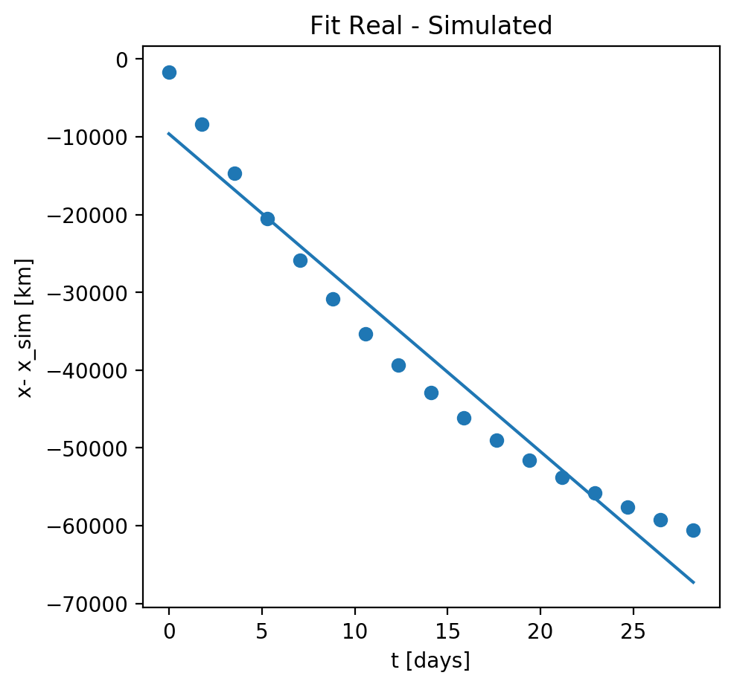
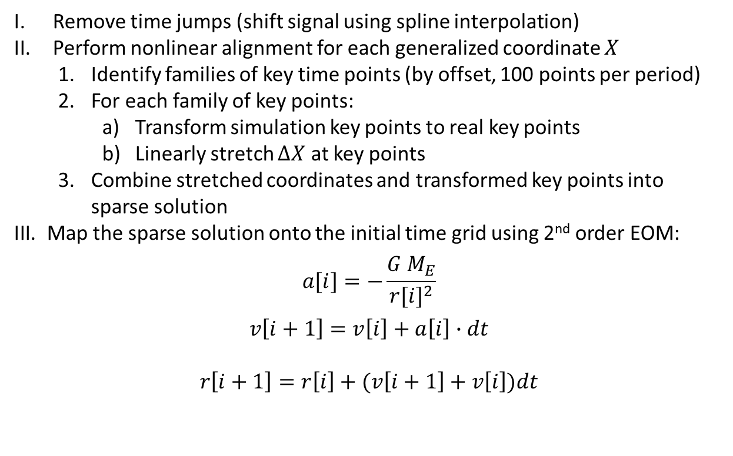

Nonlinear alignment: fit coordinate difference at key points
Full algorithm:
Remove time jumps (shift signal using spline interpolation)
Perform nonlinear alignment for each generalized coordinate $X$
Identify families of key time points (by offset, 100 points per period)
For each family of key points:
Transform simulation key points to real key points
Linearly stretch $∆X$ at key points
Combine stretched coordinates and transformed key points into sparse solution
Map the sparse solution onto the initial time grid using 2nd order EOM:
$$a[i]=−\frac{G M_{E}}{{r[i]}^{2}}$$
$$v\left[i+1\right]=v\left[i\right]+a\left[i\right]∙dt$$
$$r\left[i+1\right]=r\left[i\right]+(v\left[i+1\right]+v\left[i\right])dt$$
Linear fit $X_{real}−X_{sim}=A∙t+B$

Slide 5
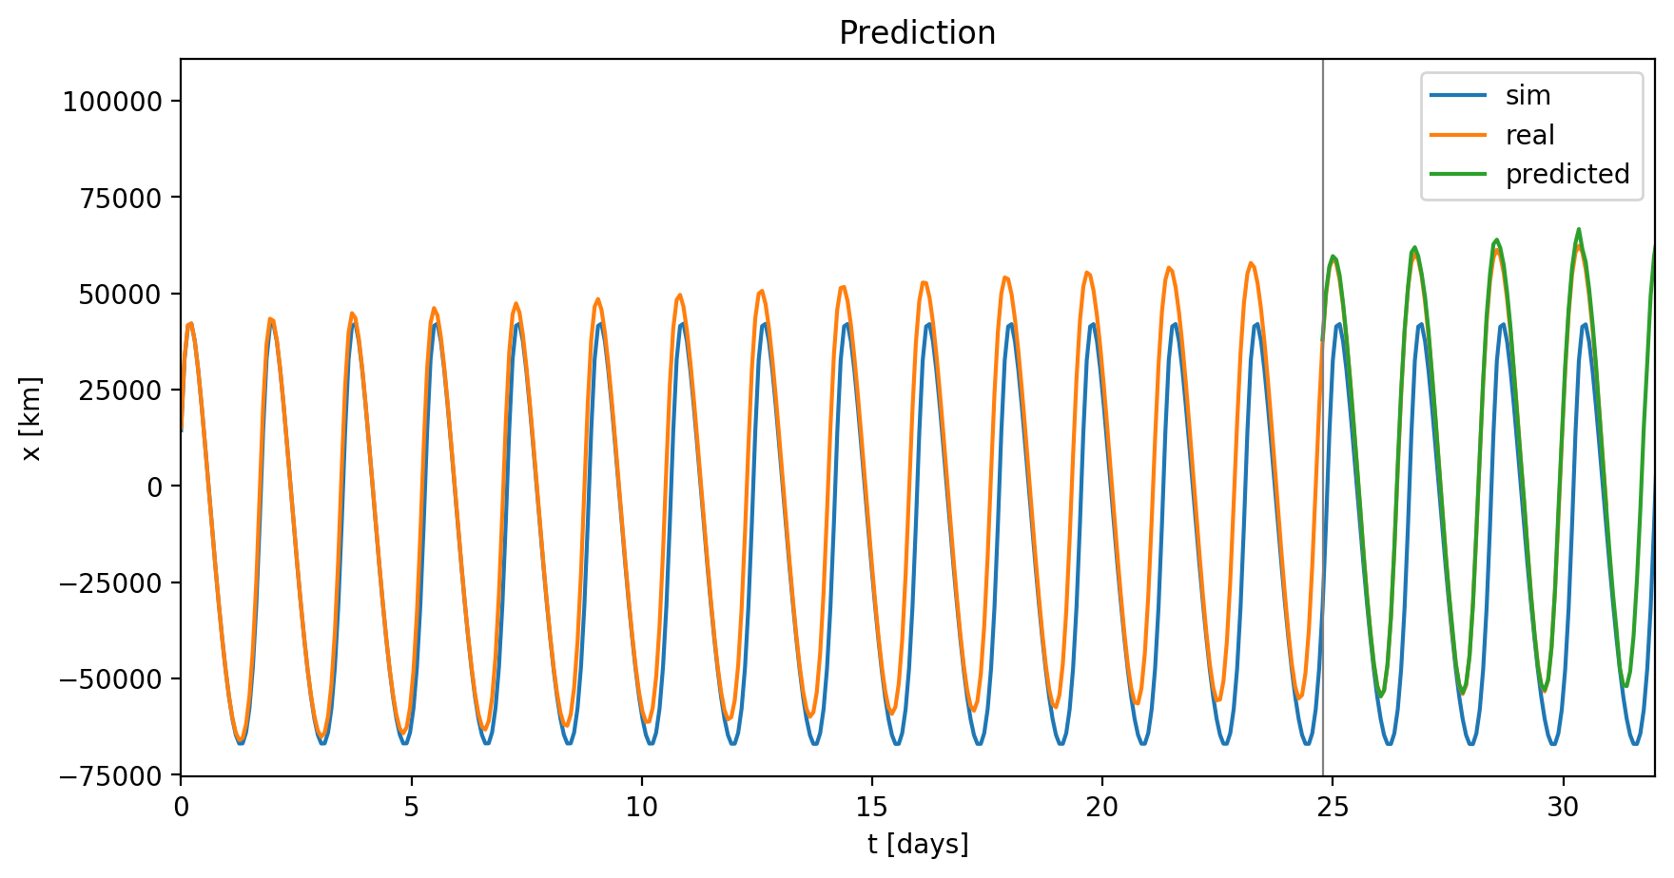
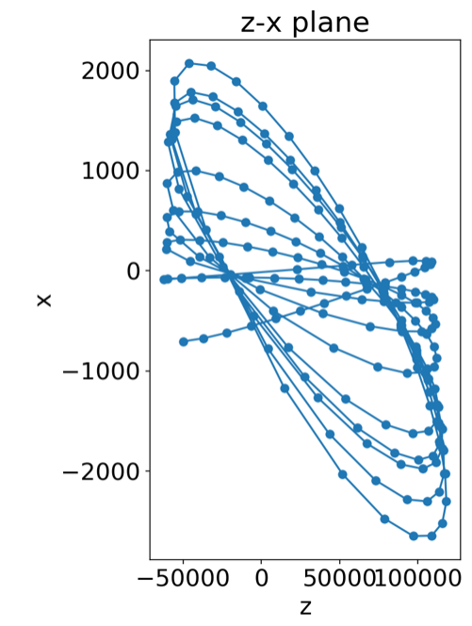
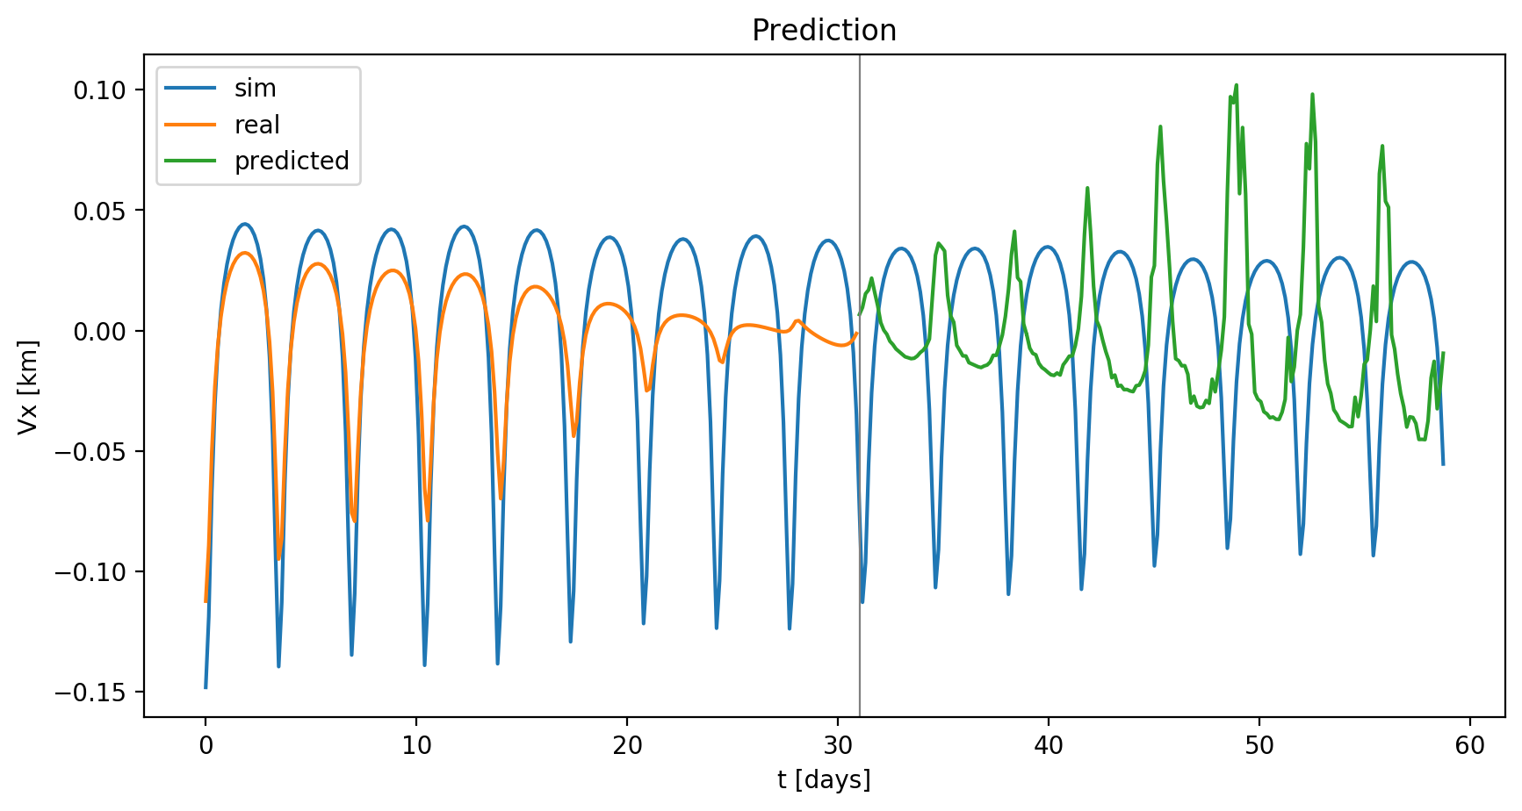
Nonlinear alignment: combining the result from all key points

