Slide 1
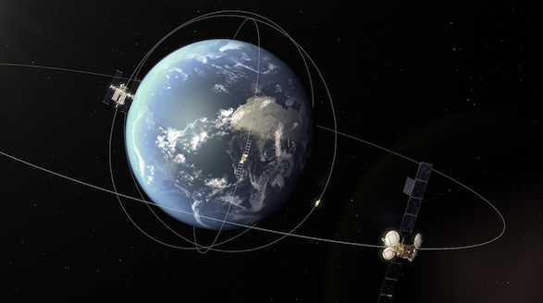
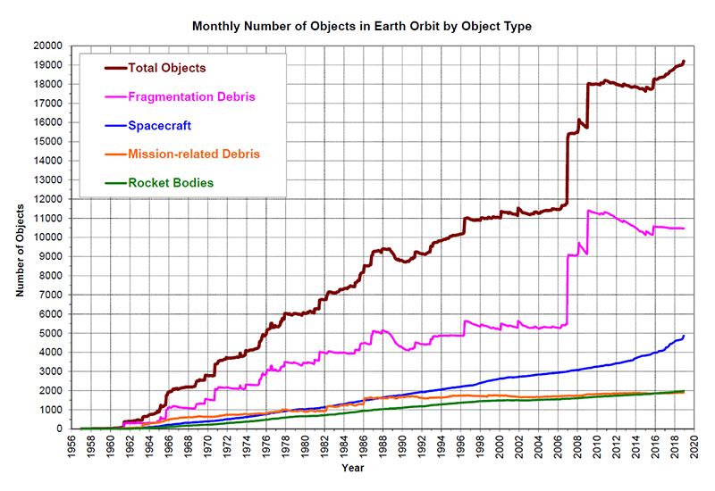
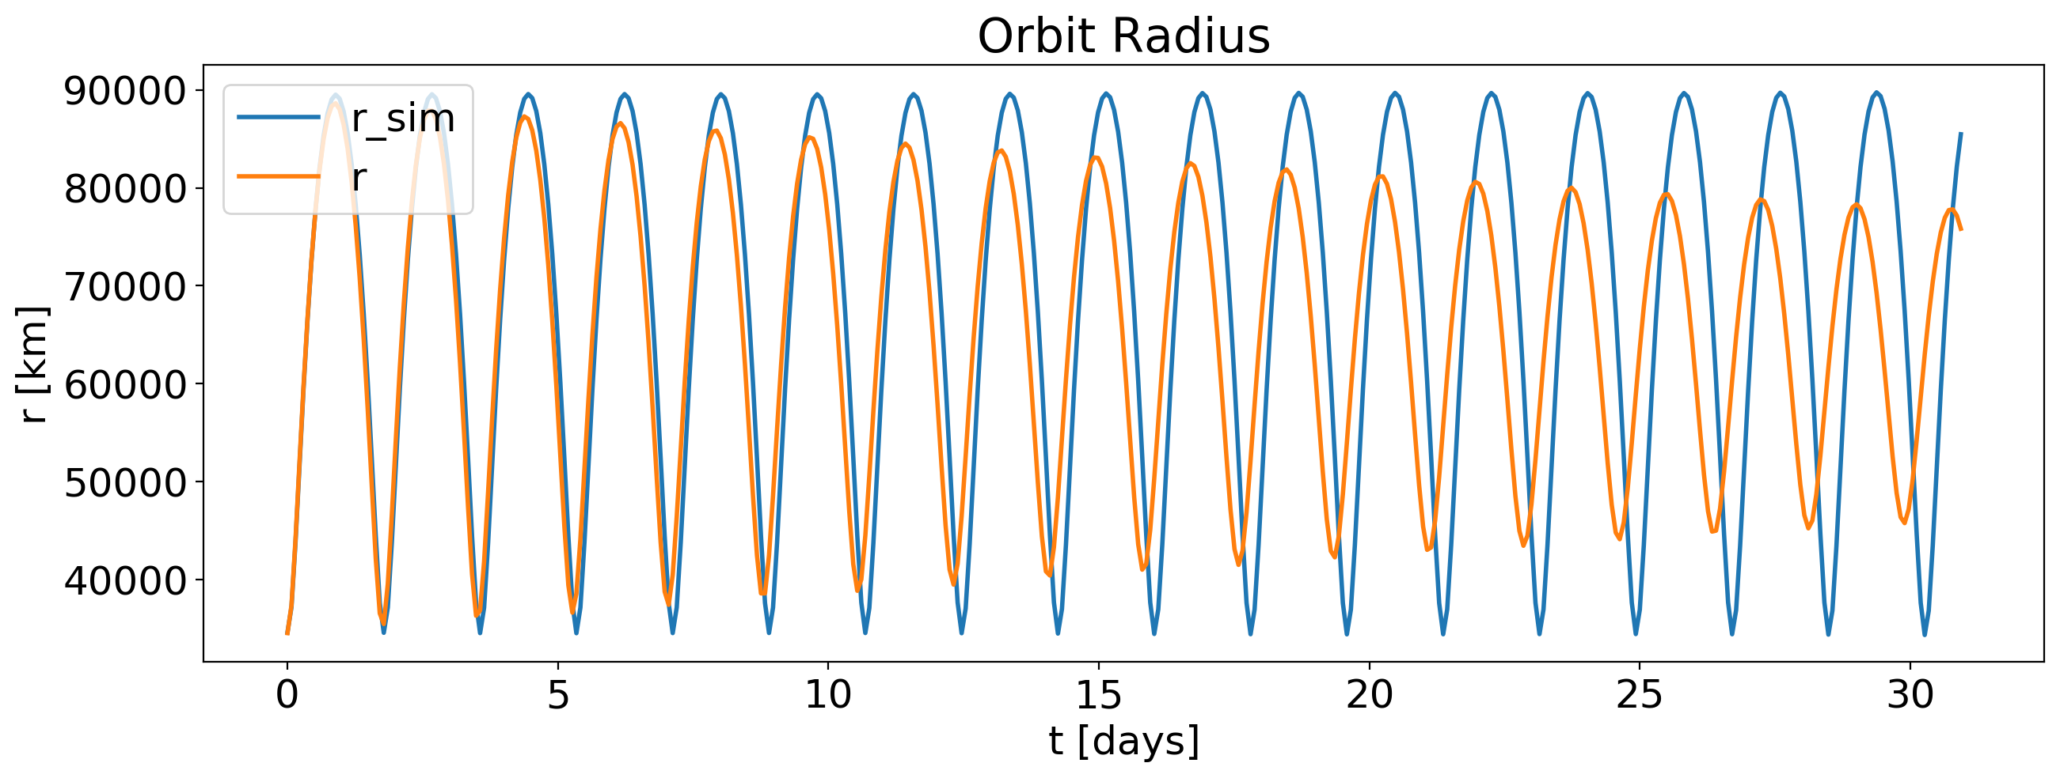
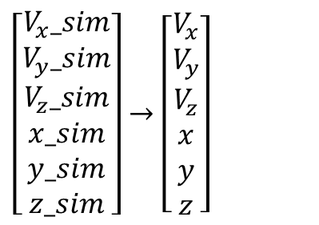
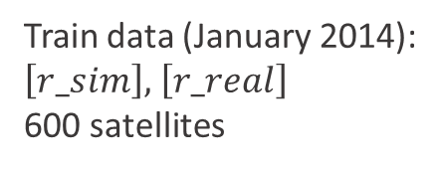
Problem statement:
Inaccurate prediction of the Earth satellite orbits can lead to dangerous collisions.
Task : predict real coordinates from simulated values
$\left[\begin{aligned}V_{x}_sim \\ V_{y}_sim \\ V_{z}_sim \\ x_sim \\ y_sim \\ z_sim\end{aligned}\right]→$ $\left[\begin{aligned}V_{x} \\ V_{y} \\ V_{z} \\ x \\ y \\ z\end{aligned}\right]$
Train data (January 2014):
$\left[r_sim\right],$ $\left[r_real\right]$
600 satellites
Images: isa.int, nasa.gov

Slide 2
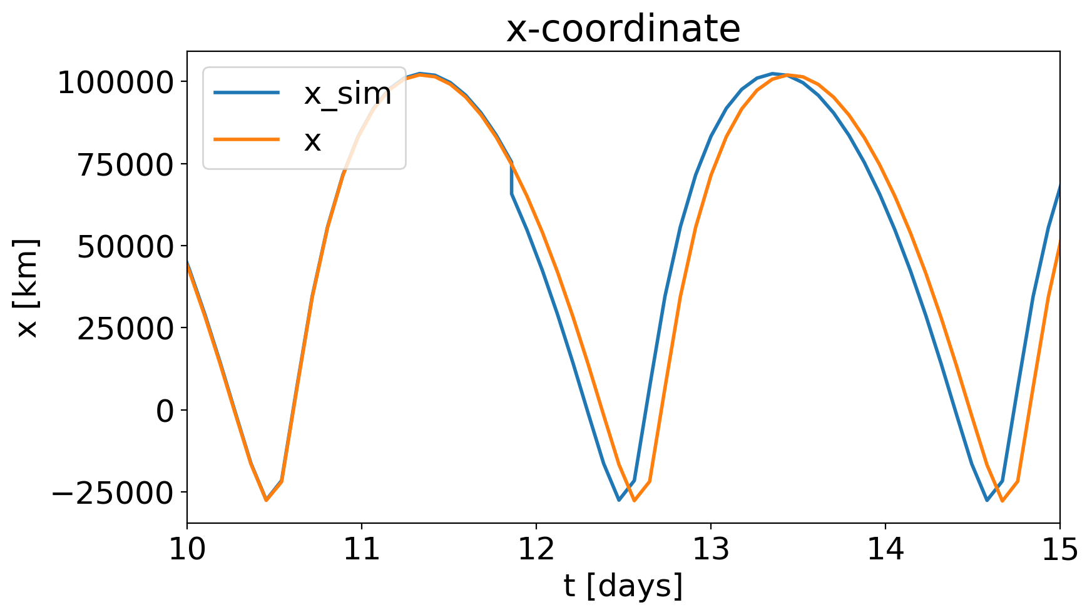
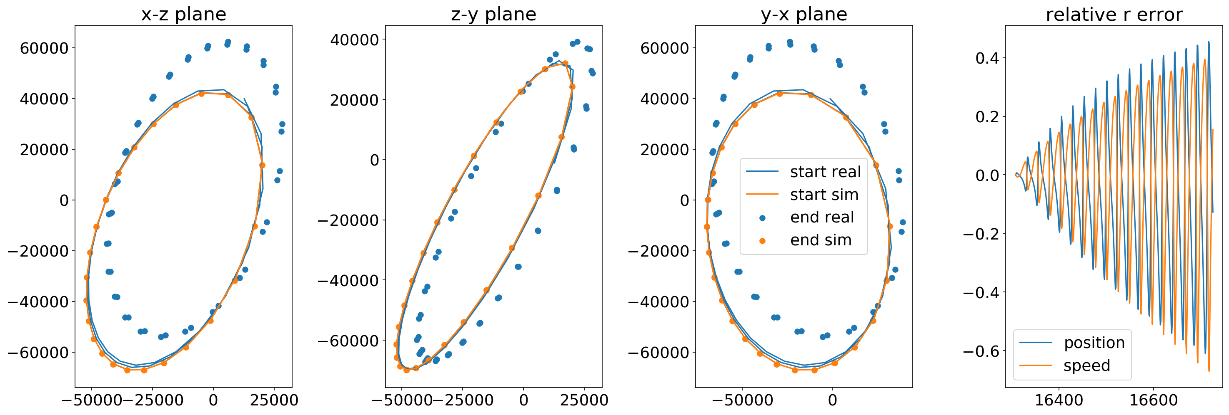
Problem statement:
Remove sudden jumps is simulated signal due to nonuniform time grid
↓
Mapping signal to the nonuniform time grid using interpolation
Address gradual dephasing and slow orbit precession
↓
Nonlinear alignment
Challenge: finding uniform approach for all satellite

Slide 3
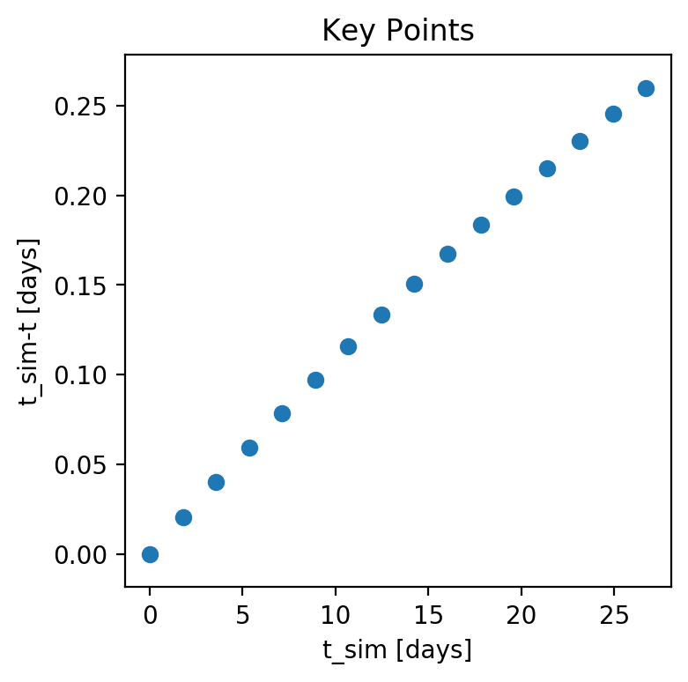
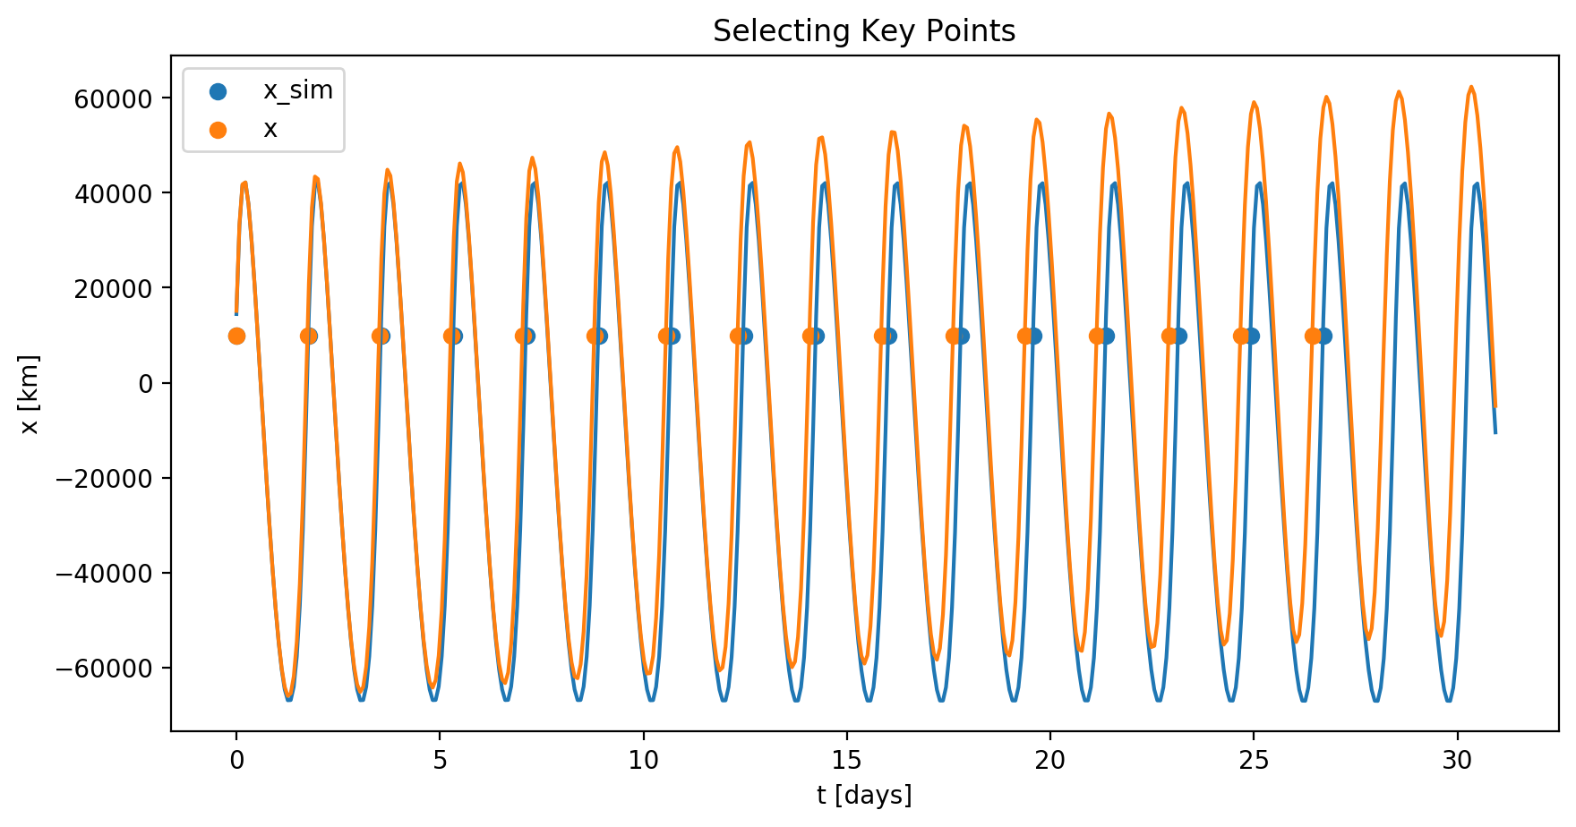
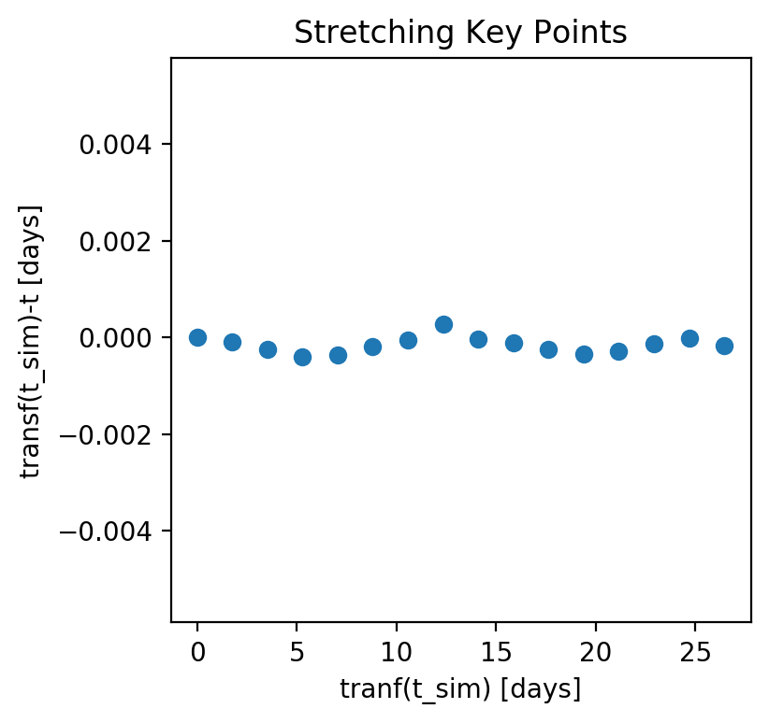

Nonlinear alignment: matching key time points
$$\operatorname{Asin}\left(x\right)+Bx+C$$

Slide 4
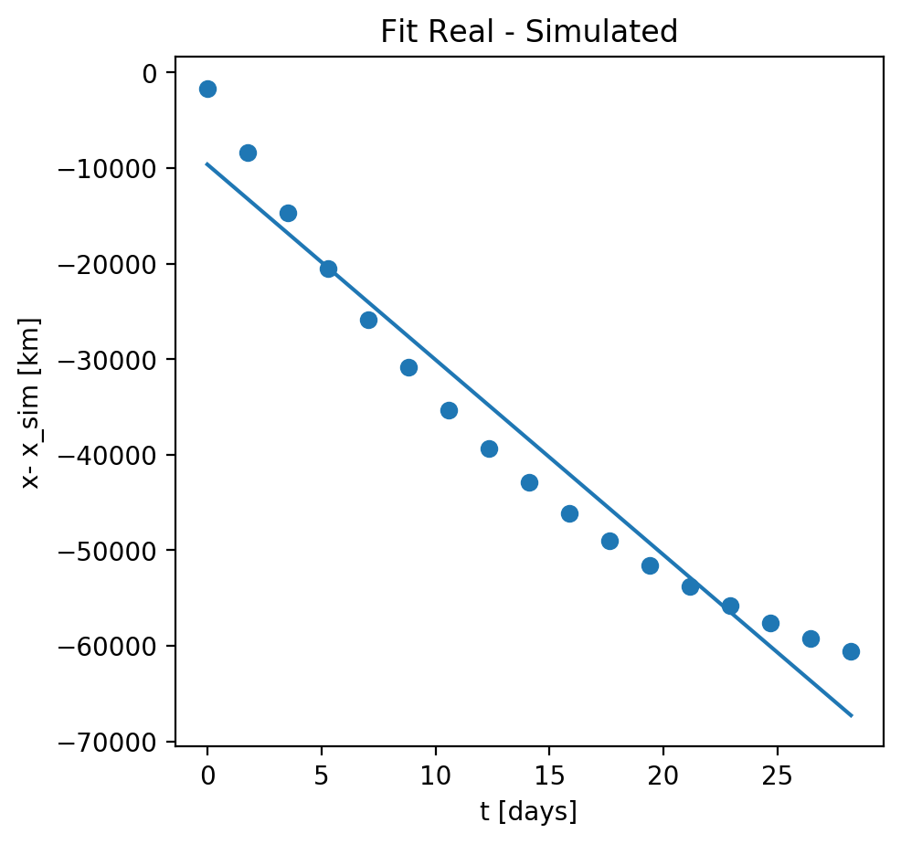
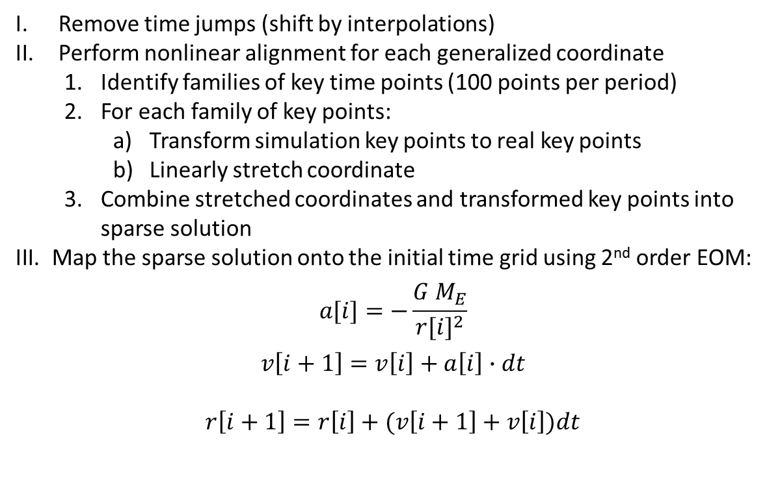

Nonlinear alignment: fit coordinate difference at key points
Full algorithm:
Remove time jumps (shift by interpolations)
Perform nonlinear alignment for each generalized coordinate
Identify families of key time points (100 points per period)
For each family of key points:
Transform simulation key points to real key points
Linearly stretch coordinate
Combine stretched coordinates and transformed key points into sparse solution
Map the sparse solution onto the initial time grid using 2nd order EOM:
$$a[i]=−\frac{G M_{E}}{{r[i]}^{2}}$$
$$v\left[i+1\right]=v\left[i\right]+a\left[i\right]∙dt$$
$$r\left[i+1\right]=r\left[i\right]+(v\left[i+1\right]+v\left[i\right])dt$$
Linear fit $X_{real}−X_{sim}=A∙t+B$

Slide 5
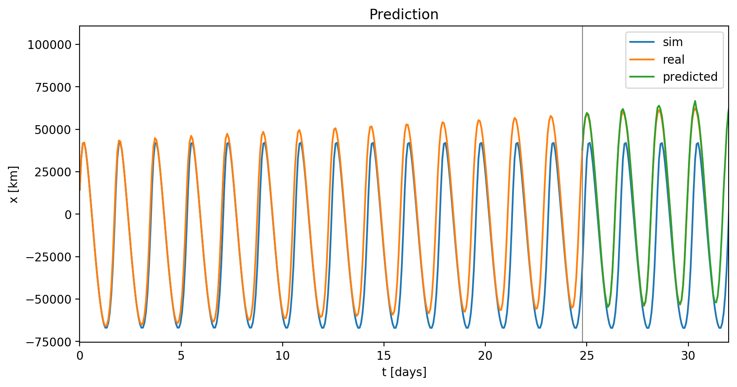
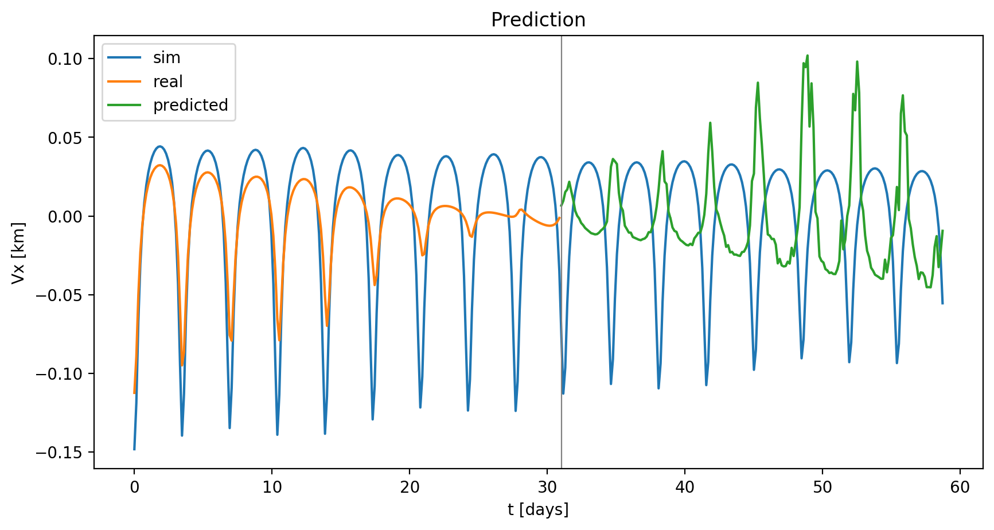
Nonlinear alignment: combining the result from all keypoints

