Slide 1
ιτλος

Slide 2
Contents

Slide 3
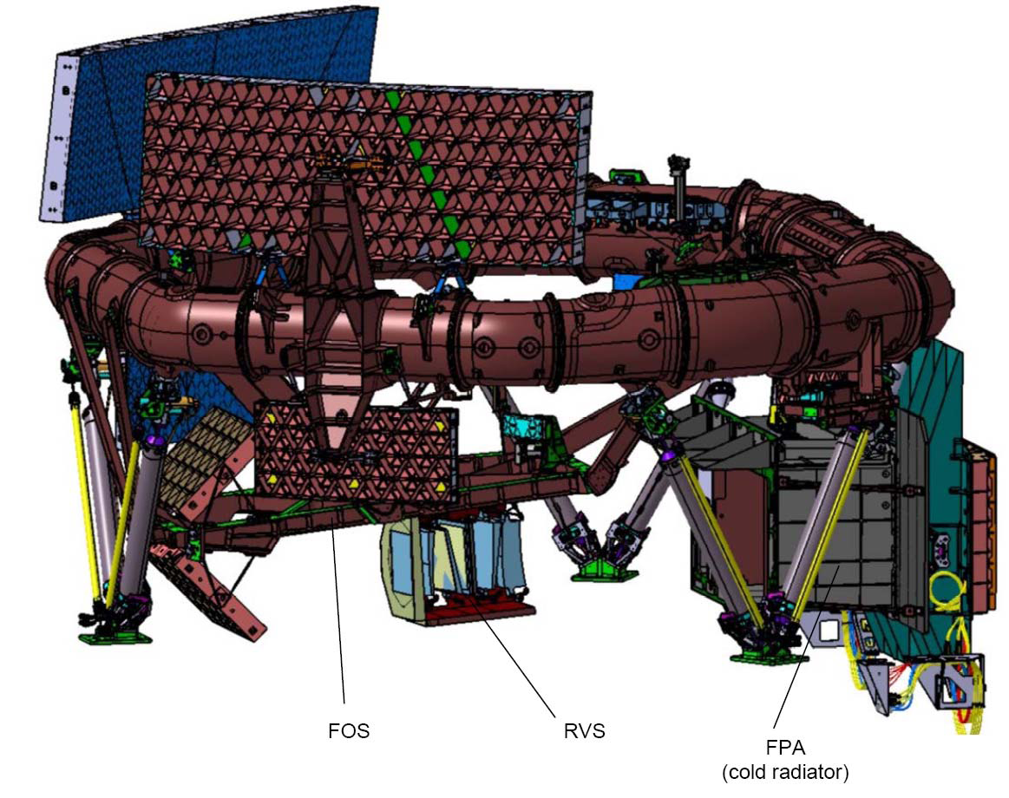
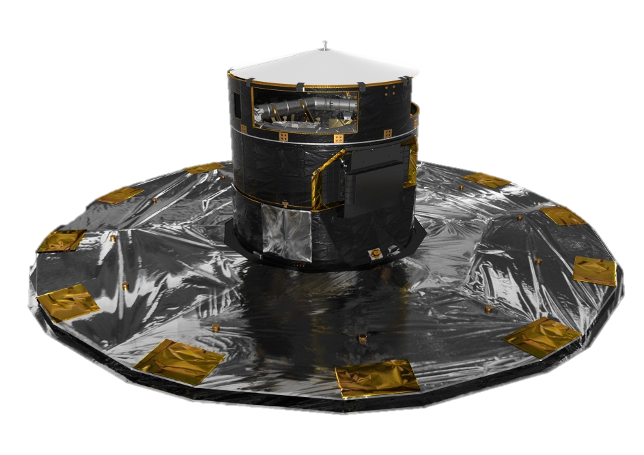
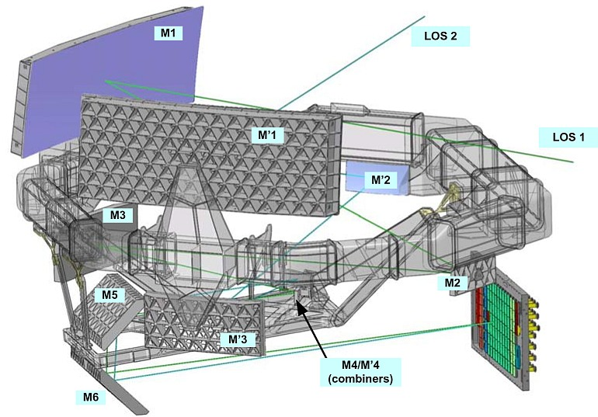
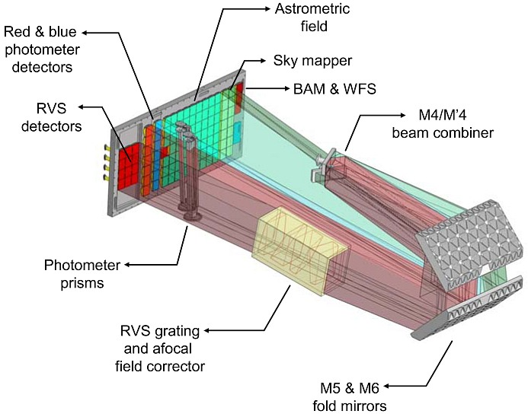
Payload and Telescope
Payload and Telescope
Payload and Telescope
Payload and Telescope
Payload and Telescope
Gaia
Rotation axis (6h)
Rotation axis (6h)
Rotation axis (6h)
Rotation axis (6h)
Rotation axis (6h)
Basic-Angle-Monitoring (BAM) system
Basic-Angle-Monitoring (BAM) system
Basic-Angle-Monitoring (BAM) system
Basic-Angle-Monitoring (BAM) system
Two Sic primary mirrors
1.45 × 0.50 m2 at 106.5°
Basic-Angle-Monitoring (BAM) system
Two Sic primary mirrors
1.45 × 0.50 m2 at 106.5°
Two Sic primary mirrors
1.45 × 0.50 m2 at 106.5°
Two Sic primary mirrors
1.45 × 0.50 m2 at 106.5°
Two Sic primary mirrors
1.45 × 0.50 m2 at 106.5°
SiC torus
(optical bench)
SiC torus
(optical bench)
SiC torus
(optical bench)
SiC torus
(optical bench)
SiC torus
(optical bench)
Combined Focal-Plane Assembly (FPA) with 106 CCD detectors
Combined Focal-Plane Assembly (FPA) with 106 CCD detectors
Combined Focal-Plane Assembly (FPA) with 106 CCD detectors
Combined Focal-Plane Assembly (FPA) with 106 CCD detectors
Combined Focal-Plane Assembly (FPA) with 106 CCD detectors
Superposition of two Fields of View (FoV)
Superposition of two Fields of View (FoV)
Superposition of two Fields of View (FoV)
Superposition of two Fields of View (FoV)
Superposition of two Fields of View (FoV)
Radial-Velocity Spectrometer (RVS)
Radial-Velocity Spectrometer (RVS)
Radial-Velocity Spectrometer (RVS)
Radial-Velocity Spectrometer (RVS)
Radial-Velocity Spectrometer (RVS)
Figure courtesy EADS-Astrium
Figure courtesy EADS-Astrium
Figure courtesy EADS-Astrium
Figure courtesy EADS-Astrium
Figure courtesy EADS-Astrium
Gaia is a scanning satellite that will repeatedly survey in a systematic way the whole sky. Gaia will provide a
5-year survey of all point sources with V=6-20 (~ one billion objects).
Notes:
SUMMARY
The main goal of the Gaia mission is to make the largest, most precise three-dimensional map of our Galaxy by surveying an unprecedented one per cent of its population of 100 billion stars.
During the mapping, Gaia will detect and very accurately measure the motion of each star in its orbit around the centre of the Galaxy. Much of this motion was imparted upon each star during its birth and studying it allows astronomers to peer back in time, to when the Galaxy was first forming. By constructing a detailed map of the stars, Gaia will provide a crucial tool to study the formation of our Galaxy, the Milky Way.
While surveying the sky, Gaia is bound to make many other discoveries. During its anticipated lifetime of five years, Gaia will observe each of its one billion sources about 70 times, resulting in a record of the brightness and position of each source over time. Together with the unprecedented accuracy of the astrometric measurements, this will lead to the discovery of: planets around other stars, asteroids in our Solar System, icy bodies in the outer Solar System, brown dwarfs, and far-distant supernovae and quasars. The list of Gaia's potential discoveries makes the mission unique in scope and scientific return.
Huge databases of information will be compiled from the Gaia data, allowing astronomers to trawl the archives looking for similar celestial objects or events and other correlations that might just provide the clue necessary to solve their particular, seemingly intractable, scientific puzzle.
THE SPACECRAFT
The Gaia spacecraft is composed of the payload module, the service module and the deployable sunshield. It has a launch mass of around 2 tonnes. The payload module is built around a toroidal-shaped optical bench (~3m diameter) which provides the structural support for the single integrated instrument that comprises three functions: astrometry, photometry and spectrometry. It further contains all necessary electronics for managing the instrument operation and processing the raw data.
The service module comprises all mechanical, structural and thermal elements supporting the instrument and the spacecraft electronics. It includes the micro-propulsion system, deployable sunshield, payload thermal tent, solar arrays and harness. The service module offers support functions to the Gaia payload and spacecraft for pointing, electrical power control and distribution, central data management and radio communications with the Earth.
THE L2 ORBIT
Gaia will be placed in an orbit around the Sun, at the second Lagrange point L2, which is named after its discoverer, Joseph Louis Lagrange (1736-1813). For the Sun-Earth system, the L2 point lies at a distance of 1.5 million kilometres from the Earth in the anti-Sun direction and co-rotates with the Earth in it's 1-year orbit around the Sun.
One of the principal advantages of an L2 orbit is that it offers uninterrupted eclipse-free observations. From L2 the entire celestial sphere can be observed during the course of one year. To ensure Gaia stays at L2, the spacecraft must perform small manoeuvres every month.
Gaia will not be the only ESA mission going to L2. Herschel and Planck have operated from there and currents plans call for JWST to be placed there, too.
THE HIPPARCOS MISSION
Gaia is not the first space mission to chart the heavens. In 1989, ESA launched Hipparcos. Sounding like the name of Hipparchus, the Greek astronomer, its different spelling reflects that the name was also an acronym for High Precision Parallax Collecting Satellite.
This entirely European mission was the first satellite to chart the positions of stars and produced a primary catalogue of about 118 000 stars, and a secondary catalogue, called Tycho, of over 2 million stars whose positions were determined to slightly less precision. The data is now widely used by the entire community of professional astronomers.
Among other results, Hipparcos' data contributed to the prediction of when comet Shoemaker-Levy 9 would collide with Jupiter. The data showed that many billions of years ago, the Galaxy swallowed a large group of stars. Hipparcos also helped astronomers to refine the age of the Universe.
THE CHALLENGE OF GAIA
Gaia will significantly improve on Hipparcos for a number of different reasons. For example, the collecting area of the primary mirrors means that Gaia will collect more than 30 times the light of its predecessor, allowing for more sensitive and accurate measurements.
Gaia will be able to measure a star's position and motion 200 times more accurately than Hipparcos. Changes in a star's position and motion are registered as tiny angles. As a comparison, if Hipparcos could measure the angle that corresponds to the height of an astronaut standing on the Moon, Gaia will be able to measure his thumbnail!
Highly efficient cameras, CCDs, will be used to record the images, so wide-angle images of many celestial objects can be obtained at the same time. Devices known as photomultipliers were used on Hipparcos, which meant that the satellite could only record information from a single celestial object at a time.
Astronomers will have the challenge of dealing with a flood of data when Gaia begins its work in 2013. Even after being compressed by software, the data produced by the five-year mission will fill over 1.5 million CD ROMs. This data will be transmitted 'raw' and will need processing on Earth to turn it into a calibrated set of measurements that can be freely used by the astronomical community.
So, not only must ESA design and build the spacecraft itself, they must also develop new computer software that will ensure the data can be processed efficiently once it is back on Earth.

Slide 4
Φασματογράφος
Blue and Red Photometers, BP/RP, sampled by 14 CCDs serving the spectro-photometer and providing low resolution prism spectra for each object over the wavelength range 330-680 nm
(3-27nm/pixel) and 640-1040 nm (7-15nm/pixel);

Slide 5
Συνθετικά Φάσματα – simulated
Galaxies spectra with Pegase.2 :
Galaxies taxonomic class galType
Early (age 13Gyr)
Spiral (13Gyr)
Irregular (9Gyr)
Quenched Star Formation (9Gyr)
Star Formation parameters galParams
E type: E_p1 , E_p2
S type: S_p1 , S_p2 , S_infall
I type: I_p1 , I_p2 , I_infall
Q type: Q_p1 , Q_p2 , Q_p3 , Q_infall
Star formation rate laws used:
Early type:
SFR(t)=(p2/p1)*e(-t/p1)
Spiral and Irregular type:
SFR(t)= Mgas(t)p1/p2
Quenched Star Formation type:
SFR(t)= Mgas(t)p1/p2 for t<Age-p3
SFR(t)= 0 for t≥Age-p3

Slide 6
Νευρωνικά Δίκτυα

Slide 7
Java NNS

Slide 8
Αποτελέσματα

Slide 11
Conclusion

