Slide 1

How to be a better presenter

Slide 2
General tips
Presenting is 50% entertainment and 50% teaching
Keep your audience engaged and they will remember you
Ask them questions
Teach them something new — anything new — and they will remember you
Show them that you are passionate about research

Slide 3
If you’re overly technical and aim your presentation at a narrow audience, then your presentation will be forgotten
Think about aiming your presentation at the person in the audience LEAST familiar with your area of research
General tips

Slide 4


Telling Stories with Data
- A Systematic Review
Schröder, Kay, Wiebke Eberhardt, Poornima Belavadi, Batoul Ajdadilish, Nanette van Haften, Ed Overes, Taryn Brouns, and André Calero Valdez
“Data without context is meaningless; for data to have an impact, it requires a story.”
—Schröder et al.(2023)

Slide 5
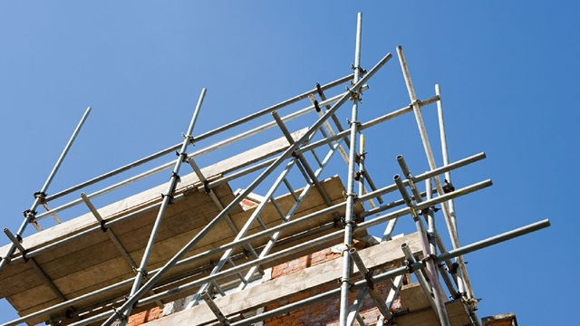
The power of stories
During your seminar, you’re going to present more information than anyone can possibly remember
Think of yourself as a storyteller
Numbers and facts w/o context are difficult to remember
Stories are easy to remember
Your story is the scaffolding upon which you fasten numbers and facts

Slide 6
Limit what you present. Less is more.
Prime your listeners
Briefly describe your ID strategy early in your presentation
Preview your main results
What comes next? What’s on the next slide? What is the goal of the next section?
“Next, I am going to try to convince you of X…It’s important that I convince you of X, because…”
How to effectively convey your story

Slide 7
Why do we use slides?
Don’t use slides to “prove” that you’ve read every paper on…
Don’t use slides to “prove” you did 27 separate robustness checks
Don’t use slides to show descriptive statistics and/or coefficients for each and every variable in your analysis

Slide 8
Why do we use slides?
Prompts for you
Numbers that you do not want to memorize
Specific language/phrasing that you might forget
Visual aids for your audience
Figures are, in general, better than tables
Each slide should convey one main point. Less is more.
Your audience will tune out if you try to present too much on one slide

Slide 9
What should be on your slide?
Try for three lines on each slide
At most one or two sub-points under each line
Keep your language simple
Avoid using jargon
Avoid using too many acronyms
“We explore the heterogenous effects of NOTDA and/or YATES exposure by…” Yuk!!!
Keep your slides clean and easy to read

Slide 10
This slide is from a seminar I attended in the fall.

Slide 11
Clean? Easy to read?
NS

Slide 12
Clean? Easy to read?

Slide 13
Pregnant women in these communities are particularly vulnerable
Evidence that in utero exposure to maternal stress can adversely affect infant health (Black et al. 2016)
Short- and long-term negative effects
Health (Currie et al. 2010)
Labor market outcomes (Black et al. 2007; Oreopoulos et al. 2008)
NS

Slide 14
Your introduction
The first five minutes are the most important
Talk about yourself with the title slide up
How did you become interested in this topic?
Why did this topic engage you?
This is a chance to create your brand
Every talk is a job talk…
Begin with the “big picture”
Why should we care about this general topic?

Slide 15
Your introduction
Don’t get bogged down in the previous literature
You do not need to cite each and every paper ever published on your topic
“Previous work on minimum wages has been done by Smith (1884), Ashenfelter and Krueger (1994), Percy (1996), Samuels et al. (1998), Pope et al. (1998), Sabia and Hansen (2001)…” Yuk!!!
Be clear about your contribution
Do not overreach
“I contribute to five different literatures…” Yuk!!!
Be enthusiastic!

Slide 16
Background
Remember, most audience members are not specialists in this area. You know more than they do.
This is a chance to teach them something new
Try to briefly characterize the state of the literature
What do we know and what don’t we know?
Show that you’re an expert in this field, broadly defined

Slide 17
Background
At the end of the background section, come back to your contribution
You can be more specific now
“Aside from Currie et al. (2004), previous researchers have not…I build upon Currie et al. (2004) by…

Slide 18
Your data
Collecting unique or difficult-to-find data is rewarded by the profession
Spend some time talking about your data
Don’t be humble!

Slide 20
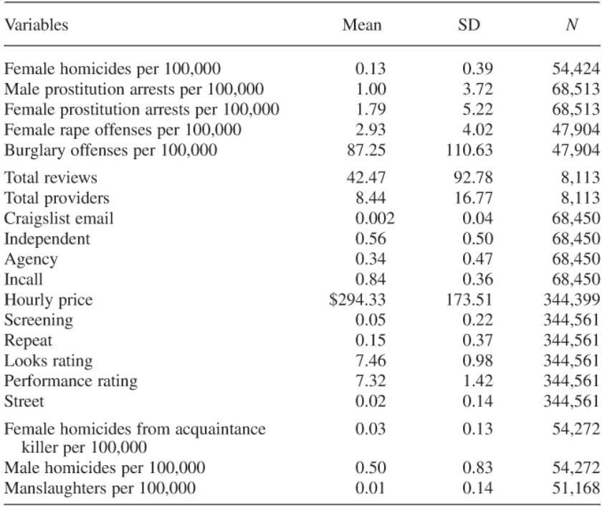
Avoid showing a long table full of descriptive statistics

Slide 21
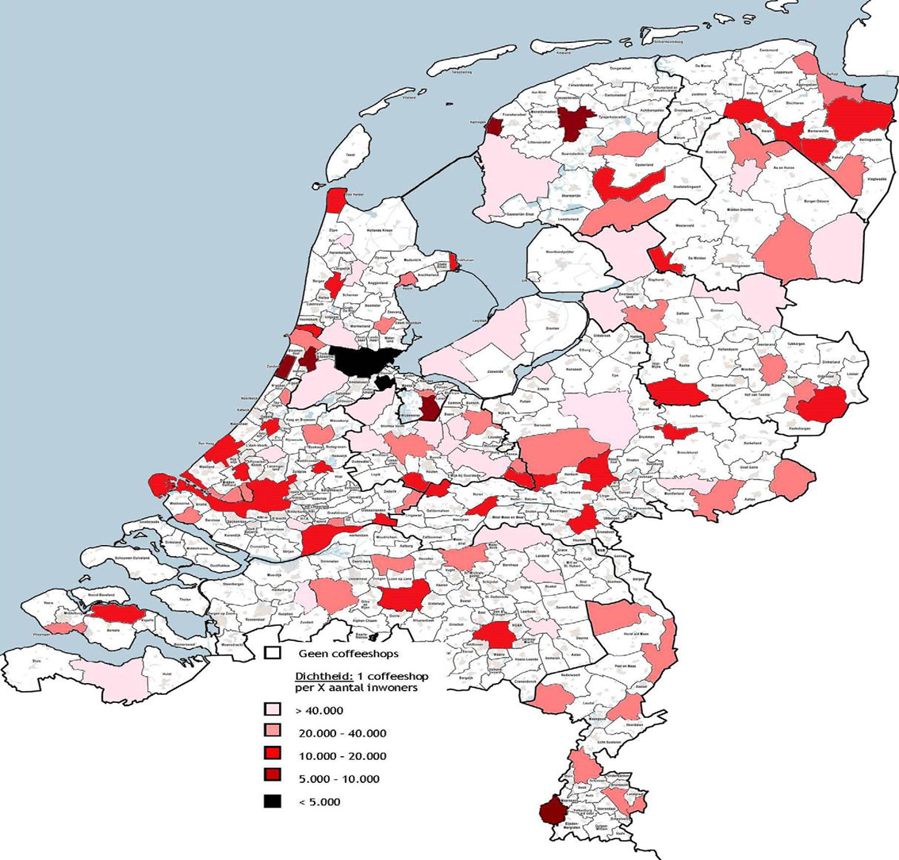
Often, you can use a figure or map to introduce the data to your audience
Talk about trends and their importance
Your data
Can you say something here about your identification strategy or maybe potential threats to identification?
You want to be the one who first mentions an obvious threats to identification
Briefly define your key variables

Slide 22
Tables
Don’t show estimates that you’re not going to talk about
Go through your columns one by one
Pay attention to the units
Is that a percentage point change? Is that a percent change?
Try to mention magnitude
Take your time!
Leave enough time to savior your results
We’ll talk about handling questions in a few slides

Slide 23
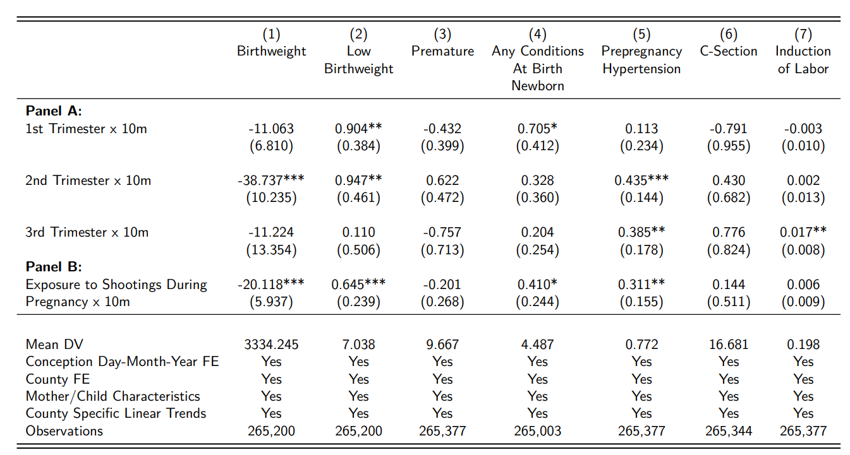
This table is from a seminar I attended in the fall. What can be improved?
NS

Slide 24
This is what it looked like from the back of the room.

Slide 25
What can be improved?

Slide 26

Plots or charts are usually better than tables
1st trimester

Slide 27
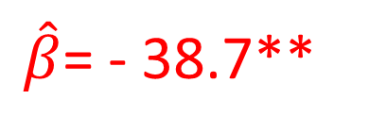
1st trimester
$\hat{β}$= - 38.7**

Slide 28
Mention magnitude. You can say that, “in a few slides I will argue that -38.7, although statistically significant, is trivially small.”
1st trimester
$\hat{β}$= - 38.7**

Slide 29
Municipal Anti-TB Measures and ln(Pulmonary TB Mortality)
 | (1) | (2) | (3)
Total # of Municipal Anti-TB Measures | -.003 (.008)
Any Municipal Anti-TB Measure
1 Municipal Anti-TB Measure
2 Municipal Anti-TB Measures
3+ Municipal Anti-TB Measures
Notes: All models control for the municipal demographics characteristics and state anti-TB measures listed in Table 1, municipality fixed effects, year fixed effects, and municipality-specific linear trends. Regressions are weighted by municipality population. Standard errors, corrected for clustering at the state level, are in parentheses. N = 7,439 (548 municipalities).
This estimate is small…

Slide 30
Municipal Anti-TB Measures and ln(Pulmonary TB Mortality)
 | (1) | (2) | (3)
Total # of Municipal Anti-TB Measures | -.003 (.008)
Any Municipal Anti-TB Measure |  | .025 (.020)
1 Municipal Anti-TB Measure
2 Municipal Anti-TB Measures
3+ Municipal Anti-TB Measures
Notes: All models control for the municipal demographics characteristics and state anti-TB measures listed in Table 1, municipality fixed effects, year fixed effects, and municipality-specific linear trends. Regressions are weighted by municipality population. Standard errors, corrected for clustering at the state level, are in parentheses. N = 7,439 (548 municipalities).
This estimate is larger, but in the “wrong” direction…

Slide 31
Municipal Anti-TB Measures and ln(Pulmonary TB Mortality)
 | (1) | (2) | (3)
Total # of Municipal Anti-TB Measures | .003 (.008)
Any Municipal Anti-TB Measure |  | .025 (.020)
1 Municipal Anti-TB Measure |  |  | .005 (.008)
2 Municipal Anti-TB Measures |  |  | -.014 (.031)
3+ Municipal Anti-TB Measures |  |  | -.007 (.022)
Notes: All models control for the municipal demographics characteristics and state anti-TB measures listed in Table 1, municipality fixed effects, year fixed effects, and municipality-specific linear trends. Regressions are weighted by municipality population. Standard errors, corrected for clustering at the state level, are in parentheses. N = 7,439 (548 municipalities).
We find consistently small, statistically insignificant estimates

Slide 32

Figures are, in general, better than tables
This is true for your papers too
Prime your audience for the figure before you show it

Slide 33
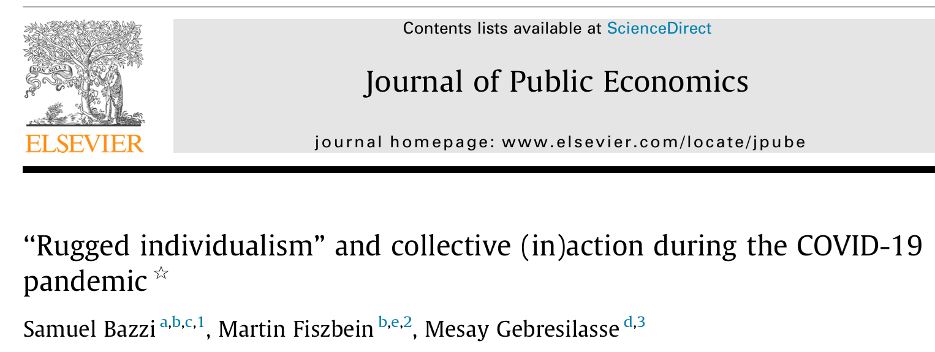
Abstract
“Rugged individualism” is a prominent feature of American culture with deep roots in the country’s history of frontier settlement. Today, rugged individualism is more prevalent in counties with greater total frontier experience (TFE) during the era of westward expansion…
Next, I’m going to show you event studies from Bazzi et al. (2021)…

Slide 34
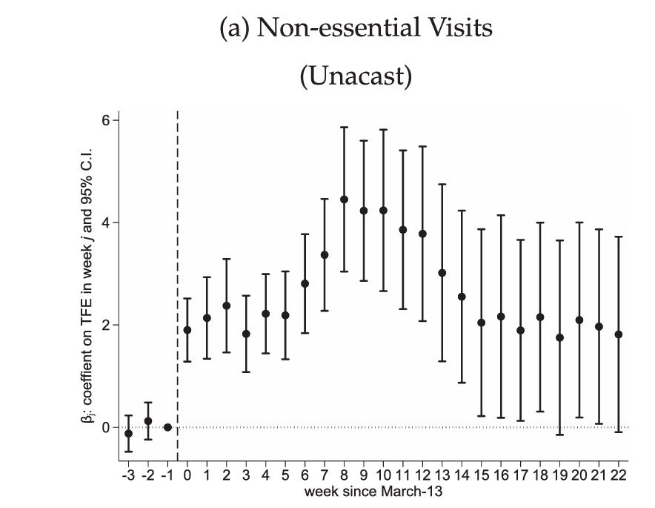
Take your time. Explain what’s on the axes.

Slide 35
What’s the main takeaway?

Slide 36
Do these estimates “prove” that
the parallel trends assumption holds?

Slide 37
Each additional decade of TFE is associated with a 2 percentage point increase in the likelihood of non-essential visits. This is large relative to…
Briefly talk about magnitude

Slide 38
Slow yourself down and allow time for questions
Maybe tell an anecdote?
Can you say something here about threats to identification?

Slide 39
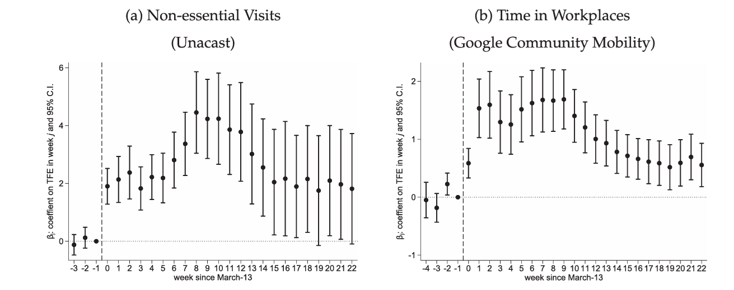
It’s a BIG mistake to squeeze two figures onto one slide…
Can you read the labels on the axes?

Slide 40
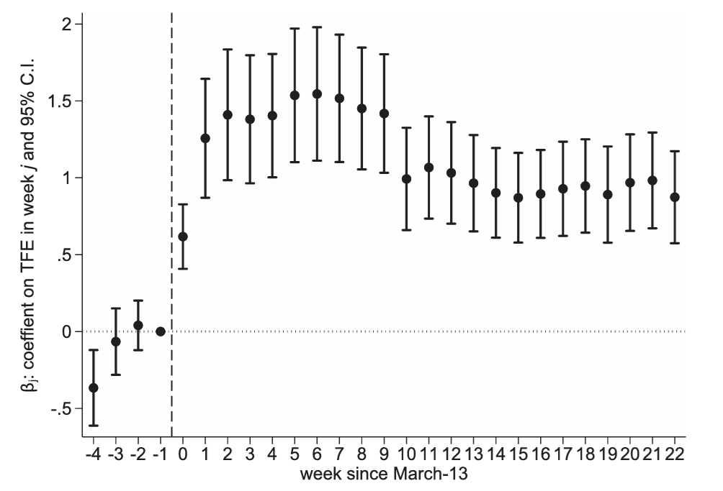
This is your chance to explain any pre-treatment trend
There is some indication of a pre-treatment trend. However, the sharp jump in coefficients after the emergency declaration suggests a clear break from the counterfactual trend.

Slide 41
After your main results
Limit yourself to one or two robustness checks and/or falsification tests
Hold the others in reserve
Job market candidates might want to briefly talk about their research agenda when wrapping up
Try to spend some time on magnitude
Describing magnitude is surprisingly difficult…

Slide 42
Handling questions
Some audience members LOVE your research so much that they take over the seminar
“I see where you’re going with that. That’s a really good point. Can we follow up right after the talk? I want to make sure I understand what you’re saying.”
Some audience members won’t let go of a point
“You’re right. If X,Y, and Z are true, then that would bias my results upwards. That’s a good point. I am not sure that the data exist to test that…”

Slide 43
Handling questions
Don’t be afraid to say “I don’t know”
Don’t be afraid to ask if you don’t understand a question
“I agree that Z is a determinant of Y, but why would it be systematically correlated with treatment in my context?”

