Slide 1
Data Challenge Assessment
Miya
12/24/2016

Slide 2
EXECUTIVE SUMMARY
Help Green taxi driver in NYC understand key trends and optimize their revenue potential through a journey of exhaustive exploratory analysis and attempted predictive modeling on a dataset of all historical green taxi trip records (from August, 2013 through June, 2016).

Slide 3
Higher passenger VOLUMNE☺
Better ridership EFFICIENCY☺
More TIP☺

Slide 4
ANALYSIS ROADMAP
Build data collection pipeline
Load the data
Data validation/cleaning/transformation
Exploratory data analysis/social network analysis/predictive modeling

Slide 5
DATA COLLECTION (Python)
Web crawling pipeline including:
Fetch data about ridership, weather, federal holiday
Transform features (e.g. “pick up time & drop off time” to ride time; “date” to year, month, day of week and hour , “longitude/latitude” to zip code, etc.)
Build a relational database (Sqlite) with tables to hold all the data
a raw data of 6 gigabytes

Slide 6
LOAD DATA (Spark)
Data Integration (weather data with 29,999 rows and ridership data with 45,299,607 rows)
Data Validation (data type, missing value, anomaly detection etc.)
loud noise:
Tax, fare, tolls, trip distance etc. being negative
Tip being hundreds
Ride time being 0
Passenger number over 5
hidden noise:
Cab speed being either over 25mph (speed limit in NYC) or under 10 mph in the city
Fare per minute less than $0.5 or over $30
Tip percentage over 100%
… …

Slide 7
LOAD DATA (Spark) Cont’d
If throwing away all polluted records, 8,314,112 (roughly one fifth) would remain.

Slide 8
METHODOLODY
Generate summary statistics with Spark
Visualize with Jupyter Notebook/Pivot table/Tableau/R
Develop insights

Slide 9
ANALYSIS

Slide 10
I. Volume

Slide 11
Overview
Trend analysis
Segmentation:
Day of week
Day of week + hour
Weather + hour
Holiday + hour
Social network analysis
Raw data used

Slide 12
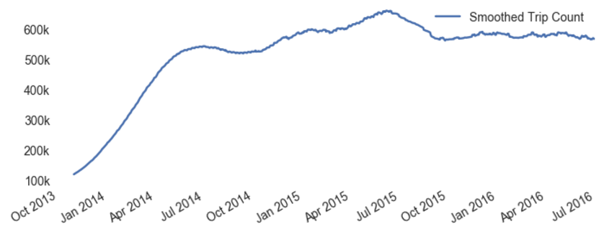
Trend
Rolling average of 3 months’ trip count

Slide 13
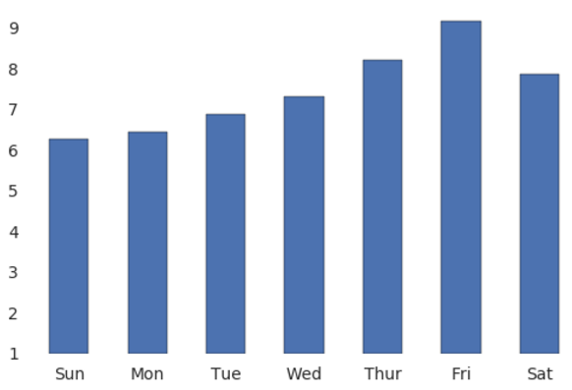
Segmentation —— Day of week
Average trip count
1M

Slide 14
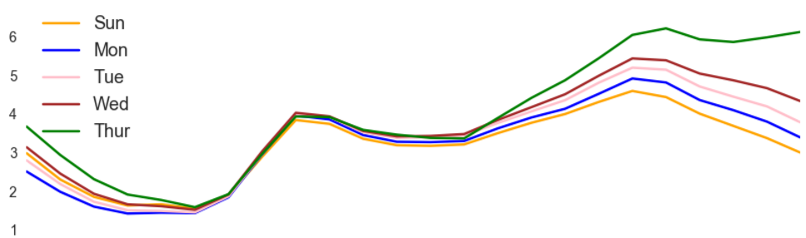
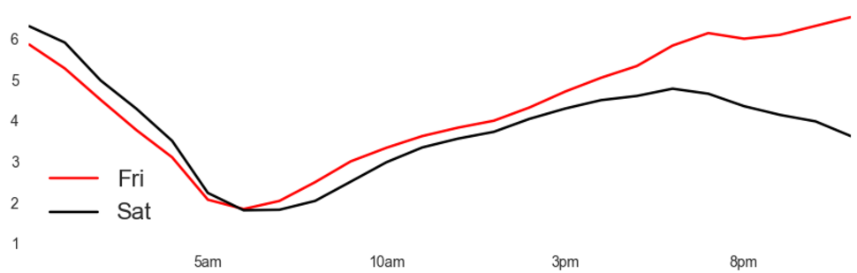
Segmentation —— Day of week & Hour
Great changes happened in February, 2015.
Ride Count
100K
3 PM
Midnight
6 AM
8 PM

Slide 15
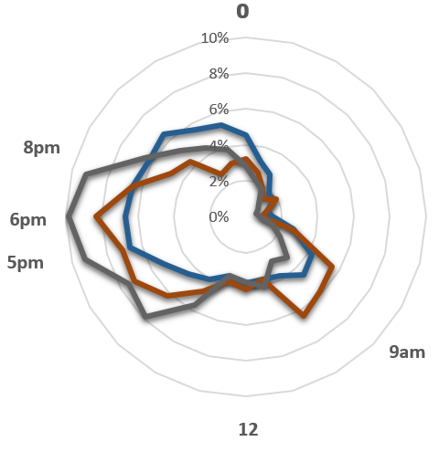

Segmentation —— Weather & Hour
Great changes happened in February, 2015.
Midnight
Noon

Slide 16
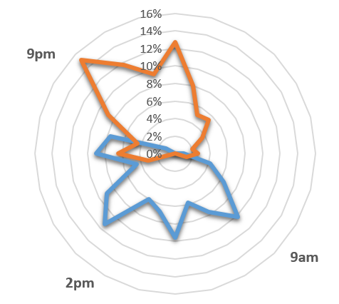

Segmentation —— Weather & Hour Cont’d
Great changes happened in February, 2015.
Midnight
Noon

Slide 17
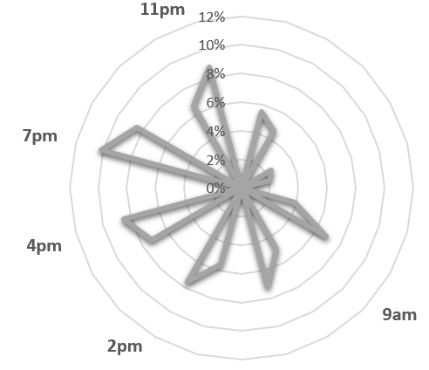

Segmentation —— Weather & Hour Cont’d
Great changes happened in February, 2015.
Midnight
Noon

Slide 18
Network Analysis

Slide 19
Recommendation

Slide 20
II. Efficiency * Money earned per ride per minute

Slide 21
Overview
Calculate “Efficiency” (Fare amount divided by ride time in minutes)
Trend analysis
Density analysis
Efficiency Prediction (Classify a trip as “efficient” or “inefficient”)
Clean sample data used

Slide 22
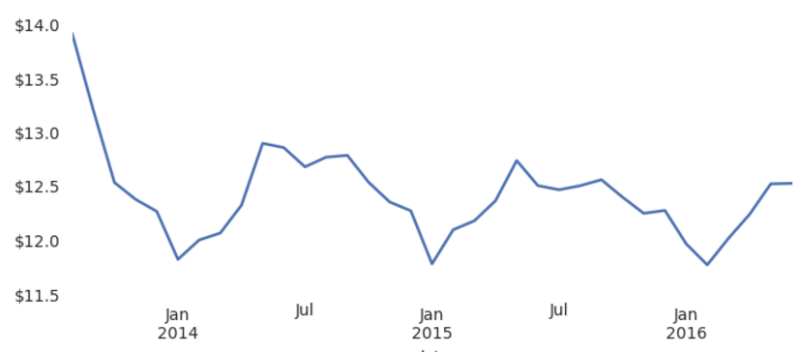
Trend
Great changes happened in February, 2015.
Earning
Per ride

Slide 23
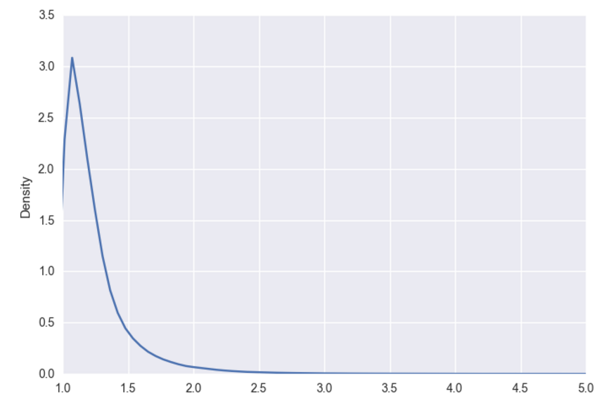
Density
Great changes happened in February, 2015.
Mean | 1.266382
Standard Deviation | 0.610673
Minimum | 1.000255
25% | 1.069418
50% | 1.159154
75% | 1.304348
Earning per minute

Slide 24
Prediction
Randomly sample 1% from cleaned dataset
Label generate:
Efficiency over average labeled as “Good”, otherwise “Low”
Features preparation:
Holiday, Passenger number, Rate Code ID, Store and fwd flag, Trip distance, Trip type, Pick up hour, month, day of week, temperature, weather, wind bearing, wind speed and visibility.
Random Forest VS Gradient Boost

Slide 25
Prediction Cont’d
Accuracy (after cross validation):
Top three important features:
Accuracy is good enough on the whole. However, the model may suffer under-fitting and is unstable when trip distance is unknown. More features are needed
Random Forest | Gradient Boost
66% | 72%
Features | Variance Explained
Trip distance | 0.68
Wind Speed | 0.06
Temperature | 0.06

Slide 26
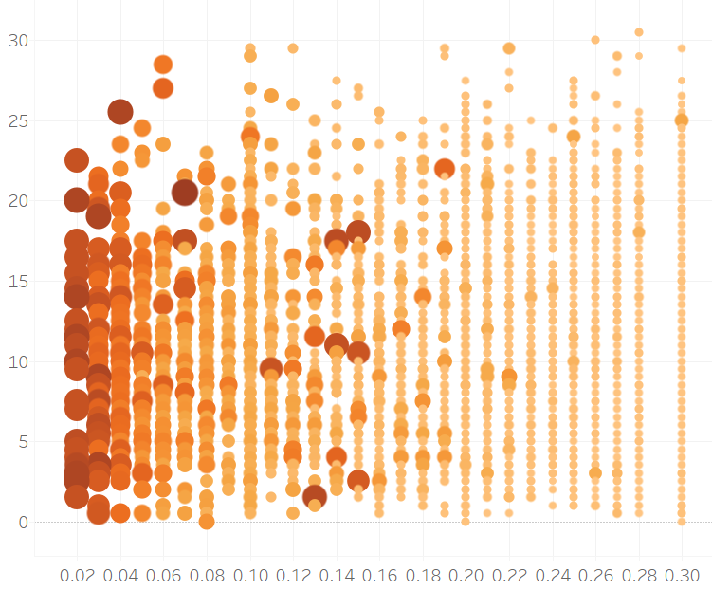
Prediction Cont’d
Efficiency
Wind speed
Trip Distance

Slide 27
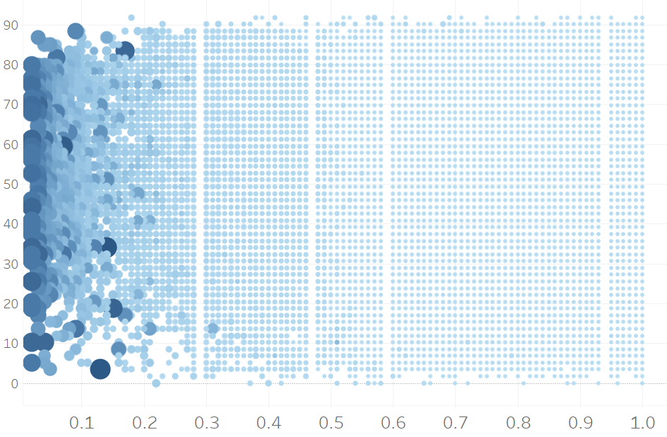
Prediction Cont’d
Temperature
Efficiency
Trip Distance

Slide 28
Conclusion

Slide 29
Recommendation

Slide 30
III. Tip

Slide 31
Overview
Drop all records before February 2015.
Trend analysis
Segmentation:
Day of week
Hour
Weather
Rate Code ID
Clean data used

Slide 32
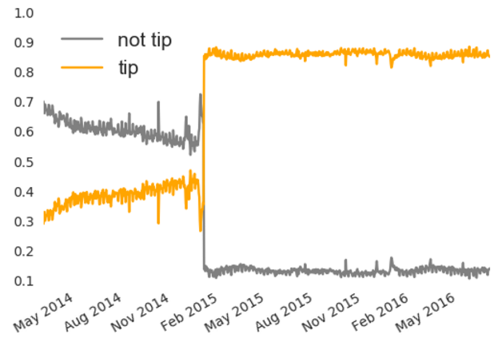
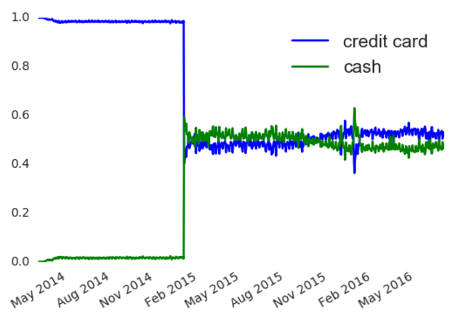
Trend
Great changes happened in February, 2015.
Percentage of daily rides paid by credit card/cash
Rides with/without tip ratio

Slide 33
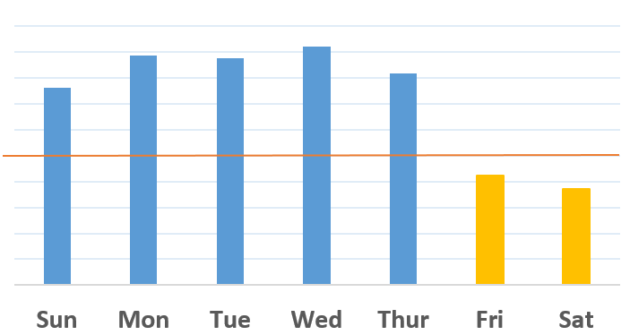
Segmentation —— Day of week
Average tip is worse on Friday and Saturday.
Average tip
22.5%
22%
21.5%

Slide 34
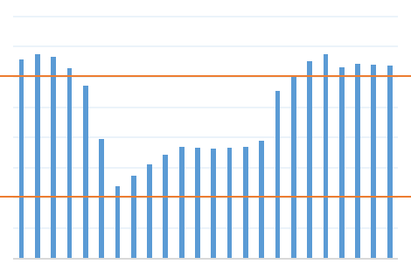
Segmentation —— Hour
Average tip is better before sunrise or after sunset.
Average tip
23.5%
22.5%
20.5%
19.5%
Midnight
6 AM
Noon
6 PM

Slide 35
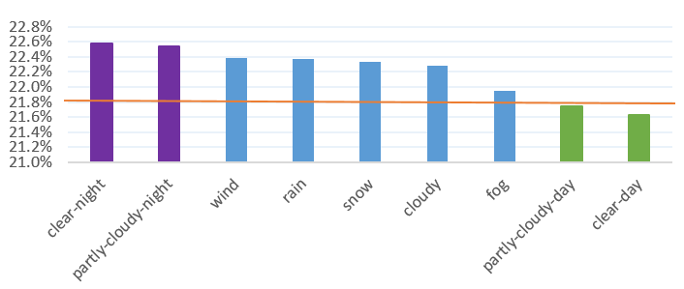
Segmentation —— Weather
Average tip is better before sunrise or after sunset.
Average tip

