Slide 1
Data Challenge Assessment
Miya
12/24/2016

Slide 2
EXECUTIVE SUMMARY
Help Green taxi driver in NYC understand key trends and optimize their revenue potential through a journey of exploratory data analysis on historical datasets about green cab ridership.

Slide 3
OBJECTIVE
Augment passenger VOLUMNE☺
Optimize financial EFFICIENCY☺
Increase TIP☺

Slide 4
ANALYSIS ROADMAP
Build data collection pipeline
Load the data
Data Integration/validation/cleaning/transformation
Statistical analysis/visualization/social network analysis/predictive modeling

Slide 5
DATA COLLECTION (Python)
Web crawling pipeline including:
Fetch data about ridership, weather, federal holiday
Transform features (e.g. “pick up time & drop off time” to ride time; “date” to year, month, day of week and hour , “longitude/latitude” to zip code, etc.)
Insert data into tables in a relational database (Sqlite)
a raw data of 6 gigabytes

Slide 6
LOAD DATA (Spark)
Data Integration (weather data with 29,999 rows and ridership data with 45,299,607 rows)
Data Validation (data type, missing value, anomaly detection etc.)
loud noise:
Tax, fare, tolls, trip distance etc. being negative
Tip being hundreds
Ride time being 0
Passenger number over 5
hidden noise:
Cab speed being either over 25mph (speed limit in NYC) or under 10 mph in the city
Fare per minute less than $0.5 or over $30
Tip percentage over 100%
… …

Slide 7
LOAD DATA (Spark) Cont’d
If throwing away all polluted records, 8,314,112 (roughly one fifth) would remain.
Assume noise is randomly distributed among data.
Deal with noise in data only when the noise would directly affect analysis, e.g. negative fare values would affect density analysis of efficiency(fare/ride time), but not trend analysis of ride count.

Slide 8
METHODOLODY
Generate summary statistics with Spark
Visualize with Jupyter Notebook/Pivot table/Tableau/R
Develop insights

Slide 9
ANALYSIS

Slide 10
I. Volume

Slide 11
Overview
Trend analysis
Segmentation:
Day of week
Day of week + hour
Weather + hour
Holiday + hour
ZIP code/social network analysis
Raw data used

Slide 12
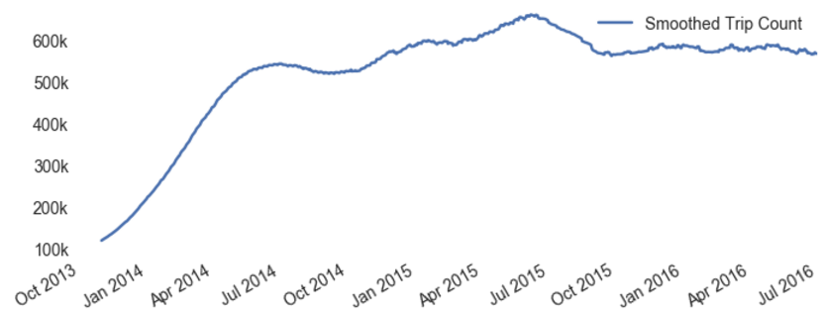
Trend
Green cab market has matured
Rolling average of 3 months’ trip count
3 PM
Stage 1: Innovation
Stage 2: Growth
Stage 3: Maturity
DATA: TAXI AND LIMOUSINE COMMISSION
Product life-cycle theory by Raymond Vernon

Slide 13
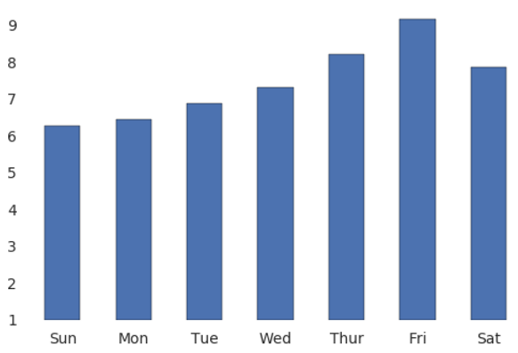
Segmentation —— Day of week
Largest passenger volume on Friday
Average trip count
1M
DATA: TAXI AND LIMOUSINE COMMISSION

Slide 14
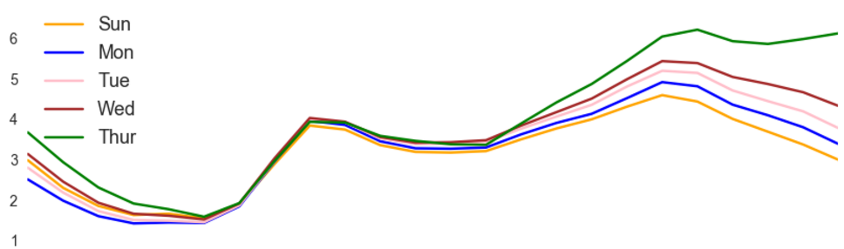
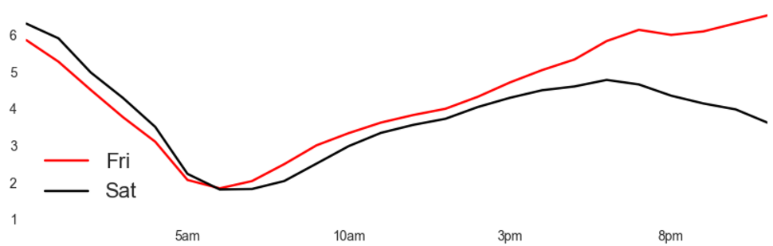
Segmentation —— Day of week & Hour
Most passenger volume on Friday
Ride Count
CYCLICAL pattern for traffic flow:
3 pm Thursday till 8 pm Saturday
peak at Midnight
slow growth since 6 am
8 pm Saturday to 3 pm next Thursday
peak at 8 pm
rapid increase from 6 am
6 am to 3 pm from Sunday to Thursday follows CONSTANT pattern.
Weekly PEAK: 8 pm till midnight Thursday and Friday.
Mini Rush-hour: 7 am till 11 am Sunday to Thursday.
100K
8 PM
Thur
10 AM
Wed
3 PM
Tue
Mon
Sun
8 PM
Fri
6 AM
Sat
Midnight
Midnight
DATA: TAXI AND LIMOUSINE COMMISSION

Slide 15
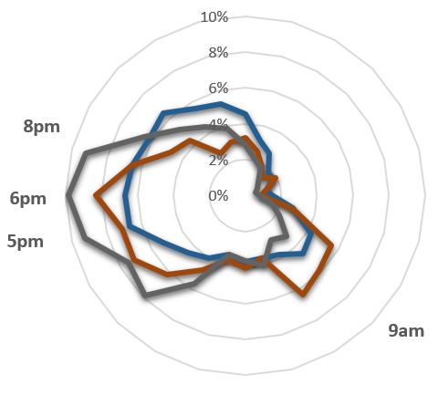
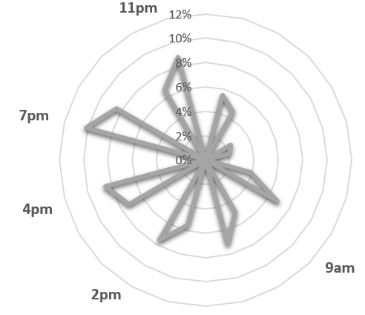


Segmentation —— Weather & Hour
Passenger flow dispersed on rainy/snowy/windy day and centralized on cloudy day
Midnight
Midnight
Hourly traffic share
Hourly traffic share
Noon
Noon
Traffic well distributed during daytime and sparse in the evening.
Mini rush period usually around 6 pm
Snow and wind greatly depress evening traffic
Passengers flow concentrated at 9 am, noon, 2 pm, 4pm, 7pm and 11 pm.
Ridership peaks at 7pm.
DATA: TAXI AND LIMOUSINE COMMISSION

Slide 16
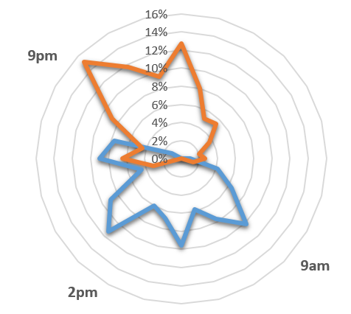
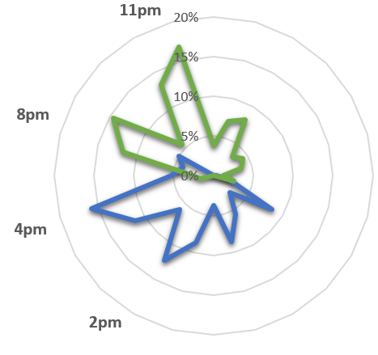


Segmentation —— Weather & Hour Cont’d
Good weather (clear and cloudy) greatly stimulates ridership.
Midnight
Midnight
Noon
Noon
Daytime traffic more evenly distributed than evening traffic on clear day.
Traffic concentrated at 9 pm/noon/2 pm for clear day, and 9 pm/midnight for clear night.
Traffic concentrated at 4 pm and 11 pm for partly cloudy day and partly cloudy night respectively.
DATA: TAXI AND LIMOUSINE COMMISSION

Slide 17
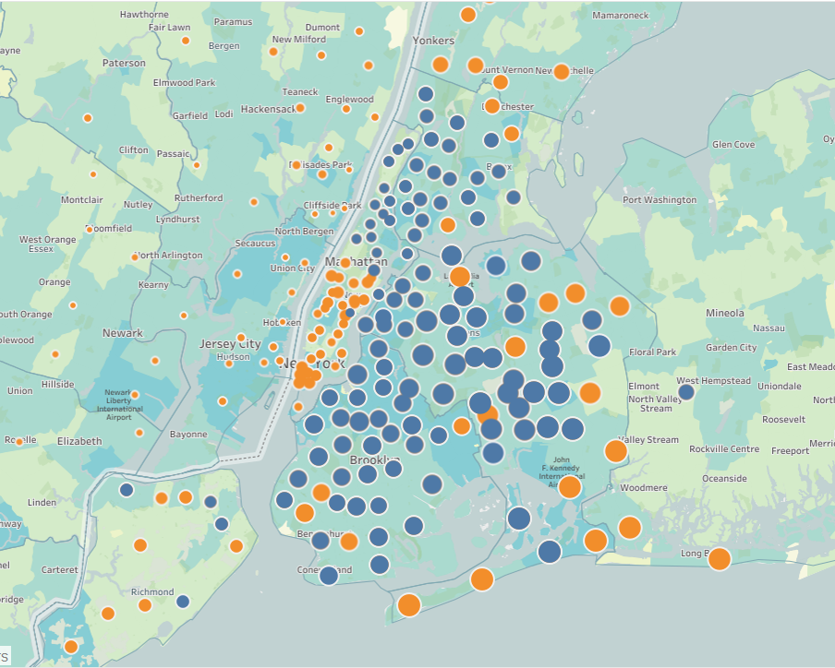
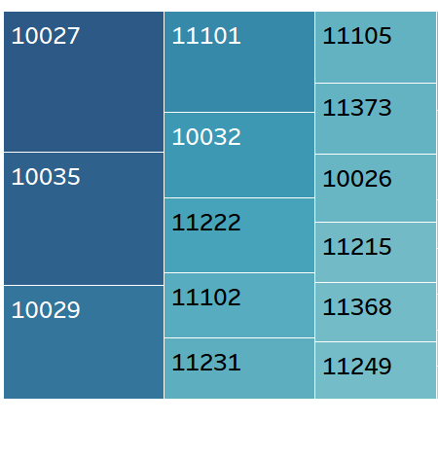
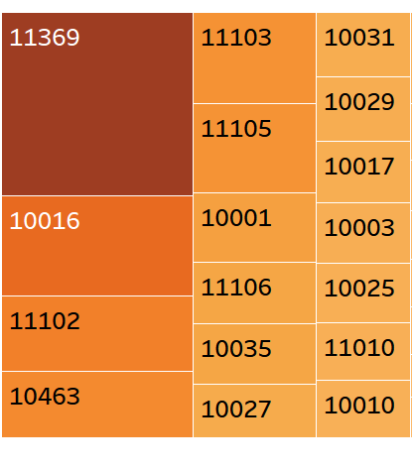
Segmentation —— ZIP Code
Blue points: pick up
Orange points: drop off
Bigger size indicates higher frequency
For map layer:
Darker blocks imply populous areas
top popular pickup spots (Blue) and drop off plots (Orange)
As expected, larger ridership usually take place in densely populated areas such as Williamsburg, Long Island city and Staten Island.
Picking up passengers at Queens or Brooklyn and dropping them off in lower Manhattan is typical green cab business routine.
Other than lower Manhattan, the most popular drop-off places, green cab ride destinations are sparsely distributed around New York: Yorkers, Rosedale and Newark.
DATA: TAXI AND LIMOUSINE COMMISSION

Slide 18
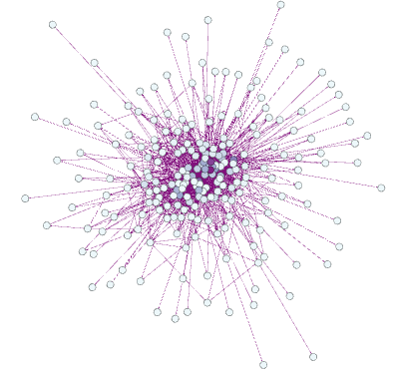
Segmentation —— ZIP Code
“Popular places of departure”:
nodes with high out-degree (10027, 10035, 10029, 11101, 10032, 11222, 11102, 11231, 11105, 11373)
“Popular destination”:
nodes with high in-degree (11369, 10016, 11102, 10463, 11103, 11105, 10001, 11106,10035, 10027)
“ Traffic hub” :
nodes with high degree (11369, 10027, 10035, 10029, 11102, 11105, 11101, 10016, 11103, 10032)
“Transportation Junction”:
Nodes with high centrality (10027, 10035, 11102, 10029, 11105, 10025, 10032, 10031, 11103)
Green cab ridership network from February 1 - 14 2016
DATA: TAXI AND LIMOUSINE COMMISSION

Slide 19
Recommendation——Volume
Peak hours:
8 PM Everyday
Thursday and Friday night
10 AM Sunday through Thursday.
Good weather indicates great but challenging business opportunities:
Don’t miss peak hours on good weather days (9 AM & 2 PM for clear day, 9 PM & Midnight for clear night, 2 PM & 4 PM for cloudy day and 8 PM & 11 PM for cloudy night), as passengers far less likely to show up other times.
Show up in places with zip codes 10027, 11222, 11102, 11231, 11105, 11373, 11369, 10035, 10029, 11101, 10016, 11103, 10032, especially those in bold, as they are both “popular places of departure” and “traffic hub”.
Avoid places with zip codes 10025 and 10031 during peak hours as there wouldn’t a lot of potential customers but a lot of traffic.
Time-wise
Place-wise

Slide 20
II. Efficiency * Money earned per ride per minute

Slide 21
Overview
Calculate “Efficiency” (Fare amount divided by ride time in minutes)
Trend analysis
Density analysis
Efficiency Prediction (Classify a trip as “efficient” or “inefficient”)
Sample cleansed data used

Slide 22
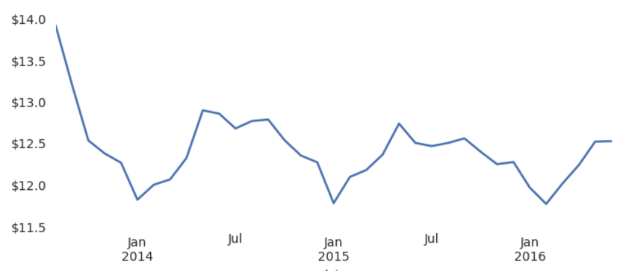
Trend
Green cab program is a seasonal business
Earning
Per ride
Since Jan 2014, average earning for each ride (tax and extras excluded) follows a SEASONALITY pattern:
average fare fluctuates regularly around $ 12.5.
Highs (above $12.5) happen during spring and summer.
Lows (below $ 12.5) happen in autumn and winter.
DATA: TAXI AND LIMOUSINE COMMISSION

Slide 23
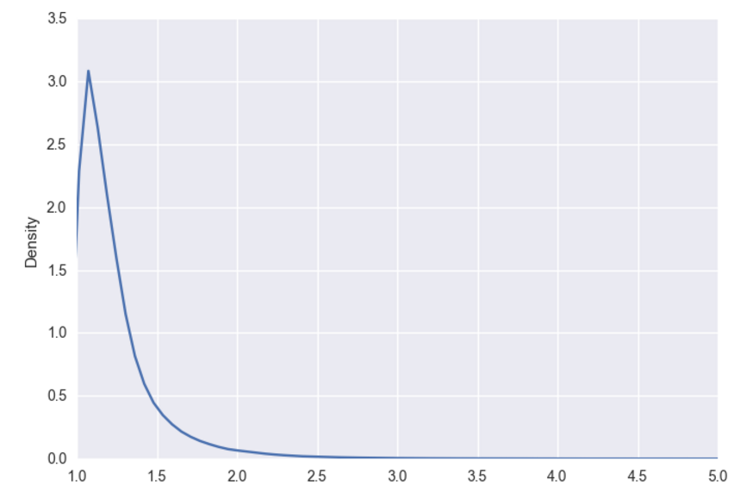
Density
Minutely earning per ride averages at $ 1.27 but could go up to tens occasionally.
Mean | 1.266382
Standard Deviation | 0.610673
Minimum | 1.000255
25% | 1.069418
50% | 1.159154
75% | 1.304348
Kurtosis: 683
Skewness: 21
In most cases, efficiency hardly vary significantly.
Kurtosis being over 683, larger than the statistical normal value of 651, accompanied by a pretty small p-value, the null hypothesis of green cab efficiency following a normal distribution is rejected.
Skewness value being 21 means there is a lot of weight in the left tail. Efficiency distribution is heavily left skewed.
Extraordinary efficiency happens among short-distance rides ( around 0.5 miles)
Earning per minute
Note: x axis is limited to a range of one to five for visualization
DATA: TAXI AND LIMOUSINE COMMISSION

Slide 24
Predictive Modeling
Randomly sample 10% from cleansed dataset
Label generation:
Efficiency over the average labeled as “Good”, otherwise “Low”
Features preparation:
Holiday, Passenger number, Rate Code ID, Store and fwd flag, Trip distance, Trip type, Pick up hour, month, day of week, temperature, weather, wind bearing, wind speed and visibility.
Random Forest VS Gradient Boost
Model validation through visualization

Slide 25
Predictive Modeling Cont’d
Accuracy (after cross validation):
Accuracy is good enough on the whole.
Top three important features generated by model:
Model may suffer under-fitting and is unstable when trip distance is unknown. More features are needed.
Random Forest | Gradient Boost
66% | 72%
Features | Variance Explained
Trip distance | 0.68
Wind Speed | 0.06
Temperature | 0.06

Slide 26
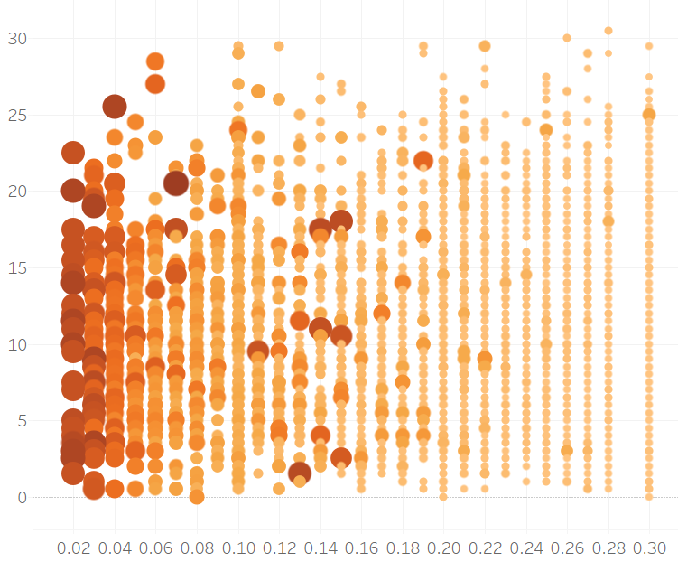
Predictive Modeling Cont’d
For short rides, distance increase and faster wind speed restrains efficiency
Wind speed
larger and darker circles indicate higher efficiency.
As trip distance increases, efficiency declines.
For ride shorter than 0.1 miles, wind speed barely show any influence on efficiency. However, as distance grows, strong wind (over 20) becomes an adverse factor for efficiency.
0.1
0.2
0.3
0.5
Trip Distance
DATA: TAXI AND LIMOUSINE COMMISSION

Slide 27
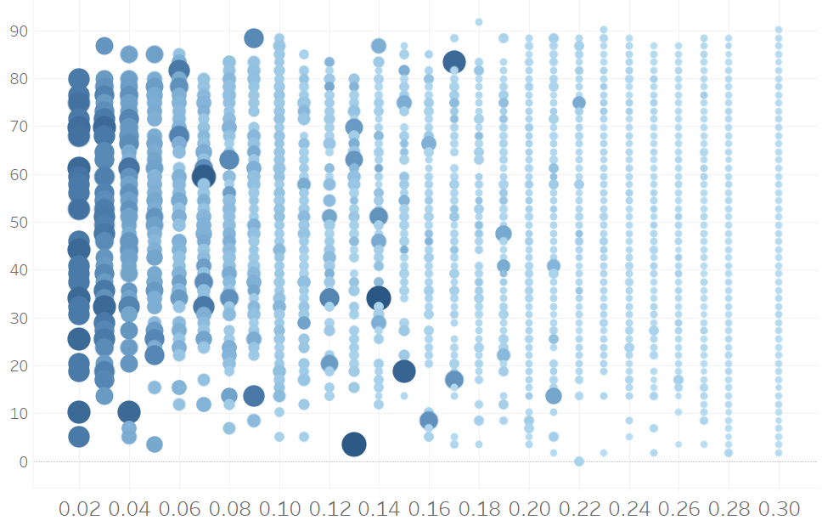
Prediction Cont’d
For short rides, polarized temperatures promote efficiency
Temperature
larger and darker circles indicate higher efficiency.
For rides shorter than 0.2 miles, either high temperature (over 80) or low temperature (below 20) stimulates efficiency.
Trip Distance
0.1
0.5
0.6
DATA: TAXI AND LIMOUSINE COMMISSION

Slide 28
Recommendation——Efficiency
Expect an earning of $ 1.20 per minute for an ordinary ride.
Each ride on the whole brings an earning ranging from $12 to $13, fluctuated by seasons.
Small chance (3%) that more than $2 could be earned per minute per ride.
For rides earning more than $2 per minutes, almost all of them are shorter than 0.6 miles.
If a ride is shorter than 1 mile, 10% of possibility it is able to gain at least $2 per minute.
As efficiency is hard to change, focus on passengers number for higher revenue.

Slide 29
III. Tip

Slide 30
Overview
Trend analysis
Segmentation:
Day of week
Hour
Weather
Rate Code ID
Cleansed data used

Slide 31
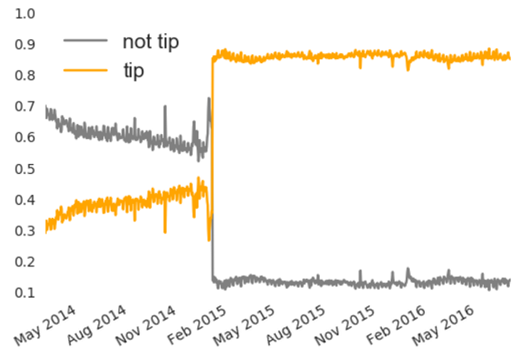
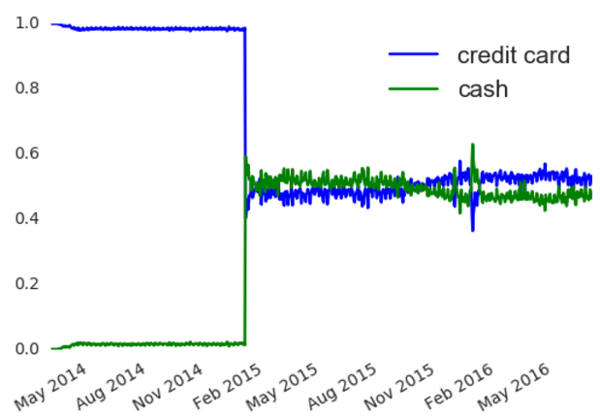
Trend
Great changes happened in February, 2015.
Percentage of daily rides paid by credit card/cash
Rides with/without tip ratio
In February 2015, violent and sudden changes happened in shares of rides with and without tip.
Nearly at the same time, passengers began paying with cash.
Before February 2015, passengers unanimously paid with credit card and 40% chance that they would tip.
After February 2015, around 50% passenger pay with credit card, among whom over 80% tip.
Despite of occasional share decline, credit card as a payment type has kept gaining popularity over cash since Aug 2015
DATA: TAXI AND LIMOUSINE COMMISSION

Slide 32
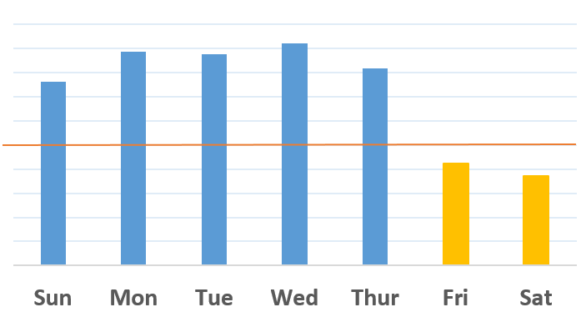
Segmentation —— Day of week
Average tip is better from Sunday through Thursday
Average tip
22.5%
22%
21.5%
DATA: TAXI AND LIMOUSINE COMMISSION

Slide 33
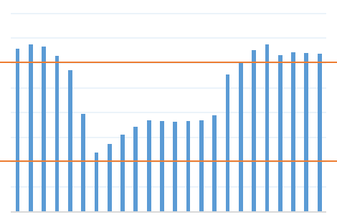
Segmentation —— Hour
Average tip is better before sunrise or after sunset.
Average tip
23.5%
22.5%
20.5%
19.5%
Midnight
6 AM
Noon
6 PM
DATA: TAXI AND LIMOUSINE COMMISSION

Slide 34
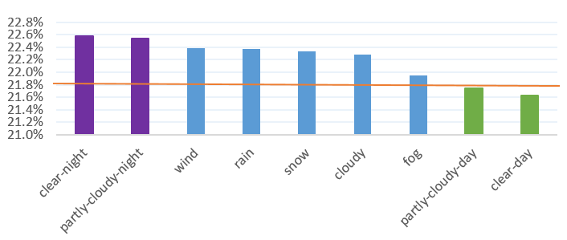
Segmentation —— Weather
Passengers tip more during bad weather.
Average tip
Good Weather Night
Bad Weather
Good Weather Daytime
22.8%
21.8%
21.0%
DATA: TAXI AND LIMOUSINE COMMISSION

Slide 35
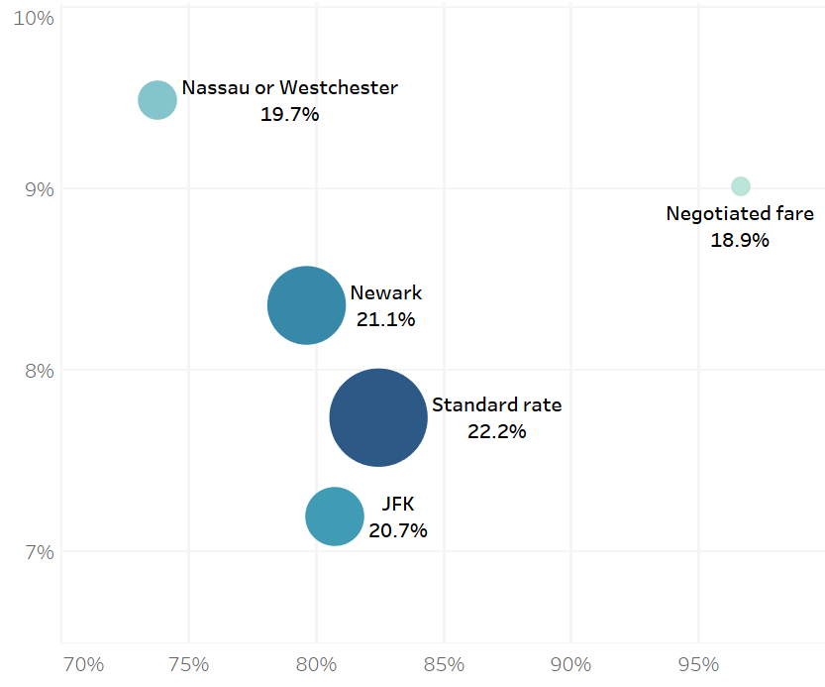
Segmentation —— Weather
Passengers tip more during bad weather.
Tip Variance
larger and darker circles indicate higher average tip.
Passengers heading to Nassau or Westchester are usually not generous tippers: over one quarter of them not tip or tip little (less than 20%). And they are the most unpredictable: great variance in their tip behaviors.
Almost all “Negotiated fare” passengers are willing to tip —— tip a little (below 19%).
“Standard rate” passengers are the most generous: over 80% of them are willing to tip over 22%.
“JFK” passengers show the most stable tipping behavior: tip around 20.7%
Tip Probability
DATA: TAXI AND LIMOUSINE COMMISSION

Slide 36
Recommendation —— Tip
Expect a tip of 22% from over 80% of “credit card” payers.

Slide 37
CONCLUSION
Don’t miss any good weather Thursday afternoons or nights, as ride demands would soar and average tip peak at 22.7%.
A trip cannot be worse if starting from Brooklyn to Nassau or Westchester as it would last long which lead to low financial efficiency, over 25% of probability the passenger would refuse to tip and highly likely you would drive back with vacant cab since few ride demands there.

