Slide 1
COLLECTIONS
Arrays, Lists, Sets, Maps

Slide 2
Collections
Data structures for collecting one or more values, all of the same type
Arrays, lists, maps, sets, trees
You can use Java’s collections
But, Scala also has higher order operations like map, reduce and filter
Write fewer lines of code than Java to implement same thing
Scala’s collections are immutable
Cannot be resized
Contents cannot be changed
Their package collections.immutable is automatically imported into the Scala namespace

Slide 3
Arrays

Slide 4
Arrays
An array is a data structure that provides space for a fixed number of elements of same data-type
In order to work with Array objects, you must import the Scala Array package i.e.
import Array._
We might declare an array like this:
val z = new Array[String](3)
z: Array[String] = Array(null, null, null)
Or we may initialize it (& Scala will infer data-type)
val z = Array("apple", "banana", "cherry")
z: Array[String] = Array(apple, banana, cherry)

Slide 5
Array Access
To access specific element (by position),
z(1)
res0: String = banana
Reassignment of values:
z(1) = "zucchini”
z
res2: Array[String] = Array(apple, zucchini, cherry)

Slide 6
Tricky points about Arrays
Reassignment?? But isn’t z a val?
Legacy from Java Arrays: immutable reference i.e. z, but mutable contents
Scala List comes both in mutable and immutable versions i.e. by default
val x = List(1,2,3)is immutable reference and immutable contents
Arrays and Lists are similar, but implemented differently under the covers
Arrays are more efficient i.e. O(1) access to contents
Lists are singly-linked-lists i.e. O(n) access to contents (for access of arbitrary position)

Slide 7
Array range method
One method you may use frequently is
def range( start: Int, end: Int, step: Int ): Array[Int]
Returns an array containing equally spaced values in some integer interval.
Similar to Python’s range method
val myList1 = range(10, 20, 2)
// Print all the array elements
for ( x <- myList1 ) {
print( " " + x )
}

Slide 8
LiSTS

Slide 9
Lists
The List type is immutable
Example of a list in Scala
val pets = List("cat", "dog", "iguana”)
Here’s the same thing in Java
list<String> pets = new ArrayList<String>();
pets.add("cat");
pets.add("dog");
pets.add("iguana");
Same thing in Python
myList = ["cat", "dog", "iguana"]

Slide 10
Basic functions
First element
pets.head
Remaining elements
pets.tail
2nd element (it’s 0 based!)
pets(1)

Slide 11
A Few functions (try these!)
Operation | Example | Description
head | pets.head | Returns first element of list
tail | pets.tail | Returns all elements except 1st
isEmpty | pets.isEmpty | Returns true if list is empty
length | pets.length | Returns length of list
List(i) | pets(i) | Returns (i+1)st element of list

Slide 12
Higher Order Functions
These are available in List and other collections as well
iterate over list
numbers.foreach((p: String) => print(p))
Convert a single list element to another value/type
pets.map((p: String) => p.size)
Let’s construct a new list,
val numbers = List(6,2,7,9)
Take a function and combine two list elements into a single element
val total = numbers.reduce((a: Int, b: Int) => a + b)
((6+2)+7)+9)

Slide 13
map & reduce methods
Every Scala collection has map and reduce methods
These methods are the fundamental building blocks of the Hadoop Map-Reduce engine
And two of many, but critical, methods in the Spark engine
map: takes a function and applies it to every member of the collection
reduce: shrink a list down to a single value
i.e max, min, average, sum, product

Slide 14
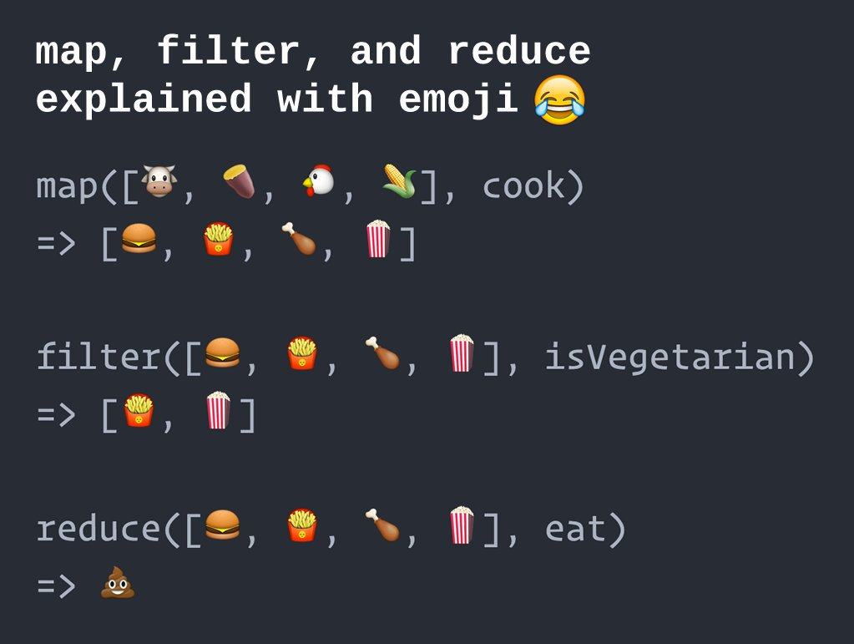
Map, Reduce & Filter

Slide 15
Some examples
Convert each member of List to upper case
val upperCasePets = List("cat","dog","iguana").map(_.toUpperCase)
Find max element of list
val numbers = List(4,9,6,2)
numbers.max
Find sum of elements of list
numbers.sum
Verify if list contains a particular value
numbers.contains(4)

Slide 16
More functions (try these!)
Operation | Example | Description
:: | 1 :: 2 :: Nil | Append elements to list, right associative
filter | List(6,2,7,9) filter (_ > 6) | Return elements from list that pass a true/false function
reverse | List(6,2,7,9).reverse | Reverse list
sortWith | List(6,2,7,9) sortWith (_ < _) | Orders list
take | List(6,2,7,9).take(2) | Extract first n elements
zip | List(6,2,7,9) zip List("a","b","c","d”) | Combine 2 lists into list of tuples of elements at each index

Slide 17
Flattening a List
Flattening a List implies collapsing a List hierarchy into a single List
Example:
val myList = List(List(1,2), List(3), List(), List(4,5))
myList: List[List[Int]] = List(List(1, 2), List(3), List(), List(4, 5))
Flattening the list:
myList.flatten
res0: List[Int] = List(1, 2, 3, 4, 5)
You can only flatten a List whose elements are all Lists

Slide 18
Zipping and unzipping Lists
Zip takes two lists and forms a pair of Lists
val newList = List(6,2,7,9).zip(List("a","b","c","d"))
Alternate notation (without the .)
val newList = List(6,2,7,9) zip List("a","b","c","d")
Useful special case: pair every element of a list with position where it appears in the list
List("a","b","c","d").zipWithIndex
Change back to tuple of lists
newList.unzip

Slide 19
Displaying Lists as Strings
All Scala objects have a toString method (inherited from List’s superclass)
Use toString to get canonical String representation
newList.toString
res4: String = List((a,0), (b,1), (c,2), (d,3))
Use mkString if you want a more customized-looking List
I want a string that starts with { , separated by - , end with }
newList mkString ("{","-","}")
res7: String = {(a,0)-(b,1)-(c,2)-(d,3)}

Slide 20
Using Map and FlatMap
You can string operations together; using pets example:
val pets = List("cat","dog","iguana")
pets map (_.toList.reverse.mkString)
You can flatten hierarchy with maps as well:
pets map(_.toList)
res10: List[List[Char]] = List(List(c, a, t), List(d, o, g), List(i, g, u, a, n, a))
Versus
pets flatMap (_.toList)
res11: List[Char] = List(c, a, t, d, o, g, i, g, u, a, n, a)

Slide 21
Folding Lists
Folds are like reduces, only with an initial value
x = List(1, 2, 3)
x.foldLeft(10)(_+_)
Gives (((10+1)+2)+3) = 16
Whereas reduce gives 16
x.reduce(_+_)
There is a foldLeft and foldRight

Slide 22
Conclusion
Lists are but one type of Scala collection: there are many others
Complete list of List methods
http://www.scala-lang.org/api/2.7.1/scala/List.html

Slide 23

Exercise
Create a list of the first 20 odd numbers.
Can you create this with a for-loop?
with the filter operation?
with the map operation?
Can you convert the above list to a string starting with [ ending with ] and separated by ;

Slide 24
Set
Immutable, unordered collection of unique elements
Supports same operations as List instance does
Try this one:
val myset = Set(6,2,7,6,7,9)
Notice the output.. It contains 4 elements!

Slide 25
Common Operations (try these!)
Operation | Example | Description
size | myset.size | Returns number of elements in set
contains | myset.contains(3) | Returns true if myset contains 3
+ | myset + 5 | Adds the element 5 to myset
- | myset - 3 | Removes element 3 from myset
empty | myset.empty | Removes all elements from myset

Slide 26
Map
Also known as HashMap (Java), Dictionary (Python), Associative Array (Perl)
Stores value associated with a unique key
Value is retrieved using key
Key-value pair tuples
Supports same operations as List
val colorMap = Map("red" -> 0xFF0000, "green" -> 0xFF00, "blue" -> 0xFF)
Iterate through key-value pairs
for (pairs <- colorMap) { println(pairs) }

Slide 27
Common Operations (try these!)
Operation | Example | Description
keys | colorMap.keys | Returns set of keys
values | colorMap.values | Returns set of values
+ | colorMap + ("purple" -> 0xFF00FF) | Adds color purple to map
- | colorMap - ("red") | Remove red (key & value)
isEmpty | colorMap.isEmpty | Returns true if map is empty

Slide 28
Performing Common Operations
Iterate through keys, values
colorMap.keys.foreach{ i =>
print( "Key = " + i )
println(" Value = " + colorMap(i) )}
See if a particular color exists
if( colorMap.contains( "red" )) {
println("Red key exists with value :”) + colorMap("red"))
} else {
println("Red key does not exist”)
}

Slide 29
For loops & maps: under the covers
Example:
for { a <- List(1, 2, 3); b <- List(5, 6, 7); c <- List(8, 9, 10)} yield a*b*c‬
Gets translated internally into:
List(1, 2, 3).flatMap(((a) => List(5, 6, 7).flatMap(((b) => List(8, 9, 10).map(((c) => a.$times(b).$times(c)))))))
All for loops translated into series of maps and flatmaps
In Scala, you don’t need loops ☺

Slide 30
Exercise
Using Maps, write a def that counts the (unique) words in a body of text
The key is the word, the value is the number of occurrences of the word
Copy and paste the text of sample_text.txt into a scala val
val sampleText = ..
Remember, periods, commas etc are not words
You may have to convert everything to lower case
Skeleton code:
import scala.collection.mutable
def countWords(text: String) = {
val counts = mutable.Map.empty[String, Int]
for (rawWord <- text.split("[ ,!.]+") { ..
<you fill in>
}
}

Slide 31
Map Types
Scala has a variety of Map types
To return elements in sorted order by keys, use a SortedMap
import scala.collection.SortedMap
val grades = SortedMap("Emily" -> 92, "Bob" -> 85, "Carol" -> 95, "Alice" -> 90, "Doug" -> 91)
To return map that retains insertion order of its elements, use a LinkedHashMap or ListMap

Slide 32
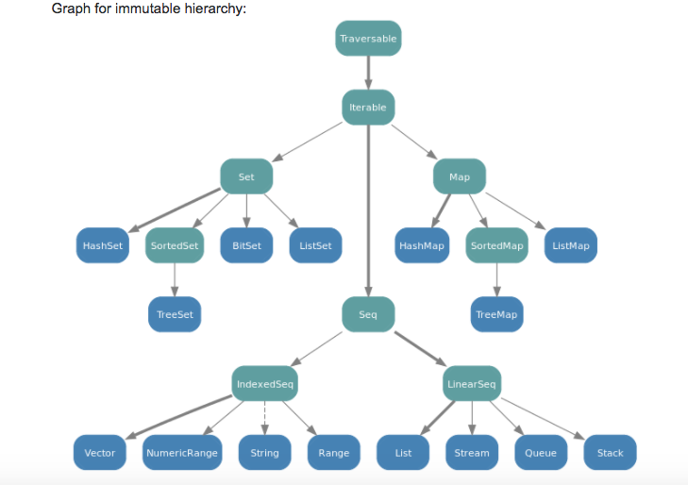
Immutable collection class hierarchy

Slide 33
Mutable Collections
The Lists, Sets & Maps we covered previously are examples of immutable collections
Data and data structures cannot change their state
This is safe to use with concurrent (i.e. distributed) code
Sometimes you may want to work with mutable data (when it is safe to use it)
Using mutable data structure that is used strictly within the bounds of a function
Convert List, Set, Map immutable collections to mutable ones by applying toBuffer method

Slide 34
Streams
We will cover this because you will see later, it is used in Spark Transformations
Stream type is a lazy collection because it consists of
A starting element
A recipe to generate subsequent elements
Add elements to collection only when they are accessed for 1st time i.e. through a reduce-type method
Immutable collections “know” / “receive” 100% of their contents when they are first created
You can construct an infinite stream!

Slide 35
Create a Stream using the construct i.e. cons method
Constructing a stream:
def inc(i: Int): Stream[Int] = Stream.cons(i,inc(i+1))
Now grab 1st element (notice how other elements don’t exist yet)
val s = inc(1)
s: Stream[Int] = Stream(1, ?)
Now if we want 10 elements as a List, we apply the take & toList
val l = s.take(10).toList
l: List[Int] = List(1, 2, 3, 4, 5, 6, 7, 8, 9, 10)
head
tail

Slide 36
Real-World Application of Streams
Streams are nifty data structures that are really useful in the world of big data
Have millions of items in a remote database
Want to write a function that scans whole database & returns only those items having some property or matching some constraint
Have too many items to hold in memory at once
user might only want the first 10 matches, shouldn’t need to retrieve the whole sequence
Scala lets us define reusable, general purpose abstractions that will do all the boilerplate for us

Slide 37
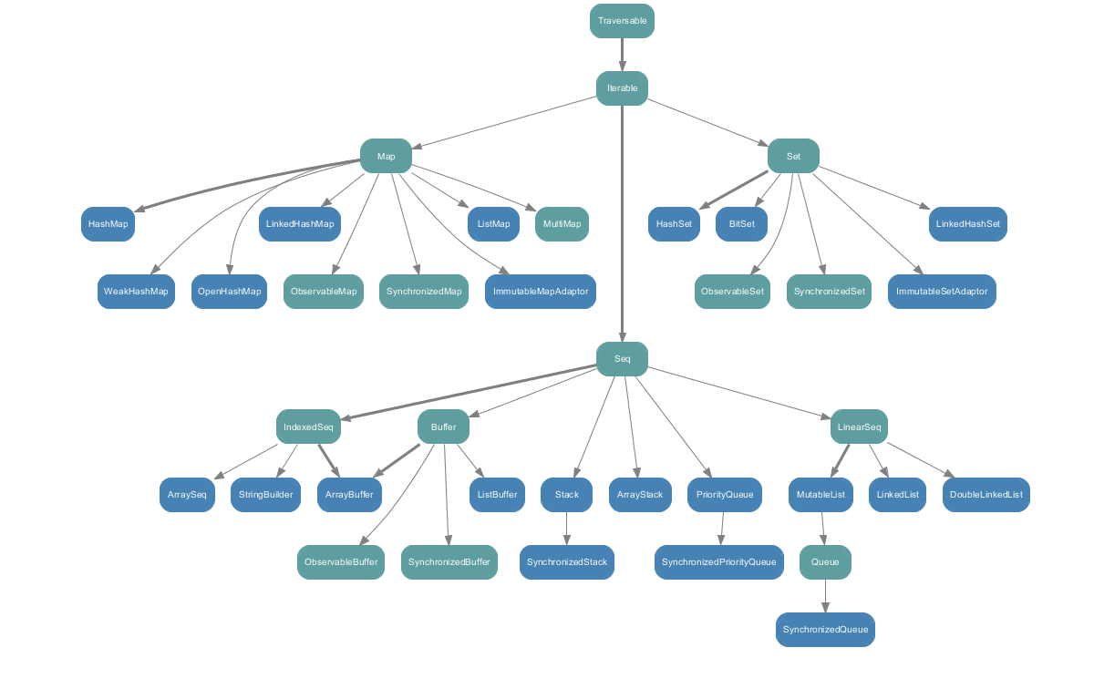
Immutable collection class hierarchy

Slide 38
Exercise
Stream contains recursive call to generate new elements
Write a function that returns a list of the first n elements of the Fibonacci series
Fibonacci numbers map the sum of two previous values to the next value of a i.e. 1,1,2,3,5,8 (you need to specify the 1st 2 values)
What data structure (Collection) would be appropriate here?
def fib(a: Int, b: Int): Stream[Int] = <you fill in>
How do you output a list of the first 100 Fibonacci numbers?

Slide 39
File I/O
Import a package from Scala
Here we read lines from a file & prints them out
import scala.io.Source
object HelloWorld {
def main(args: Array[String]): Unit = {
if (args.length > 0) {
for (line <- Source.fromFile(args(0)).getLines())
println(line.length + " " + line)
}
else
Console.err.println("please enter filename")
}

Slide 40
References
Learning Scala by Jason Swartz, O’Reilly
Programming in Scala: Third Edition by Martin Odersky, Lex Spoon and Bill Venners, Artima
Scala Documentation
http://docs.scala-lang.org/overviews/collections/introduction
Scala Tutorials
http://docs.scala-lang.org/tutorials/

