Slide 1
Cloud Computing
With AWS & Databricks

Slide 2
Key features of cloud computing
Infrastructure is shared
Multiple clients share a common technology platform and even a single application instance.
Services are accessed on demand in units that vary by service
Units can be, for example, user, capacity, transaction
Services are scalable
Pricing model is by consumption
Instead of paying the fixed costs of a service sized to handle peak usage, you pay a variable cost per unit consumption (users, transactions, capacity, etc.) that is measured in time periods that can vary, such as hour or month.
Services can be accessed from anywhere in the world by multiple devices

Slide 3
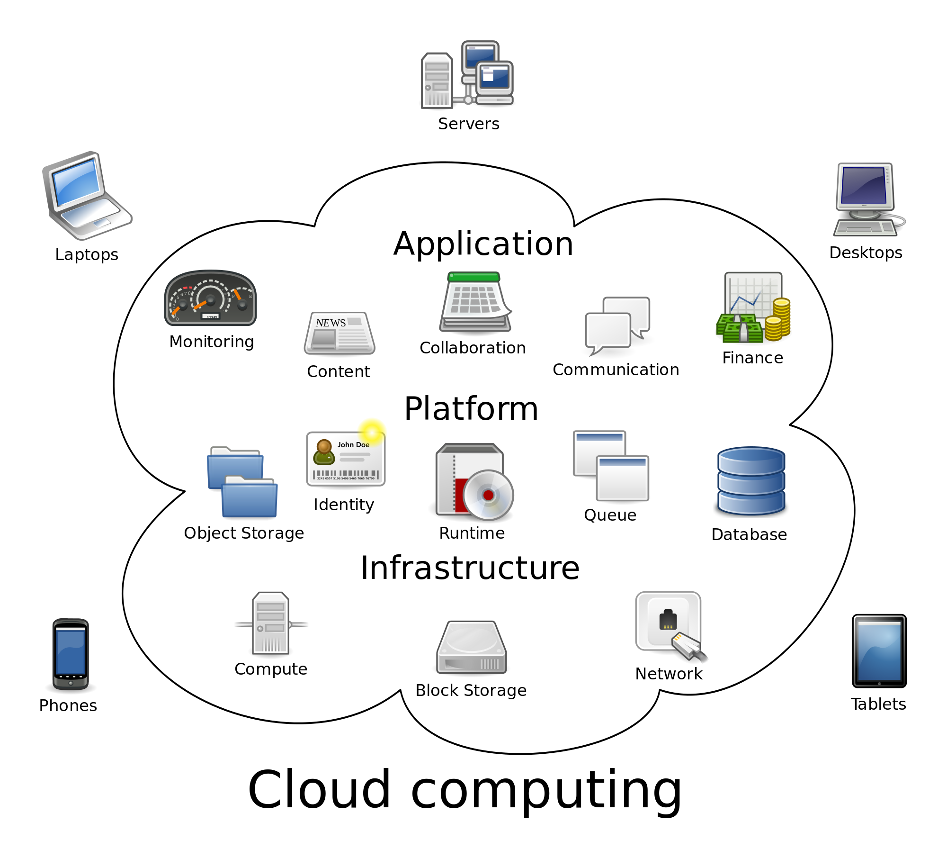
Components of a Cloud System

Slide 4
Public cloud providers
Examples of (public) cloud providers
Amazon Web Services (AWS),
Microsoft Azure
Google Cloud
Databricks (for Spark!)
Many others
Access through their data center via http/ftp etc
Nominally, fairly lax security
Cost is very reasonable; for moderate computing your bill might be $150 per month

Slide 5
Amazon Web Services
http://aws.amazon.com

Slide 6
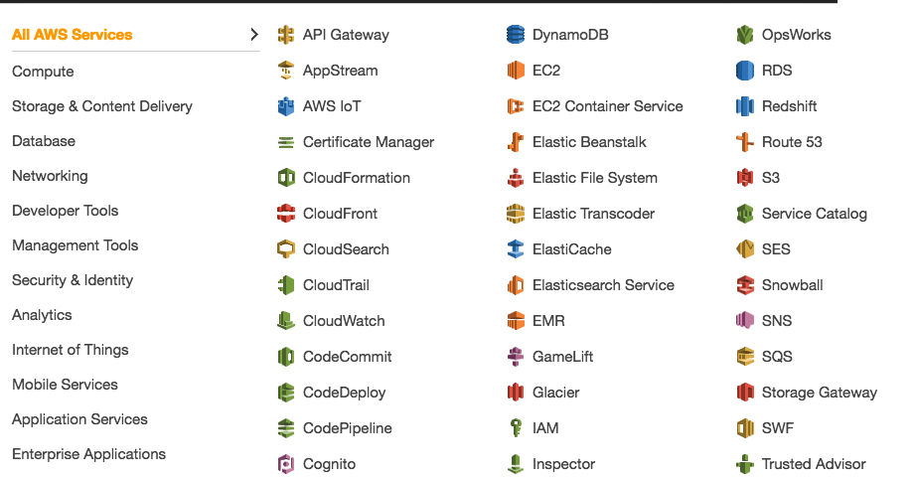

Slide 7
Elastic Compute Cloud (EC2)
EC2 is a “blank slate”… given a few configuration settings, Amazon will spin up a cluster for you
The cluster is essentially “empty”
There is no Spark installed
You have to install everything yourself
Add capacity automatically

Slide 8
Terminology
Instances = EC2 virtual environments
Different types have varying combinations of CPU power, amount of memory, storage size, networking capacity
Amazon Machine Images (AMIs) = pre-configured templates for your instances
Can be OS like Windows/Linux and/or actual software packages
Instance sizes range from micro to x-large

Slide 9
Security
Security Groups = Settings that enable to specify ports, source IP addresses that can access your instances (i.e. firewall)
Key pairs = Security features that control access to your instance after it is created
If you don’t have right key pair you won’t be able to access your instance

Slide 10
Step 3: Configure your instance
In this wizard, you have the option to configure your instance features. Below are some guidelines on setting up your first instance.
Choose an Amazon Machine Image (AMI): In step 1 of the wizard, we recommend the Amazon Linux AMI (free-tier eligible).
Choose an instance type: In step 2 of the wizard, we recommend the t2.micro (free-tier eligible).
Create a key pair: Select Create a new key pair and assign a name. The key pair file (.pem) will download automatically.

Slide 11
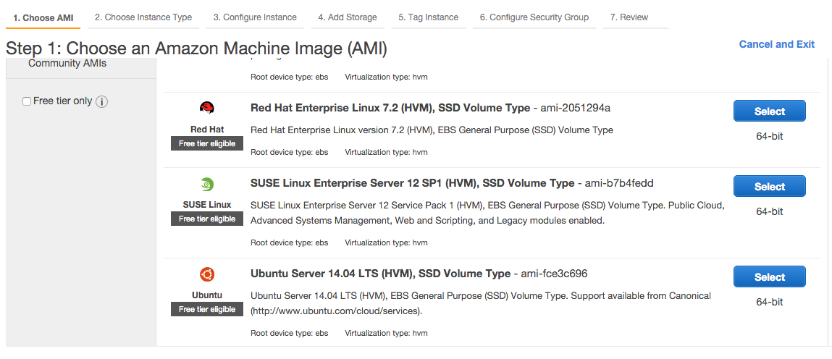

Slide 12
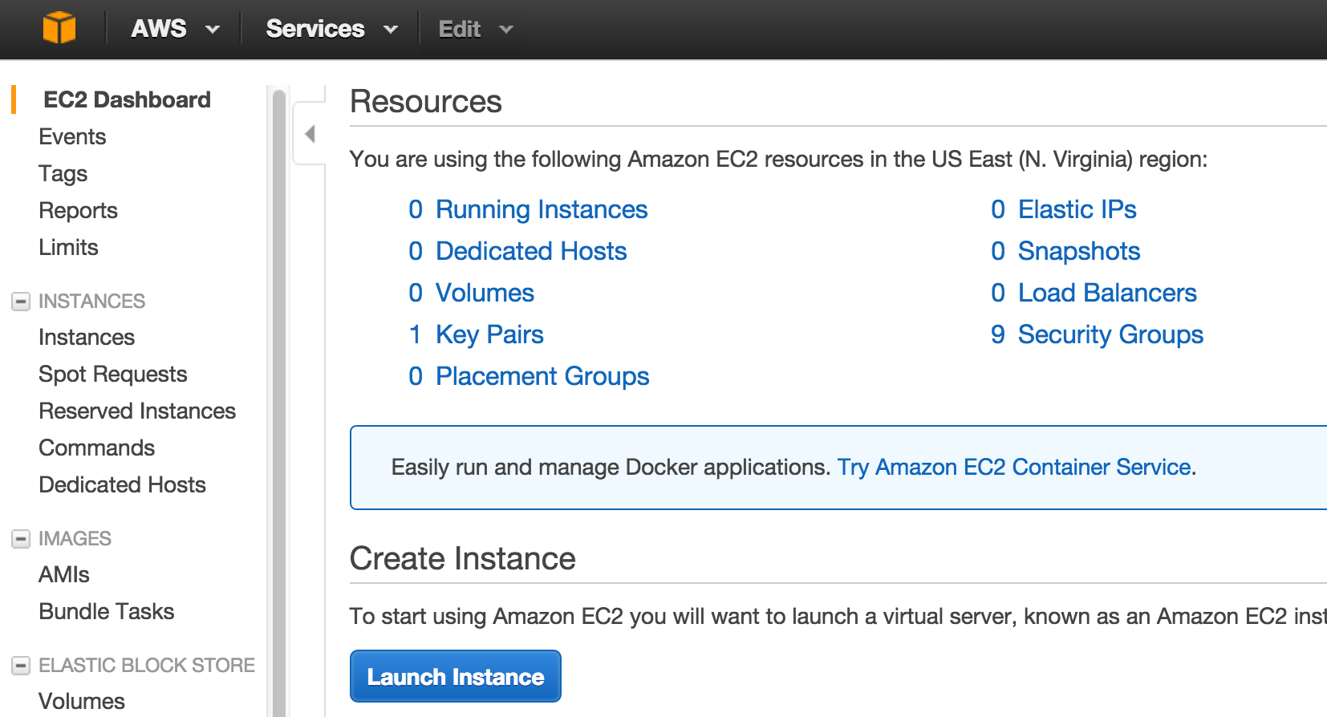
Step 2: Launch an Amazon EC2 Instance

Slide 13
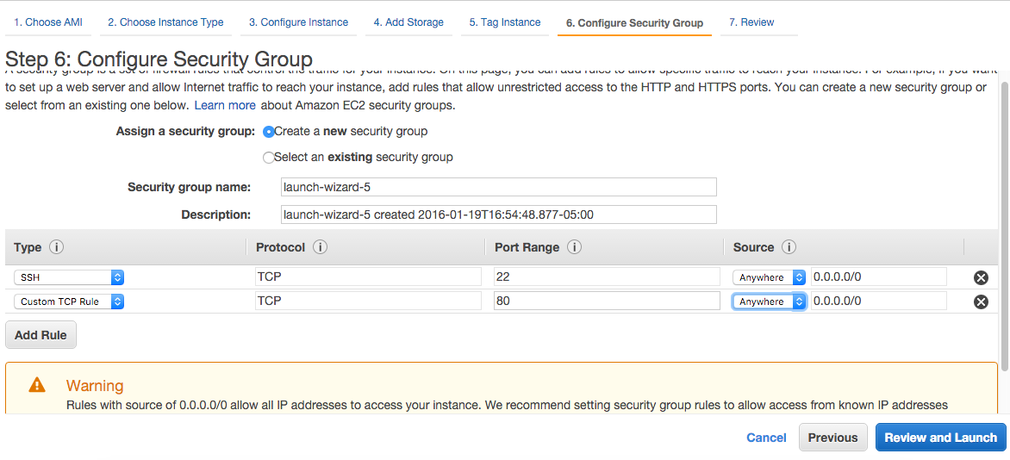
Security Settings

Slide 14
Aside (Port Settings)
21: File Transfer Protocol (FTP)
22: Secure Shell (SSH)
23: Telnet remote login service
25: Simple Mail Transfer Protocol (SMTP)
53: Domain Name System (DNS) service
80: Hypertext Transfer Protocol (HTTP) used in the World Wide Web
110: Post Office Protocol (POP3)
119: Network News Transfer Protocol (NNTP)
123: Network Time Protocol (NTP)
143: Internet Message Access Protocol (IMAP)
161: Simple Network Management Protocol (SNMP)
194: Internet Relay Chat (IRC)
443: HTTP Secure (HTTPS)

Slide 15
Step 4: Connect to your Instance
After you launch your instance, you can connect to it and use it the way that you'd use a computer sitting in front of you. To connect from the console, follow the below steps:
Select the EC2 instance you created and click Connect.
Select A Java SSH client directly from my browser. Ensure Java is installed and enabled.
Enter the Private key path (example: C:\KeyPairs\my-key-pair.pem).
Choose Launch SSH Client.

Slide 16
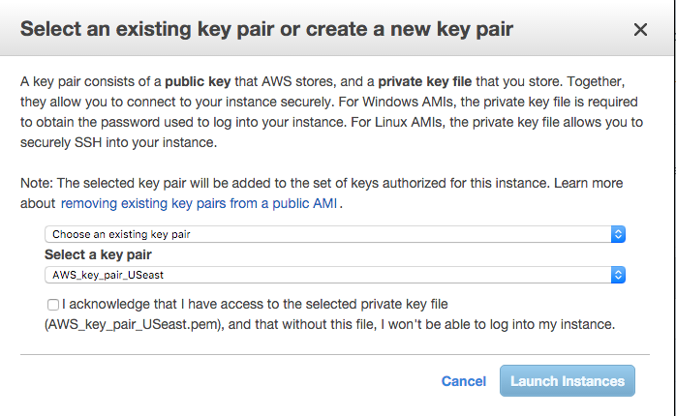

Slide 17
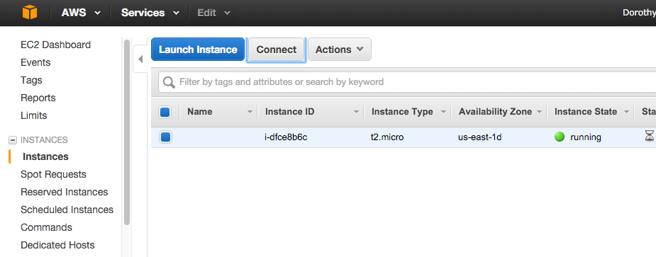

Slide 18
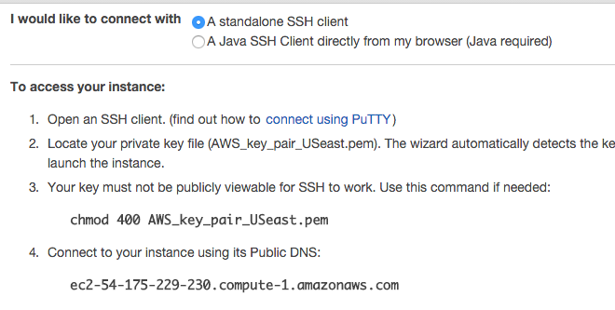

Slide 19
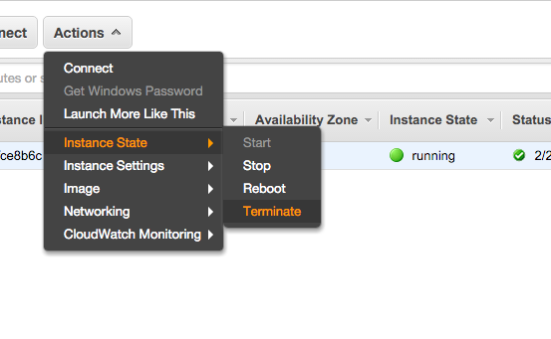
Terminate instance

Slide 20
Simple Storage Service (S3)
Secure, highly scalable storage in the cloud
Amazon’s distributed file system
Upload, download, set permissions
Avoid paying for storage you don’t use
Allows versioning so you can rollback to previous version if needed

Slide 21
Accessing S3
Command line interface (aws cli)
Web interface
Use REST interface so you can programmatically store/retrieve data (SDK)

Slide 22
Terminology
Buckets = containers for objects where data is stored
Control who can list, create, delete objects in bucket
Only charged for storing objects in a bucket
Regions = pick location closest to you so as to reduce latency
Java applet to upload an entire folder

Slide 23
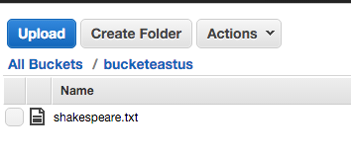
Using Amazon Simple Storage Service (S3)
You’ll need to create a bucket
Go to this location, create bucket, give it unique name
https://console.aws.amazon.com/s3
You can upload a file to it

Slide 24
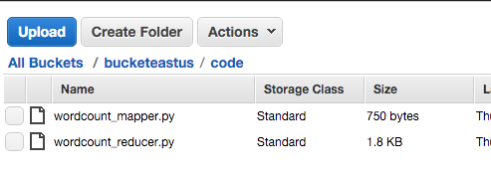
Uploading *py code to S3
I also need to upload my mapper & reducer code to S3
I create a folder called “code” in my S3 bucket, also created a folder called “output” (!!)
And I upload my mapper & reducer to it

Slide 25
Elastic Map Reduce (EMR)
Amazon’s managed (i.e. everything set up for you) service
Use EC2 instances
Use S3 to read input/write output (you will have to create an S3 bucket!)
When you launch an EMR job, EMR provisions EC2 instances to perform computation
EMR is actually an AMI that is customized to run Hadoop applications (Hive, MapReduce, Spark, etc)

Slide 26
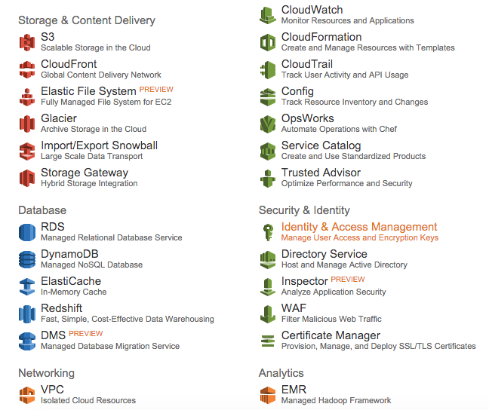

Slide 27
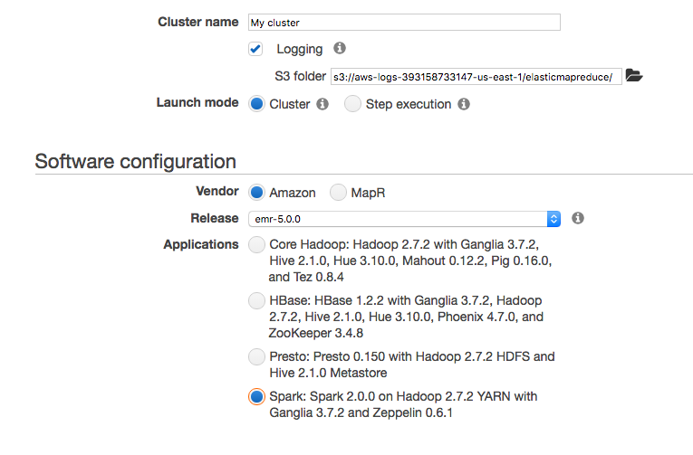

Slide 28
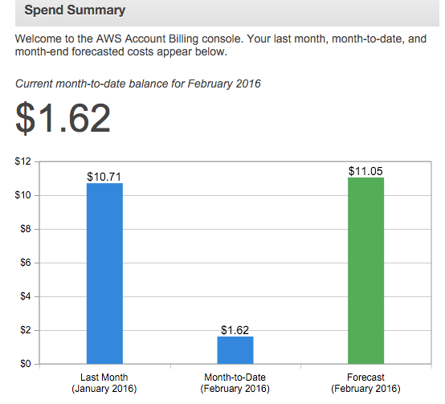
Check your Billing!!
https://console.aws.amazon.com/billing/home?region=us-east-1#/

Slide 29
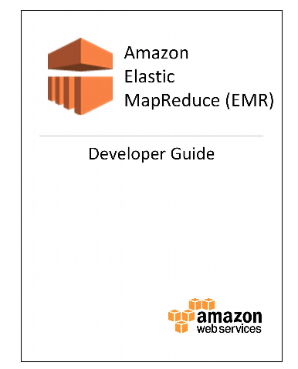
More Information
Download Amazon Elastic Map Reduce (EMR) Developer Guide to your Kindle application (it’s free and the Kindle application is also free)
http://docs.aws.amazon.com/ElasticMapReduce/latest/DeveloperGuide/UseCase_Streaming.html

Slide 30
Windows Users
To set up ssh, follow the instructions on this page
http://docs.aws.amazon.com/AWSEC2/latest/UserGuide/putty.html

Slide 31
Databricks
https://community.cloud.databricks.com/login.html

Slide 32
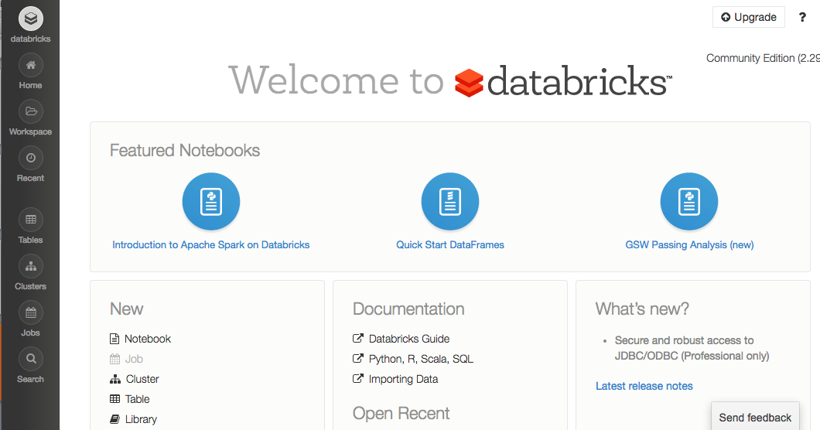
Databricks: creators of Spark

Slide 33
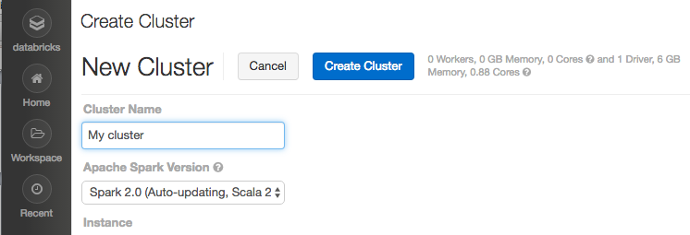
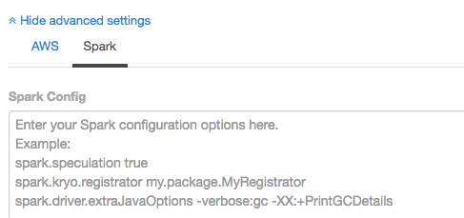
Create new Cluster

Slide 34
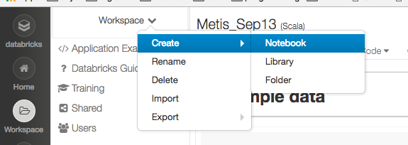
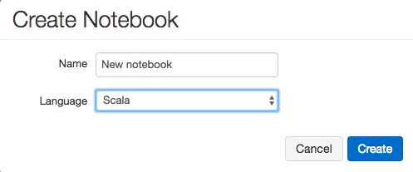
Create a new Notebook

Slide 35
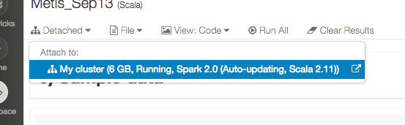
Running a Notebook
When you are ready to run a notebook (having created a cluster), you should attach the notebook to a cluster i.e.

Slide 36
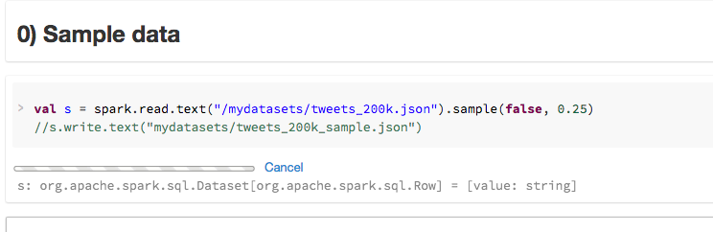
Running lines in a notebook
Click on Command-Enter (like in an iPython notebook) and it will execute the row
This is what it looks like when you execute a notebook

