Slide 1
Slicing: Features vs Layers
Jorge Gueorguiev Garcia
Notes:
Well, not my idea of course, just standing on someone shoulders.
Intro:
I like talking and mentoring. Not because I consider myself the knees bees (sometimes I am no expert). But because it helps me to understand better the topic. And because then I hear myself talking and go “did I say that? What was I thinking?”. It helps me learn. It helps others. Impostor syndrome? I look at the rubber-duck style of resolving issues.

Slide 2

FreeImages.com/Esther Groen

Slide 3

FreeImages.com/Matt Kitson
Notes:
So, you are all my rubber ducks

Slide 4
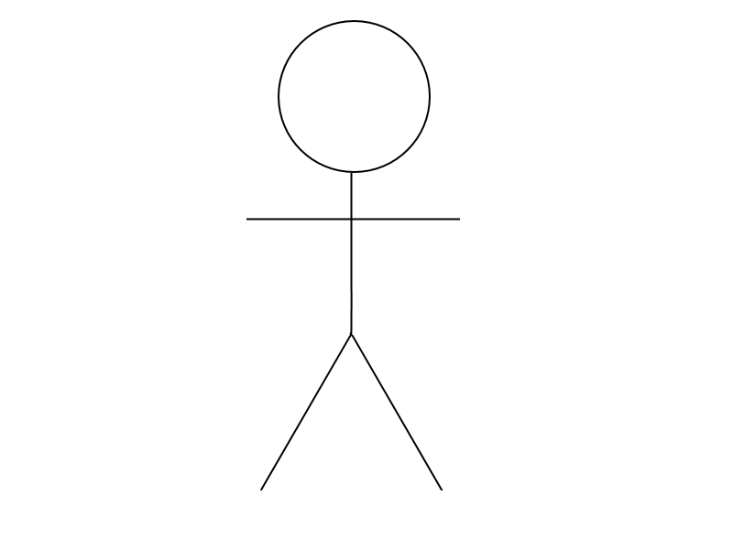
Notes:
Let me introduce you to Bill. He will be helping us on getting this through.
Say Hello Bill <click>

Slide 5
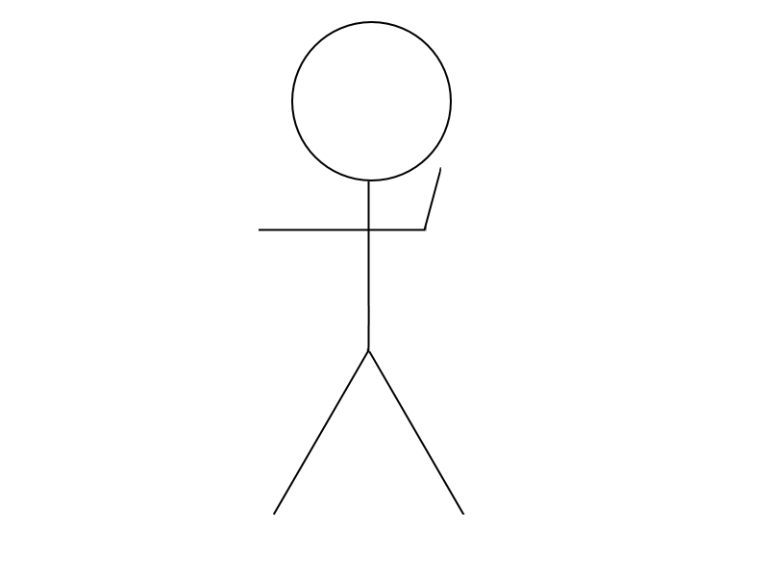
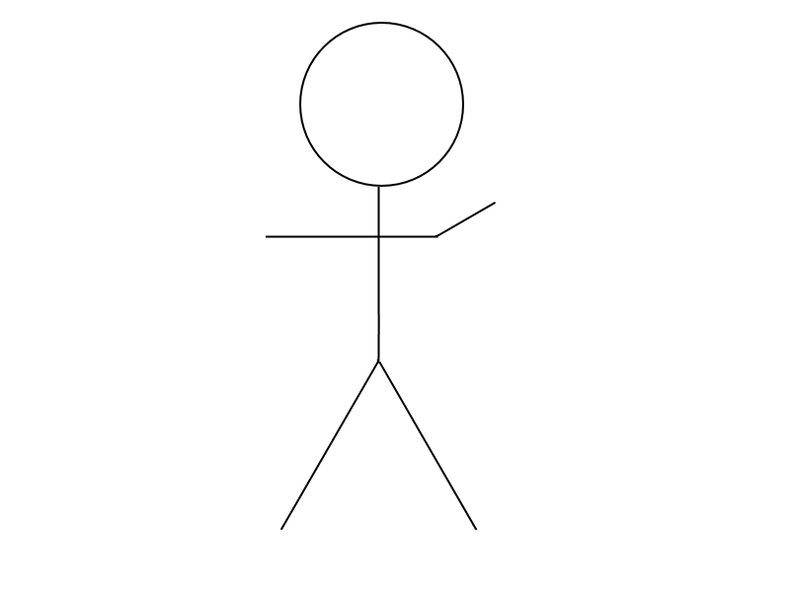
Notes:
Time to start working on this <click>

Slide 6
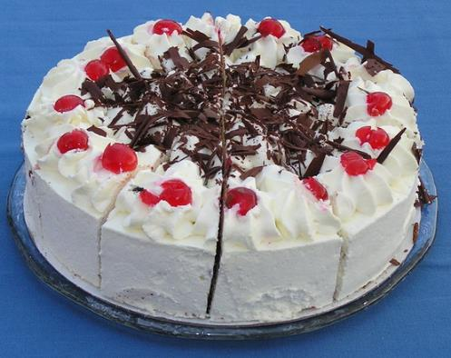
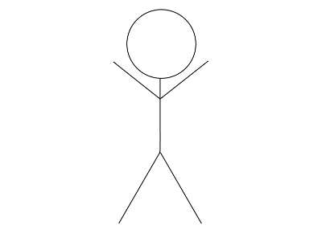
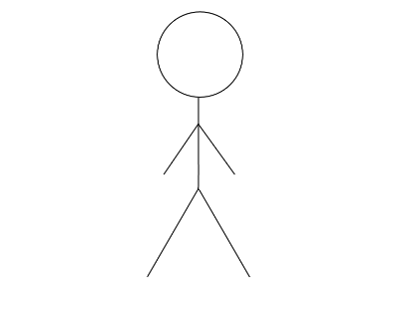
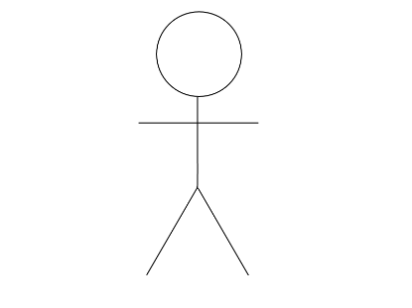
Software
FreeImages.com/Helmut Gevert
Notes:
Today we are actually going to be talking about <click>
Cakes!!
Actually, sorry, no, Bill <click>
Today we are going to talking about software <click>
And how we create/design/despair

Slide 7
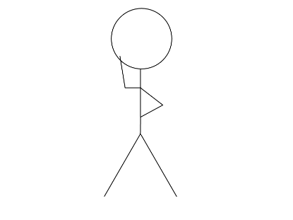
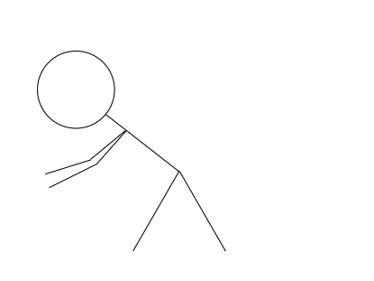
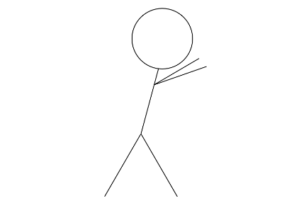
An Initial Approach
Change
Scale?
Improve
Notes:
The first thing that we need is always to make something work. How it works is not as important. Make it run, make it right, make it fast (Douglas Kent Beck, who just passed away)<click>
So, how we do achieve that? <click>
Well, we can just create a single thing (be either class or object) <click>
That we will put together with all the functionality<click>
But of course. This is problematic. You know, a monolith is more difficult to change, more difficult to imrpove, more difficult to scale?<click>
DHH – Majestic monolith (yesterday) – Good for small teams/small codebases. We already doing distributed computing.

Slide 8
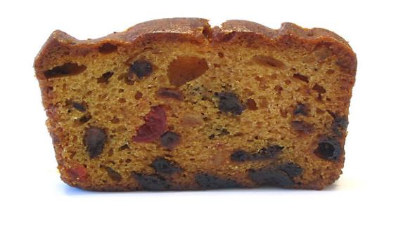
FreeImages.com/Mark Mordecai
Notes:
Then what can we do? <click>

Slide 9

Notes:
A nice a layered cake, looks more tasty

Slide 10
Layering up
Controller
Validation
Business Logic
Adapter
Data
Command
Query
Notes:
Controller
Business Logic
Adapter
Data
Going back to the fruit cake
Usually setup as separate classes/projects.
Lets see an example!!
But if we use layers, the objects that deal with a layer do they need to know what is below them?
Owin middleware how to deal with it kind of nicely. Static language is on the way.
But what happens when we need to add a new endpoint, or modify or improve one of the others?
But layers are logical, not the actual separation of projects on your code.
Show Promocode before any change

Slide 11

Notes:
Another way of looking at this. What if you want one slice to be different to the rest?

Slide 12
Time to Change
Validation
Adapter
Controller
Data
Business Logic
Notes:
But what you do when a change comes? A new endpoint, a new page.
Then we have to go an modify all layers/projects.

Slide 13
Alternative: Features
Implementation Detail
Validation
Controller
Feature A
Feature B
Feature C
Data
Query
Command
Adapters
Business Logic
Notes:
There is this alternative, using feature projects. Which are just vertical slices instead of horizontal ones.
Controller Layer. Because other wise we will have a service per endpoint. Let’s be pragmatic
To be truthful, the layers are still present, but only from a logical point of view. Is much easier to skip unneeded layers. And when you want to add new functionality, you will not be affecting other features functionality
But, are we duplicating code? Duplicating code is only hurtful when two pieces of code that are equal have to change for the same reason. If that is the case
Show example after

Slide 14
Isolation
Cohesion

Slide 15
Duplication
Granularity
Notes:
But Bill
What about Duplication
DeDuplication only has to happen when the code is the same (or you can make it look the same) and the reason for changing is the same. Otherwise you will end introducing complexity
Granularity. You have to decide, it depends on the language and the project. Do you want to group features because they will always go together?

Slide 16

FreeImages.com/Nico van Diem
Notes:
Which actually points to another thing.

Slide 17

This is the end
@yefoakira
twoormore.eu
gitlab.com/MiyamotoAkira
github.com/MiyamotoAkira
Notes:
Add twitter github and blog

Slide 18
Q&A

Slide 19

Q&A
Ha, Ha, 42

Slide 20
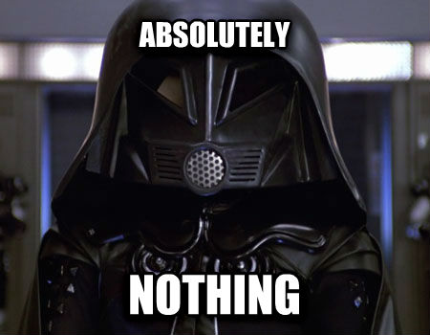
Notes:
(Was second slide)
(Before this slide)
Is not related to the main point.
I hate null. Originally mean memory location 0x0 on memory. Is a value without real meaning. There is no metadata associated.
When you can’t use null because is not a reference? String.IndexOf() -1
Same, no real meaning, no metadata.
Tony Hoare, the creator of null, 1 billion mistake. He would prefer not to have invented it.
Some languages having null, but not being location 0x0. Nil in Swift. Is a construct. But with the same properties.
And then I learned about Algebraic Data Types and the Maybe Monad on functional languages. Oh the breeze, so much easier to deal with mistakes and errors.
What this have to do with what I’m talking about?
(Click into this slide)
Well, will be telling if I told you otherwise.
I need an assistant, anyone? Not pretty enough/too pretty (will distract from me)
So, now I’m going to introduce you to my assistant: Bill (click)

