Slide 1
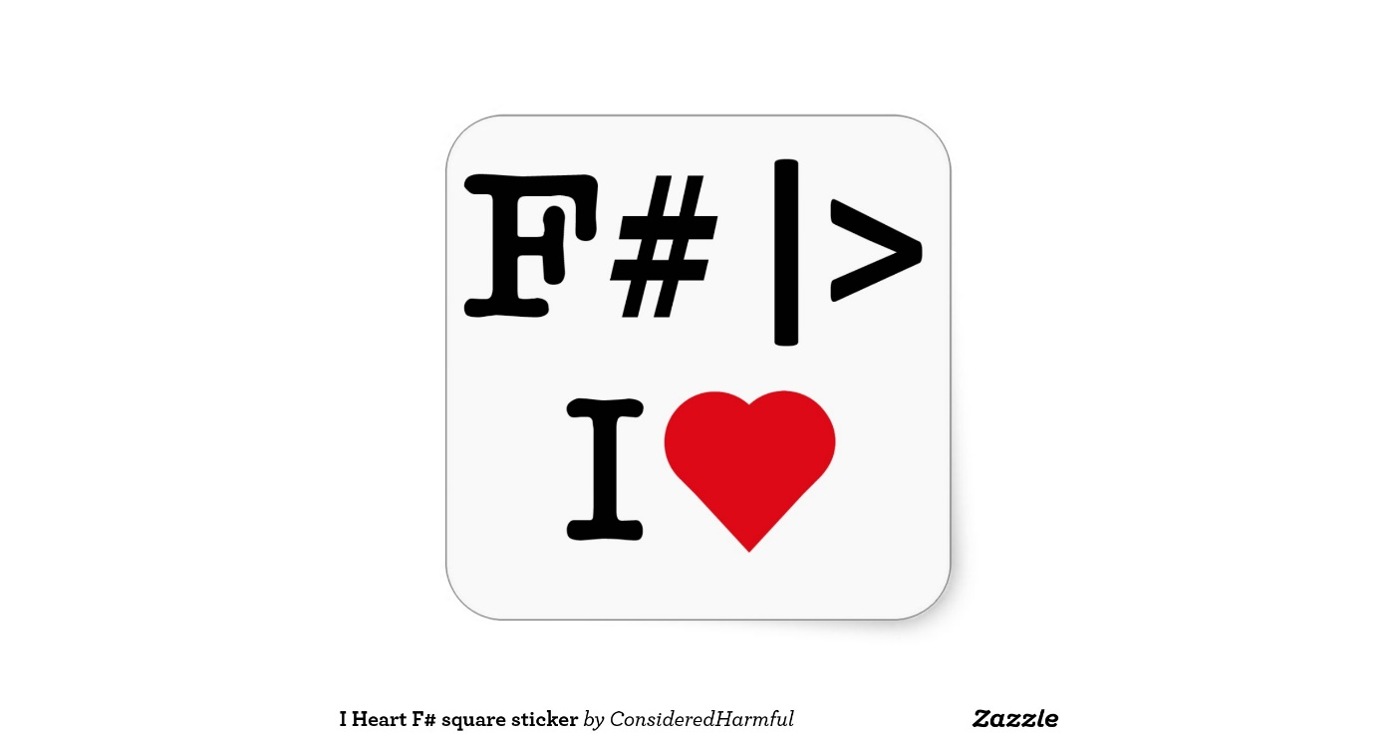
.Net Language
Multiparadigm
Functional
WHAT IS IT?
Order of declarations
What, not How
Indentation scopes
OCaml child
Type inference
Static
Immutability

Slide 2
Succint Language
Less lines of code
Less bugs
WHY?
Pattern Matching
Easier to reason about
Units of Measure
Less cruft code
Concurrency
Native access C#
F# Console

Slide 3

OOP vs FP
Binding
!=
Assignment

