Slide 1
SOLID
Adventures on mantainable code
By Jorge Gueorguiev Garcia

Slide 2
S
Single Object Responsibility Principle

Slide 3
O
Open/Closed Principle

Slide 4
L
Liskov Substitution Principle

Slide 5
I
Interface Segregation Principle
Notes:
First Class Functions

Slide 6
D
Dependency Inversion Principle

Slide 7
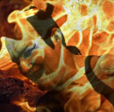
This is the end
@yefoakira
twoormore.eu
gitlab.com/MiyamotoAkira
github.com/MiyamotoAkira
Notes:
Add twitter github and blog

