Slide 1

Computer Architecture
IT1020 Introduction to Computer Systems
Part 01 – Computer Fundamentals

Slide 2
Content
This lecture covers:
fundamentals of computer organization,
the heart of a computer system, CPU, its structure and functionality,
how CPU is seen by programmers and CPU design engineers
instruction set architecture of a processor.

Slide 3
Computer organization
Different groups of engineers see computer different manner
Hardware Engineers see how different components work, their configuration, how they are organized – Computer Organization
Software Engineers see how computer can be used for different applications, how their high level language codes can be executed in machine, How easily it can be used for programs – Instruction Set Architecture

Slide 4
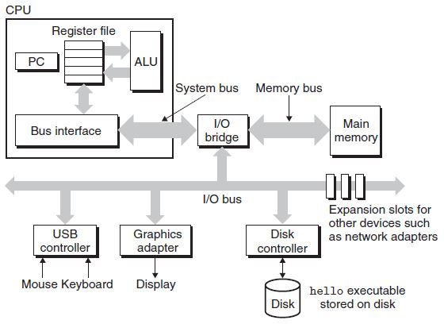
Computer organization
Computer organization is concerned with the way the hardware components operate and the way they are connected together to form the computer system.
CU
Notes:
Adapter: Connects to the mother board, Controller: Chips embedded to the Motherboard or Device (Disk controller comes as a circuit embedded to HDD)

Slide 5
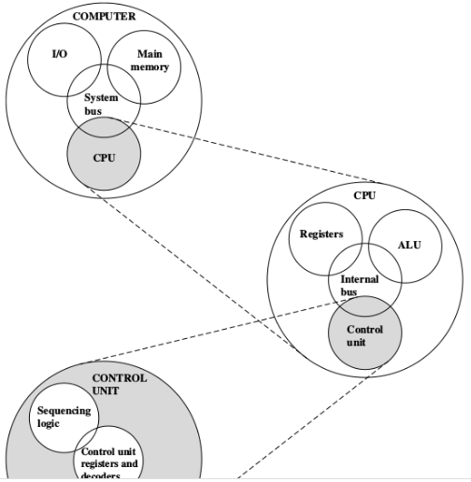
Computer organization
CPU: Controls the operation of the computer and performs its data processing functions.
Main Memory: Stores data and Instructions (Programs)
I/O: Moves the data between the computer and its external environment.
System Interconnections (System Bus): Mechanism that provides for communication among CPU, MM, and I/O.

Slide 6
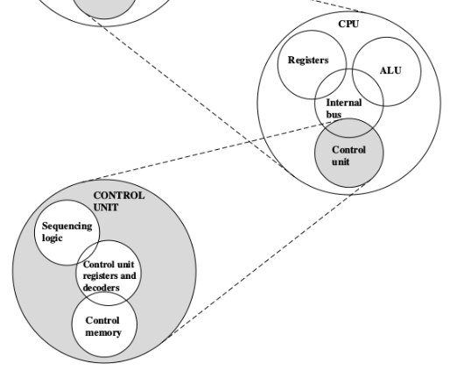
Computer organization
ALU: Performs the computer’s data processing functions
Registers: Provides storage internal to the CPU
Control Unit: A digital circuitry within the processor that coordinates the sequence of data movements into, out of, and between a processor's sub-units

Slide 7
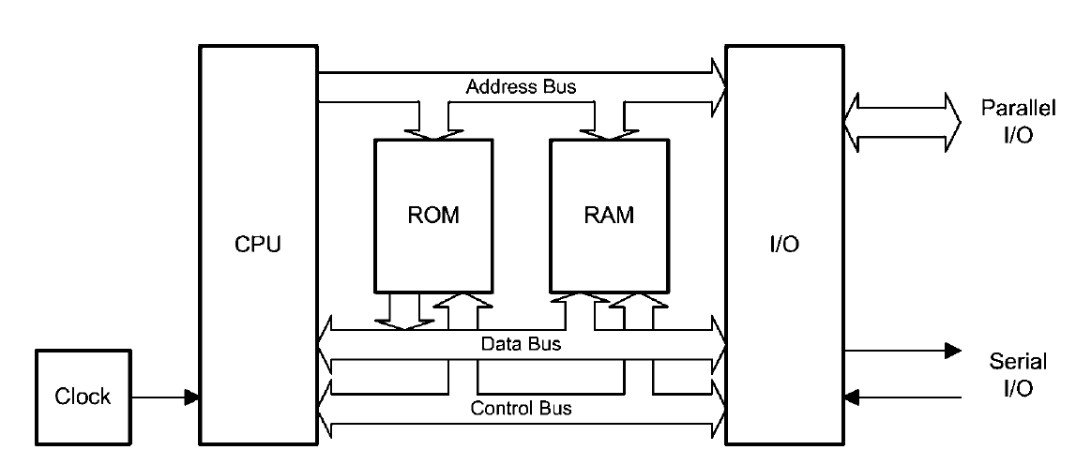
Modern computer
Address Bus: CPU specify the address of MM or I/O, Uni-directional
Data Bus: Transfer data/instruction to and from CPU
Control Bus: Carries commands from CPU and status signals to CPU

Slide 8
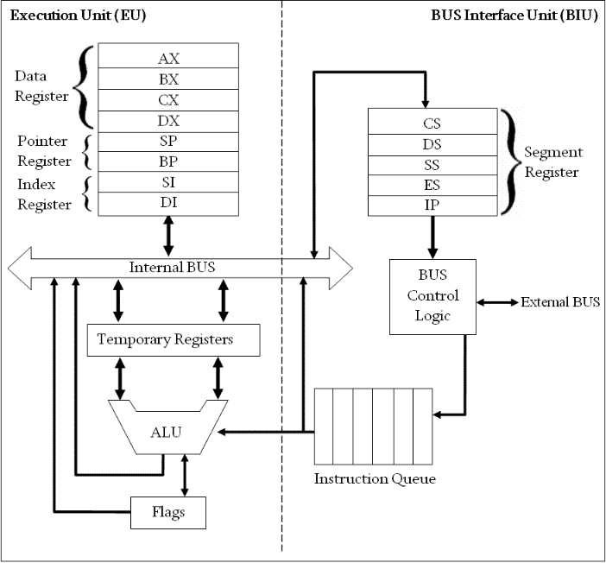
8086 architecture

Slide 9
8086 Registers
They are grouped into several categories as follows:
Four general-purpose registers, AX, BX, CX, and DX.
Four special-purpose registers, SP, BP, SI, and DI.
Four segment registers, CS, DS, ES, and SS.
The Program Counter/Instruction Pointer
The status flag register, FLAGS

Slide 10
8086 registers
General Purpose | Special Purpose (Addressing registers)
AX is the accumulator. It is used for all input/output operations and some arithmetic operations. BX is the base register. It can be used as an address register. CX is the count register. It is used by instructions which require to count (Ex: Looping) DX is the data register. It is used for some input/output and also when multiplying and dividing. | The addressing registers are used in memory addressing operations, such as holding the source address of the memory and the destination address. SI is the source index and is used with extended addressing commands. DI is the destination index and is used in some addressing modes. BP is the base pointer. SP is the stack pointer.

Slide 11
8086 Registers
The two status registers have 16 bits and are called the Instruction Pointer (IP) or Program Counter (PC) and the flag register (F)
IP is the instruction pointer and contains the address of the next instruction of the program. This is called as Program Counter (PC)
Flag register holds a collection of 16 different conditions. (Ex: result is zero or not, there is a “carry” etc)

Slide 12
8086 Registers
Segments registers: There are four areas of memory called segments, each of which are 16 bits and can thus address up to 64KB (from 0000h to FFFFh).
Code segment (cs register), where the program code is stored.
Data segment (ds register), where data from the program is stored
Stack segment (ss register), where the stack is stored.
Extra segment (es register), a spare segment
All addresses are with reference to the segment registers.

Slide 13
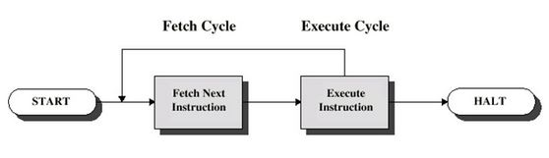
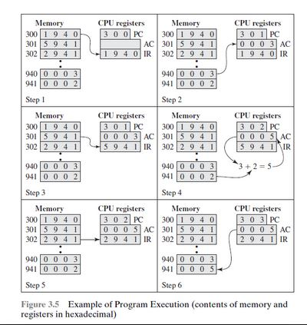
Instruction cycle
The basic function performed by a computer is execution of a program
Program is a well defined set of Instructions
Processing a single instruction is called instruction cycle
It has two steps referred as fetch cycle and execute cycle

Slide 14
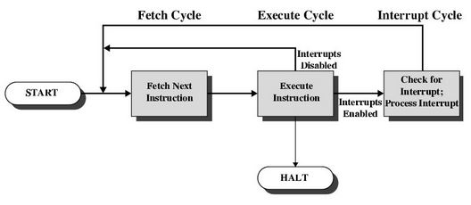
Instruction cycle with Interrupt
All computers provide a mechanism by which other modules (I/O, Memory) may interrupt the normal processing of the processor
Processor engaged in executing other instructions while slow external devices (ex. I/O module) become ready and send interrupt request to processor
Processor responds to such interrupt request by running interrupt handler

Slide 15
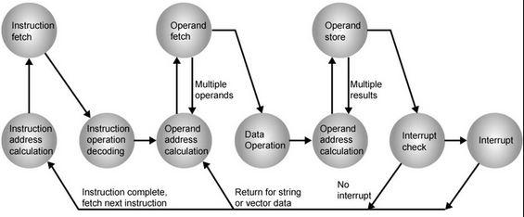
State Diagram of Instruction cycle with Interrupt

Slide 16
Instruction set architecture (ISA)
Instruction Set is a part of the computer that pertains to internal (or low level) programming, which is basically machine language.
The instruction set provides commands to the processor.
Instructions instruct (give orders to) the processor what it needs to do. Consider as “words” in processor’s language.
User codes, normally written in High Level Languages (closer to Natural Language) must convert to Machine Language to be run on the processor

Slide 17
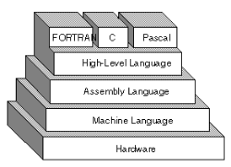

Instruction set architecture (ISA)
Assembly Language has rich set of mnemonics to represent Machine Language Instructions
Assembly Language commands are in a human readable format.

Slide 18
Instruction set architecture (ISA)
Typical ISA defines:
How to access data in Registers, Memory, and other I/O devices
Mechanisms to transfer data and instruction to and from processor
Operations such as additions, subtractions which processor can execute
Control mechanisms such as branch, jump
To be effective as a programmer or processor designer, one should know how ISA works.

Slide 19
Instruction Format
Opcode: Specifies the operation to be performed (Ex-ADD, SUB).
Operand: One or more inputs/outputs, or their source or destination
Next instruction reference: Tells the processor where to fetch the next instruction once the execution of this instruction is completed.

Slide 20
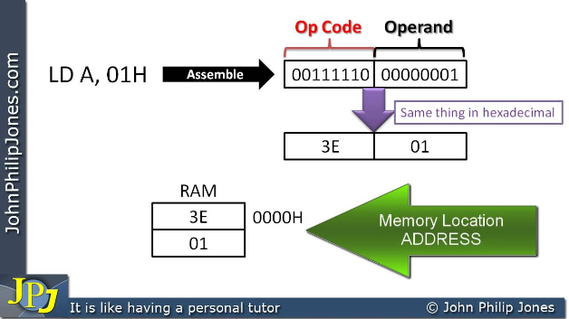
Instruction format
Machine Language
Assembly Language
How it is kept in Memory
Memory Address

Slide 21
Instruction set
Sample Instructions
ADD - Add two numbers.
CMP - Compare numbers.
IN - Input from port into AL or AX. Second operand is a port number.
JMP - Unconditional Jump. Transfers control to another part of the program.
JNE - Short Jump if first operand is Not Equal to second operand.
LOAD - Load information from RAM to the CPU.
OUT - Output information to device, e.g. monitor.
STORE - Store information to RAM.

Slide 22
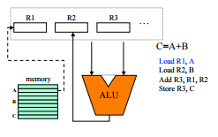
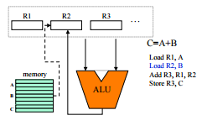
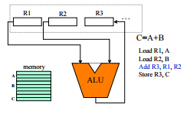
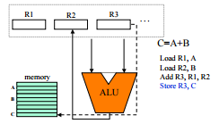
Execution of instructions
Processor Executes one instruction at a time.

Slide 23
Execution of instructions

Slide 24
Execution of instructions

Slide 25
Execution of instructions

Slide 26
Execution of instructions

Slide 27
Cisc & risc
CISC:
Primary goal is to complete a task in as few lines of assembly as possible
Processor hardware complex; Needs less RAM to store the code; Instruction set is high-level, hence Compiler workload is low
Ex: MULT M1,M2

Slide 28
Cisc & risc
RISC:
Simple instructions that can be executed within one clock cycle
Processor hardware simple; Need more RAM; Instruction set Low-Level, hence Compiler workload high
Ex: LOAD A, M1
LOAD B, M2
PROD A, B
STORE M1,A

Slide 29
CISC & RIsc
CISC | RISC
Includes multi-clock complex instructions Emphasis on hardware Memory-to-memory: "LOAD" and "STORE" incorporated in instructions Small code sizes, high cycles per second Transistors used for storing complex instructions | Single-clock, reduced instruction only Emphasis on hardware Register to register: "LOAD" and "STORE" are independent instructions Low cycles per second, large code sizes Spends more transistors on memory registers

Slide 30
CISC & RIsc
CISC | RISC
Intel X86 family, AMD processors are heavily used in desktop, laptop and server computers | SPARC and Power PC are used in desktop computers and game consoles RISC processors are heavily used in real-time embedded systems such as mobile phones, washing machines, Routers Raspberry pi and Arduino IoT drives by RISC processors

Slide 31
Thank you
Post-lecture activities
Instruction Set of Core i5, ARM processor
Lecture 04
Operating system
Lecture 04 – Pre-lecture activities
Types of OSs, Windows, Linux, MacOS descriptions

