Slide 1
STACK E HEAP
Detailed analysis

Slide 2

What are they?
Stack: A region of memory automatically managed by the compiler, used to store local variables and data related to function calls.
Heap: A region of memory managed manually by the programmer (in C) or automatically by the garbage collector (in C#), used for dynamic storage of data.

Slide 3
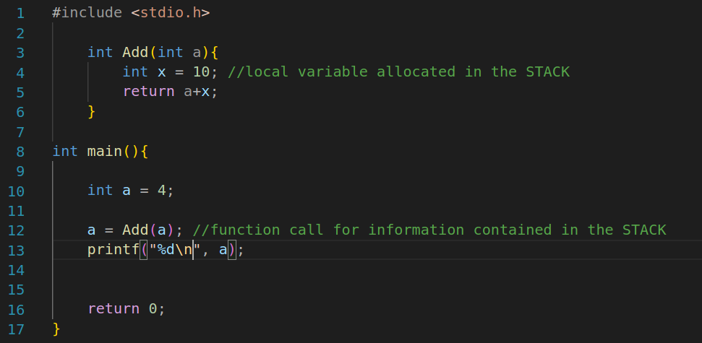
Examples:
Stack:
Heap:

Slide 4
What they are useful for?
Stack: automatically manages the life of local variables and provides a function call handling mechanism.
Heap: Unlike the stack, which is limited in size and automatically manages local variables, the heap allows memory to be allocated more flexibly.

Slide 5
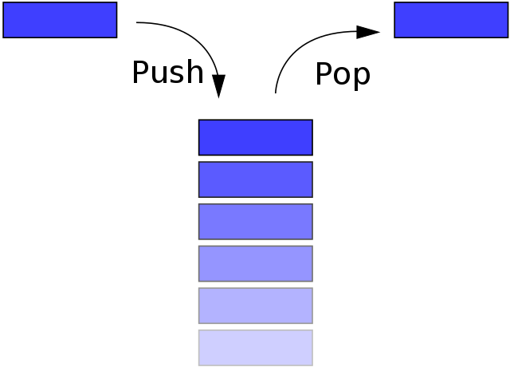
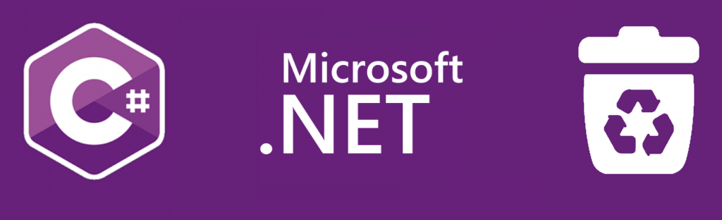
Management policies:
Stack: Management is automatic, with the variables being allocated and deallocated in LIFO (Last In, First Out) mode, the last variable to be allocated is the first to be deallocated.
Heap: In C, management is manual, the programmer must allocate and deallocate memory. In C# however, management is automatic and takes place via the garbage collector.

Slide 6
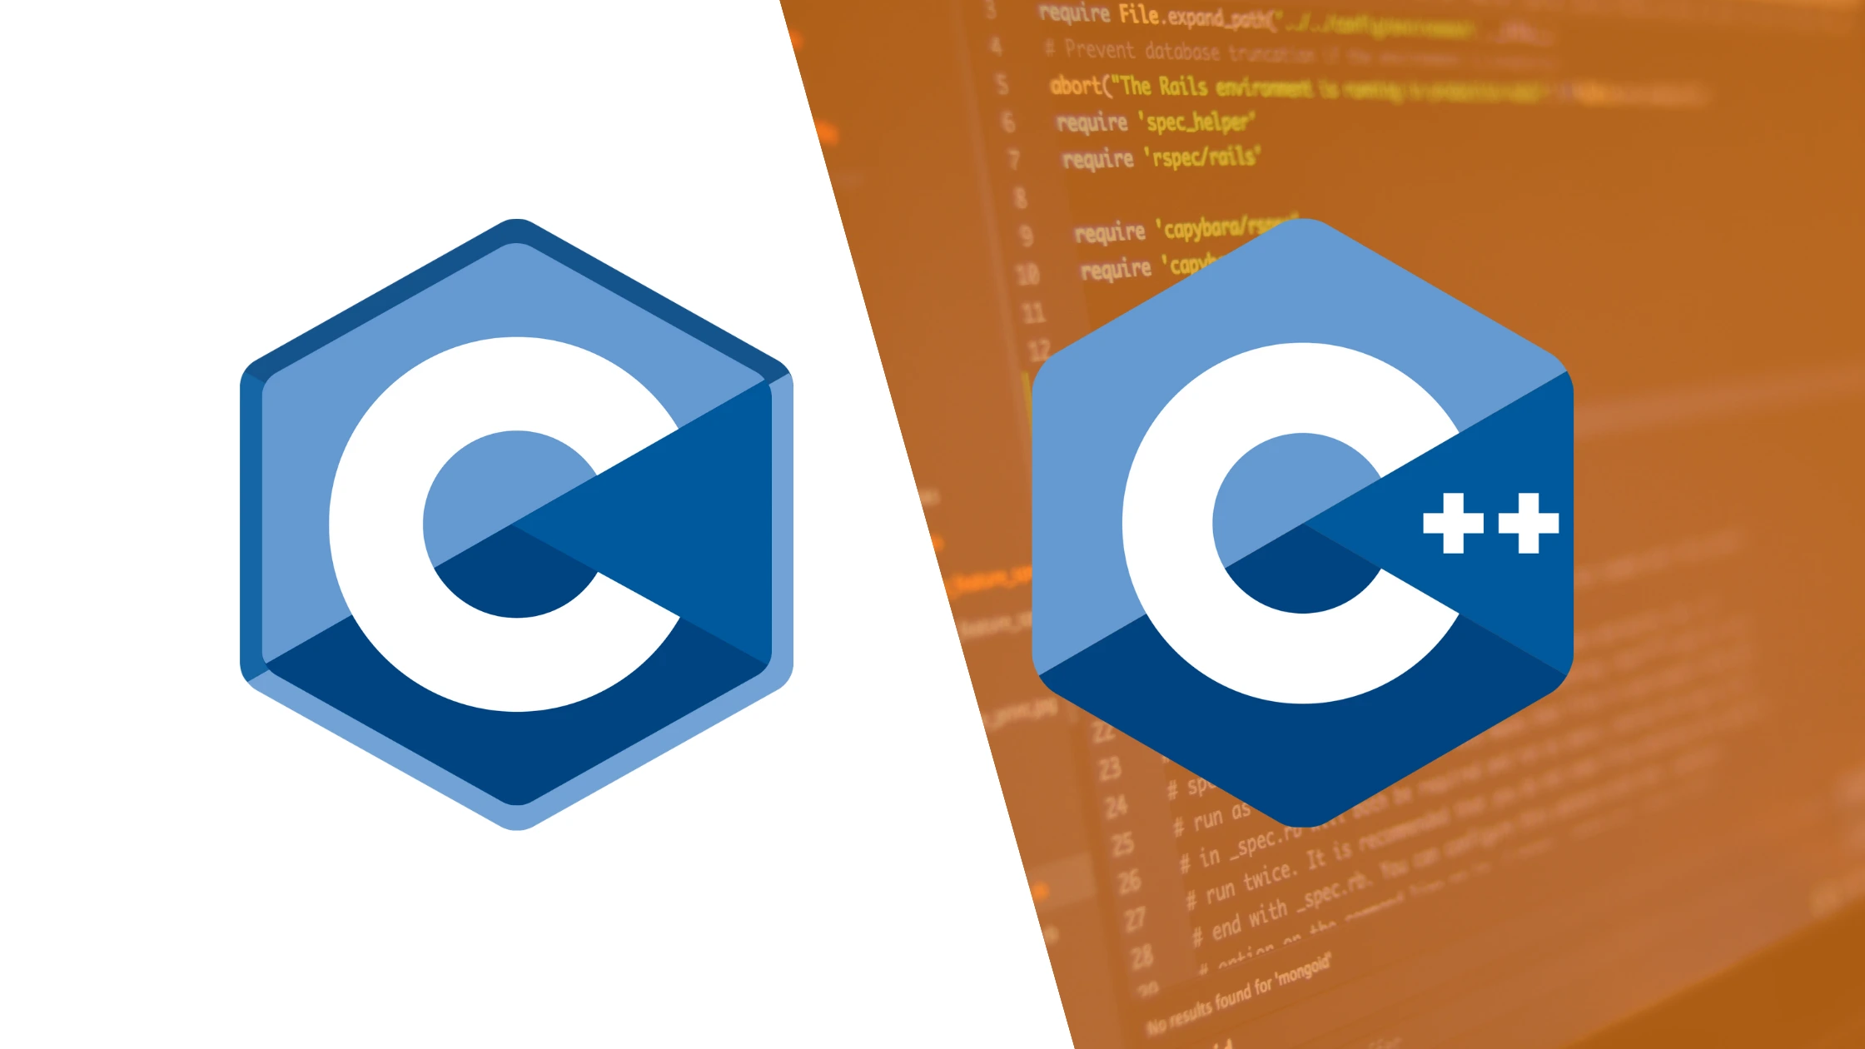

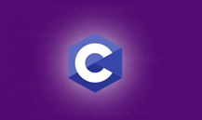
What is stored?
Stack (C and C#): Local variables, return addresses, function parameters.
Heap (C): Data dynamically allocated with malloc() or new.
Heap (C#): Objects and data allocated with new, automatically managed by the garbage collector.

Slide 7
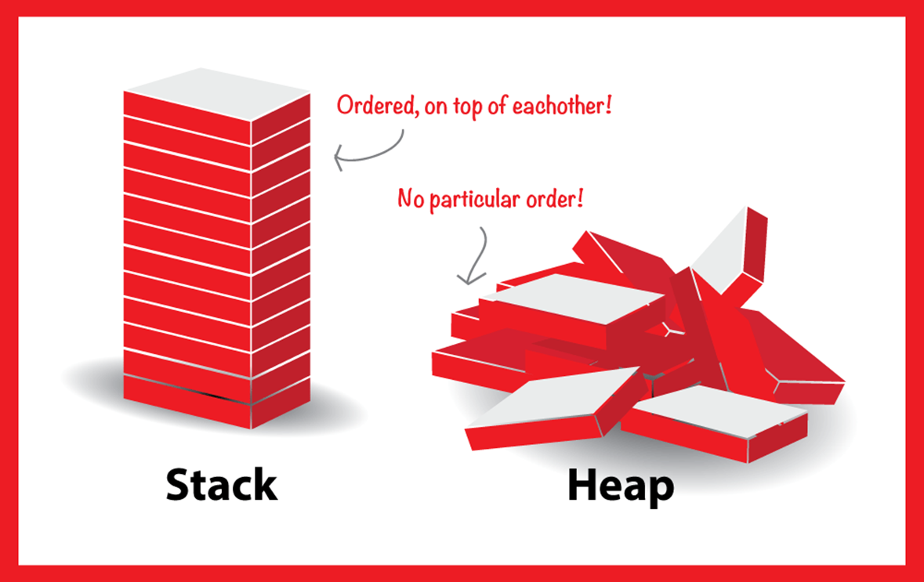
Example diagram
This example represents the STACK, which operates using LIFO (Last In First Out) and which is necessary for the compiler's allocation of static variables, and the HEAP which instead sees the manual allocation in C and automatic allocation in C# with the garbage collector of static variables.

