Slide 1
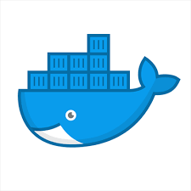


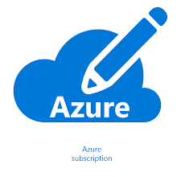
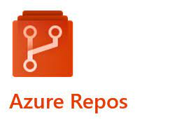


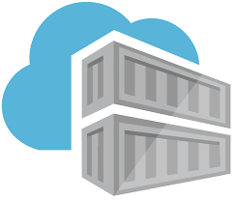

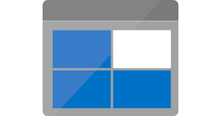







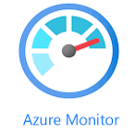

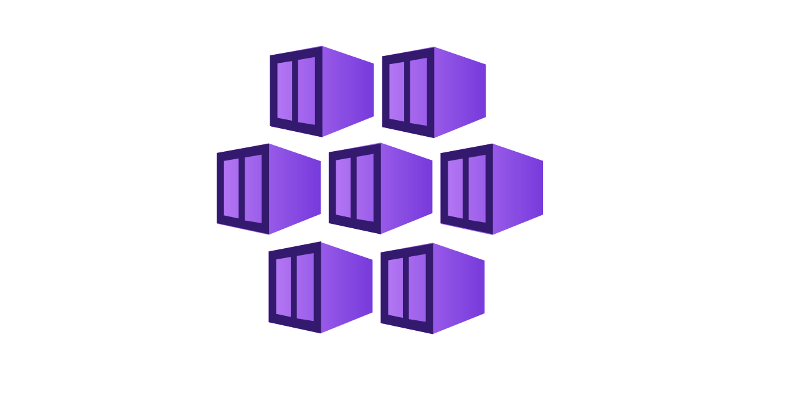





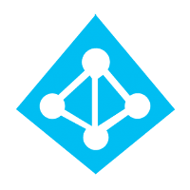
Micro Service Architecture & Deployment
App build ,image creation, push to ACR
3
7
1
Key Vault
Sensitive info
Azure Subscription
Application Code
Service Principal Info
Group Variables
VNET
Storage Account (Terraform State)
Terrform Code
YAML (if Needed)
Pull code
POD1
10
4
9
On Premise VPN Network
5
6
Azure DevOps
POD2
Push code
DevOps & Admin User could login
Configure Pipeline
Doc Creation
Run Pipeline
Application
Gateway
11
Access with Public IP
POD3
DevOps
2
8
Admin
Users

