Slide 1


Course Code: ETE 205(Sec:1)
Course Title: Digital Electronics Lab
Project: Password Based Door Lock Security System
Submitted by: 1. Morium Begum Id: 201014072 2. Md. Mizanur Rahman Id: 201014061 | Submitted to: Abul Barkat Mollah Sayeed Ud Doulah Assistant professor of department of ETE and EEE of ULAB

Slide 2
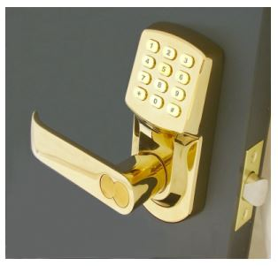
Short Brief:
Time demanding initiative to protect things from thefts
Use digit based password instead of keys
Automatically locked after 5 seconds
Only open the door after entered the correct password

Slide 3
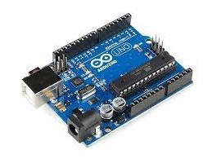
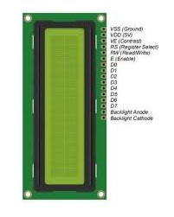
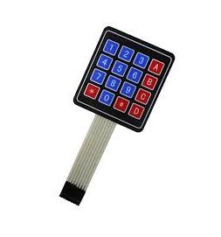
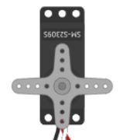
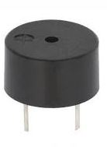
Components Required:
Bread board
Arduino (Arduino UNO R3 Development Board)
Keypad (4X4 Keypad)
Servo Motor (SG90 Servo Motor)
Buzzer (5V Active Buzzer)
Resistors (10k)
Connecting Wires (Jumper Wires)
LCD display (I2C 16×2 LCD Display)

Slide 4
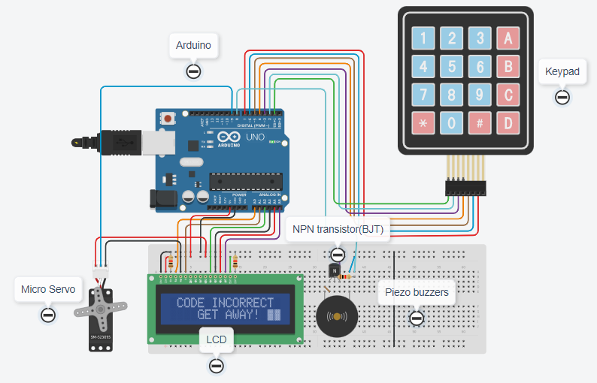
Procedure
Connect keypad with Arduino using D2-to- D9 pins
Connect servo motor with Arduino using D11 pin and PWM pin
Connect positive wire of servo to 5 volt pin of Arduino
Negative wire to the ground
Built connection between the LCD and Arduino

Slide 5
Experimental Results:
Defined the default password
Allow the user to enter the password
Checks the password stored in this Arduino
If it is correct, it will show ‘Access is granted, welcome’, and then the door is opened
If the password is incorrect then it will go back to the standby mode by displaying “Incorrect Code Get Away”.

Slide 6
Thank You

