Slide 1
Introduction To Flowcharting

Slide 2
Flowchart:
Represents an algorithm in graphical symbols

Slide 3
Flowchart Symbols
 | Terminal: Used to indicates the start and end of a flowchart. Single flow line. Only one “Start” and “Stop” terminal for each program. The end terminal for function/subroutine must use “Return” instead of “Stop”.
 | Process: Used whenever data is being manipulated. One flow line enters and one flow line exits.
 | Input/Output: Used whenever data is entered (input) or displayed (output). One flow line enters and one flow line exits.

Slide 4
Flowchart Symbols
 | Decision: Used to represent operations in which there are two possible selections. One flow line enters and two flow lines (labeled as “Yes” and “No”) exit.
 | Function / Subroutine: Used to identify an operation in a separate flowchart segment (module). One flow line enters and one flow line exits.
 | On-page Connector: Used to connect remote flowchart portion on the same page. One flow line enters and one flow line exits.
 | Off-page Connector: Used to connect remote flowchart portion on different pages. One flow line enters and one flow line exits.
 | Comment: Used to add descriptions or clarification.
 | Flow line: Used to indicate the direction of flow of control.

Slide 5
Comments or description

Slide 6
Connectors on the same page
1- connection on the same
flowchart portion
2- connection on the different
flowchart portion

Slide 7
Connectors on a different page
Page 1
Page 2

Slide 8
The detail of how the function works
is put in another flowchart.
This is known as Function-Definition
Function
Page 1
Start terminal for a
Function is different.
Do not use “Start”
Page 2
Body of a function is
the same with
normal flowchart
At this point,
we only focus on what
to do. How to do it,
it comes later.
This part is known as
Function-Call
End terminal
must be a “Return”
This flowchart calculates the average of three numbers

Slide 9
Example:
What is the output of the following flowchart when the input is N = 6
10
average
5
Page 1
Page 2
N=6
Sum = 10 + 5 + 6
average =
21/3
Output:
Average: 7

Slide 10
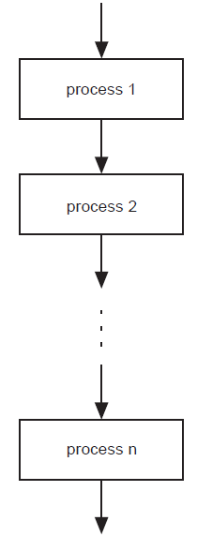
Sequence
In a computer program or an algorithm,
sequence involves simple steps which are
to be executed one after the other.
The steps are executed in the same order in which they are written.
In a flowchart,
sequence is expressed as:
In pseudocode,
sequence is expressed as:
process 1
process 2
…
…
process n

Slide 11
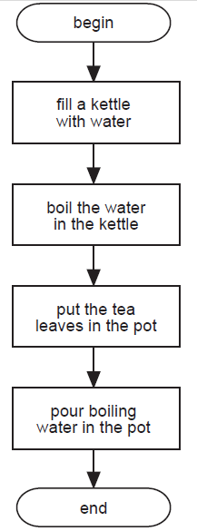
Sequence
An Example Using Sequence
Problem: Write a set of instructions that describe how to make a pot of tea.
Pseudocode
BEGIN
fill a kettle with water
boil the water in the kettle
put the tea leaves in the pot
pour boiling water in the pot
END
Flowchart

Slide 12
Example:
Input:
Length <- 5
Width <- 3
Process:
Area = 5 * 3 = 15
Process:
Perimeter =
2* (5+3) = 16
Output
Area: 15
Perimeter: 16

Slide 13
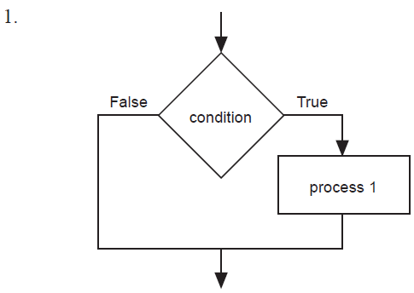
Selection is used in a computer program or algorithm to determine which particular step or set of steps is to be executed
Binary Selection
In pseudocode, binary selection is expressed in the following ways:
IF condition THEN
process 1
ENDIF
IF condition THEN
process 1
ELSE
process 2
ENDIF
Binary Selection
In flowcharts, binary selection is expressed in the following ways:

Slide 14
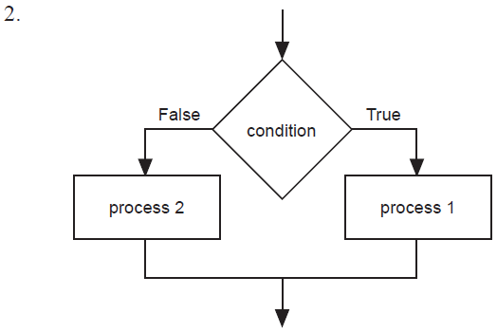
Selection Binary (structure)
Binary Selection
In pseudocode, binary selection is expressed in the following ways:
IF condition THEN
process 1
ENDIF
IF condition THEN
process 1
ELSE
process 2
ENDIF
Binary Selection
In flowcharts, binary selection is expressed in the following ways:

Slide 15
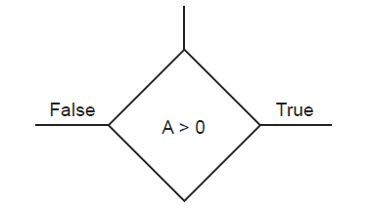
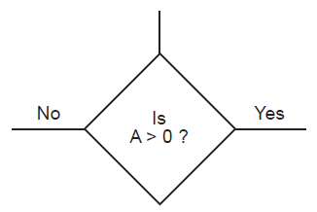
Selection Binary (flowchart structure)
Note: In a flowchart it is most important to indicate
which path is to be followed when the condition is true, and
which path to follow when the condition is false.
Without these indications the flowchart is open to more than one interpretation.
Note: There are two acceptable ways to represent a decision in all of the structures.
Either method is acceptable. For consistency, the method 1 is used throughout this document.
The condition is expressed as a statement and the two possible outcomes are indicated by
True
False
2. The condition is expressed as a question and the two possible outcomes are indicated by
Yes
No

Slide 16
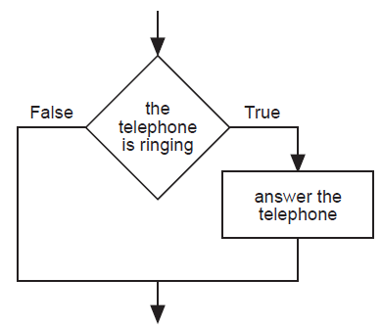
Selection Binary (examples)
Selection is used in a computer program or algorithm
to determine which particular step or set of steps is to be executed.
Examples Using Binary Selection
Problem 1: Write a set of instructions to describe when to answer the phone.
Binary Selection
Flowchart
Binary Selection
Pseudocode
IF the telephone is ringing THEN
answer the telephone
ENDIF

Slide 17
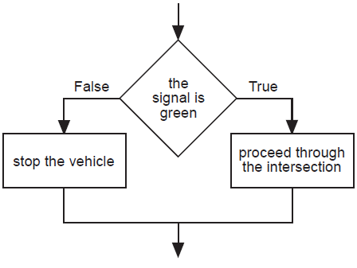
Selection Binary (examples)
Examples Using Binary Selection
Problem 2: Write a set of instructions to follow when approaching a set of traffic control lights.
Binary Selection
Flowchart
Binary Selection
Pseudocode
IF the signal is green THEN
proceed through the intersection
ELSE
stop the vehicle
ENDIF

Slide 18
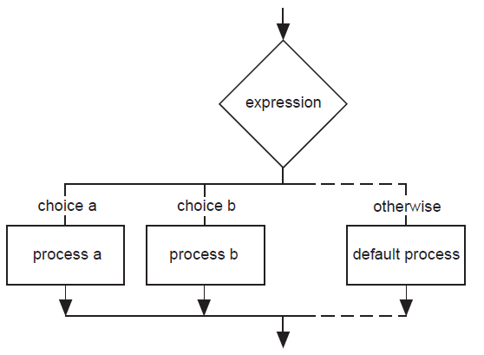
Selection Multi-way (structure)
Multi-way Selection
In pseudocode, multiple selection is expressed as:
CASEWHERE expression evaluates to
choice a : process a
choice b : process b
. .
. .
. .
OTHERWISE : default process
ENDCASE
Note: As the flowchart version of the multi-way selection indicates, only one process on each pass is executed as a result of the implementation of the multi-way selection.
Multi-way Selection
In flowcharts, multi-way selection is expressed as:

Slide 19
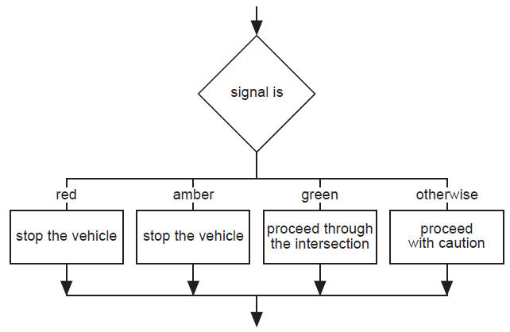
Selection Multi-way (examples)
Example Using Multi-way Selection
Problem: Write a set of instructions that describes how to:
respond to all possible signals at a set of traffic control lights.
Multi-way Selection
Pseudocode
CASEWHERE signal is
red : stop the vehicle
amber : stop the vehicle
green : proceed through the intersection
OTHERWISE : proceed with caution
ENDCASE
Multi-way Selection
Flowchart

Slide 20
Pseudo Code
Algorithms are commonly written using Pseudo code.
The term “Code” usually refers to as programming language.
Pseudo code is an English like language that is similar to programming language that is used to write Algorithms.

Slide 21
Looping
Ask the user for the Centigrade temperature
Store the value in box C
Calculate the corresponding Fahrenheit temperature
Store it in box F
Print the values in boxes C and F, Appropriately labelled
Go to step 1.

Slide 22
When the Algorithm reaches step 6, it does not stop but rather transfers control to step 1 to repeat the Algorithm again.
A Loop is a set of instructions which can be repeated. In this case. Step 1 to step 5 form a loop.
The problem is there’s no condition under which the loop can be stopped.
How long will the loop go for ?
How do we stop the Algorithm ?

Slide 23
The While loop
Ask the user for the Centigrade temperature
Store the value in box C
If C = 0, then Stop.
Calculate the corresponding Fahrenheit temperature
Store it in box F
Print the values in boxes C and F, Appropriately labelled
Go to step 1.
WHILE C is not 0 DO
Set F to 32+(9C/5)
Print C and F,
Prompt the user for the
Centigrade temperature C
END WHILE
STOP

Slide 24
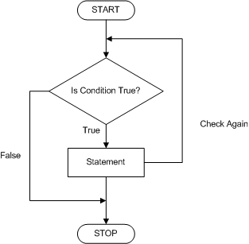
The While loop
When a WHILE loop has the following steps
The condition is tested.
If it is true the statements in the loop are tested and the process is repeated from step 1.
If the condition is false then the WHILE loop terminates/Ends with the END WHILE statement. And the program ends with the STOP statement.

Slide 25
Repetition
Repetition allows for a portion of an algorithm or computer program
to be done any number of times
dependent on some condition being met.
An occurrence of repetition is usually known as a loop.
An essential feature of repetition is that
each loop has a termination condition
to stop the repetition,
or the obvious outcome is that
the loop never completes execution (an infinite loop).
The termination condition can be checked or tested
at the beginning and is known as a pre-test loop or
at the end of the loop and is known as a post-test loop.

Slide 26
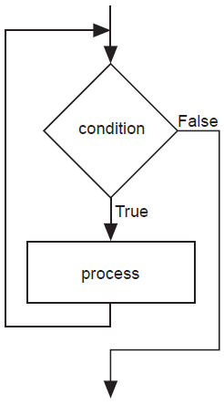
Repetition Pre-test (structure)
Repetition: Pre-Test
A pre-tested loop is so named because the condition has to be met at the very beginning of the loop or the body of the loop is not executed.
This construct is often called a guarded loop.
The body of the loop is executed repeatedly while the termination condition is true.
Repetition
In flowcharting
pre-test repetition
is expressed as:
Repetition
In pseudocode, pre-test repetition is expressed as:
WHILE condition is true
process(es)
ENDWHILE

Slide 27
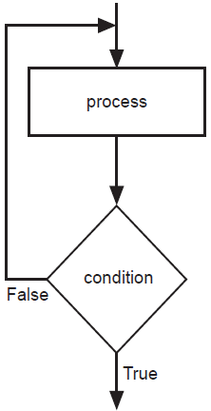
Repetition Post-test (structure)
Repetition: Post-Test
A post-tested loop executes the body of the loop before testing the termination condition.
This construct is often referred to as an unguarded loop.
The body of the loop is repeatedly executed until the termination condition is true.
An important difference between a pre-test and post-test loop is that the statements of a post-test loop are executed at least once even if the condition is originally true, whereas the body of the pre-test loop may never be executed if the termination condition is originally true.
A close look at the representations of the two loop types makes this point apparent.
Repetition
In a flowchart
post-test repetition
is expressed as:
Repetition
In pseudocode, post-test repetition is expressed as:
REPEAT
process
UNTIL condition is true

Slide 28
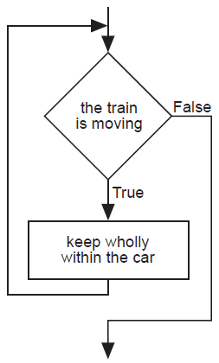
Repetition Pre-test (example)
An Example Using Pre-Test Repetition
Problem: Determine a safety procedure for travelling in a carriage on a moving train.
Pre-test Repetition
Flowchart
Pre-test Repetition
Pseudocode
WHILE the train is moving
keep wholly within the carriage
ENDWHILE

Slide 29
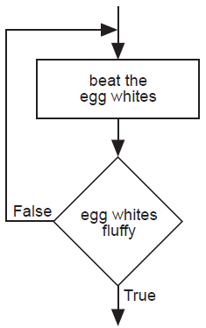
Repetition Post-test (example)
An Example Using Post-Test Repetition
Problem: Determine a procedure to beat egg whites until fluffy.
Post-test Repetition
Flowchart
Post-test Repetition
Pseudocode
REPEAT
beat the egg whites
UNTIL fluffy

Slide 30
For Loop
The For construct is a simple statement which executes a piece of code a set number of times.
It consists of
The word FOR
The loop variable, (problem in the example)
The word TO
The final value
To word DO
One or more lines of instructions to be executed ( The body of the for loop)
The END FOR statement
For C = 0 to 100
Set F to 32+9C/5
Print (C,F)
END FOR
STOP

Slide 31
For Loop
RESULT
C F
0 32.0
33.8
35.6
37.4
39.2
41.0
42.8
44.6
46.4
48.2
50.0

Slide 32
IF Then ELSE statement
The IF then ELSE consists of
The word IF
A condition
The word THEN
One or more statements called the THEN PART
The word ELSE
One or more statements called the ELSE PART
The word END IF
Prompt the user for two numbers A & B
IF A>B THEN
PRINT (“A is bigger”)
ELSE
PRINT (“B is bigger”)
END IF
STOP

Slide 33
Interesting ?

