Slide 1
DOC2PPT: Automatic Presentation Slides Generation from Scientiﬁc Documents
A generated deck - draft, not final
Notes:
Title slide. State the paper, then the one-sentence claim of the talk.

Slide 2
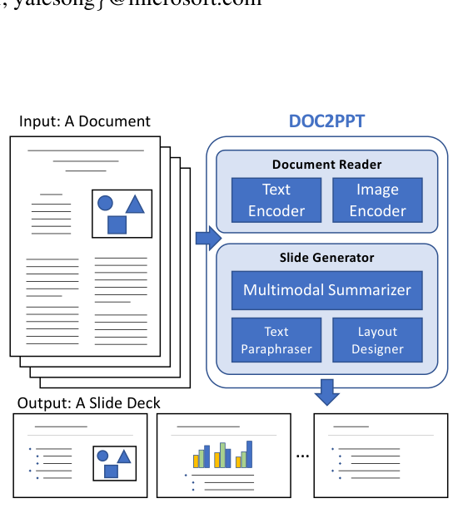
Abstract
- We propose a hierarchical sequence-tosequence approach to tackle our task in an end-to-end manner
- Can machines learn to emulate this laborious process?
- Our approach exploits the inherent structures within documents and slides and incorporates paraphrasing and ...
- We show that our approach outperforms strong baselines and produces slides with rich content ...
- We present a novel task and approach for document-to-slide generation
- Creating presentation materials requires complex multimodal reasoning skills to summarize key concepts and arrange ...
Figure 1: We introduce DOC2PPT, a novel task of gener- ating a slide deck from a document. This requires solving several challenges in the vision-and-language domain, e.g., visual-semantic embedding and ...
02
Notes:
This slide covers abstract. Open with: We propose a hierarchical sequence-tosequence approach to tackle our task in an end-to-end manner. Then move to: Can machines learn to emulate this laborious process?. Target roughly 65 seconds here.

Slide 3
Introduction
- We hope that our DOC2PPT will advance the state-of-the-art in the vision-and-language domain
- In this paper, we introduce DOC2PPT, a novel task of creating presentation slides from ...
- Lastly, we explore both template-based and learning-based layout design and compare them both quantitatively ...
- It requires skills to abstract complex concepts and conveys them in a concise and ...
- Furthermore, none of the above addresses the challenge of finding an optimal visual layout ...
- These aspects make ours a unique task in the vision-and-language literature
03
Notes:
This slide covers introduction. Open with: We hope that our DOC2PPT will advance the state-of-the-art in the vision-and-language domain. Then move to: In this paper, we introduce DOC2PPT, a novel task of creating presentation slides from .... Target roughly 65 seconds here.

Slide 4
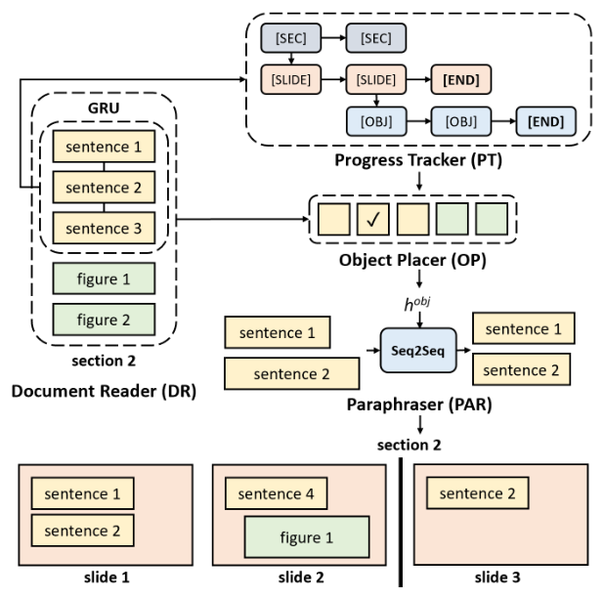
Related Work
- We propose a large dataset of 5,873 pairs of high-quality scientific documents and slide ...
- Learning text-image similarity has been studied in the visual-semantic embedding (VSE) literature (Karpathy and ...
- As argued above, our task brings a new suite of challenges to vision-and-language understanding
- Furthermore, existing datasets in this domain (such as TalkSumm (Lev et al
- Joint modeling of vision-andlanguage has been studied from different angles
- Our task involves generating slides with relevant text and figures
Figure 2: An overview of our architecture. It consists of modules (DR, PT, OP, PAR) that read a document and gen- erate a slide deck in a hierarchically structured manner.
04
Notes:
This slide covers related work. Open with: We propose a large dataset of 5,873 pairs of high-quality scientific documents and slide .... Then move to: Learning text-image similarity has been studied in the visual-semantic embedding (VSE) literature (Karpathy and .... Target roughly 65 seconds here.

Slide 5
Approach
- The goal of DOC2PPT is to generate a slide deck from a multimodal document ...
- This is a natural choice to encode our prior knowledge about the hierarchical structure
- We do not assign figures to any particular section because multiple sections can reference ...
- This step is crucial because without it the text would be too verbose for ...
- Given the multi-objective nature of the task, we design our network with modularized components ...
- We paraphrase sentences before placing them on slides
05
Notes:
This slide covers approach. Open with: The goal of DOC2PPT is to generate a slide deck from a multimodal document .... Then move to: This is a natural choice to encode our prior knowledge about the hierarchical structure. Target roughly 65 seconds here.

Slide 6
Training
- While there exist several solutions to bounding box regression (He et al
- This term is slide-insensitive, i.e., the correct/incorrect inclusion is not affected by which specific ...
- Text-Figure matching loss (δ([Etxt u , Efig v ]))
- We follow the literature on visual-semantic embedding and learn an additional multimodal projection head ...
- The series of actions asec j and aslide k determines the structure of output ...
- The third term measures the relevance of text and figures appearing in the same ...
06
Notes:
This slide covers training. Open with: While there exist several solutions to bounding box regression (He et al. Then move to: This term is slide-insensitive, i.e., the correct/incorrect inclusion is not affected by which specific .... Target roughly 65 seconds here.

Slide 7
Inference
- We tune the two hyper-parameters θR and θA via cross-validation (we set θR = ...
- The inference procedures during training and test times largely follow the same process, with ...
- That is, once our model generates a slide deck, we remove figures that have ...
- The inference procedures during training and test times largely follow the same process, with ...
07
Notes:
This slide covers inference. Open with: We tune the two hyper-parameters θR and θA via cross-validation (we set θR = .... Then move to: The inference procedures during training and test times largely follow the same process, with .... Target roughly 65 seconds here.

Slide 8
Dataset
- For simplicity, we discard F out if its highest visual embedding similarity is lower ...
- Lastly, we match figures from slides to those in the corresponding document
- Note that some figures in slides do not appear in the corresponding document (and ...
- We limit the search space only within the corresponding sections using the slide-section matching ...
- We match sentences from slides to the corresponding document
- For each document D, we extract sections S and sentences T in using ScienceParse ...
08
Notes:
This slide covers dataset. Open with: For simplicity, we discard F out if its highest visual embedding similarity is lower .... Then move to: Lastly, we match figures from slides to those in the corresponding document. Target roughly 65 seconds here.

Slide 9
Experiments
- DOC2PPT is a new task with no established evaluation metrics and baselines
- We carefully ablate various components of our approach and evaluate them on our proposed ...
- We propose automatic metrics specifically designed for evaluating slide generation methods
- We also perform human evaluation to assess the generation quality
09
Notes:
This slide covers experiments. Open with: DOC2PPT is a new task with no established evaluation metrics and baselines. Then move to: We carefully ablate various components of our approach and evaluate them on our proposed .... Target roughly 65 seconds here.

Slide 10
Evaluation Metrics
- Therefore, we propose the slide-level ROUGE: ROUGE-SL = ROUGE-L × e |Q− ˜ Q| ...
- Intuitively, the number of slides in a deck is a good proxy for the ...
- Ablation Settings ROUGE-SL LC-FS TFR mIoU Hrch-PT PAR TIM Post Proc
- A good design layout makes it easy to consume information presented in slides
- To measure the quality of text in the generated slides, we adapt the widelyused ...
- To evaluate the layout quality, we adapt the mean intersection over union (mIoU) (Everingham ...
10
Notes:
This slide covers evaluation metrics. Open with: Therefore, we propose the slide-level ROUGE: ROUGE-SL = ROUGE-L × e |Q− ˜ Q| .... Then move to: Intuitively, the number of slides in a deck is a good proxy for the .... Target roughly 65 seconds here.

Slide 11
Implementation Detail
- Each layer of the PT is based on a 256-unit GRU
- For the DR, we use a Bi-GRU with 1,024 hidden units and set the ...
- The PAR is designed as Seq2Seq with 512-unit GRU
- We train our network end-to-end using ADAM (Diederik P
- All the MLPs are two-layer fullyconnected networks
11
Notes:
This slide covers implementation detail. Open with: Each layer of the PT is based on a 256-unit GRU. Then move to: For the DR, we use a Bi-GRU with 1,024 hidden units and set the .... Target roughly 65 seconds here.

Slide 12
Conclusion
- We release a large set of 5,873 paired documents and slide decks, and provide ...
- We present a novel task and approach for generating slides from documents
- We hope our work will help advance the state-of-the-art in vision-and-language understanding
- This is a challenging multimodal task that involves understanding and summarizing documents containing text ...
12
Notes:
This slide covers conclusion. Open with: We release a large set of 5,873 paired documents and slide decks, and provide .... Then move to: We present a novel task and approach for generating slides from documents. Target roughly 65 seconds here.

